Slide 1
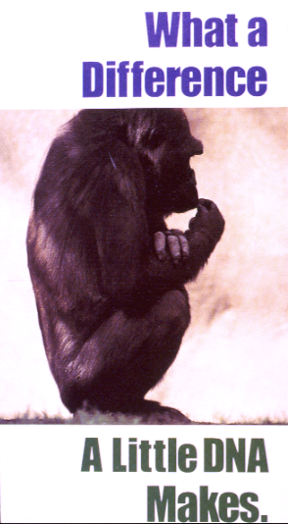
GeneNetwork and WebQTL:
a PowerPoint Presentation
Part 1: How to study expression variation and covariation (slides 2–16)
Part 2. Discovering upstream modulators (slides 17–30)
PowerPoint “Normal view” has notes that may be useful companions to these slides.
RNA
You can also download this PowerPoint at
ftp://atlas.utmem.edu/public/webqtl_demo2.ppt
RWW 07.23.2005
Notes:
Welcome to a short demonstration of the GeneNetwork and its WebQTL module. Please adjust the size of the windows on your monitor so that you can see part of this page, as well as GeneNetwork windows. WebQTL produces a large number of new windows, so you may need to modify your browser preferences to permit pop-ups. In this demonstration, we explore one important transcript expressed in the brain: the amyloid beta precursor protein messenger RNA. A protein product of this mRNA, the APP protein, is associated with Alzheimer’s disease.
My thanks to Dr. Robert F. Clark and Wenli Cai for testing this PowerPoint demonstration and making many improvements.
(Initial version of June 2003 by Rob Williams. Edits July 13, 2005 by RW and RFC. Edit July 14, 2005 by WC. Final edits by RF Clark, July 22, 2005.

Slide 2
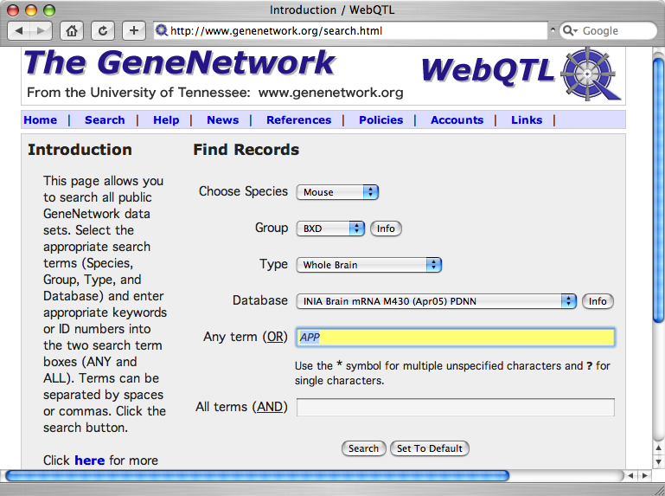
PART 1: How to study variation and covariation
Choose species, group, and type
Choose
database
Enter
APP
Select
search
Notes:
Please link to the web site: http://www.genenetwork.org
To begin a search you make choices about what species, group, and database to explore.
For this demonstration enter APP as above and click on the SEARCH button. Make sure that the DEFAULT SETTINGS are species = Mouse, Group = BXD, Type = Whole Brain, and Database = INIA BRAIN mRNA M430 (Apr05) PDNN.
Notes:
1. The GeneNetwork and WebQTL are often used to work with public data sets. However, it is possible to enter and analyze your own data for specific genetic reference populations such as the BXD genetic reference population of mice or the HXB strains of rat. Entering your own data is a more advanced topic, but if you click on the HOME pop-down menu (upper left), you will see “Enter Trait Data” that will explain the process.
For help on advanced searching methods read the left side of the page (INTRODUCTION). If you make a search term too complex, you may get no hits (try entering “amyloid beta” for example). If you make it too simple, you may also get too many.
Use the asterisk * as a wildcard. For example, to find all Hoxb transcripts, search for Hoxb*.
In some cases you can also research for transcripts and genes using special search strings such as “Mb = (Chr1, 100 102)” to find all genes on Chromosome 1 between 98 and 104 megabases (don’t actually use the quotes). Details are described at http://www.genenetwork.org/searchHelp.html.
5. These INFO buttons provide links to data about the different data types. Try them.
6. The SET TO DEFAULT button is used to change the database default setting to match your typical search categories.

Slide 3
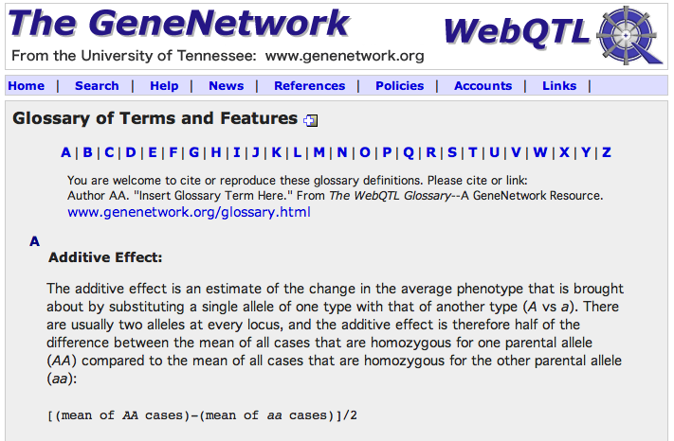
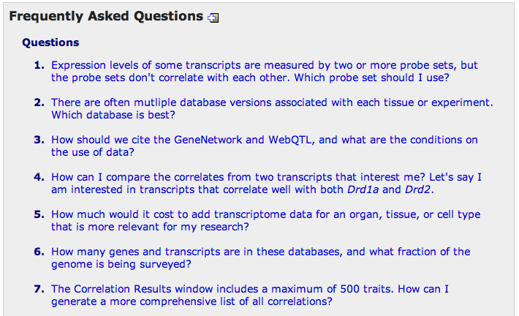
Please also use the Glossary, FAQ, and News
Notes:
SHORT DETOUR to the HELP menu. If you are new to the GeneNetwork, you may find it helpful to review the The Glossary and FAQ pages shown above. We are in the process of making “live” demos for some of the key modules in the GeneNetwork. Check the NEWS every month or two to find out about new features.

Slide 4
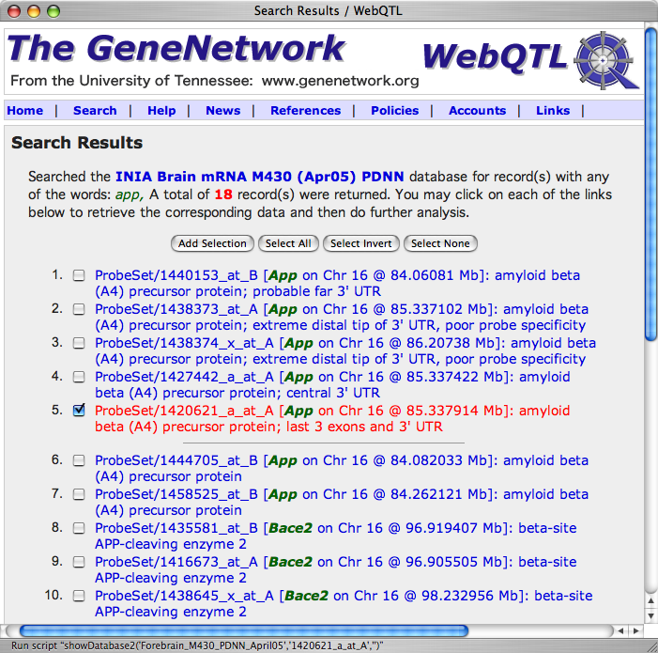
Search results
Highlight this probe set in red and
click. You do NOT have to select the checkbox
Notes:
RESULTS OF THE APP SEARCH. A search of the INIA Brain database generates 18 matches, 10 of which are shown above. The GeneNetwork will display several hundred matches in pages of 40 each. If a search generates a larger numbers of hits, then you will need to refine search terms.
Notes:
1. APP is a great transcript to introduce you to the complexity and power of new array platforms that often provide “alternative” expression estimates for single genes. There are seven probe sets that target different parts of the APP transcript. Which of the alternative measurements is most appropriate and informative? Have a look at the FAQ page for more on this topic, but general advice: 1. be skeptical and try to validate that the correct transcript and gene is being measured; 2. check what part of the transcript is complementary to the probes; 3. evaluate the performance of individual probes based on expression level, signal-to-noise and other error terms such as the standard deviation and error.
2. In this particular case we have highlighted and selected # 5 on this SEARCH RESULTS page. The annotation for this probe set mentions that it targets the last three exons and the 3’ untranslated region (UTR) of the amyloid precursor protein (APP). That is just what we want.
3. Most probe sets have not been annotated in as much detail as App. Refer tot the FAQ to learn how to annotate probe sets yourself.

Slide 5
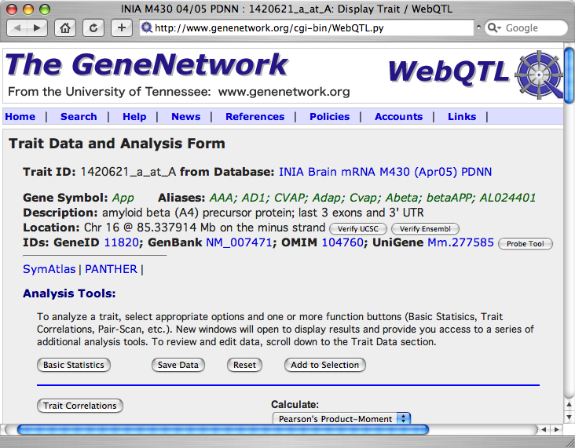
First page of data: The Trait Data and Analysis Form
Click here
to learn
about
data
source
Notes:
The Trait Data and Analysis Form is the single most important page from the point of view of working with GeneNetwork data. Please read the text carefully. Explore the links, but do not close this page. We will need it many more times in this demonstration.
Notes:
1. What is this database? It is called INIA Brain mRNA M430 (Apr05) PDNN, but what does that actually mean. How much of the brain was used? How were the animals processed? Most of these types of questions can be answered by clicking on the DATABASE link.
2. Transcript/gene LOCATION data is usually from the most recent assembly. You can VERIFY the location of the probes and probe set using the two VERIFY buttons. VERIFY UCSC performs a sequence alignment (BLAT analysis) of the probes to the most recent assembly.
3. The PROBE TOOL button provides you with highly detailed information on the probe sequences used to assemble the probe set. For example, in this case you can find out which probes correspond to which of the three exons. You can also review the performance of the individual probes. Please check the GLOSSARY for additional details on probes.
4. The identifiers (IDs) provide links to other key resources.

Slide 6
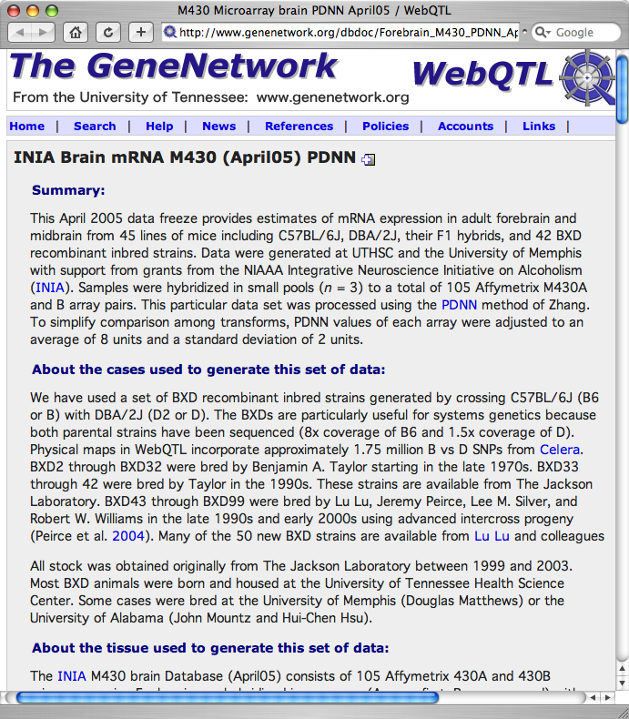
Data sources: Metadata for each resource
Notes:
Most of the database components and resources in The GeneNetwork are linked to metadata pages that provide a human-readable summary of how, why, where, when, and with whom the data were generated. Before you get too involved with a data set, it is naturally important to read this information. While the data in The GeneNetwork may be accessible and useful, that does not always mean that the data is public domain and available for you to use in publication or for profit purposes. If you want to know more about the data ownership and usage, please read through the POLICIES pop-down menu items.

Slide 7
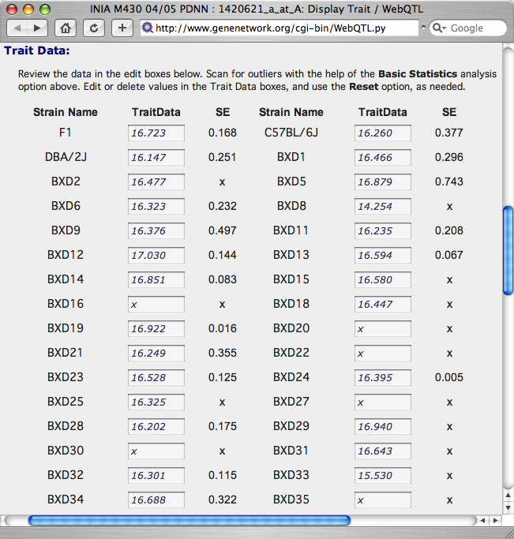

Expression estimates for App on the Trait Data form
These values can all be changed by the user. (Yes, there is a RESET)
Trait data for each strain with SE when known. For array data the scale is ~ log base 2. F1 data = 16.723 = 2^16.723 = 108,174
Notes:
This slide shows you the lower parts of the Trait Data and Analysis Form with the data for the first set of BXD strains

Slide 8
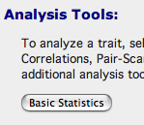
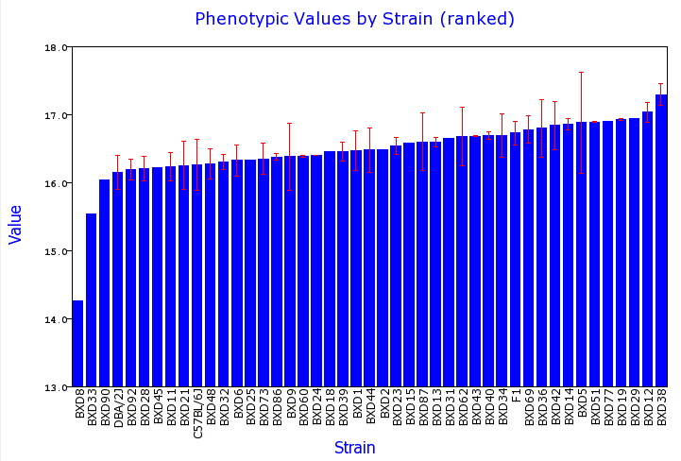
Critiquing the App data the Trait Data
Use the BASIC STATISTICS button to evaluate the App data. You will find that App data from the different strains are not equally trustworthy. BXD8 is an obvious outlier without replication (no error bar). BXD33 is also suspiciously low. BXD5 is noisy.
Notes:
The Basic Statistics page allows you to evaluate some aspects of the data quality. In this case, BXD8 is a potential problem. An outlier of this type may be generated by a technical artifact (bad sample?). However, it is also possible that BXD8 just has genuine low endogenous expression of App and may therefore be a particularly valuable model for research. There are different ways to treat problematic data of these types. One way is simply to discard this datum. The other way is to prevent outliers from have too much influence quantitatively, while leaving them in their low (or high positions). This is called windsorizing the data (after King Henry the VIII who had a habit of chopping heads). In this case, we have windsorized the BXD8 to a value of 16.0 and the BXD33 to a value of 16.02. Rank is retained. We are making a bet that the two lowest strains are really low, but we are hedging our bet and just making them a little lower than BXD90. This removes their “undue” influence.
Notes:
1. It turns out that BXD8 is a strain with many odd phenotypes. The whole strain is essentially an outlier for many traits. Therefore, the low App expression data may be quite accurate. Still, it would be comforting to have at least two more replicates.

Slide 9
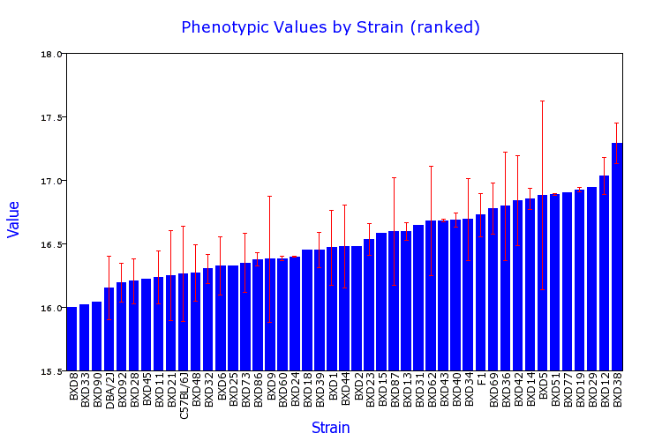
App expression after windsorizing
Notes:
Now we get a much better feel for the variation in the error among the cases. Those without error bars are of course the “noisiest” of all. This data set is not complete yet (the aim is to acquire at least one male-female sample for each BXD strain).

Slide 10
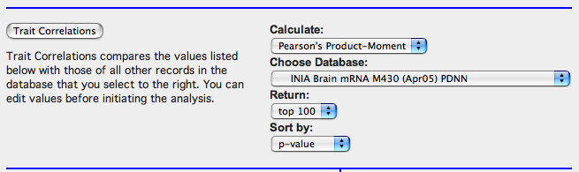

Discovering shared expression patterns
Notes:
Finally, we can now start an analysis.
We ask a simple question:
Do differences in this particular App transcript steady-state abundance level correlate with those of any other transcripts in the same INIA Brain mRNA M430 data set?
Notes:
You can CHOOSE many other DATABASES at this point if you want, but for now let’s stick with the default.
2. There are different ways to sort the correlations. The most obvious is by p-value (most significant values at the top of the list), but it is also interesting to sort the top 100 or top 500 by their gene symbol (gene ID) or by their chromosomal location (position).
3. If you don’t want your analysis to be sensitive to outliers, then you may want to choose to use the Spearman Rank Order method of calculating correlations.

Slide 11
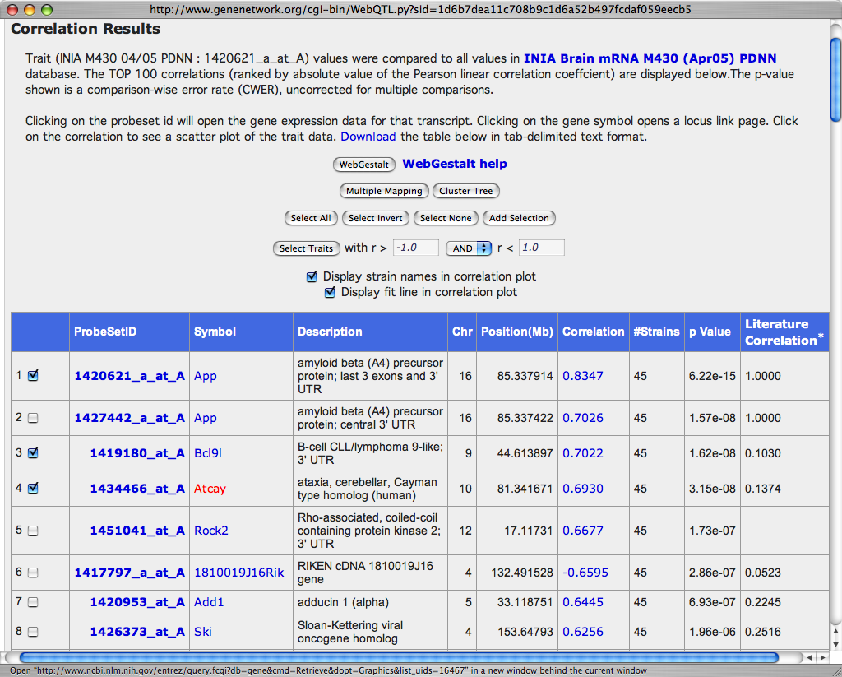
Transcript neighborhoods
Notes:
The Traits Correlation output window (Correlation Results) compares App expression data with all other traits in this INIA Brain data set. The most significant 100 or 500 transcripts are sorted by their p-values. The top correlation is that of the probe set to itself (often a value of 1.0, but in this case we modified the App values manually by windsorizing the data). The next best correlation is to another App probe set. The fourth correlation is interesting and suggests that there may be a link between App and a particular type of ataxia (Atcay).
Notes:
Use the checkboxes to the far left to select traits that you want to study together. Once you have selected interesting traits, click on the ADD SELECTION button. This puts all of the selected traits into a SELECTIONS WINDOW for other types of analysis.
2. The p-value is not corrected for multiple tests. A conservative approach for array data would be to assume 10,000 nominally independent tests. Subtract 4 from the exponent and if the value is still smaller than 0.05 you may have a real correlation.
3. The LITERATURE CORRELATION is a data type generated by Drs. Ramin Homayouni and Michael Berry. Click on the header column by the asterisk for more information on this highly useful data type.
4. We are using Pearson product moment correlations rather that the Spearman rank order correlation. But you can select either in the previous step.

Slide 12
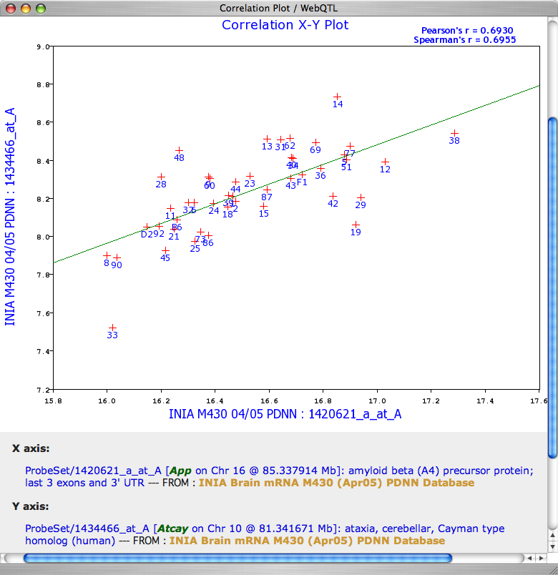
App and Atcay transcript scatterplot
Notes:
By clicking on the CORRELATION of the Atcay transcript to the App transcript, you can generate a Correlation plot between these two transcripts. In this App and Atcay scatterplot, each point is a strain mean value. For example, BXD33 and BXD8 have low App and Atcay expressions. The two parental strains and the F1 are also included in this plot.

Slide 13
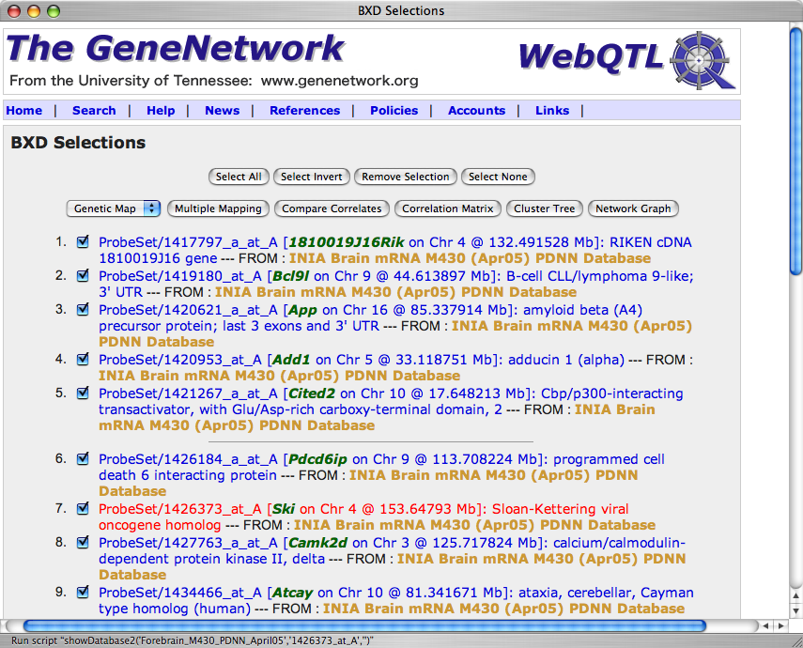
App transcript and eight of its neighbors
Notes:
A group of traits from many different databases can be selected and brought together for joint analysis. In this case all of the content of the BXD SELECTIONS is from a single BRAIN database, the top 20 neighbors of the App transcript from the Correlation Results table. Eight of these neighbors plus App is shown in the slide.
Notes:
All of items in the BXD SELECTIONS were selected using the SELECT ALL button
2. The buttons at the top (and bottom) of this page can do some cool stuff. We will work with NETWORK GRAPH first.
3. Think of the SELECTIONS as your shopping cart. You go to different aisles in the supermarket to acquire different types of items of interest. These could include transcripts, classical phenotypes (longevity, brain weight, prepulse inhibition, iron levels in midbrain). “Checking out” in this case involves doing some analysis with the items in the cart.
4. Different tools handle different numbers of items. Most will handle up to 100 traits.

Slide 14
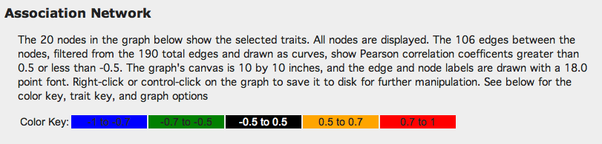

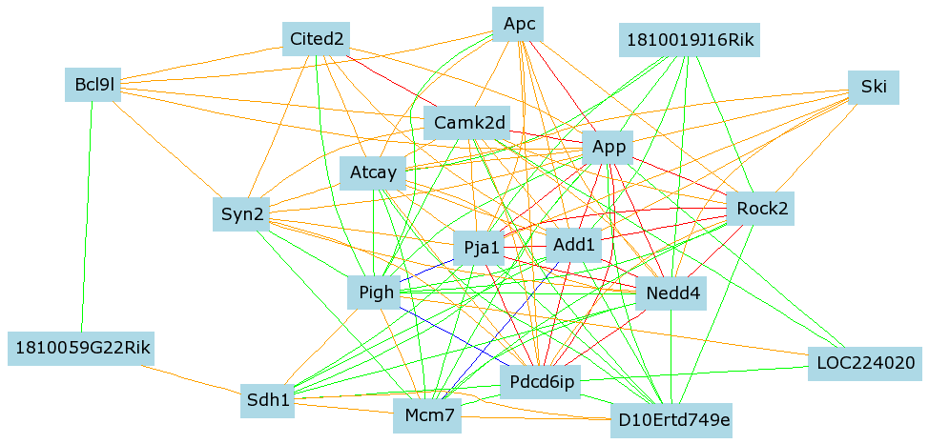
App transcript coexpression neighborhood
Notes:
Output of the Network Graph. Warm colors (orange and red) are positive correlations above 0.5 whereas cool colors (green and blue) are negative correlations. Notes:
All of the nodes (gene/transcripts) on this graph are clickable.
2. For this graph the App expression values have “reverted” to their pre-Windsorized values.
3. To generate this graph, we used the default setting: Size of 16 by 16 inches; Gene Symbols; Don't Show Correlations; Use curved lines (aka “edges”).

Slide 15
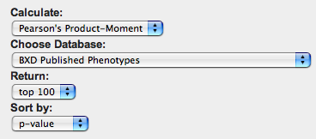
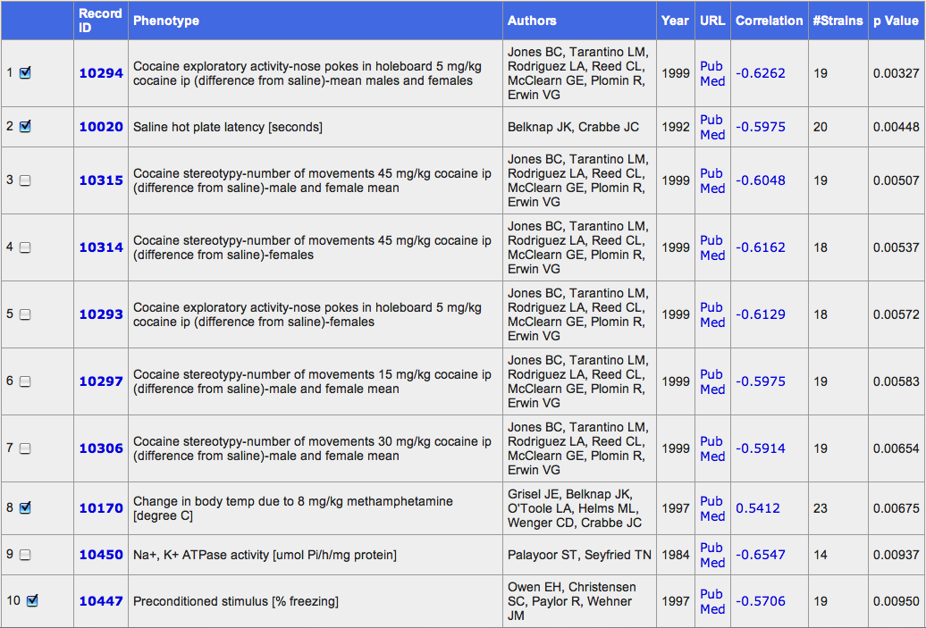
Correlations of App with classical traits
Notes:
Going back to the Trait Data and Analysis Form window, we have computed the correlations between strain variation in App expression level and other classical phenotypes that have already been measured in many of the same BXD strains.
Notes:
The number of common strains varies widely--in this case from 14 to 23 strains.
2. We can add these traits (four are selected) to our BXD SELECTIONS window.

Slide 16
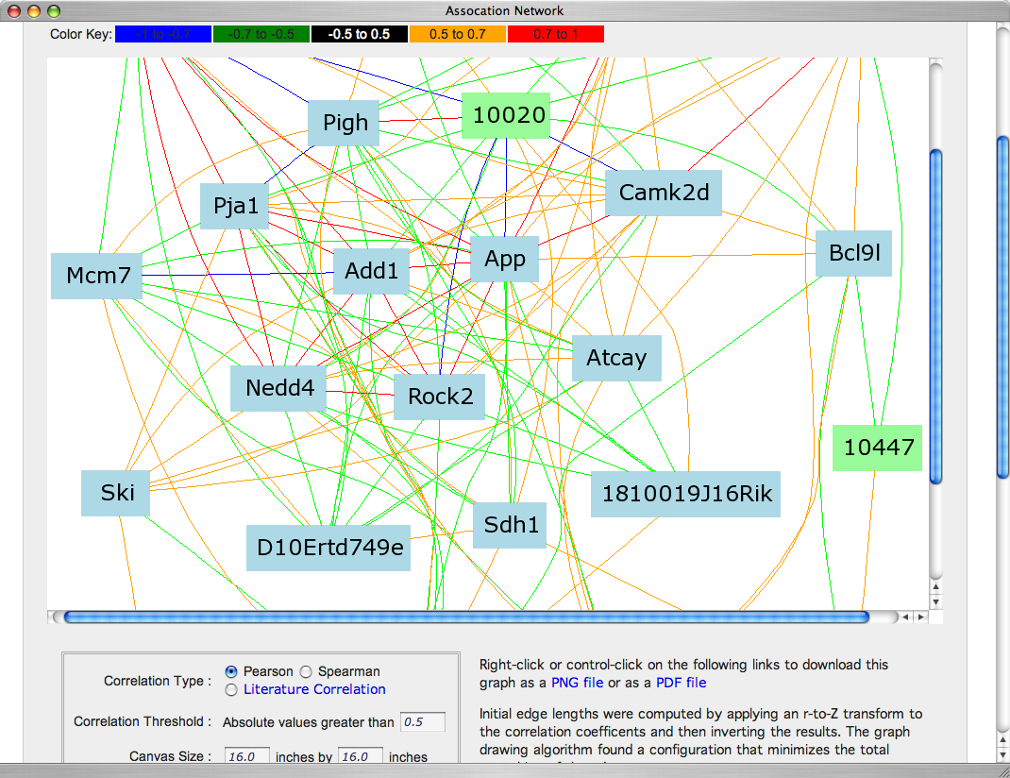
Network Graph of App with classical traits
Notes:
We have computed the Network Graph, now using other types of traits.
Saline Hot Plate Latency is the green node labeled 10020.
Freezing (fear) is the green node labeled 10447.
Notes:

Slide 17
Summary of Part 1:
You have learned the basics about searching for traits
You know some methods to check data quality
You know how to edit bad or suspicious data
You know how to review the basic statistics of a trait
You know how to generate a scattergram between two traits using the Traits Correlation tool
You know how to add items to your SELECTIONS window
You know how to generate a Network Graph of traits that co-vary.
What does genetic covariance mean? The genetic covariance can be functional and mechanistic, but it can also be due to linkage disequilibrium. Finally, it can be due to sampling error or poor experimental design. Evaluate the biological plausibility of correlations. Test and be skeptical.

Slide 18
Contact for comments and improvements:
rwilliam@nb.utmem.edu
kmanly@utmem.edu
The App findings reviewed in this presentation are part of an ongoing study by R. Williams. R. Homayouni, and R. Clark (July 15, 2005)
Notes:
END

