Slide 1
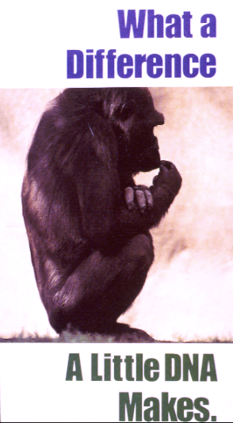
The GeneNetwork and WebQTL : PART 2 link to www.genenetwork.org
Part 1. How to study expression variation and genetic correlation (slides 2–17)
Part 2. Discovering upstream modulators (slides 18–29)
RNA
Notes:
Part 2: Discovering upstream modulators and quantitative trait loci (QTLs). A quantitative trait locus is a chromosomal region that harbors one or a few polymorphic gene loci that influence a trait. We are going to be looking for QTLs that modulate the steady state expression level of App in the adult mouse forebrain.

Slide 2
How to make recombinant inbred strains (RI)
female
male
C57BL/6J (B)
DBA/2J (D)
BXD
fully
inbred
chromosome pair
isogenic
F1
hetero-
geneous
F2
20 generations brother-sister matings
BXD RI
Strain set
Recombined chromosomes are needed for mapping
Inbred
Isogenic
siblings
+ … +
BXD1
BXD2
BXD80
Notes:
The next few slides provide a short introduction to mapping the loci that are responsible for variation in a trait such as App expression level. These modulatory regions of the genome are sometimes called quantitative trait loci or QTLs. You may want to do some independent reading on this topic if this is your first exposure to QTL analysis.
The genetic reference population (GRP) of BXD recombinant inbred strains were originally generated about 25 years ago by Benjamin Taylor at The Jackson Laboratory. He crossed female C57BL/6J mice with male DBA/2J mice to generate the F1 and F2 progeny. At the bottom of this slide we have schematized one chromosome pair from three of the BXD RI strains. The dashed vertical lines that lead to the final BXD RI lines involve 21 full sib matings (about 7 years of breeding). Some lines die out during inbreeding. For example, there is no longer any BXD3 strain.
Notes:
1. Over the last decade, our group (Lu Lu and Rob Williams) and Jeremy Peirce and Lee Silver at Princeton have enlarged Ben Taylor’s set. There are now just over 80 BXD strains. They have all been genotyped using about 13,700 markers (SNPs and microsatellites). These markers are used to define the “blue” and “red” regions of the chromosomes as shown in the figure above.
2. Chromosomes of RI GRPs usually have about 4 times as many recombinations as those of F2 animals. However, unlike an F2, both chromosomes of an RI are identical. Therefore, 50 RI strains contain as many recombinations as 100 F2 animals.
3. BXD43 through BXD100 were generated using a special method that resulted in a further doubling of the average recombination density per chromosome. The entire set of 80 BXDs therefore contains as many recombinations as about 260 F2 animals.

Slide 3
UPSTREAM
modulators
High
4 units
D
B
aaaa
amount of transcript
D2 strain
trans QTL
2 units
_x0004_
_x0004_
_x0004_
_x0004_
aa
Low
B6 strain
>>>>PROMOTER--ATG-Exon1-Intron1-Exon2-Intron2 - etc-3'UTR >>>>>
D
B
cis QTL
D and B may be SNP-like variants in the promoter itself (cis QTL) or in upstream genes (trans QTLs).
Notes:
This slide is illustrates two major types of QTLs that modulate variability in transcript-relative steady state abundance.
1. cis QTLs are defined as QTLs that are closely linked to the gene whose transcript is the measured trait. For example, a polymorphism in the promoter that affects binding of a transcription factor. However, cis QTLs can be far upstream or downstream polymorphisms in enhancers or may be in 3’ UTR binding sites that affect message stability.
2. trans QTLs map far enough away from the location of the gene that gives rise to the transcript that is being measured so that we can be fairly certain that the QTL is not in the gene itself. The most blatant type of trans QTL would be a polymorphism in a transcription factor. But in the majority of cases, the trans QTLs can be far removed in a mechanistic sense from the actual events modulating transcript abundance. That is why there are three overlapping arrows in the figure. The way in which an upstream polymorphism influences a downstream difference in mRNA abundance can be indirect. Effects can:
a. cross tissue types (a polymorphic liver enzyme may affect CNS gene expression)
b. cross time (the modulator is only expressed for one day during development but has permanent effects in adults)
c. may be contingent on environmental factors (heat shock may trigger the expression of a polymorphic factor that affects mRNA abundance).

Slide 4
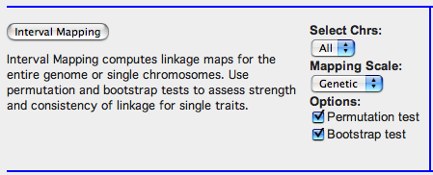
Discovering upstream modulatory loci
Notes:
Please bring the Trait Data and Analysis window to the front and look for the Interval Mapping button. Confirm that you are back to the trait amyloid beta precursor protein. If so, then just click the button.
Notice that the default for:
Select Chrs (chromosomes) is ALL
Select Mapping Scale is set to GENETIC
Options: Permutation test YES (2000 is the default number)
Options: Bootstrap test YES (2000 is the default number)

Slide 5
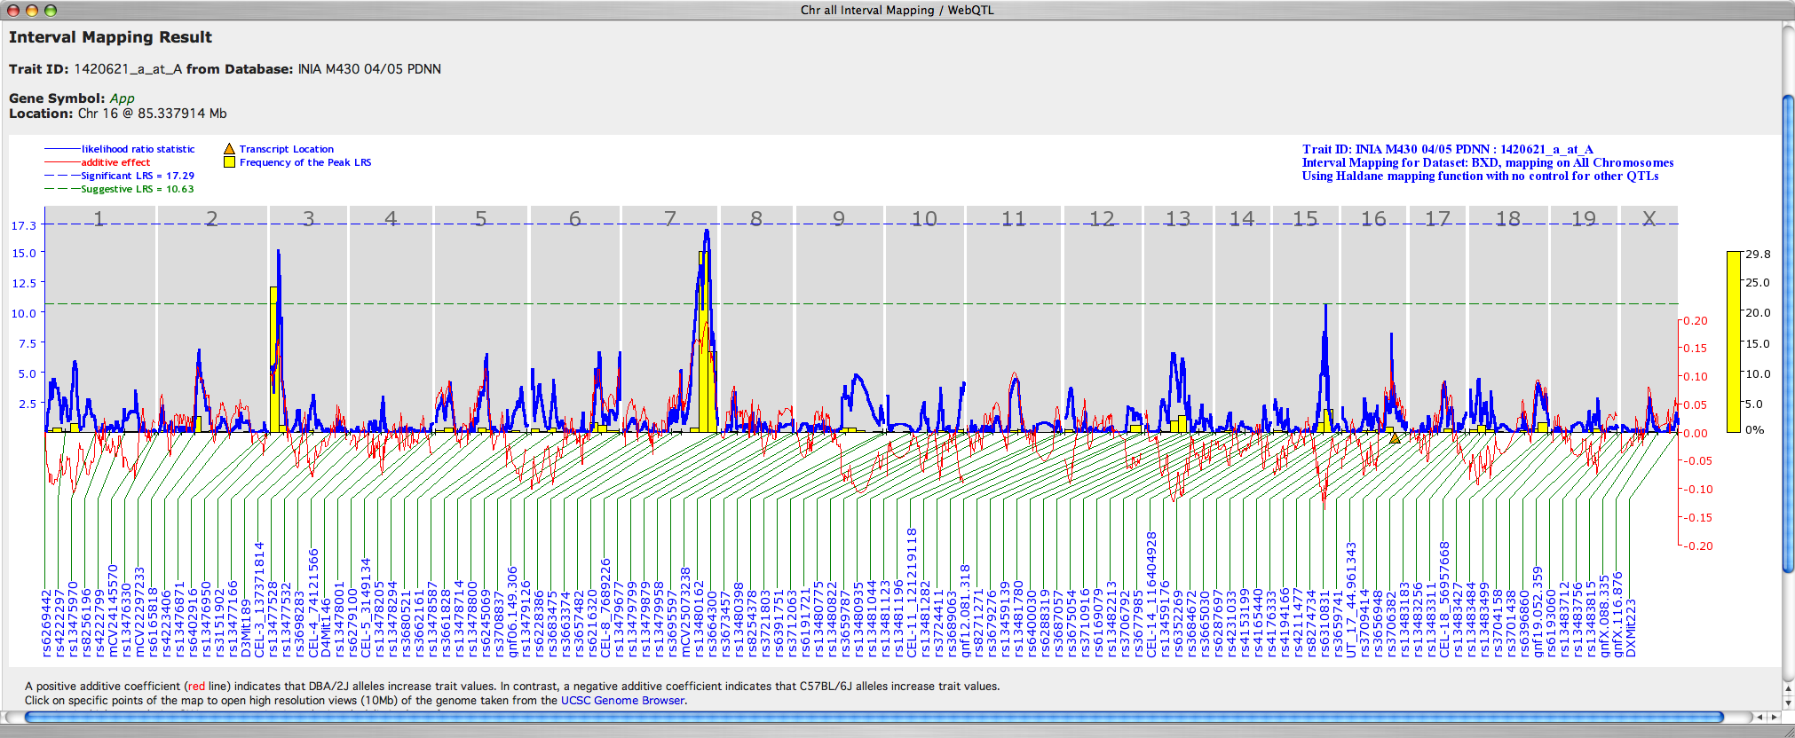
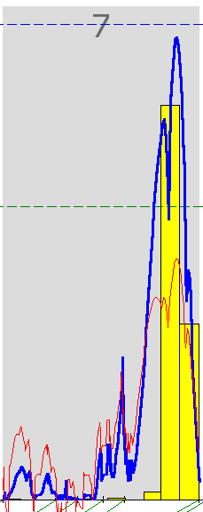
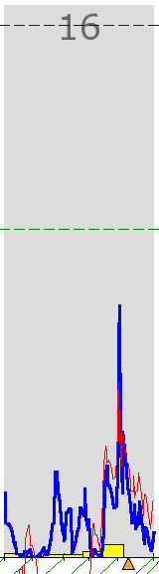
WebQTL searches for upstream controllers
App maps on Chr 16 (blue arrow points to the orange triangle) but the best locus is on Chr 7.
Notes:
This is a major output type: a so-called full-genome interval map.
The X-axis represents all 19 autosomes and the X chromosome as if they were laid end to end with short gaps between the telomere of one chromosome and the centromere of the next chromosome (mouse chromosomes only have a single long arm and the centromere represents the origin of each chromosome for numerical purpose: 0 centimorgans at almost 0 megabases). The blue labels along the bottom of the figure list a subset of the 3795 markers that were used in mapping.
The thick blue wavy line running across chromosomes summarizes the strength of association between variation in the phenotype (App expression differences) and the two genotypes of all markers and the intervals between markers (hence, interval mapping). The height of the wave (blue Y-axis to the left) provides the likelihood ratio statistic (LRS). Divide by 4.61 to convert these values to LOD scores. Or you can read them as a chi-square-like statistic.
The red line and the red axis to the far right provide an estimate of the effect that a QTL has on expression of App (this estimate of the so-called additive effect tends to be too high). If the red line is below the X-axis then this means that the allele inherited from C57BL/6J (B6 or B) at a particular marker is associated with higher values. If the red line is above the X-axis then the DBA/2J allele (D2 or D) is associated with higher trait values. Multiply the additive effect size by 2 to estimate the difference between the set of strains that have the B/B genotype and those that have the D/D genotype at a specific marker. For example, on distal Chr 7 the red line peaks at a value of about 0.2. That means that this region of chromosome 2 is responsible for a 0.4 unit expression difference between B/B strains and the D/D strains.
The yellow histogram bars: These summarize the results of a whole-genome bootstrap of the trait that is performed 1000 times. What is a bootstrap? A bootstrap provides a method to evaluate whether results are robust. If we drop out one strain, do we still get the same results? When mapping quantitative traits, each strain normally gets one equally weighted vote. But using the bootstrap procedure, we give each strain a random weighting factor of between 0 and 1. We then remap the trait and find THE SINGLE BEST LRS VALUE per bootstrap. We do this 1000 times. In this example, most bootstrap results cluster on Chr 3 and Chr 7 under the LRS peaks. That is somewhat reassuring. But notice that a substantial number of bootstrap are scattered around on other chromosomes. About 30% of the bootstrap resamples have a peak on Chr 7. That is pretty good, but does makes us realize that the sample we are working with is still quite small and fragile.
The horizontal dashed lines at 10.5 and 17.3 are the likelihood ratio statistic (LRS) values associated with the suggestive and significant genome-wide probabilities that were established by permutations of phenotypes across genotypes. We shuffle randomly 2000 times and obtain a distribution of peak LRS scores to generate a null distribution. Five percent of the time, one of these permuted data sets will have a peak LRS higher than 17.3. We call that level the 0.05 significance threshold for a whole genome scan. The p = 0.67 point is the suggestive level, and corresponds to the green dashed line. These thresholds are conservative for transcripts that have expression variation that is highly heritable. The putative or suggestive QTL on Chr 3 is probably more than just suggestive.
One other point: the mapping procedure we use is computationally very fast, but it is relatively simple. We are not looking for gene-gene interactions and we are not fitting multiple QTLs in combinations. Consider this QTL analysis a first pass that will highlight hot spots and warm spots that are worth following up on using more sophisticated models.
CLICKABLE REGIONS:
1. If you click on the Chromosome number then you will generate a new map just for that chromosome.
2. If you click on the body of the map, say on the blue line, then you will generate a view on a 10 Mb window of that part of the genome from the UCSC Genome Browser web site.
3. If you click on a marker symbol, then you will generate a new Trait data and Analysis window with the genotypes loaded into the window just like any other trait. More on this in Section 3.
4. You can drag these maps off of the browser window and onto your desktop. They will be saved as PNG or PDF files. You can import them into Photoshop or other programs.
5. There is also an option at the bottom of the page to download a 2X higher resolution image of this plot for papers and presentations.
6. You can also download the results of the analysis in a text format

Slide 6
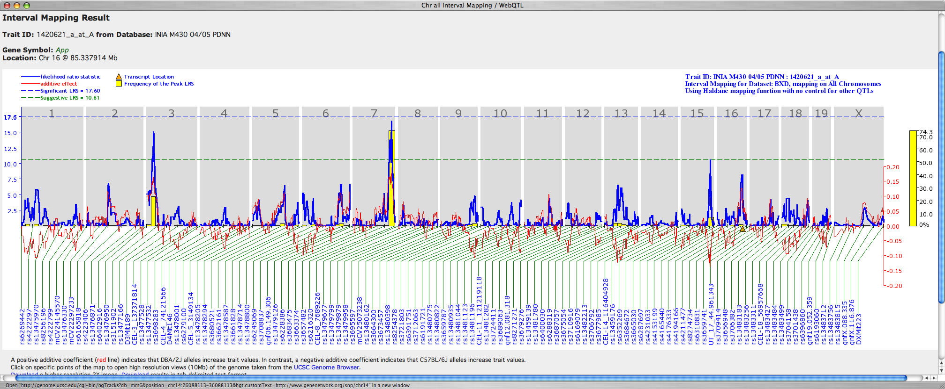
Genetic versus Physical maps for App expression
The difference between genetic and physical scale is analogous to measuring the separation between New York and Boston in either travel hours or kilometers.
Notes:
The map on the top has an X-axis scale based on frequency of recombinations events between markers (B to D transitions, see slide 19 for a color-coded example). These so-called genetic maps are scaled in centimorgan (recombinations per 100 gametes). In contrast, the physical map shown below the genetic map has an X-axis scale based on DNA length measured in nucleotides or base-pairs. Notice the large difference between the two maps in the size of Chr 19 (large on the genetic scale but small on the physical scale).
Also notice the large difference in the width of the chromosome 7 QTL peak. In mice, recombinations occur with higher frequency toward the telomeric side (right side) of each chromosome. As a result, genetic maps are stretched out more toward the telomere relative to a physical map. The QTL on distal Chr 7 is therefore actually more precisely mapped than might appear looking at the genetic map.
The physical scale is becoming more useful than the genetic scale primarily because many other data types can be easily superimposed on a physical map. You will see more examples in the next several slides.

Slide 7
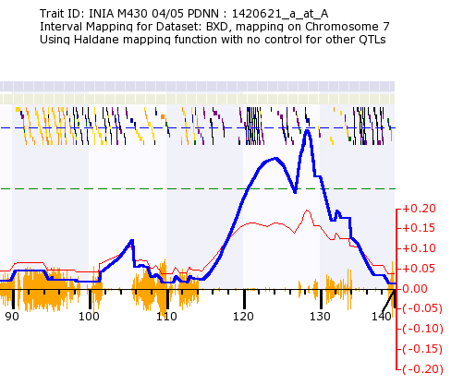
Physical map for distal chromosome 7
Distal Chr 7 from ~120 and 132 Mb may modulate App
Notes:
Physical map of variation in App expression in brain on distal Chr 7 (a blow up of the whole-genome map on the previous slide).
Notes:
You can now see that the X-axis is on a physical scale of megabases (Mb). The QTL peak is roughly between 120 and 132 Mb.
2. The small irregular colored blocks and marks toward the top of the map mark the locations of genes superimposed on the physical map. Neighboring genes are offset slightly in the vertical axis for display purpose. Note one region of very high gene density from about 120 to 123 Mb.
3. The orange hash marks along the X-axis represent the number of single nucleotide polymorphisms that distinguish the two parental strains (C57BL/6J and DBA/2J) from each other. We call this the SNP seismograph track (see Glossary for more details). Regions with low numbers of SNPs have closely matched sequences and are less likely to contain QTLs.
4. As before, the thin red line shows the additive effect size. By convention the positive values signify the D alleles are associated with higher expression of App in this region of Chr 7 than the B alleles. The maximum effect size is about +0.20 log2 expression units per D allele. The differences been the BB and DD genotypes (BB and DD because each strain has two alleles; one per chromosome) is therefore about 2^0.4 = 1.32 or a 32% increment in DD relative to BB at this locus.
5. If you scroll just under the Physical Map you will see text that reads “DISPLAY from XXX Mb TO YYY Mb…..” These physical maps are zoomable, a feature we will exploit to evaluate candidate genes in this QTL interval.

Slide 8
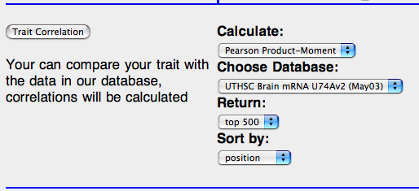
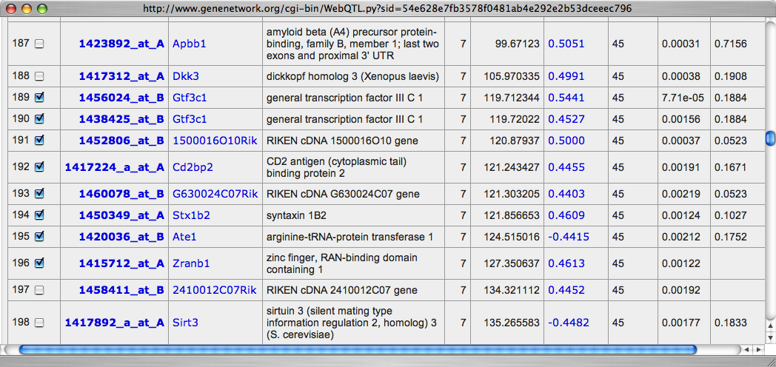
Evaluating candidate genes
Right position
and high correlation
= better
candidates
Notes:
Evaluating candidate genes (CHECKED BOXES) responsible for variability in APP expression:
A large number of genes are usually in the QTL interval and are therefore POSITIONAL CANDIDATES, but they will differ greatly in their biological and bioinformatic plausibility. Assume that the QTL has been located between 119 and 131 Mb (12 Mb). There will typically be 12 to 15 genes per Mb, so we might need to evaluate several hundred positional candidates. In this particular case there are about 100 known genes in this interval. Eight of these are highlighted in the table above with check marks in the boxes to the left. We need to highlight and objectively score the biologically relevant subset of all 100 positional candidate genes. We could look through gene ontologies and expression levels to help us shorten the list. An alternate way available using WebQTL is to generate a list of those genes in this interval that have transcripts that co-vary in expression with App expression. That is what the table shows.
Notes:
1. To replicate this table go back to the Trait Data and Analysis Form. Choose to sort correlations by POSITION and select RETURN = 500. Then scroll down the list to Chr 7 and review the subset of positional candidates that share expression with App. You should see a list similar to that shown above. Gtf3c1 is a good biological candidate and has a high covariation in expression with App.
2. Caveat: Of course, the gene or genes that control App expression may not be in this list. A protein coding difference might be the ultimate cause of variation in App transcript level and the expression covariation might be close to zero. Our list may also simply be missing the right transcript since the microarray is not truly comprehensive. Furthermore, even if the list contains the QTL gene, an expression difference may only have been expressed early in development or even in another tissue such as liver. While it is important to recognize these caveats, it is equally important to devise a rational way to rank candidates given existing data. Coexpression is one of several criteria used to evaluate positional candidates. We will see others in the next slide.
3. We can also assess the likelihood that candidates contain functional polymorphism in promoters and enhancers that affect their expression simply by mapping the transcripts of all candidate genes to see if they “map back” to the location of gene itself. A transcript that maps to its own location is referred to as a cis QTL. We essentially ask: Which of the transcripts listed in the Correlation Table above (from Gtf3c1 to Zranb1) has variation in expression that maps to Chr 7 at about 120 Mb? The logic of this search is that if a gene controls the level of its own expression it is also much more likely to generate other downstream effects. The Gtf3c1 transcript is a weak cis QTL with a local LRS maximum of about 7.0 (D alleles are high). That is just about sufficient to declare it to be a cis QTL. [No whole genome correction is required and a point-wise p-value of 0.05 is the appropriate test. A p-value of 0.05 is roughly equivalent to an LRS of 6.0 (LOD = 1.3).]

Slide 9
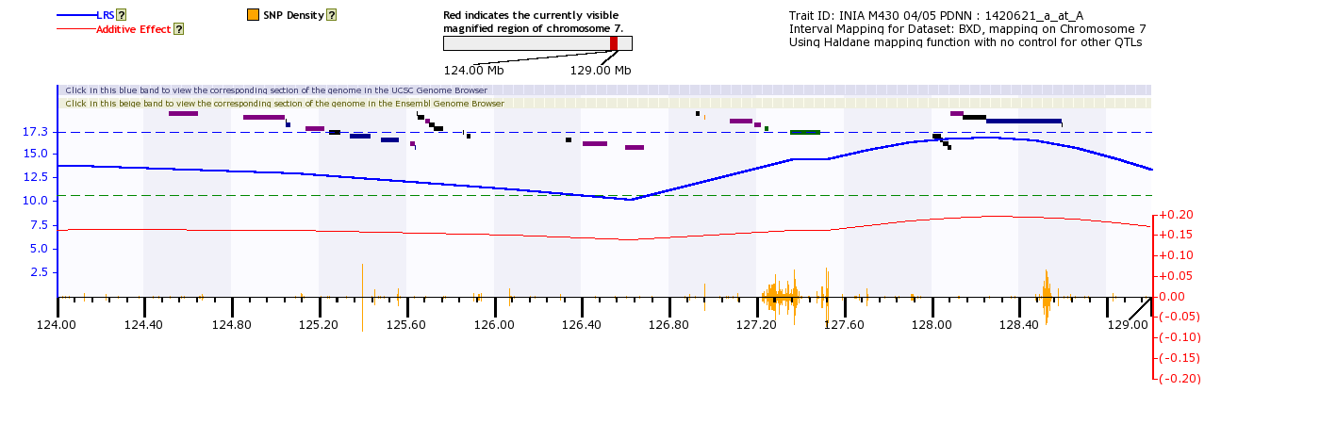
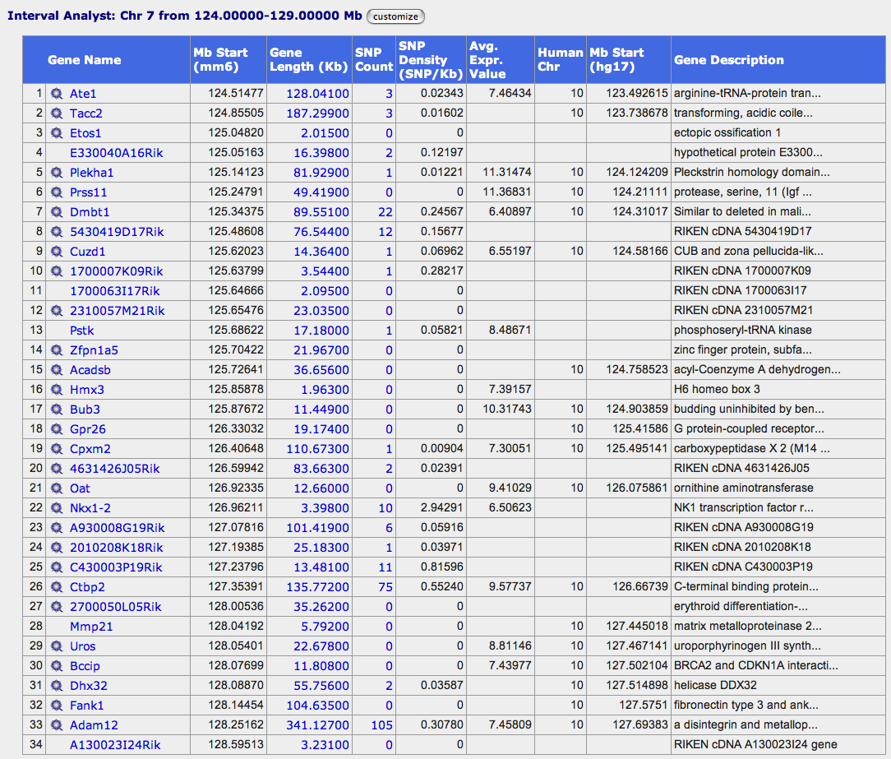
Physical maps are zoomable
Notes:
An even higher blow-up of part of the Chr 7 physical map of variation in App expression in brain. The QTL region actually extends from about 119 to 129.
Notes:
1. As mentioned in the previous slide another important approach to ranking candidates is based on the number of sequence variants that distinguish the parental strains. If we were sure that the sequences of the gene, its promoter, and its enhancers were identical between the strains then we could discount--but not eliminate--that gene as a candidate. The Gtf3c1 candidate almost falls into this category: of 663 known SNPs in and around this gene, only four differ between C57BL/6J and DBA/2J. Gtf3c1 is essentially identical-by-descent in these strains and is a less likely candidate. In contrast, if the two alleles of the gene have dozens of functional variants in exons, promoters, enhancers, and splice sites, then it becomes a higher priority candidate.
Of course it only takes a single critical sequence variant to generate downstream effects. The argument above is really about the prior probabilities. Where would you place your bets given the information at hand?
2. If you scroll down the INTERVAL ANALYST you will find that Ctbp2 is a particularly interesting candidate that contains lots of SNPs (n = 75 and a SNP density of 0.55 SNP/Kb). Ctbp2 is also closer to our QTL peak than was Gtf3c1. Not only does Ctbp2 contain lots of SNPs but it is also is associated with a powerful cis QTL with an LRS of 24.2 (divide by 4.61 to get the equivalent LOD score of 5.25).
3. At this high magnification, individual genes are distinct. They are color coded by their density of SNPs. Bright orange represents those genes that have a high SNP density (C57BL/6J versus DBA/2J), black represents genes with low SNP density. Roll the cursor over a gene block and its name will pop up, along with information on exon number.
4. Beneath the physical map you will find an INTERVAL ANALYST table that lists information on known genes in the region on which you have zoomed the Physical Map.
5. As always: error-checking is important. Some genes may be missing from the Interval Analyst (recent additions or errors of omission). In this case the Zranb1 gene that is located just proximal to Ctbp2 is not listed in the INTERVAL ANALYST. Double-check the interval using the Genome Browser links (blue and beige horizontal bars) at the top of the PHYSICAL MAP.

Slide 10
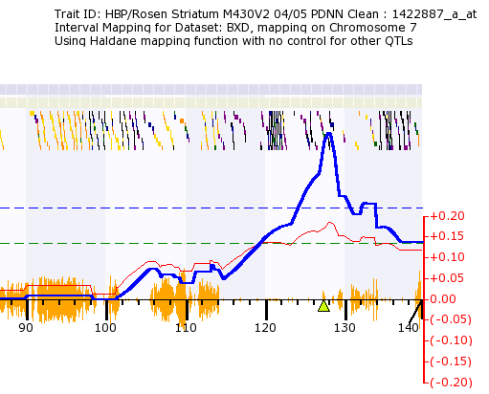
Evaluating Ctbp2 as a candidate QTL for App
This is the App QTL in the INIA data set.
This is the Ctbp2 cis QTL, but is detected only in the Rosen striatum data set.
Notes:
This slide illustrates one reason why Ctbp2 should be considered a high priority positional candidate gene that may modulate the expression level of App. Ctbp2 is a strong cis QTL in some brain regions (here the data are taken from the striatum). If Ctbp2 contains variants that modulate its own expression then these expression differences may produce many downstream effects. Of course, we now want to know much more about the known biology of Ctbp2. What kind of gene is it? To begin to answer that question we can use a number of resources listed in the LINKS page.
Notes:
The App QTL is bimodal. Perhaps there are actually two causal factors in this region--one close to 123 Mb and the other close to 127 Mb.
2. The precision of QTL mapping depends on several factors, including the effect size and interactions among QTLs modulating a trait, the number of genetic individuals that are studied, and the distribution of recombinations in the study population. In the case above, the QTL(s) are likely to be confined to the interval from 120 to 132 Mb. The bootstrap test (yellow bars shown in some of the previous slides) can be usual for estimating the consistency of QTL peaks.

Slide 11
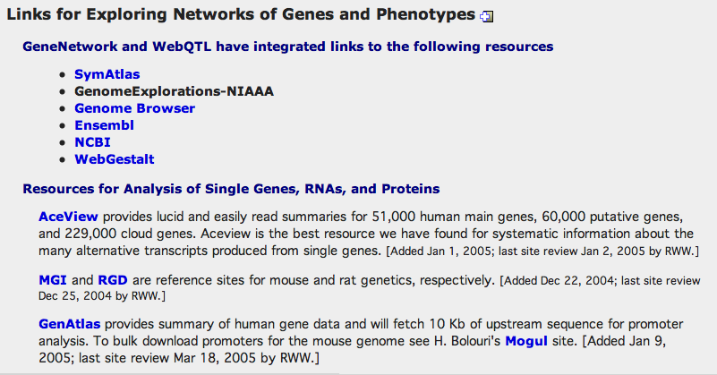
Evaluating Ctbp2 using other resources
Notes:
Ctbp2 should also be considered a high priority biological candidate gene responsible for modulating App expression levels. The C-terminal binding protein 2 is a transcriptional co-repressor also known as Ribeye. The gene produces two transcripts encoding distinct proteins. The short form is a transcriptional repressor that binds a Pro-X-Asp-Leu-Ser peptide motif and interacts with several transcription factors including EVI1, ZFPM1, and ZFHX1A (aka TCF8, deltaEF1). The longer isoform is a major component of specialized synapses in photoreceptors. Both proteins contain a NAD+ binding domain similar to NAD+-dependent 2-hydroxyacid dehydrogenases.
Notes:
1. To find out more about CTBP2 protein and the Ctbp2 gene, link to iHOP at http://www.pdg.cnb.uam.es/UniPub/iHOP/ and type in CTBP2
Try Arrowsmith at http://arrowsmith.psych.uic.edu/cgi-test/arrowsmith_uic/pubsmith.cgi
2. Both APP and CTBP2 are involved in oxidoreducatase activity or Notch signaling. To establish this common gene ontology visit NCBI http://www.ncbi.nih.gov/entrez/query.fcgi?db=gene and enter each gene symbol.
3. You can get interesting hints regarding Ctbp2 expression partners by examining the genetic correlations between Ctbp2 probe set 1422887_a_at and all other transcripts on the M430 Affymetrix array. Use the Striatum data set because we already know from previous work (the previous slide) that this gene is a cis QTL. You should be able to show that Ctbp2 and Notch3 have antagonistic expression patterns in striatum. The negative genetic correlation with E2f4 is even stronger. The transcript also has a high positive genetic correlation with Rdh14. Of particular interest with respect to APP protein processing, Ctbp2 covaries positively with Bace2 (the transcript of the beta site APP-cleaving enzyme 2).

Slide 12
Summary of Part 2
Covered the basics of QTL analysis and mapping.
Reviewed difference between genetic and physical maps.
Discussed interpreting features of QTL maps including the LRS function, the additive effect function, the bootstrap bars, and the permutation thresholds.
Illustrated techniques to generate a list of positional candidates.
Discussed some factors used to evaluate candidate genes.
What does a QTL signify? A good QTL is a claim that a particular chromosomal region contains a causal source of variation in the phenotype. The importance of this hypothesis depends on the quality and relevance of the phenotype and the statistical strength of the QTL. As usual, test and be skeptical.

Slide 13
Test Questions
1. Evaluate candidates for the Chr 3 App QTL.
2. Do App and Ctbp2 expression share any other QTLs beside that on Chr 7?
3. Can you exploit literature mining tools to find a strong relationship between App and Ctbp2?
4. Why might the cis QTL for Ctbp2 expression only be detected in the striatum data set?

Slide 14
Contact for comments and improvements:
rwilliam@nb.utmem.edu
kmanly@utmem.edu
The App findings reviewed in this presentation are part of an ongoing study by R. Williams. R. Homayouni, and R. Clark (July 15, 2005)
Notes:
END

