Slide 1
Metrowest developers machine learning group
Welcome
December 13th 2017

Slide 2
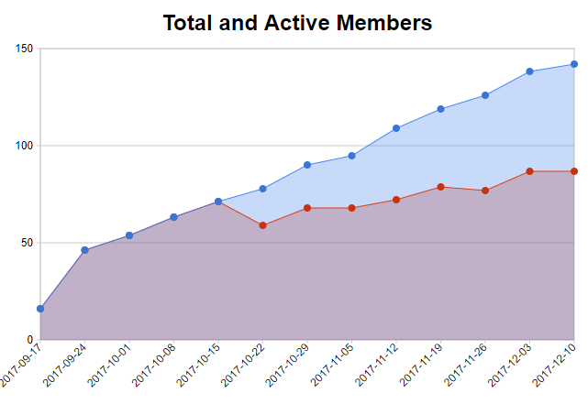
membership

Slide 3
Housekeeping
Cancelled meeting due to weather
Plymouth Church weather close announcements on channel 5 (WCVB)
A post to the meeting announcement will announce a weather-related cancellation
Future Dates:
December 13th
January 3rd
January 17th
January 31st

Slide 4
Meeting Structure
Fundamentals – Toolkit, Language, Platform Agnostic
Data: Acquisition, Analysis, Conditioning, Visualization
Training: Set Separation, Model Selection, Validation
Production: Pipeline, Deployment
Hands-On Machine Learning with Scikit-Learn & Tensorflow
Technology Demonstration

Slide 5
Agenda
Feature Extraction
Simple Linear Regression - Sid Shrivastava
Optimizing Pandas
Introduction to TensorFlow

