Slide 1

oscillator
A project proposal: Model-to-code generator
Gene Olafsen

Slide 2
simple
Define a Model
Generate Code

Slide 3
Learning: machine learning
Define the problem
Acquire the data
Select an ML technique
Build a model
Train the model
Evaluate model performance
Repeat!

Slide 4
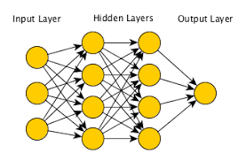
What is a model?

Slide 5
Model interchange standards
Predictive Model Markup Language (PMML) is an XML-based predictive model interchange format.
Dr. Robert Lee Grossman, then the director of the National Center for Data Mining at the University of Illinois at Chicago. 1998
Open Neural Network Exchange (ONNX).
September 2017, Microsoft and Facebook
https://github.com/onnx/onnx

Slide 6
Define your own
JSON syntax is derived from JavaScript's object notation syntax:
Data is in name/value pairs
Data is separated by commas
Curly braces hold objects
Square brackets hold arrays
A relatively 'compact' format
Not XML?
Because it's 2018, check your calendar.

Slide 7
Sample json
var person = { "name":"John", "age":31, "city":"New York", "cars":[ "Ford", "BMW", "Fiat" ] };
Var layer1 = {"name":"Hidden1", "activation":"relu"}

Slide 8
.GMD File
"Gene"ric
Model
Definition

Slide 9
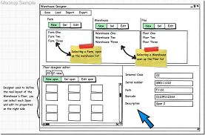
capture the model details
Custom user interface
React
Angular
Vue

Slide 10
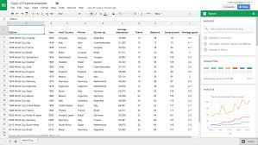

Off the shelf

Slide 11
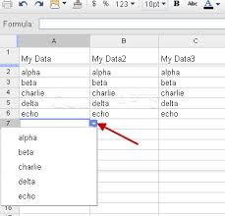
Drop down selection

Slide 12
layer per row
Keeping it simple
A spreadsheet offers a convenient user interface, especially if you limit yourself to defining a layer per row.

Slide 13
Spreadsheet to model file transformation
Populate spreadsheet rows
Save as CSV file(with headers)
Convert to JSON (.GMF)

Slide 14
Model definition to model code
There are a number of possible render formats:
TensorFlow (Raw)
Tensorflow (Layers)
SciKit-Learn
Keras
CNTK
PyTorch
Straight-up Python

Slide 15
Abstract the generation
Code (modules) can be created to render model output to any number of formats.

Slide 16
Code Generation options
Languages that are most compatible with JSON
JavaScript
Typescript (strong typing)
Cross-platform runtime for code
NodeJS
Libraries
npm package manager for JavaScript libraries (bundled with NodeJS)

Slide 17
Suggestion
First cut of the code written in Typescript utilizing the free/cross-platform VSCode environment.
VSCode runs on a (local) NodeJS server.

Slide 18
Model definition file to model code
Populate spreadsheet rows
Save as CSV file(with headers)
Convert to JSON (.GMF)
Interpret JSON and produce a model (Python)

Slide 19

Experimentation is essential
Evaluating and documenting each model's performance is an essential part of the machine learning process.
Jupyter Notebooks are a convenient way to accomplish this task.

Slide 20
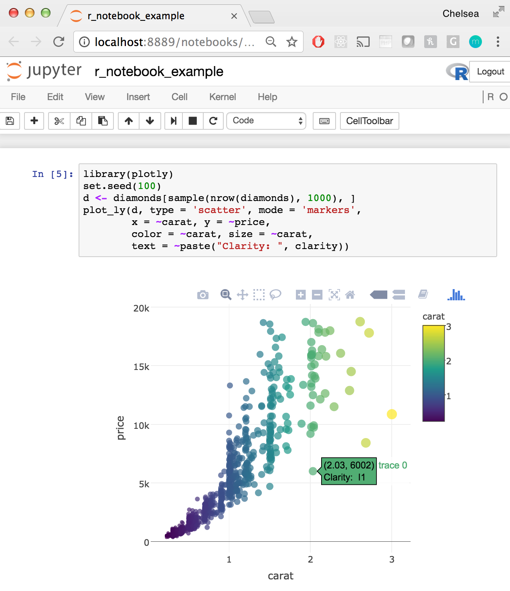
Jupyter connection

Slide 21
Produce a notebook page
Conveniently, the Jupyter Notebook file format is JSON.
Populate spreadsheet rows
Save as CSV file(with headers)
Convert to JSON (.GMF)
Interpret JSON and produce a model (Python)
Insert model into Jupyter Notebook page

Slide 22
Model definition sample
var sample_gmf = {
"header": {
"name": "model for iris dataset",
"purpose": "test of the model definition",
"output": "tensorflow-layers"
},
"experiments": {
"experiment":{
"purpose":"push sample code to jupyter notebook",
"modeldef": {
"layer": { "inputsize": 40, "activation":"relu"},
"layer": { "inputsize": 20, "activation":"relu"}
}
}
}
}
}
JSON:

Slide 23
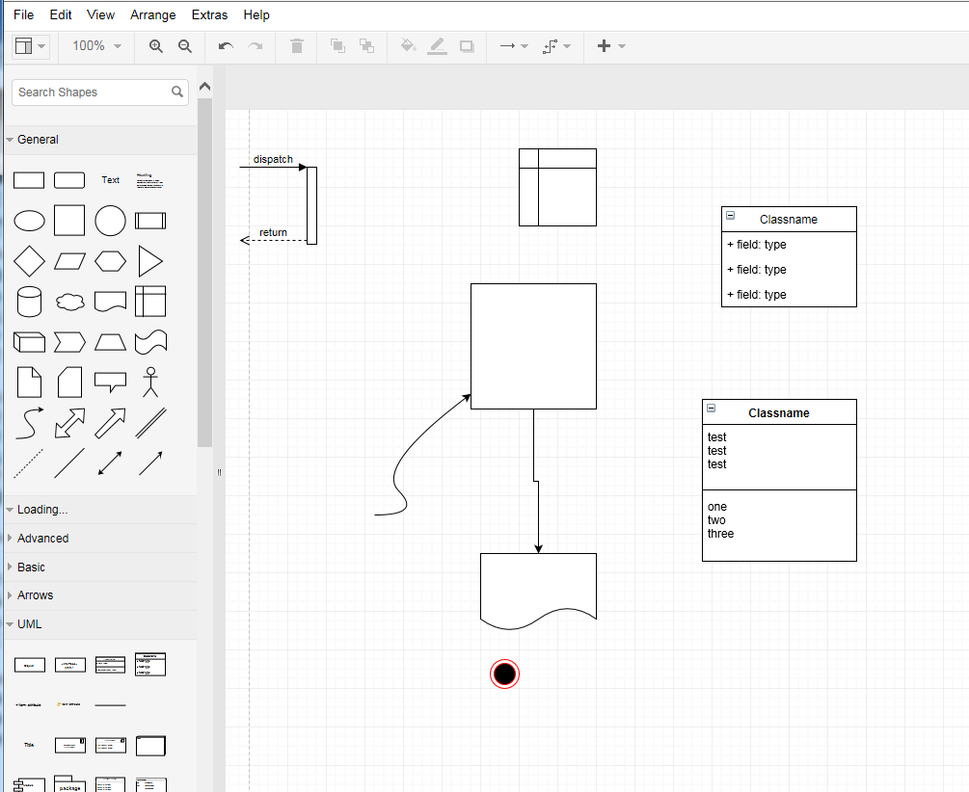
possible Front-end
Mxgraph:

Slide 24
Software Stack
UI
Spreadsheet
React, Angular, Vue
mxgraph
Logic
NodeJS
Output
Jupyter Notebook Page
Python Model
Code Generator Modules
VSCode Extension

Slide 25
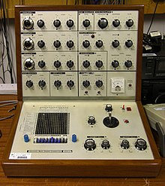
Welcome to the machine (learning)
EMS VS3
Voltage Controlled Oscillators
Used on Pink Floyd's: "Welcome to the Machine"

