Slide 1
Inception Architecture
Dimensionality and compute reduction
Gene Olafsen

Slide 2
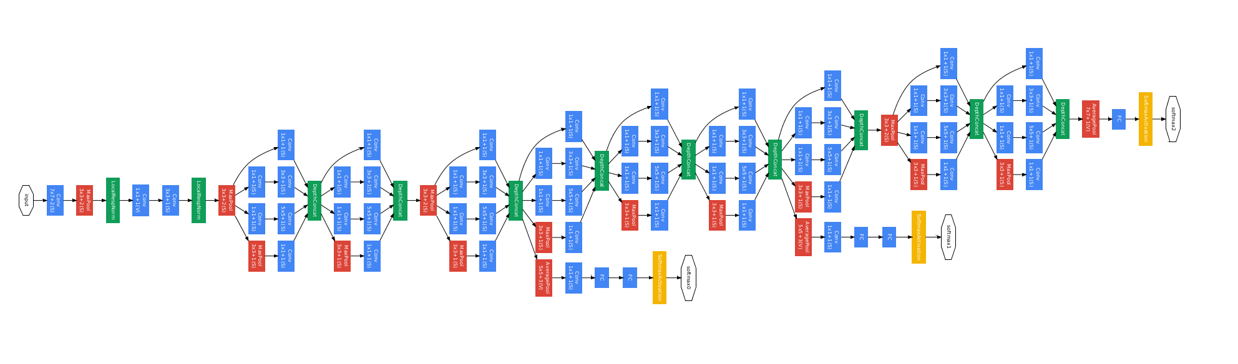
GoogLeNet architecture with nine inception modules

Slide 3
Select a convolution...
The inspiration for 'inception' comes from the idea that you need to make a decision as to what type of convolution (3×3 or 5×5 or 1x1?) you want to perform at each layer.
The answer pursued by Inception is to use all of them and let the model decide. Perform each convolution in parallel and concatenate the resulting feature maps before going to the next layer.

Slide 4
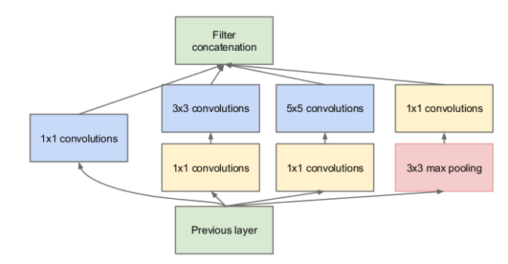
Inception Convolutions

Slide 5
Art not science
What is max pooling is doing there with all the other convolutions? Pooling is added to the Inception module for no other reason than, historically, good networks having pooling.

Slide 6
Inception Advantage
This architecture allows the model to recover both local feature via smaller convolutions and high abstracted features with larger convolutions.

Slide 7
1x1 convolution
1x1 convolution is a ‘feature pooling’ technique.
The larger convolutions are more computationally expensive, so the paper suggests first doing a 1×1 convolution reducing the dimensionality of its feature map, passing the resulting feature map through a ReLU, and then doing the larger convolution (in this case, 5×5 or 3×3).
The 1×1 convolution is used to reduce the dimensionality of its feature map. 1x1 convolutions are used to compute reductions before the expensive 3x3 and 5x5 convolutions.

Slide 8
Rectified linear unit
To add more non-linearity by having ReLU immediately after every 1x1 convolution.
ReLu is nonlinear in nature, and combinations of ReLu remain nonlinear.

Slide 9
Sample input to 1x1 Convolution layer
A convolution layer whose output tensor is defined with the following shape: (N, F, H, W):
N is the batch size
F is the number of convolutional filters
H, W are the spatial dimensions

Slide 10
Dimensionality reduction
Create a second convolution layer with F1 1x1 filters, zero padding and stride 1 and feed it with the first convolution layer's tensor. The output of this 1x1 convolution layer will have shape (N, F1, H, W).
So 1x1 convolution filters can be used to change the dimensionality in the filter space. If F1>F then we are increasing dimensionality, if F1<F we are decreasing dimensionality, in the filter dimension.

Slide 11
Computation is reduced
A reduction from 120+ million operations to about 12+ million operations.
Computing resources is reduced by a factor of 10X.

Slide 12
#Inception Module
conv1_1x1_1 = conv2d_s1(x,W_conv1_1x1_1)+b_conv1_1x1_1
conv1_1x1_2 = tf.nn.relu(conv2d_s1(x,W_conv1_1x1_2)+b_conv1_1x1_2)
conv1_1x1_3 = tf.nn.relu(conv2d_s1(x,W_conv1_1x1_3)+b_conv1_1x1_3)
conv1_3x3 = conv2d_s1(conv1_1x1_2,W_conv1_3x3)+b_conv1_3x3
conv1_5x5 = conv2d_s1(conv1_1x1_3,W_conv1_5x5)+b_conv1_5x5
maxpool1 = max_pool_3x3_s1(x)
conv1_1x1_4 = conv2d_s1(maxpool1,W_conv1_1x1_4)+b_conv1_1x1_4
#concatenate all the feature maps and apply relu
inception1 = tf.nn.relu(tf.concat(3,[conv1_1x1_1,conv1_3x3,conv1_5x5,conv1_1x1_4]))

