Slide 1

Differential Gene Expression
Reminder: we want to find what genes, processes, pathways are differentially expressed in tumor vs normal tissue
Notes:
Now we are transitioning to learning about some common bioinformatics analyses
First one is Differential Expression

Slide 2
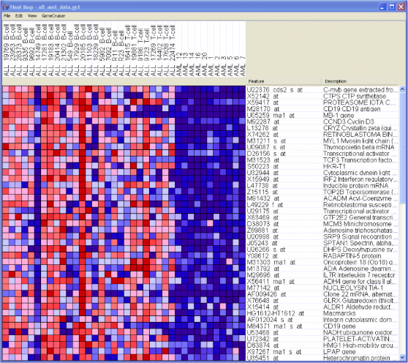
Gene Expression Matrix
Sample
annotations
Samples
Gene
annotations
Gene
expression
matrix
Genes
Notes:
one of the most common ways to represent and visualize data in GenePattern (and Bioinformatics in general) – Gene Expression matrix

Slide 3
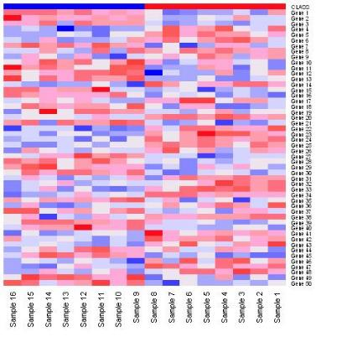
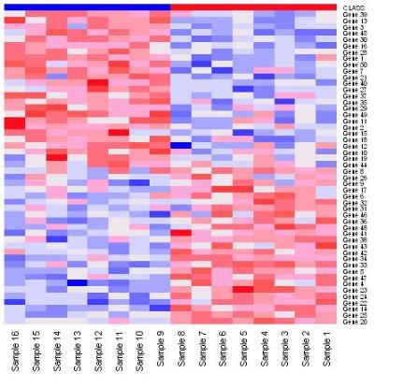
Differential Expression Analysis
Marker selection
Given phenotypically distinct classes, find “markers” that distinguish these classes from one another
Tumor
Normal
Tumor
Normal
Notes:
Marker selection is when given distinct classes, you want to find “markers” that distinguish between these classes.
The heatmap on the left show an unsorted heatmap, and on the right the genes are sorted by their ability to distinguish the two classes
Note that distinguishing the classes works both ways – up-and down-regulated in both classes.

Slide 4
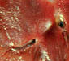
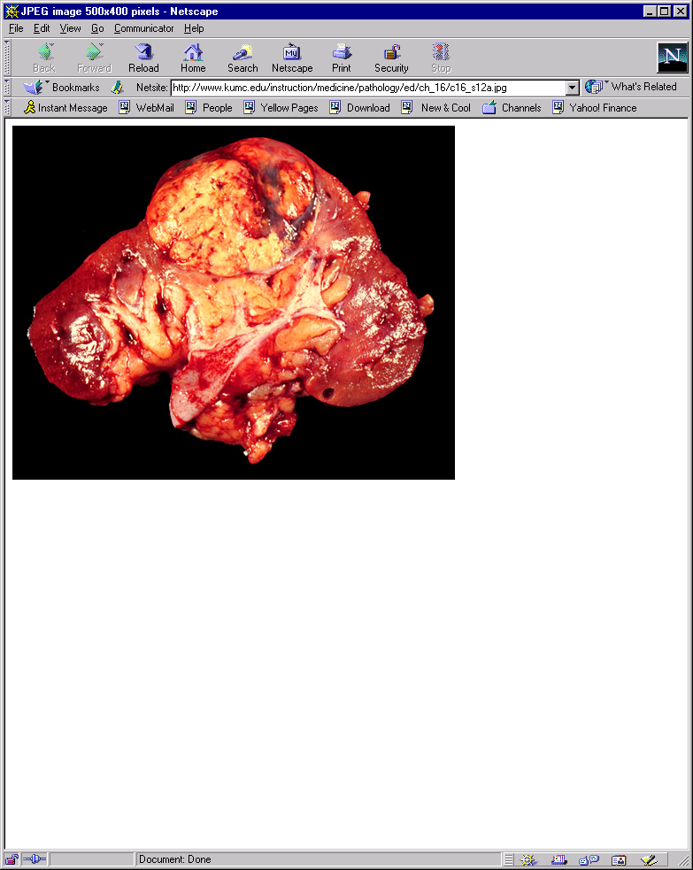
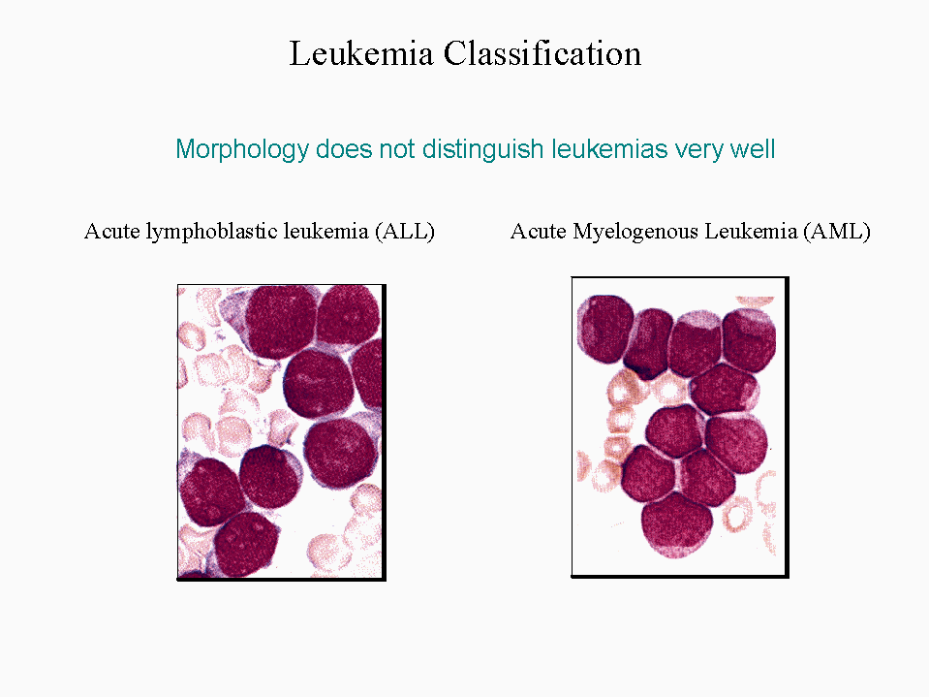
Gene Marker Selection
Hierarchy of difficulty
Problem Gene Markers Error Example
I. Tissue or Cell Type ~1000-2000 ~0% Normal vs. Renal carcinoma
Normal vs. Abnormal
II. Morphological ~200-500 ~0-5% Leukemia ALL vs. AML
Type
III. Morphological Subtype ~50-100 ~0-15% ALL B- vs. T-Cell
Multiclass Classification
IV. Treatment Outcome ~1-20 ~5-50% AML Treatment Outcome
Drug Sensitivity
Degree of Difficulty
adapted from P. Tamayo
Notes:
When doing marker selection there are several levels of difficulty
The first level is finding genes that distinguish between tissue or cell type
The second level is finding genes that distinguish between morphological types such as Leukemia ALL vs. AML

Slide 5
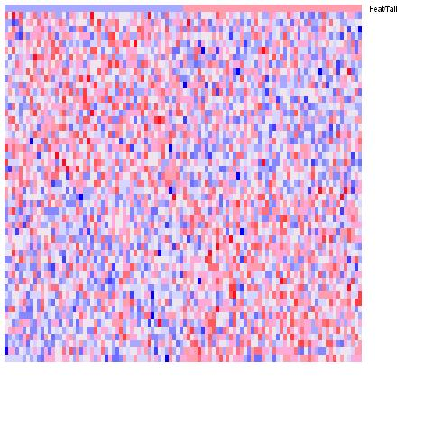
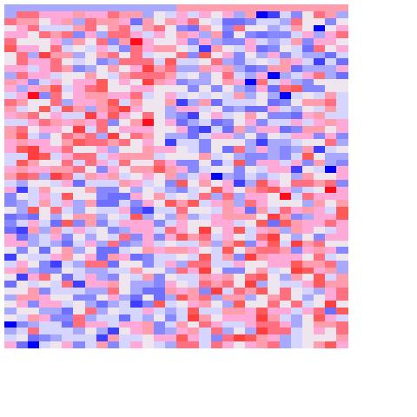
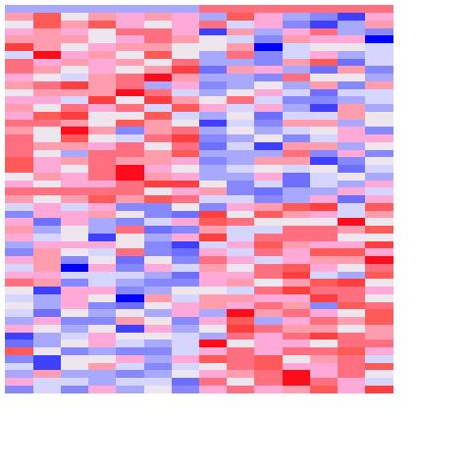
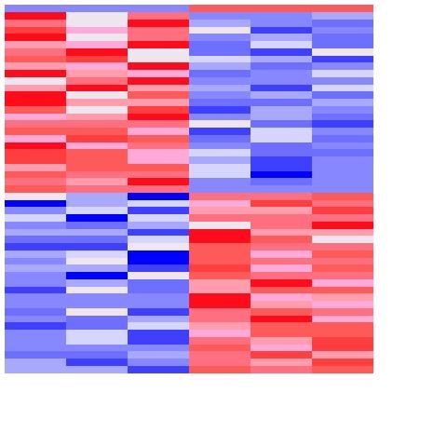
Effect of Sample Size
Exercise: select markers for random samples
Generate a 10,000x100 matrix of random data → N(μ=0, σ=0.5)
Pick n columns at random → n = [100, 30, 14, 6]
Assign label yellow (e.g., tumor) to half of samples (chosen at random) and green (e.g., normal) the rest
Select top 25 markers for yellow, top 25 markers for green
Yellow Green
Yellow Green
Yellow Green
Yellow Green
25
25
100 samples
30 samples
14 samples
6 samples
With small sample size it is easy to find genes considered significant by chance!
Notes:
Old notes:
Here we have 4 heatmaps with increasing sample size.
With small sample size, easy to find genes correlated w/ anything
Head/Tail example suggests a way of testing for the significance of the results: is the observed difference in expression bigger than what we can observe with respect to a random phenotype (head/tail)?
Fit the story you want to tell --> With so few samples/columns it is easy to find rows that look the way you want them to look.

Slide 6
Differential Analysis Exercise
Open notebook:
2018-03-14_05_UCSF_Differential Analysis
Notes:
6
Both raise the bar for calling something significant (i.e., smaller nominal p-values are required as the number of hypotheses tested increases)
In practical terms, the FDR is the expected false positive rate; for example, if 1000 observations were experimentally predicted to be different, and a maximum FDR for these observations was 0.10, then 100 of these observations would be expected to be false positives.

Slide 7
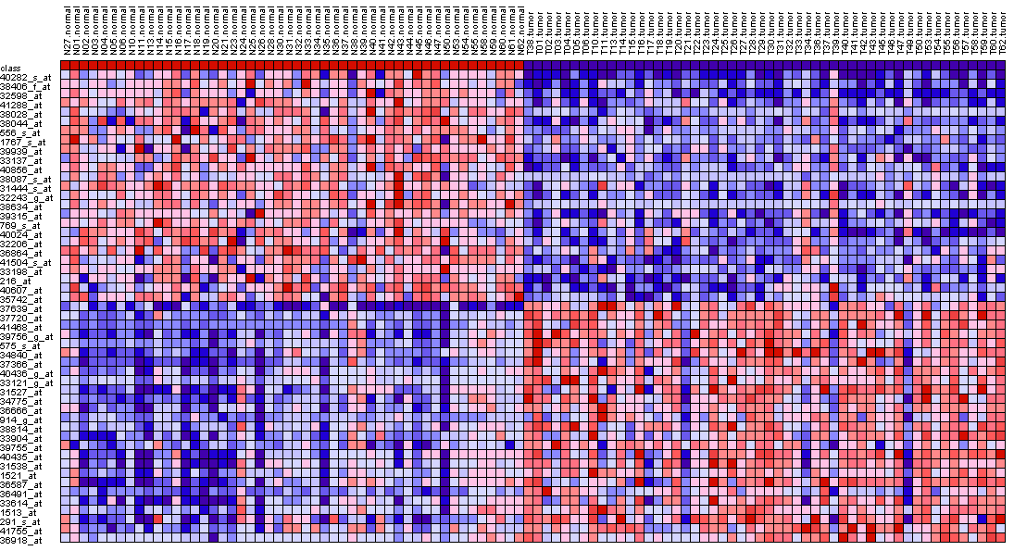
Gene Marker Selection
Compute score for each gene
Compute
score:
t-test,
SNR,
IC,
etc.
Ranked gene list
Dataset
Score
Phenotype/
class labels
t-test
Signal-to-Noise
Ratio (SNR)
Other metrics such as
information coefficient
Hypothesis testing method:
Standardized mean difference between the two classes.
It is the difference between the mean expression of class A and class B divided by the variability of expression.
Similar to the t-test but takes the standard deviation of the two distributions into account which is more representative of the differences between classes when there may be differences between the SD of class A and the SD of class B.
μ = class mean
σ = std deviation
n = # of samples
Notes:
Don’t go into t-test vs SNR
(In DESeq2 we use the Wald statistic)
What is DESeq2 doing?
It is computing a “score” for each gene in order to rank those genes and then pick markers (correlated with each phenotype)
There are many ways to compute this score…

Slide 8
One Slide of IC

Slide 9
Differential Analysis Cookbook
Reduce number of hypotheses/genes by variation filtering (attempt at reducing false negatives)
Choose test statistic (e.g., IC, SNR, t-score, ...) → DELETE
If enough samples, compute p-values by permutation test (otherwise, compute asymptotic test using the standard t-distribution).
Control for Multiple Hypothesis Testing by using the FDR correction
Remember: if you choose FDR ≤ 0.05, you’re willing to accept 5% of false positives.
If number of significant hypotheses/genes “too large” even for very small threshold values, either:
use the maxT correction (possible w/ empirical p-values only).
use additional criteria (e.g., min fold-change, min expression value, etc.)
Notes:
maxT correction. Benjamini Hockberg computation of the "FDR BH"

Slide 10
Differential Analysis
GenePattern modules
Create count data set – download_from_gdc
Filter and transform data – PreprocessReadCounts
Make class/phenotype file – ClsFileCreator
Run Differential Analysis – ComparativeMarkerSelection/DESeq2/OC Notebook?
Choose test statistic (say, Information Coefficient)
View results with ComparativeMarkerSelectionViewer
If enough samples, compute p-values by permutation test (otherwise, use asymptotic test).
Control for Multiple Hypothesis Testing by using the FDR correction
Use HeatMapViewer to view results for top genes
How?
Use GSEA to find gene sets (or pathways) that are enriched in your dataset – coming up after the break!
Notes:
Don't go over all the modules

Slide 11
Differential Gene Expression
The “basic units” of DNA are called genes
DNA → RNA → Protein
(Central dogma of molecular biology)
Quantifiable “expression” levels
https://genius.com/Biology-genius-the-central-dogma-annotated
Active, ongoing process
Notes:
Proteins are the most interesting of these three, however, they are particularly challenging to quantify at large scales. So we are looking at RNA.

Slide 12

Differential Gene Expression
Gene “A”, condition “1”
E.g., normal cell
Gene “A”, condition “2”
E.g., cancer cell

Slide 13
Multiple Hypothesis Testing
Remember: Each gene/row is a hypothesis!
Reduce number of hypotheses/genes by variation filtering (attempt at reducing false negatives)
There are ways quantifying this such as False Discovery Rate
¿
?
¿
?
¿
?
¿
?
Notes:
Multiple Hypotheis. Testing: every time you test a gene, that’s a hypotesis you you increase the probability of getting ”false positive” results by chance.

