Slide 1

Gene Set Enrichment Analysis (GSEA)

Slide 2
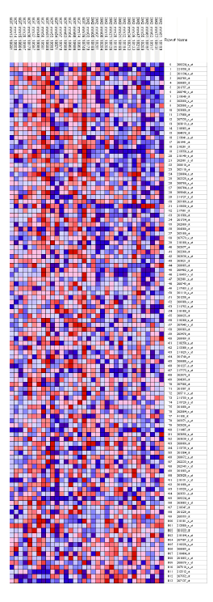
Gene Set Enrichment
Example: human diabetes
Skeletal muscle biopsies
No single gene was found to be significantly differentially expressed.
GSEA was used to assess enrichment of 149 gene sets including 113 pathways from internal curation and GenMAPP, and 36 tightly co-expressed clusters from a compendium of mouse gene expression data.
The oxidative phosphorylation pathway genes were found to be coordinately downregulated.
Normal Diabetic
PGC-1α-responsive genes involved in oxidative phosphorylation are coordinately downregulated in human diabetes
Mootha et al. Nature Genetics 15 June 2003, vol. 34 no. 3 pp 267 – 273:
Notes:
What if there is *no* significant marker gene?

Slide 3
GSEA outline
Take gene expression data from two different groups and rank all genes according to the differential expression across the groups.
Take a group of genes and determine whether they are differentially expressed as a set.
Randomly swap the gene-set labels of the data and repeat the test many times as a gauge of significance of the enrichment analysis results.

Slide 4
Gene by gene analysis
A
B
Uses signal-to-noise ratio (SNR) to score genes:
max difference in mean expression between two groups
min variation of expression within each group
fold change
SNR
t-test
p-value < 0.05

Slide 5
Gene by gene analysis
A
B
gene1
gene2
gene3
gene4
what’s the biological meaning?
p-value < 0.05
other issues:
nothing passed the cutoffs
too many genes found
the results disagree
fold change
t test
SNR
p-value < 0.05

Slide 6
GENE SET
a group of genes that have something in common
it is just a bag of genes
no internal order ⬅
no numbers attached ⬅

Slide 7
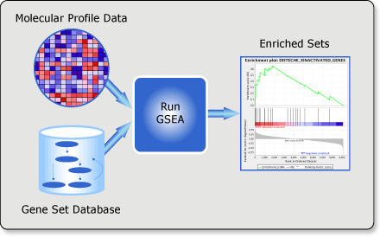
Notes:
MSigDB provides gene sets for GSEA. In addition, the gene sets represent a reference repository of current biological and medical knowledge.

Slide 8
Advantages of GSEA
Accepts any type of gene set or source of annotation
Operates on the entire list of genes (no filtering or trimming!)
Operates on any ordered gene list
Uses distribution-free, non-parametric, permutation-based test procedures.
Preserves the “biological” correlation structure of the markers when evaluating significance.
Notes:
The GSEA method is very general and has the following desirable properties:
Agnostic to the type of gene set and the source of annotation.
Operates on any ordered gene list.
Does not require the choice of a gene selection threshold or the explicit definition of a statistically significant marker set.
Uses distribution-free, non-parametric, permutation-based test procedures with increased statistical power.
Incorporates the permutation of phenotype labels thereby preserving the “biological” correlation structure of the markers.
Takes into account multiple hypotheses testing for multiple gene sets.
NO NEED TO SEPARATE the MARKERS FROM THE NON-MARKERS

Slide 9
The Gene Set Enrichment Score (ES)
Enriched Gene Set Un-enriched Gene Set
Max. Enrichment Score ES
Max. Enrichment Score ES
Enrichment Score S
Enrichment Score S
Ranked list of genes
Ranked list of genes
Every hit adds a bit to the score (1/N_{H})
Every miss subtracts a bit from the score (1/N_{M})
Enrichment Score (ES) = maximum height
The size of the step depends on correlation (current, weighted mode), so early hits get larger steps than hits to the middle of the gene list
Notes:
The primary result of the gene set enrichment analysis is the enrichment score (ES), which reflects the degree to which a gene set is overrepresented at the top or bottom of a ranked list of genes. GSEA calculates the ES by walking down the ranked list of genes, increasing a running-sum statistic when a gene is in the gene set and decreasing it when it is not. The magnitude of the increment depends on the correlation of the gene with the phenotype. The ES is the maximum deviation from zero encountered in walking the list. A positive ES indicates gene set enrichment at the top of the ranked list; a negative ES indicates gene set enrichment at the bottom of the ranked list.
One starts by defining the ordered gene list obtained by using any gene marker selection method and the selection of genes to include in a gene set. We define empirical cumulative distribution functions Phit and Pmiss to represent the fraction of gene set G genes that are present (“hits”) or absent (“misses”) in the ordered gene list up to a given position.
The size of the step is a function of the correlation. So early hits get larger steps than hits to the middle of the gene list.
The maximum deflection of the mountain plot is defined as the enrichment scoe (ES).
MOUNTAIN PLOT
p = 0 Classic Kolmogorov-Smirnov (no weighting)
p = 1 Use gene correlation as weight (standard weighting)

Slide 10
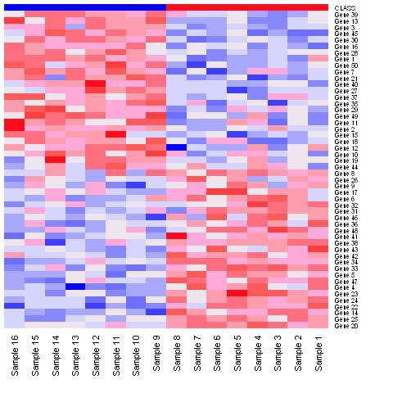


Enrichment: KS-score
Rank genes according to their “correlation” with the class of interest.
Test if a gene set (e.g., a GO category, a pathway, a different class signature) is enriched.
Use Kolmogorov-Smirnoff score to measure enrichment.
Max. Enrichment Score ES
Enrichment Score S
Phenotype
Gene Set G
Gene List Order Index
Ordered Marker List
hit (member of G)
miss (non-member of G)
Subramanian et al., PNAS 2005
Mootha et al., Nature Genetics 2004
Notes:
The GO collaborators are developing three structured, controlled vocabularies (ontologies) that describe gene products in terms of their associated biological processes, cellular components and molecular functions in a species-independent manner.
The ontologies
The three organizing principles of GO are molecular function, biological process and cellular component. A gene product has one or more molecular functions and is used in one or more biological processes; it might be associated with one or more cellular components. For example,the gene product cytochrome c can be described by the molecular function term electron transporter activity, the biological process terms oxidative phosphorylation and induction of cell death, and the cellular component terms mitochondrial matrix and mitochondrial inner membrane. Before we go any further, here are some definitions that should help you to distinguish a gene product from what it does.
Molecular function
Molecular function describes activities, such as catalytic or binding activities, at the molecular level. GO molecular function terms represent activities rather than the entities (molecules or complexes) that perform the actions, and do not specify where or when, or in what context, the action takes place. Molecular functions generally correspond to activities that can be performed by individual gene products, but some activities are performed by assembled complexes of gene products. Examples of broad functional terms are catalytic activity, transporter activity, or binding; examples of narrower functional terms are adenylate cyclase activity or Toll receptor binding.
It is easy to confuse a gene product with its molecular function, and for that reason many GO molecular functions are appended with the word "activity". The documentation on gene products (above) explains this confusion in more depth.
Biological process
A biological process is accomplished by one or more ordered assemblies of molecular functions. Examples of broad biological process terms are cell growth and maintenance or signal transduction. Examples of more specific terms are pyrimidine metabolism or alpha-glucoside transport. It can be difficult to distinguish between a biological process and a molecular function, but the general rule is that a process must have more than one distinct steps.
A biological process is not equivalent to a pathway. We are specifically not capturing or trying to represent any of the dynamics or dependencies that would be required to describe a pathway.
Cellular component
A cellular component is just that, a component of a cell but with the proviso that it is part of some larger object, which may be an anatomical structure (e.g. rough endoplasmic reticulum or nucleus) or a gene product group (e.g. ribosome, proteasome or a protein dimer).

Slide 11
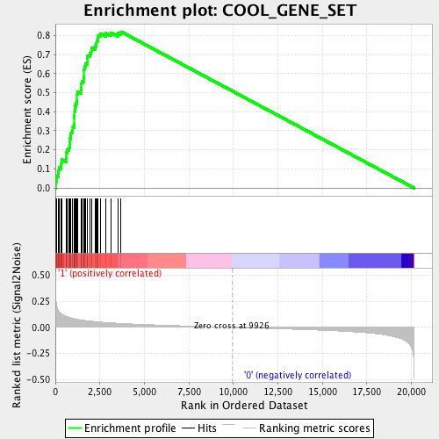
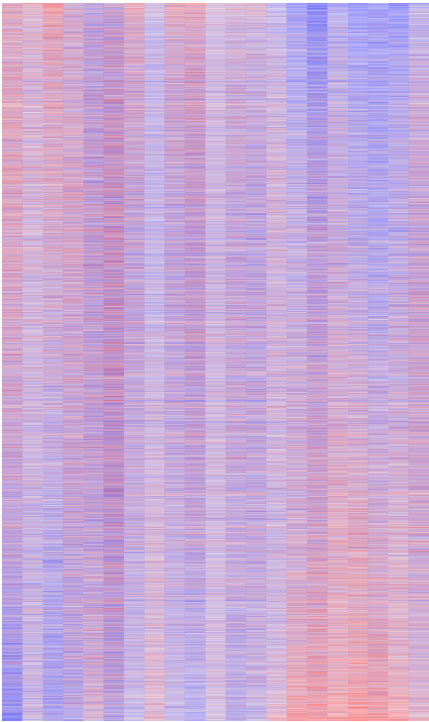
A
B
A
B

Slide 12
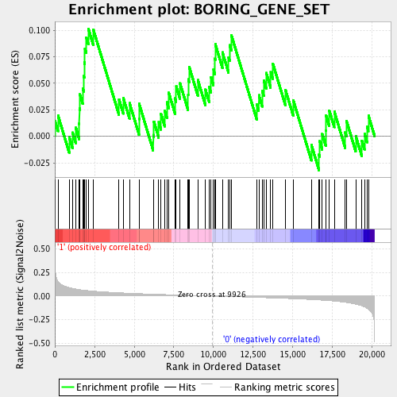
A
B
A
B

Slide 13
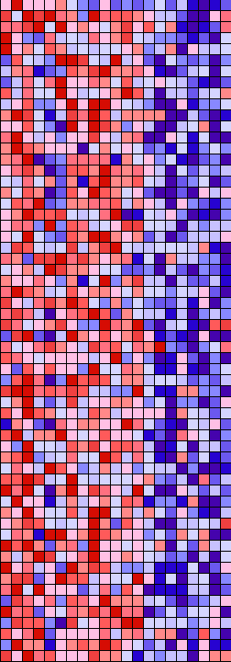
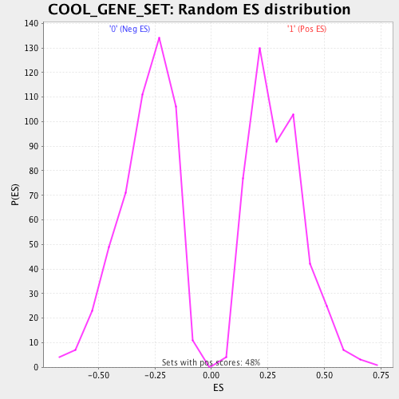
A
B
Dataset | myData
Phenotype | A_versus_B
Upregulated in class | 1
GeneSet | COOL_GENE_SET
Enrichment Score (ES) | 0.82
Normalized Enrichment Score (NES) | 2.82
Notes:
Explain Normalized ES: how many standard deviations from the normal

Slide 14
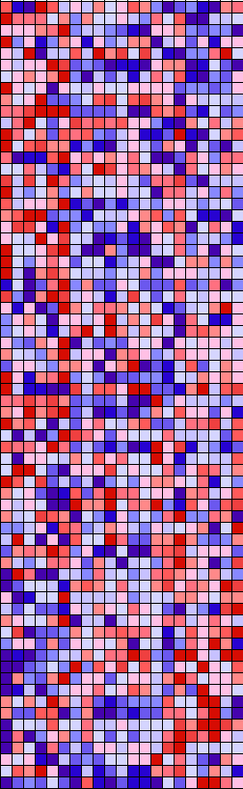
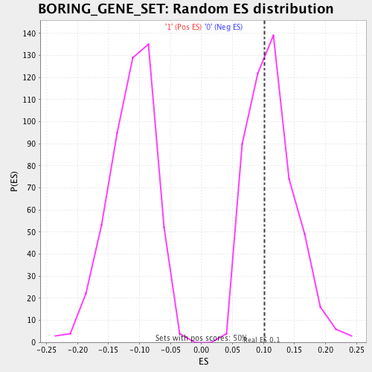
A
B
Dataset | myData
Phenotype | A_versus_B
Upregulated in class | 1
GeneSet | BORING_GENE_SET
Enrichment Score (ES) | 0.10
Normalized Enrichment Score (NES) | 0.58

Slide 15
Testing many sets by GSEA
so far:
you have a single gene set
is the set significantly enriched in my data?
GSEA stats: ES, nominal p-value
now:
you have many gene sets
what sets are most significantly enriched?
GSEA stats: ES, NES, FDR and FWER

Slide 16
GSEA mechanics
gene expression matrix (GCT, RES, PCL or TXT file)
ranking metric
ranked list of all the genes
collapsed to symbols
if necessary
phenotype classes
(CLS file)
gene set(s)
(GRP, GMT or GMX file)
for each gene set
compute:
ES
NES
nominal p-value
multiple test correction
gene annotations
(CHIP file)

Slide 18
MSigDB Gene Set Databases
H | hallmark gene sets are coherently expressed signatures derived by aggregating many MSigDB gene sets to represent well-defined biological states or processes.
C1 | positional gene sets for each human chromosome and cytogenetic band.
C2 | curated gene sets from online pathway databases, publications in PubMed, and knowledge of domain experts.
C3 | motif gene sets based on conserved cis-regulatory motifs from a comparative analysis of the human, mouse, rat, and dog genomes.
C4 | computational gene sets defined by mining large collections of cancer-oriented microarray data.
C5 | GO gene sets consist of genes annotated by the same GO terms.
C6 | oncogenic signatures defined directly from microarray gene expression data from cancer gene perturbations.
C7 | immunologic signatures defined directly from microarray gene expression data from immunologic studies.

Slide 19
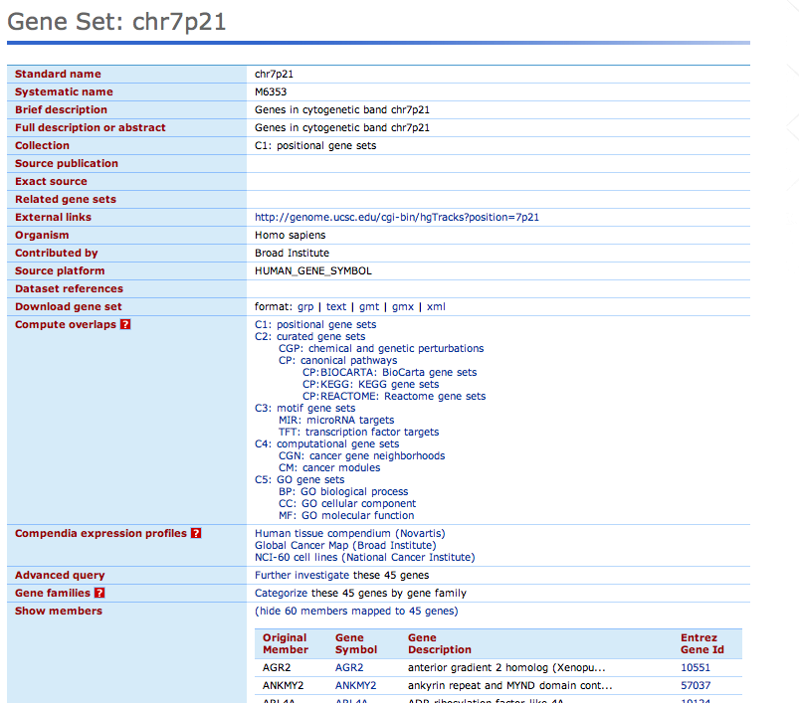
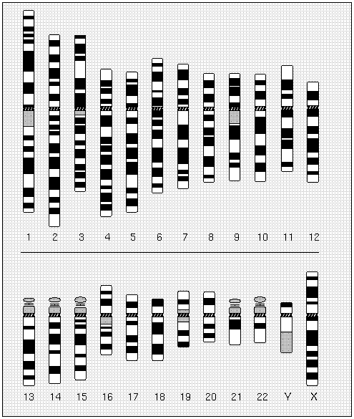
C1 Collection: positional
Gene sets correspond to cytogenetic bands
help when studying regional effects, e.g.:
chromosomal deletions or amplifications
dosage compensation
epigenetic silencing
chr7p21
Idiogram Album: Human copyright 1994 David Adler

Slide 20


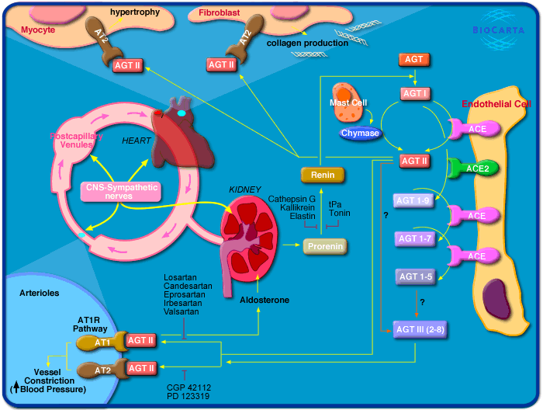
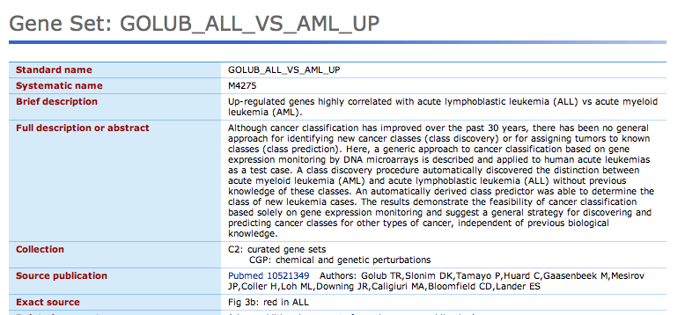
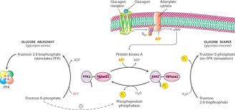
C2 Collection
GCP: Genetic & Chemical Perturbations (papers & labs)
CP: Canonical Pathways
(wiring diagrams and cartoons)
labs
journals
KEGG (enzyme reactions)
Reactome (biol. processes)
BioCarta (pathway cartoons)

Slide 21
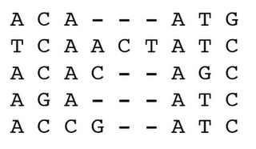
C3: motifs
upstream (promoters): transcription factor binding sites
downstream (3’-UTR): microRNA binding sites
TF
microRNA
ORF
ORF

Slide 22
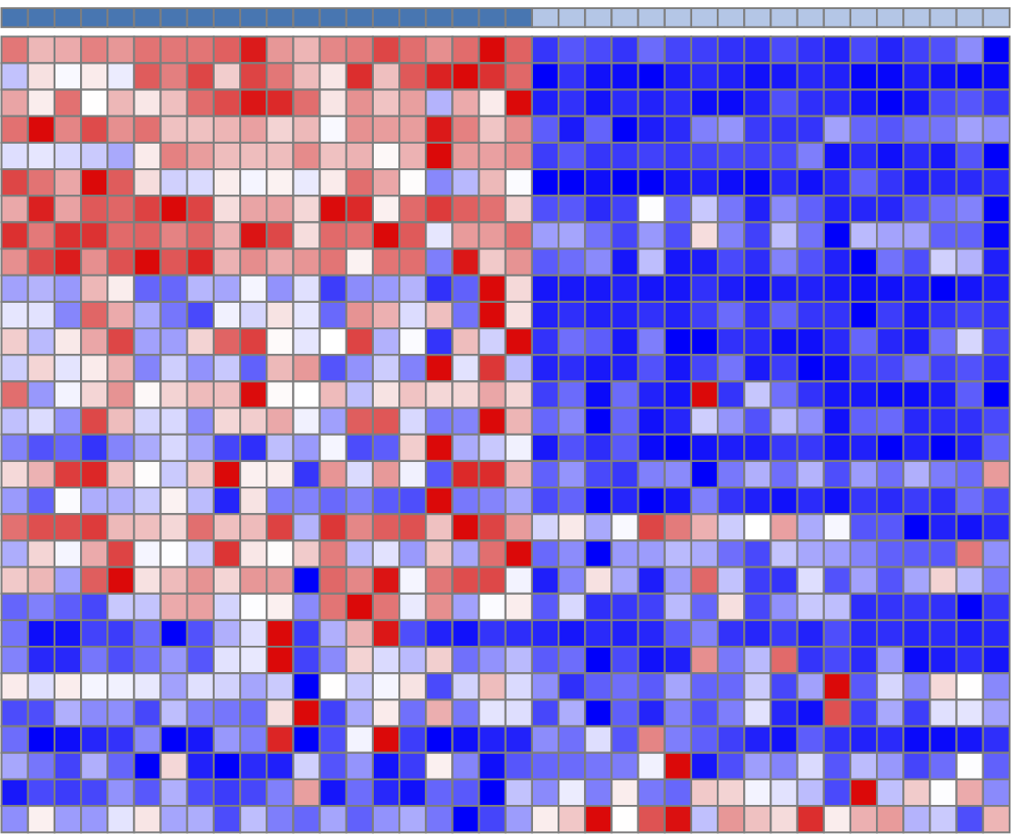
C4, C6, C7: computational
clusters of similarly expressed genes

Slide 23
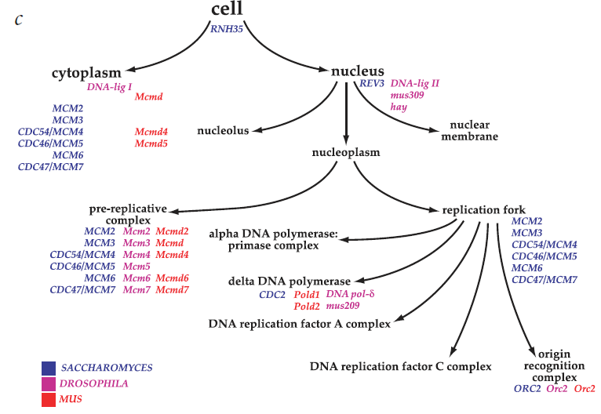
C5: Gene ontology (GO) terms
Gene sets are consist of genes annotated with a particular GO term
Consists of 3 subcollections:
CC: GO Cellular Component (WHERE) (233 gene sets)
MF: GO Molecular function (WHAT) (396 gene sets)
BP: GO Biological process (HOW) (825 gene sets)
Nature Genet. (2000) 25: 25-29

Slide 24
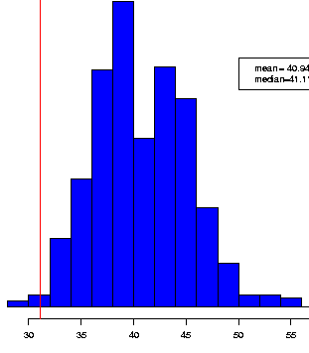
P-value calculation
If a gene is normally distributed the t-score follows the t-distribution
What if they aren’t normally distributed?
Permutation Test:
shuffle labels (class membership)
compute score for each gene (t-score, SNR, .. )
repeat many times
Result: Empirical null distribution of scores for each gene
Compare observed score to empirical distribution.
Observed score of gene
Distribution of permuted scores for given gene
scores
No distributional assumptions are made - compute gene-specific p-values
Notes:
24
Remove the signal by reshuffling the sample labels.
After this process, the data should not have genes that are differentially expressed, and the changes are only false positive.
For each gene, one can select a threshold by fixing a false detection rate.
If gene is not normally distributed you can shuffle the class membership labels and compute the score.
Then to calculate a p-value you would compare the observed score to the distribution of the permuted scores for the gene.

Slide 25
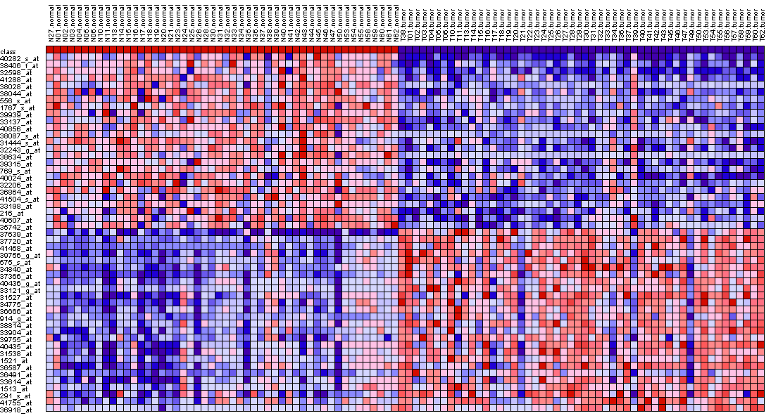
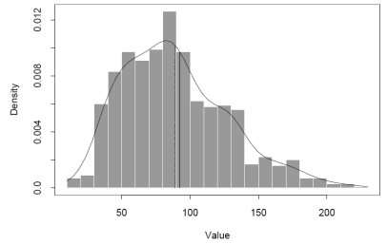
Marker Selection Process
Compute
score:
t-test,
SNR, etc.
Measure of
significance
Ranked gene list
Measure
significance:
permutation
test
Dataset
Score
Phenotype/
class labels
Notes:
Markers are also referred to as FEATURES
Here is a workflow of the marker selection process.
Given a dataset and phenotype labels you would:
Compute a statistic for each gene or feature
Measure the significance of the score using a permutation test
Correct for multiple hypothesis testing using the FDR or FWER
End of with genes that are differentially expressed between the two phenotypes

Slide 26
Permutation test and P-value
Aim: Determine the significance of gene’s statistical score
Class A
Class B
Known class A samples
Known class B samples
Score
“True” classes
7 | 4 | 1 | 9 | 9 | 4 | 6 | 7 | 1 | 9 | 4 | 5 | 6 | 10 | 3 | 8 | 4 | 1 | 2 | 1
7 | 3 | 5 | 1 | 4 | 3 | 9 | 4 | 5 | 5 | 7 | 6 | 9 | 8 | 8 | 3 | 10 | 6 | 7 | 3
8 | 10 | 9 | 7 | 8 | 5 | 10 | 10 | 2 | 4 | 2 | 8 | 10 | 2 | 4 | 1 | 10 | 9 | 6 | 6
5 | 10 | 10 | 10 | 3 | 8 | 10 | 8 | 4 | 9 | 7 | 9 | 8 | 10 | 4 | 5 | 6 | 5 | 2 | 7
7 | 2 | 4 | 9 | 6 | 2 | 4 | 1 | 2 | 9 | 10 | 9 | 1 | 3 | 7 | 1 | 1 | 1 | 5 | 5
7 | 5 | 4 | 7 | 1 | 2 | 6 | 5 | 8 | 1 | 10 | 9 | 4 | 8 | 7 | 2 | 9 | 1 | 10 | 3
8 | 4 | 2 | 6 | 6 | 9 | 2 | 10 | 5 | 2 | 5 | 3 | 7 | 10 | 7 | 6 | 2 | 9 | 3 | 10
5 | 9 | 9 | 7 | 10 | 2 | 5 | 2 | 4 | 8 | 4 | 2 | 9 | 2 | 5 | 8 | 2 | 10 | 7 | 5
5 | 3 | 2 | 5 | 8 | 9 | 3 | 4 | 5 | 6 | 1 | 1 | 9 | 2 | 6 | 2 | 5 | 1 | 6 | 5
6 | 1 | 5 | 2 | 7 | 9 | 9 | 3 | 4 | 2 | 2 | 9 | 1 | 4 | 8 | 3 | 8 | 6 | 6 | 6
3 | 1 | 7 | 2 | 8 | 2 | 4 | 2 | 4 | 1 | 2 | 9 | 10 | 8 | 3 | 7 | 3 | 9 | 8 | 6
8 | 10 | 7 | 4 | 3 | 10 | 3 | 1 | 5 | 6 | 1 | 8 | 3 | 1 | 9 | 3 | 4 | 1 | 2 | 6
9 | 2 | 8 | 8 | 4 | 7 | 9 | 8 | 9 | 10 | 8 | 9 | 6 | 5 | 5 | 7 | 3 | 6 | 5 | 2
4 | 2 | 10 | 8 | 9 | 3 | 8 | 3 | 9 | 10 | 5 | 2 | 9 | 6 | 5 | 2 | 10 | 5 | 3 | 9
1 | 9 | 7 | 1 | 8 | 10 | 10 | 2 | 7 | 10 | 2 | 9 | 1 | 4 | 3 | 2 | 8 | 8 | 9 | 2
1 | 6 | 6 | 1 | 8 | 8 | 6 | 4 | 9 | 8 | 8 | 5 | 5 | 5 | 8 | 7 | 4 | 10 | 4 | 9
5 | 1 | 1 | 5 | 5 | 2 | 1 | 7 | 2 | 4 | 9 | 10 | 1 | 4 | 10 | 9 | 7 | 7 | 7 | 5
Permutation 1
Permutation 2
Permutation n
Generates a “null distribution” of scores for this gene
Compare with “real” score for this gene
Notes:
We first compute the actual score for this gene

Slide 27
Marker Selection Process
Compute
score:
t-test,
SNR, etc.
Measure of
significance
Ranked gene list
Measure
significance:
permutation
test
Dataset
Score
Phenotype/
class labels
Notes:
Markers are also referred to as FEATURES
Here is a workflow of the marker selection process.
Given a dataset and phenotype labels you would:
Compute a statistic for each gene or feature
Measure the significance of the score using a permutation test
Correct for multiple hypothesis testing using the FDR or FWER
End of with genes that are differentially expressed between the two phenotypes

Slide 28
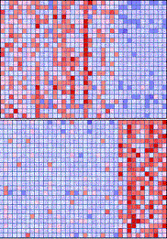
Marker Selection Process
Compute
score:
t-test,
SNR, etc.
Measure of
significance
Ranked gene list
Measure
significance:
permutation
test
Dataset
Score
Phenotype/
class labels
Correct for multiple hypotheses:
FDR, FWER, etc.
Markers
Notes:
Markers are also referred to as FEATURES
Here is a workflow of the marker selection process.
Given a dataset and phenotype labels you would:
Compute a statistic for each gene or feature
Measure the significance of the score using a permutation test
Correct for multiple hypothesis testing using the FDR or FWER
End of with genes that are differentially expressed between the two phenotypes

Slide 29
Multiple Hypotheses
What to control
FDR (False Discovery Rate): the expected proportion of false positives among all significant hypotheses/features
FWER (Family-Wise Error Rate): the probability of making one or more false discoveries among all the hypotheses/features
Bonferroni Correction:
Divides the p-value by the number of hypotheses/features
Most conservative metric
Try to reduce the number of hypotheses tested in the first place (i.e. filtering)
Notes:
29
Both raise the bar for calling something significant (i.e., smaller nominal p-values are required as the number of hypotheses tested increases)
In practical terms, the FDR is the expected false positive rate; for example, if 1000 observations were experimentally predicted to be different, and a maximum FDR for these observations was 0.10, then 100 of these observations would be expected to be false positives.

Slide 30
Multiple hypothesis testing
GSEA: a gene set is significantly enriched if the nominal p-value of the ES statistic is smaller than 0.05
Multiple testing problem: if you ran GSEA on 200 sets then 10 sets will have nominal p-value lower than 0.05 PURELY BY CHANCE!
Conservative approach (FWER)

Slide 31
GSEA input files
Gene expression dataset
[or alternatively, a ranked list of genes]
Phenotype labels
Discrete phenotypes – two or more
Continuous phenotypes, e.g. time series
Gene sets
Select an MSigDB gene set collection
Or supply a gene set file
Chip annotations
Used to (optionally) collapse expression values into one value per gene
Used to annotate genes in the analysis report
Notes:
1) Gene expression dataset
Contains features (genes or probesets), samples, and an expression value for each feature in each sample
2) Phenotype labels
Contains phenotype labels and associates each sample with a phenotype
3) Gene sets
Contains one or more gene sets, where each gives the gene set name and list of features.
(for example from the MSigDB)
4) Chip annotations
Lists each probe on a DNA chip and its matching HUGO gene symbol

Slide 32

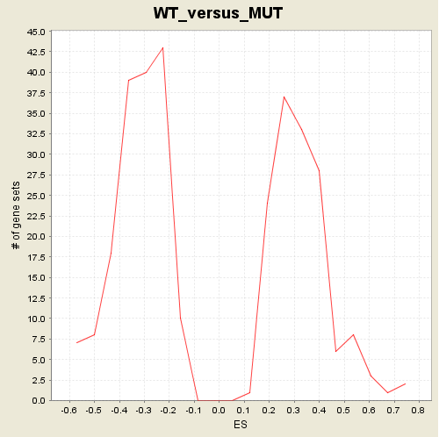

GSEA Example: p53
Datasets: http://www.broadinstitute.org/gsea/datasets.jsp
Gene sets: http://www.broadinstitute.org/gsea/msigdb/collections.jsp
Analysis results: http://www.broadinstitute.org/gsea/resources/gsea_pnas_results/p53_C2.Gsea/index.html
Histogram of # gene sets
vs. enrichment score
The Broad Institute of MIT and Harvard
Notes:
Datasets are from GSEA home page sample datasets
Gene sets are from our Molecular Signatures Database

Slide 33
GSEA community
Over 92,000 registered users of the GSEA desktop software
Over 300 new registrations per week
Cited by 9310 publications as of 6/2016

Slide 34
Options for running GSEA
GenePattern module
Stand-alone desktop application
R implementation
2 and 3 are available at
www.broadinstitute.org/gsea/downloads

Slide 35
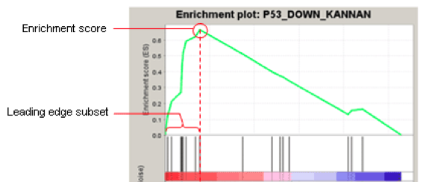
Leading edge analysis
Leading edge subset of a gene set = the genes that appear in the ranked list before the running sum reaches the max value.
Leading edge analysis = examine the genes that are in the leading edge subsets of the enriched gene sets.
Notes:
Leading edge subset = the genes that appear in the ranked list at or before the point at which the running sum reaches its maximum deviation from zero
Can be interpreted as the core that accounts for the gene set’s enrichment signal
A gene that is in many of the leading edge subsets is more likely to be of interest than a gene that is only in a few of the leading edge subsets.

Slide 36
MSigDB web site
Search for gene sets
View gene set details
Download gene sets
Compute overlaps between your gene set and gene sets in MSigDB
http://www.broadinstitute.org/msigdb

Slide 37
GSEA Exercise
Run the 2018-03-14_07_GSEA notebook
Notes:
Remove

