Slide 1



Visualization with igv.js
Notes:
In this next section of the workshop we’re going to be looking at how to use igv.js to visualize your data.

Slide 2
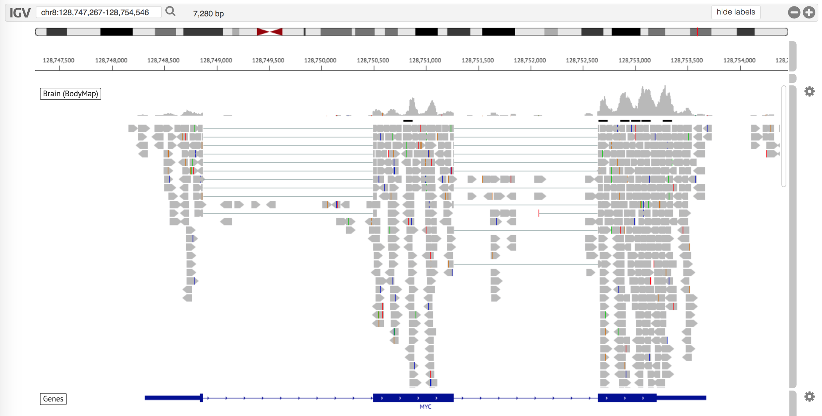
igv.js
Lightweight embeddable web version of popular visualization tool
Notes:
IGV.js is a lightweight web app version of the Integrative Genomics Viewer (also known as IGV).
.
It has the ability to read and display many types of indexed genomic data, including mapped reads and variant calls. It then can display these in comparison to a reference genome.
igv.js is one of many visualizations that has been integrated into the GenePattern environment.

Slide 3
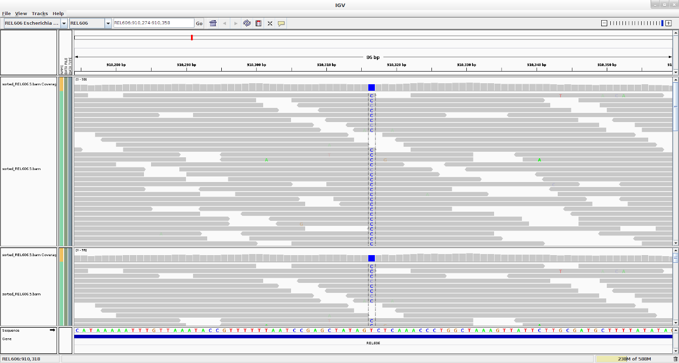
Integrative Genomics Viewer
High performance visualization tool
Can be downloaded at www.igv.org
Notes:
igv.js is an outgrowth of the popular desktop Integrative Genomics Viewer application, which is developed by the same team.
.
Among its uses are the ability to display copy number data, NGS alignments, epigenomics, variants and genotypes, RNA-seq data and gene annotations.
.
IGV has, I over 100,000 users has been going strong since 2008.

Slide 4
Exercise
Notes:
So now that you have some background on IGV, we’re going to be a bit of a follow-along exercise.

Slide 5
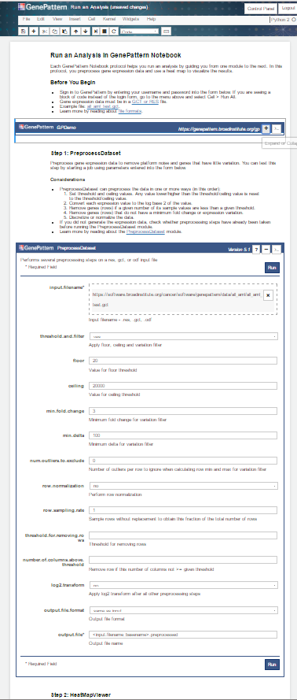
IGV Exercise
2017-12-15_11_CCMI_igv.js.ipynb
Notes:
In this exercise we’re going to grab a copy of the igv.js notebook. We’re then going to open and run through the notebook, which uses the igv.js GenePattern modules to display visualizations for several types of data.
.
**Walk through through getting the notebook and opening it**

Slide 6
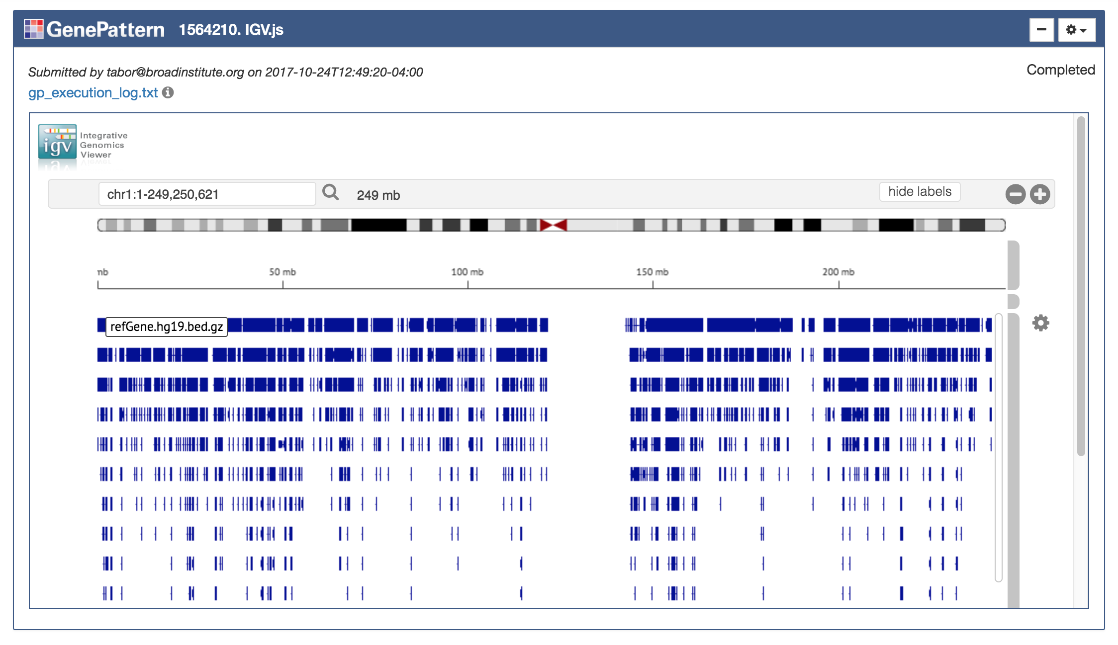
IGV Module in GenePattern
Notes:
Once you’ve got the notebook open, go ahead and find the GenePattern authentication cell and log in.
.
**Wait a few seconds.**
.
After that, you should see the igv.js analysis cells. They’re already filled out with the data you need. So then go ahead and run the first analysis, and I’m going to talk a little bit about what you’re seeing and the data loads.
** Go to next slide to say what the data is**

Slide 7
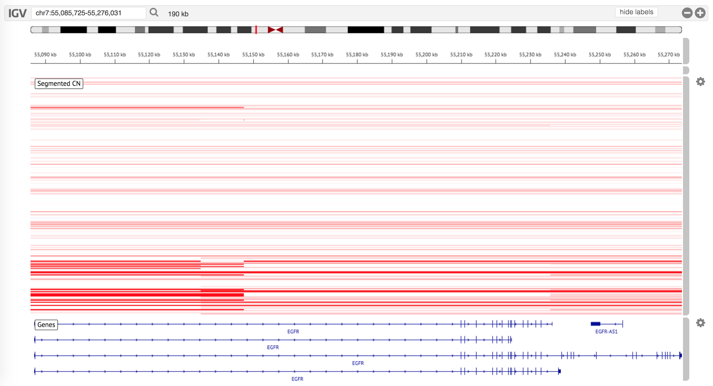
Viewing Tracks
Multiple tracks may be viewed side-by-side.
Notes:
**Give them a second to run the first analysis**
.
Explain data. In this analysis, we are looking at segmented copy number data aligned to the human HG 19 build. This segmented copy number profile represents the many (noisy) copy number measurements at probe sites into regions of equal copy number. In a tumor there are often significant structural variations that can result in deletion, or many copies of different chromosomal segments.
.
**Explain how to zoom in, out, scroll and choose track options (color, name. height) using the gear icon on the right of the track**
Also note that track options change depending on the type of data being displayed

Slide 8
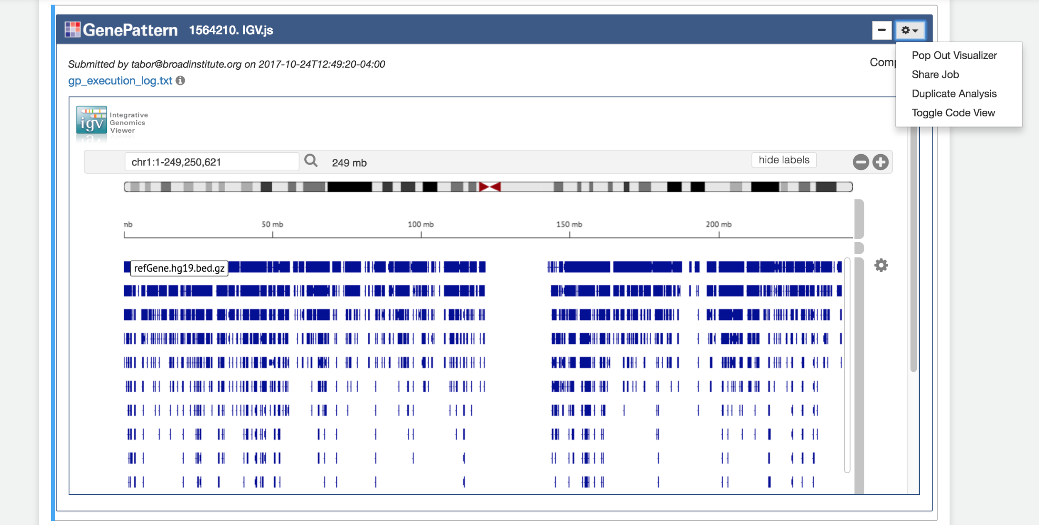
Full Screen Visualization
Select “Pop Out Visualizer” in the gear menu in the upper right corner of the cell.
Notes:
While we’re looking at these visualizations, I also want to take a moment to mention that any of these visualizers can be displayed full screen.
.
You can do this by clicking on the gear menu in the upper right hand part of the cell, and then selecting “Pop Out Visualizer” in the menu.

Slide 9
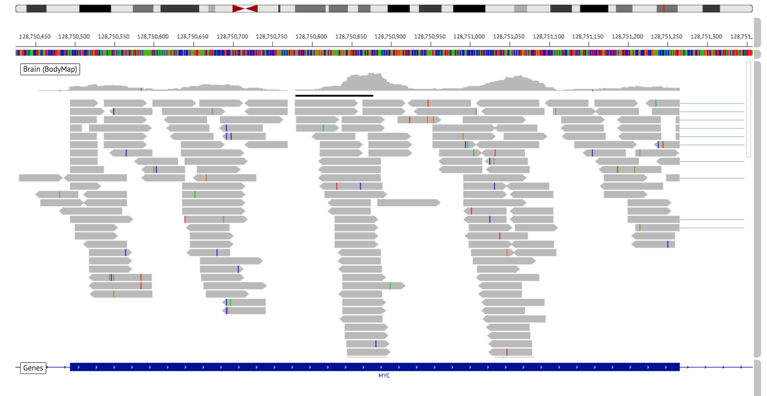
Read Pileup
Read pileup displays track coverage
Variants can be identified by color
Notes:
Alright. Now let’s scroll down a bit in the notebook and find the second igv.js analysis. Let’s go ahead and run that analysis, and then we’ll take a look at the visualization.
.
**Give them a bit to run the second igv.js module.**
.
TODO Explain what it is displaying
TODO Explain pileup

Slide 10
Coming Soon
Expanded data support
Additional data sources
RNA-seq visualizations
Gap junction view
Splice variant view
Notes:
To close, I want to mention that igv.js is in active development, and many new features are in the works. These include the ability to load genomic data from additional sources…
.
As well as improved RNA-seq functionality, such as a gap junction view and well as a splice variant view.

