Slide 1

Closing

Slide 2
Resources
Public GenePattern server
cloud.genepattern.org
GenomeSpace
genomespace.org
GenePattern Notebook
notebook.genepattern.org
Integrative Genomics Viewer (IGV)
www.igv.org
GenePattern Website
genepattern.org
GenePattern Archive (GPArc)
gparc.org

Slide 3
Our Team
Anthony Castanza– San Diego, CA
David Eby - Japan
Barbara Hill – Cambridge, MA
Edwin Juarez – San Diego, CA
Forrest Kim – San Diego, CA
Ted Liefeld – San Diego, CA
Michael Reich – San Diego, CA
Jim Robinson – San Diego, CA
Thorin Tabor – San Diego, CA
Pablo Tamayo – San Diego, CA
Helga Thorvaldsdottìr – Cambridge, MA
Douglass Turner – Cambridge, MA
PI
Jill P.Mesirov – San Diego, CA

Slide 4
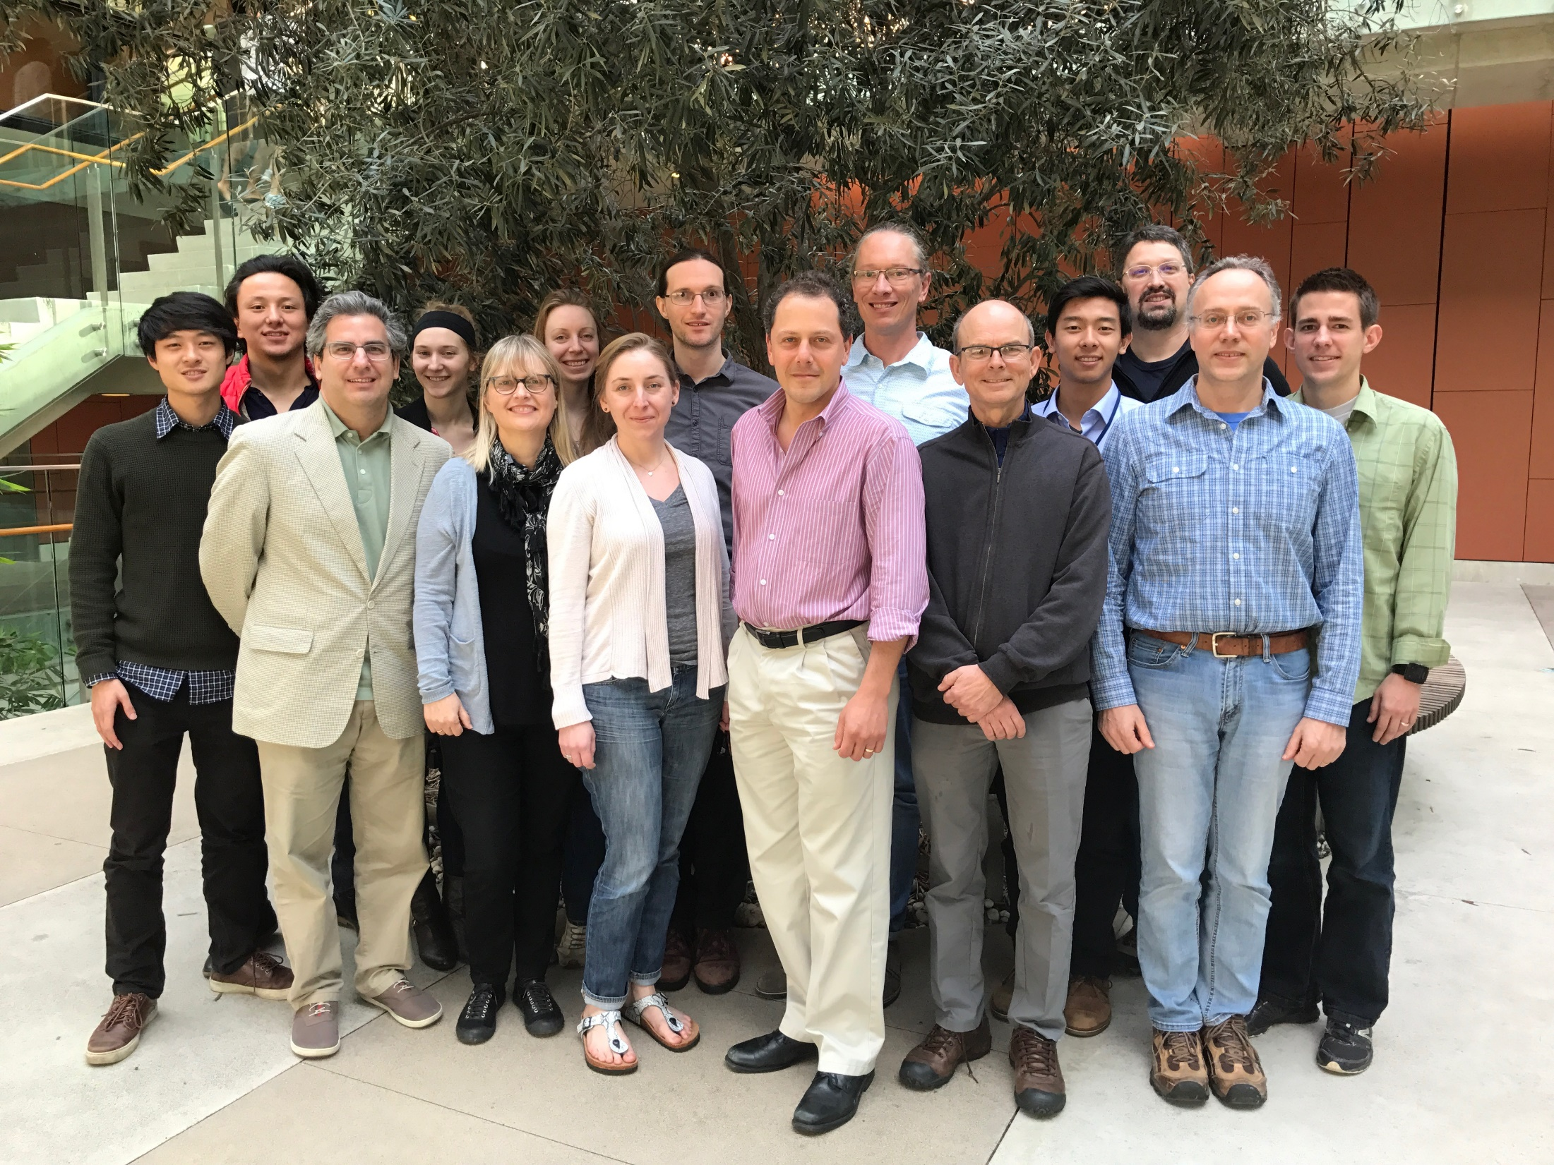

Slide 5



Keep in touch!
Feature requests, bug reports, and general help
genepattern.org/help
Mailing list to receive GenePattern news.
Sign up at www.genepattern.org/gp_mail.html
@GenePattern

Slide 6
Thank You!

