Slide 1
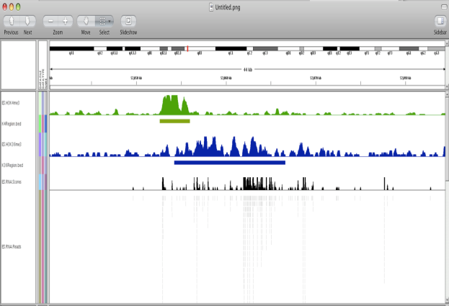
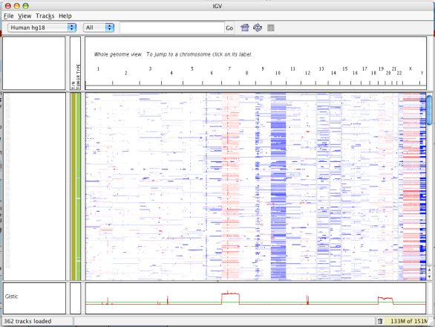
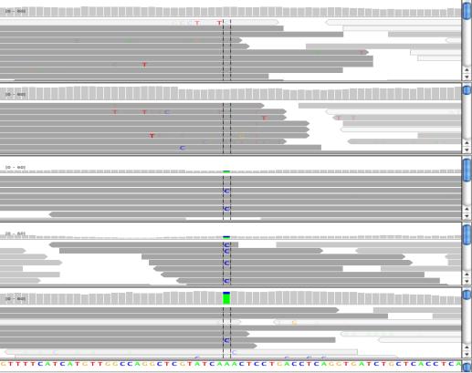
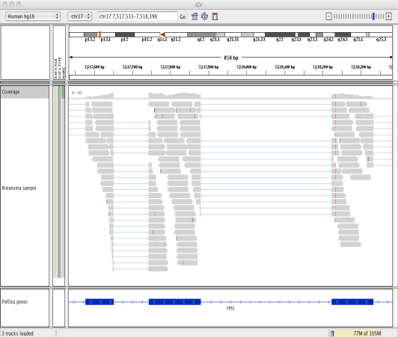
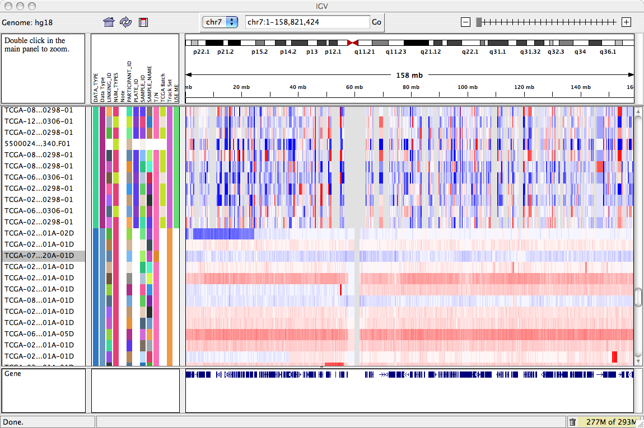
Integrative Genomics Viewer (IGV)
A desktop application for the interactive
visual exploration of integrated genomic datasets
Epigenomics
Microarrays
NGS alignments
RNA-Seq
mRNA, Copy Number
www.igv.org
Notes:
NOTES TO THE PRESENTER:
It’s a desktop application, meaning you download the program to your computer and run it there – you do not use it in a web browser window.
It’s for visual exploration of data – it’s not for analyzing data. Of course, visualization is certainly a crucial component in an analysis workflow, but IGV itself is not an computational analysis tool.
It’s for viewing genomic data – meaning data in the context of a reference genome
It supports viewing integrated datasets – ie viewing different data types, and data from different sources in a single view

Slide 2
IGV Features
With IGV you can…
explore large genomic datasets with an intuitive, easy-to-use interface.
integrate multiple data types with clinical and other sample information.
view data from multiple sources: local, remote, and “cloud-based”.
Notes:
There are many genome browsers. Each has a different set of feature and strengths.
These were the goals that we had in mind when developing IGV.
--From the beginning it has been our goal to handle very large datasets, even on standard desktop systems. That has become increasingly important as dataset size increases with next-generation technologies.
--An important feature of IGV is its focus on the integrative nature of genomic studies and it allows you to view many different types of data together – and importantly also integrate with the display of sample attribute information such as clinical data and phenotypical info.
--Importantly, IGV allows you to view data from multiple sources – DETAILS W NEXT SLIDE

Slide 3


IGV Data Sources: How do I load data?
Local files
(computer or LAN)
HTTP server (GenePattern)
FTP server
GenomeSpace
View local files without uploading.
View remote files without downloading the whole dataset.
Notes:
Note that as IGV is running on your computer, there is no need to upload files to a remote location to view them.
BUT, when you do view remote files, IGV does not need to download the whole file – just the parts you view.
--I do want to mention that IGV’s focus is on user-supplied data –while we host and provide easy access to a number data sets and genome annotation data - it is not our mission to create a large repository of data.

Slide 4
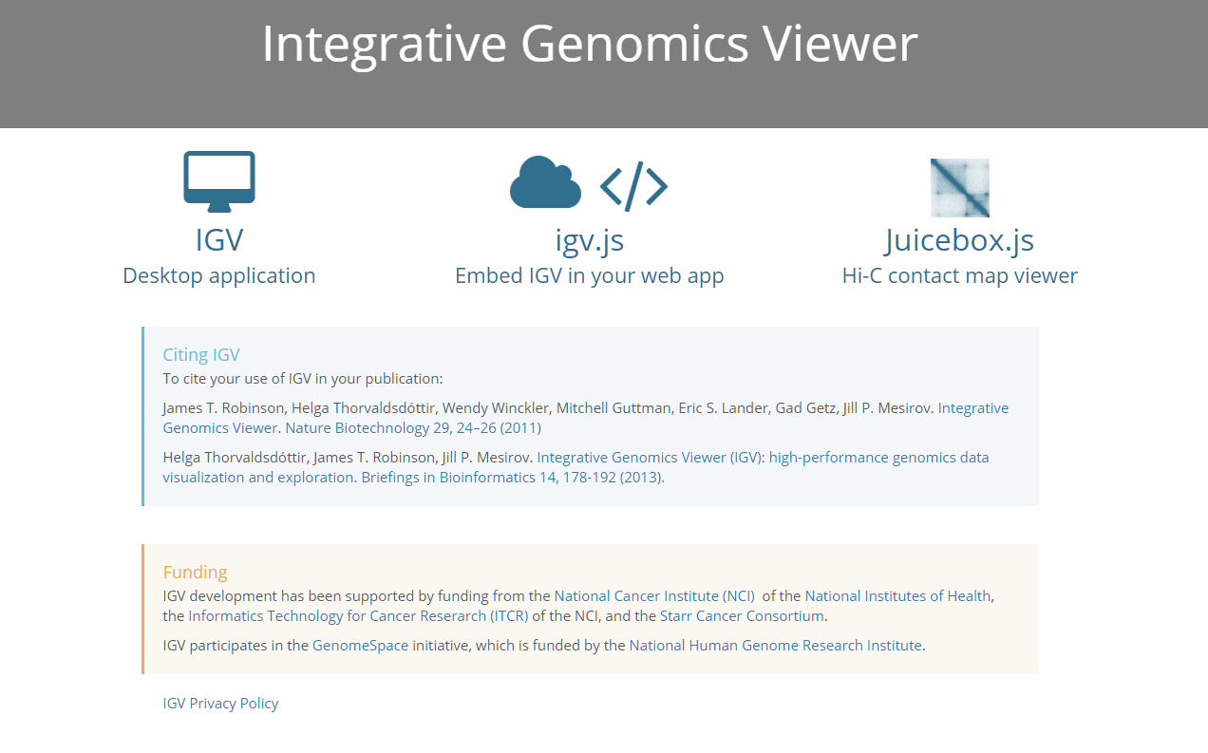
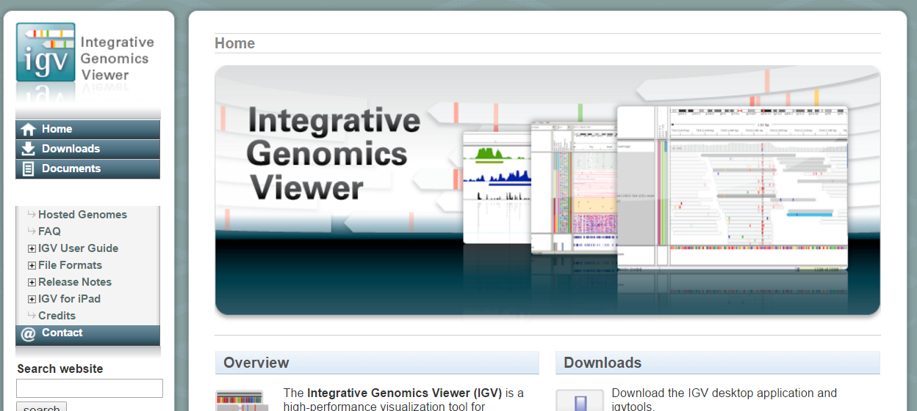
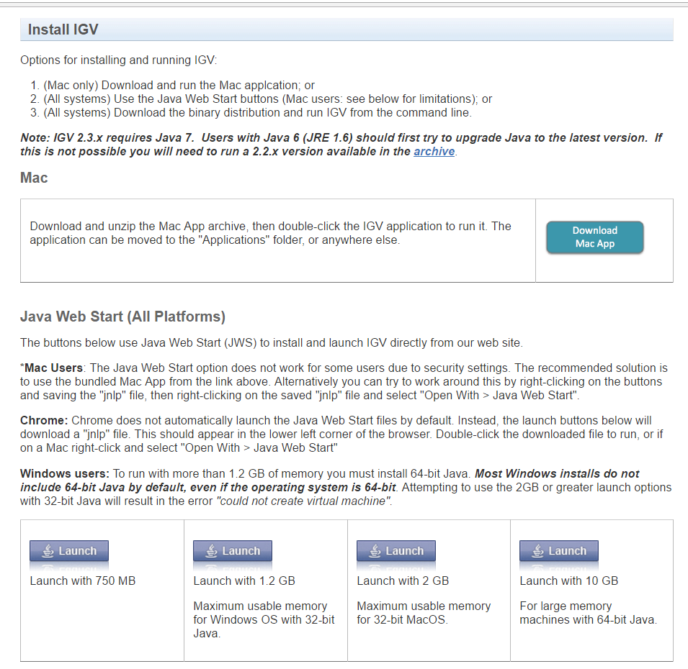
How to use IGV
Next…
Select a reference genome
Load data
Navigate through the data
Notes:
We’re going to step through the basic steps of getting started in IGV.
how to select the reference genome, how to load data, and then how to navigate through the data.

Slide 5
Viewing next generation sequencing (NGS) data in IGV
Notes:
But first, a little more background - So what does short-read data look like in IGV?

Slide 6
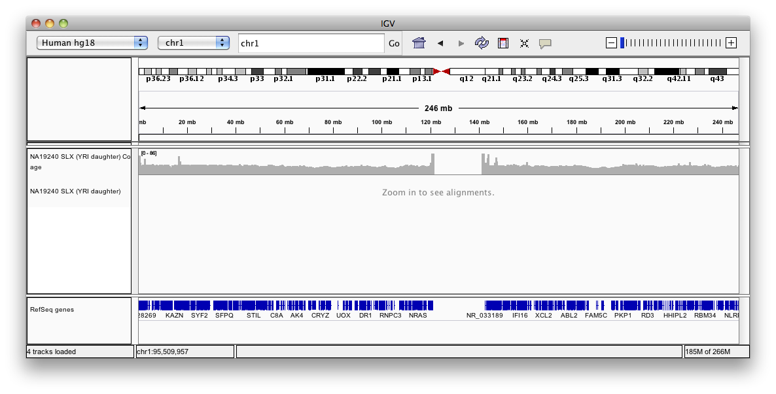
Viewing alignments
Whole chromosome view.
Notes:
Point out this is NOT Hands on / follow along.
Sequence alignments are displayed in a special track type. And the most common file format is a BAM file.
Here we see what it looks like in whole chromosome view.
You’ll see a message informing you that the view needs to be zoomed in to a smaller region before IGV will load any alignments.
The primary reason is that the bam files are just too large to be read into memory.
But each aligned read is typically short, from 10s to 100s of bases, so at this scale, you wouldn’t even be able to discern individual reads.

Slide 7
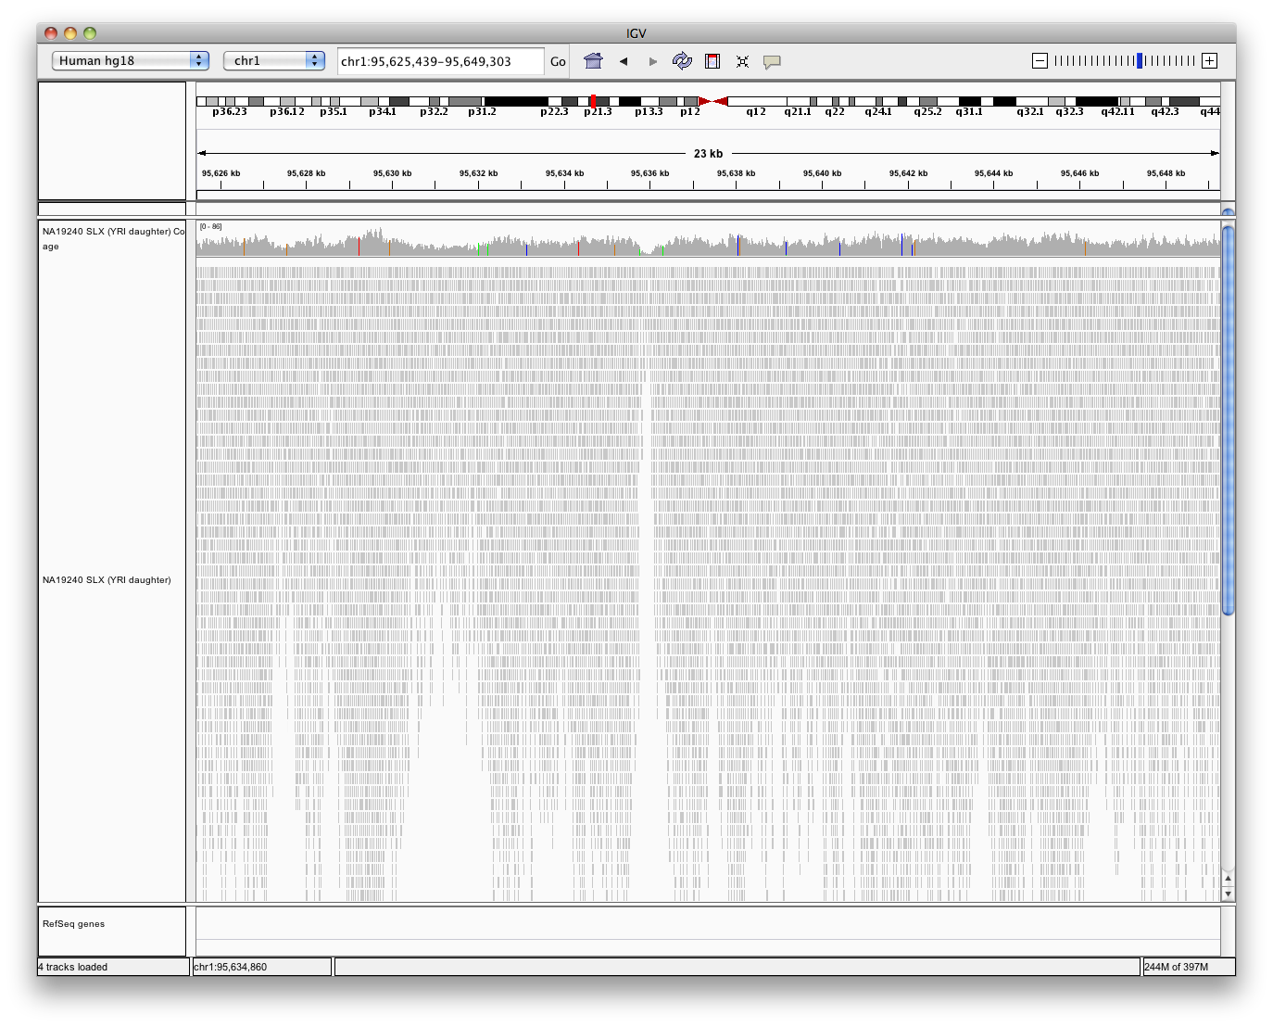
Viewing alignments
Zoom in to view alignments.
Coverage
Aligned reads
Notes:
Here we’ve zoomed in sufficiently far so IGV has loaded the reads for this region, which in this case is about 23 kilobases.
Each read displayed as a small grey band – we see basically a pile up of reads because we’re still zoomed out so far that they blur together a bit.
In addition to the aligned reads, IGV displays a coverage track that indicates the number reads at each locus.

Slide 8
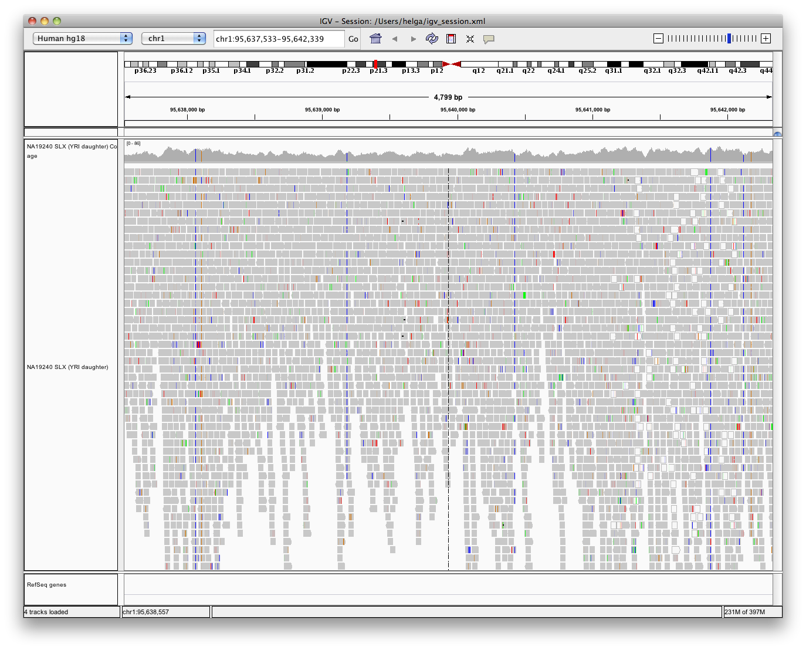
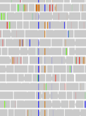
Viewing alignments
Bases that do not match the reference sequence are highlighted by color.
Notes:
Now we’ve zoomed in a bit further ~5000 basepairs.
Now we see color in some of the reads. This is an example of how IGV tries to highlight events that might be of interest. The reads are mostly drawn in grey, but the color indicates bases in the read that do not match the reference sequence. This is the default behavior in IGV, but it can be disabled in the preferences.

Slide 9
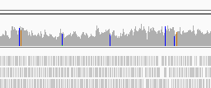
Viewing alignments
Coverage track indicates loci with large number of mismatches.
Notes:
Similarly, color in the coverage track indicates loci where a large number of reads do not match the reference sequence. The threshold for flagging these loci is also adjustable in the preferences. As most things are in IGV. In general we want to highlight what is typically of interest, but allows you to change or disable the highlighting if it is not what your are interested in.

Slide 10
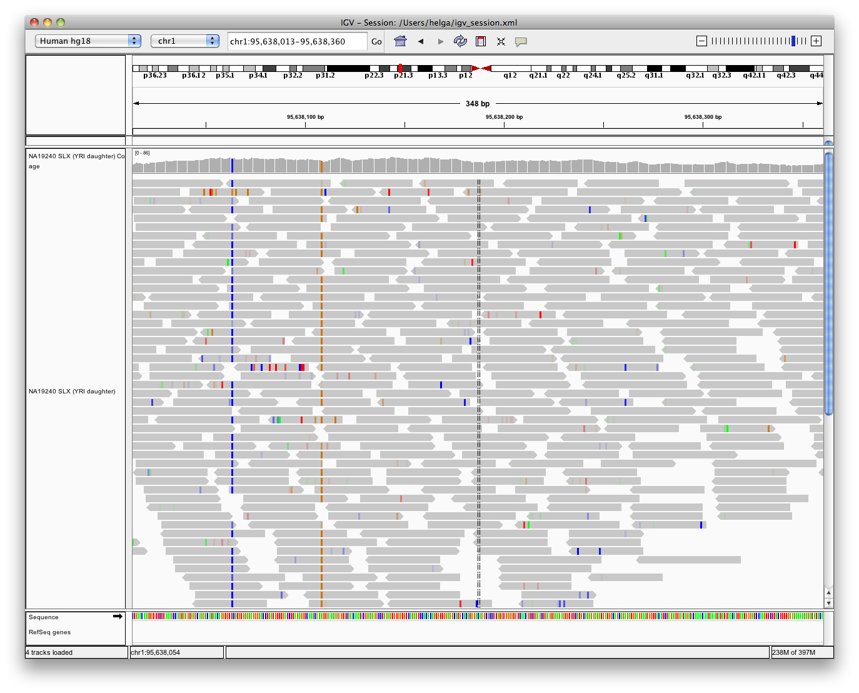
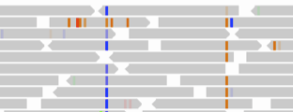
Viewing alignments
Zoom in to see more detail.
Notes:
Now we’re zoomed in to ~350 base pairs and can clearly see each read.

Slide 11
Viewing alignments
How far do you need to zoom in to see the alignments?
Notes:
I said you have to zoom in sufficiently far for IGV to start loading the alignments.
So exactly how far do you need to zoom in?

Slide 12
Viewing alignments
How far do you need to zoom in to see the alignments? 30kb.
Or you can set another threshold in View > Preferences > Alignments.
Higher values require more memory
Low coverage files can use higher values
Very deep coverage files should use lower value
Notes:
NOTE TO PRESENTER – View the animation
By default, you need to zoom in to a region that is 30 kb or smaller.
But you can change this threshold in the preferences.
Note that If you set the threshold to a higher value, it will in general require more memory because IGV will load more reads.
However, if you have low coverage files, there are in general fewer reads per region, and you therefore you can view larger regions than the default.
If you have very deep coverage files, we recommend using a lower value.
So shallow and wide, or deep and narrow.

Slide 13
Viewing RNA-seq data in IGV

Slide 14
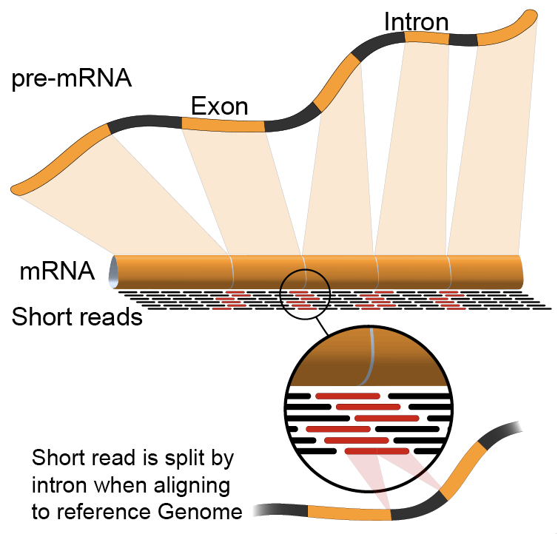
RNA-seq alignments
Intron
http://en.wikipedia.org/wiki/RNA-Seq#Gene_expression
Notes:
With RNA sequencing, only the exons of a gene are sequenced, but the reads are aligned back to the whole genome.
This has two immediately visible effects when viewing the data in IGV, or other genome browsers.
First, the data is quite sparse, in comparison to DNA sequence, since the introns are not sequenced.
And also, an individual read that came from one section of the mRNA, might be split across two exons, causing a gap when it’s aligned back to the full genome reference sequence.
Let’s look at an example of rna-seq data in IGV.

Slide 15
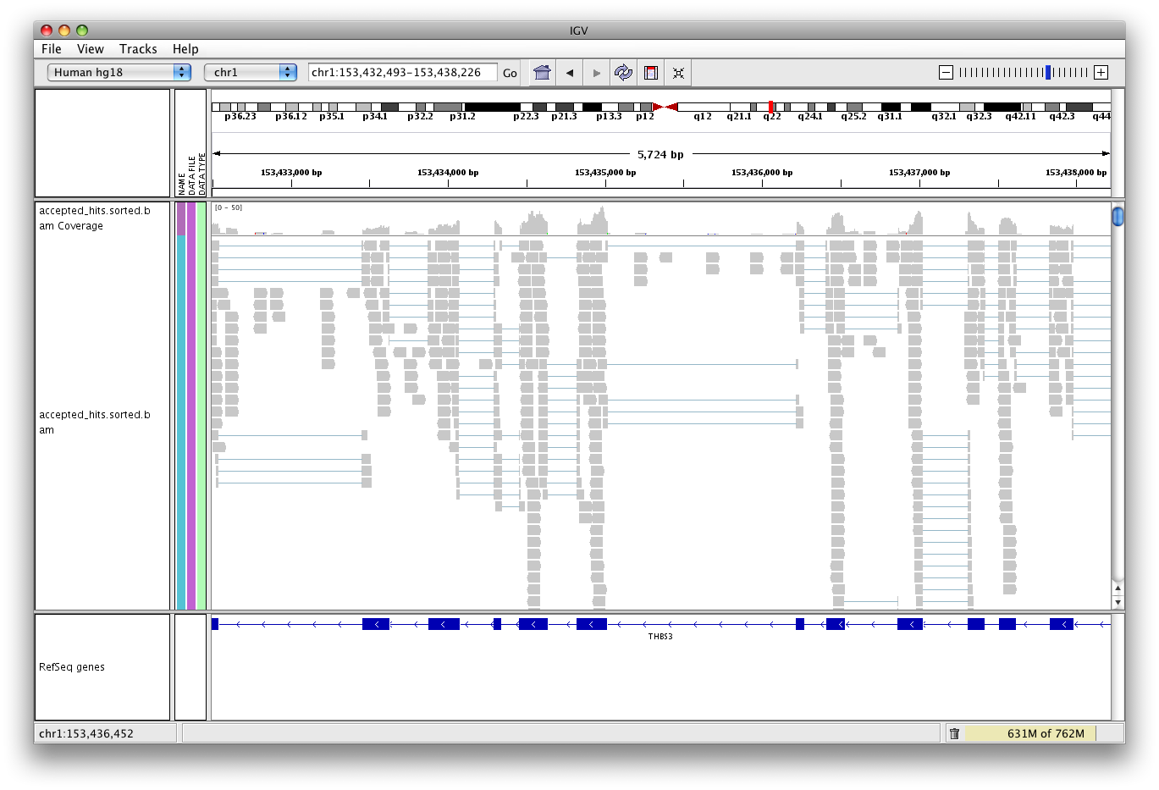
RNA-seq alignments
RNA-seq reads can span splice junctions.
Notes:
The gaps within reads are displayed with a thin blue line in IGV.

Slide 16
RNA-seq alignments
You can display a separate splice junction track which shows how many reads span exon junctions.
Arcs represent reads that span exon junctions. Height is proportional to the number of reads.
Many reads connect these exons.
Relatively few span to this exon.
Notes:
You can enable the display of a splice junction track, which will show you how many reads span exon junctions.
FYI – NOT Sashimi

Slide 17
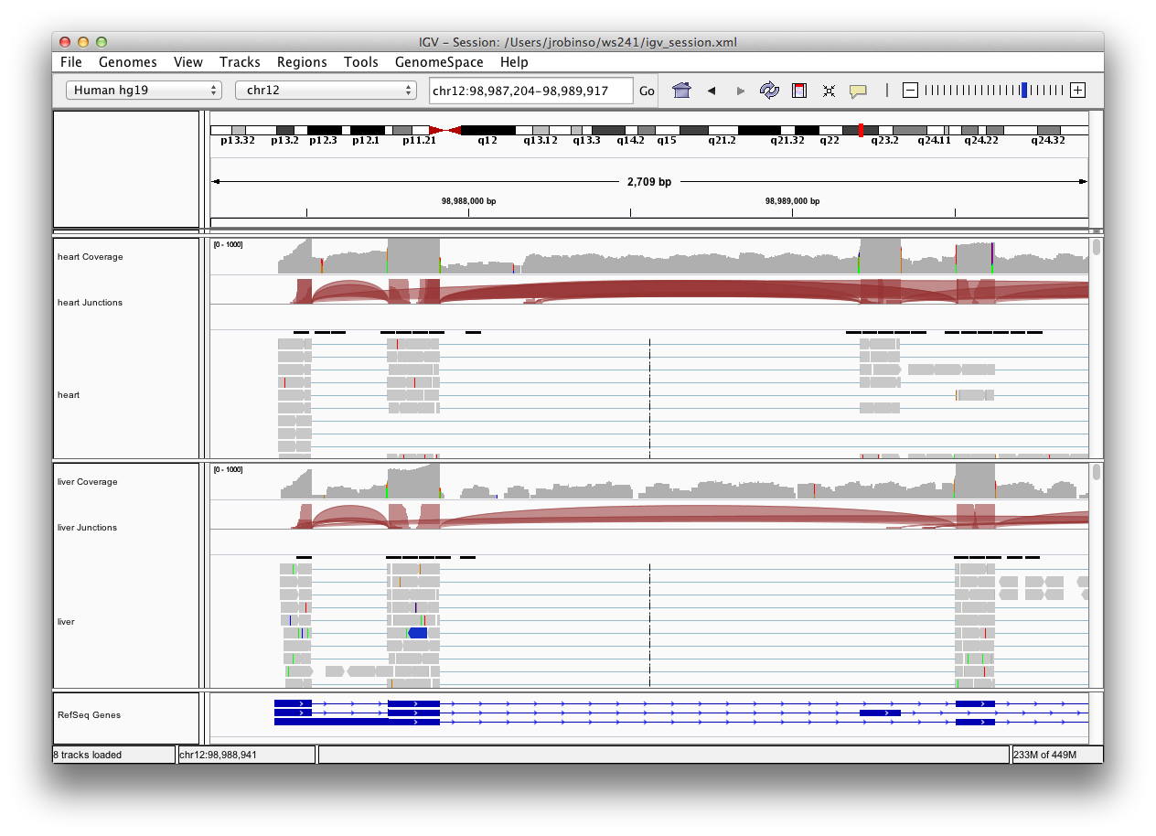
RNA-seq alternative splicing
IGV lets you visualize evidence of alternative splicing.
Heart
Liver
Notes:
You can tell that the heart read came form the isoform in the middle, where as the liver is harder to tell.

Slide 18
Viewing our aligned reads in IGV

Slide 19

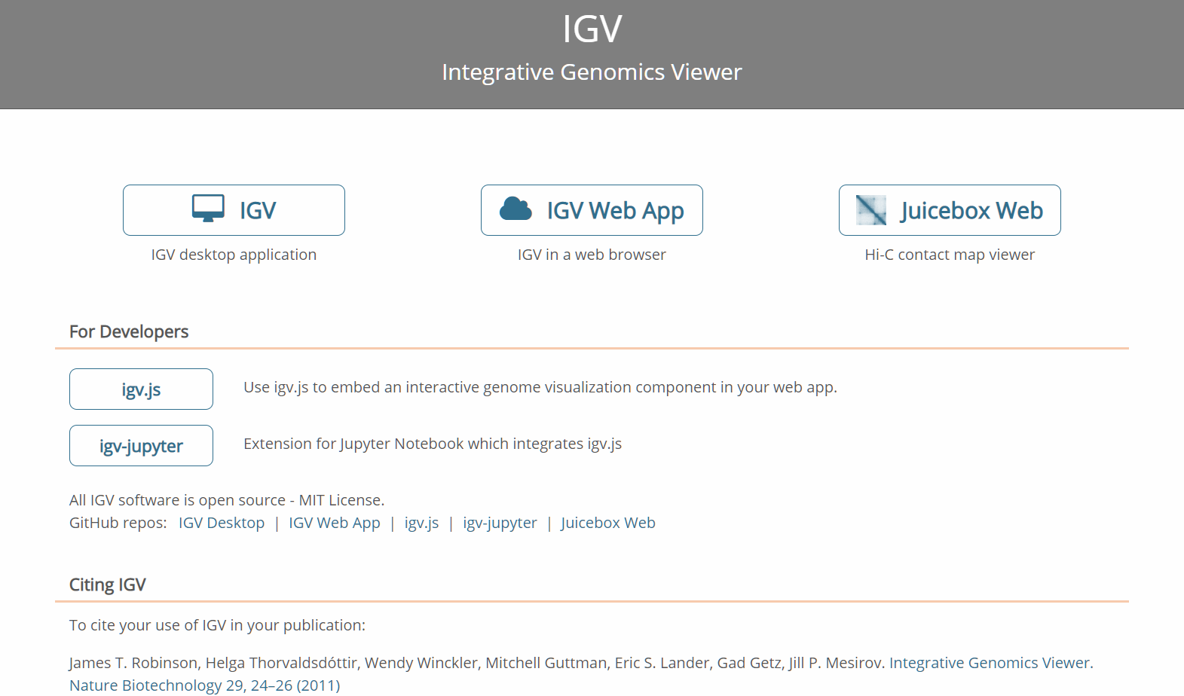
Visualization in IGV | FA
Open a web browser ( ), then navigate to igv.org, and click on Desktop application.
Notes:
NOW time to follow along again

Slide 20
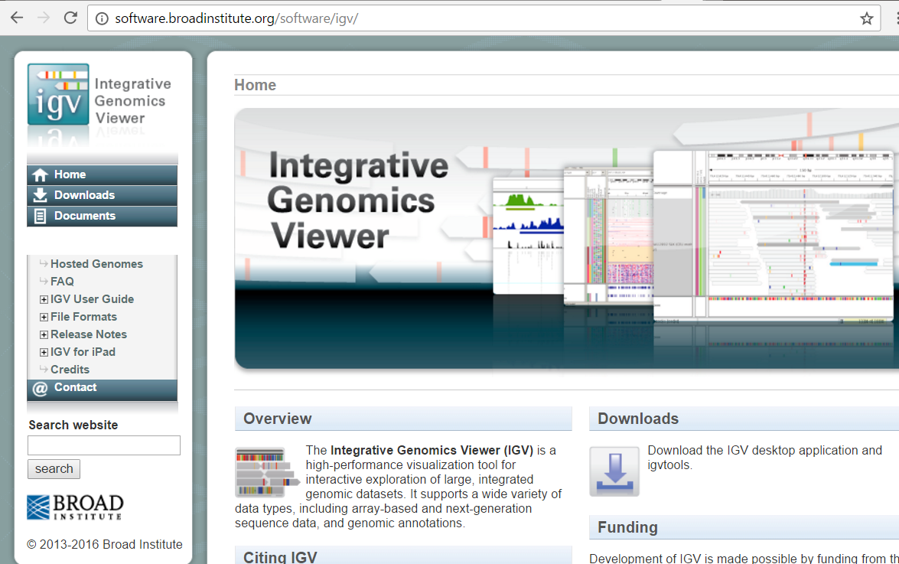
Visualization in IGV | FA
Click on the Downloads button.
Notes:
Or if you’ve already done this – find igv.jnlp on your computer and launch it

Slide 21
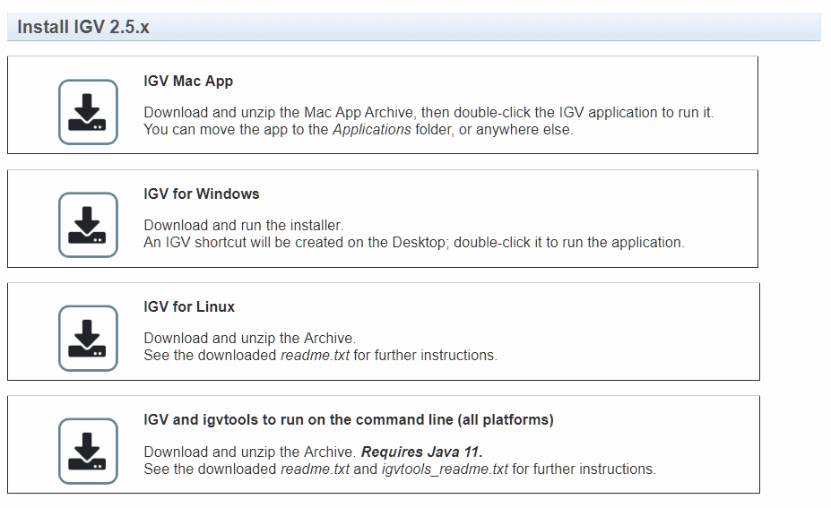
Visualization in IGV | FA
Select the appropriate button for your computer.
Notes:
Follow instructions from your button – not that you may need to run as administrator – should make a shortcut on desktop or in the dock

Slide 22
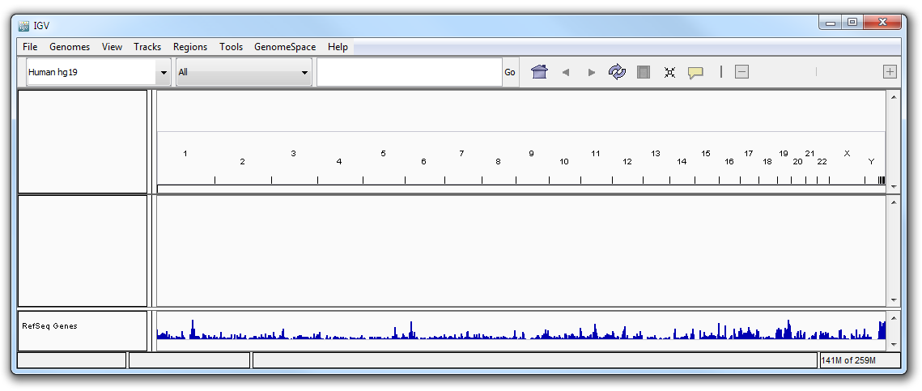
Visualization in IGV | FA
An executable IGV file will be downloaded to your computer. Click to launch IGV. If a Java security warning pops up make sure to allow IGV access to the internet – it needs this to download genomes.

Slide 23
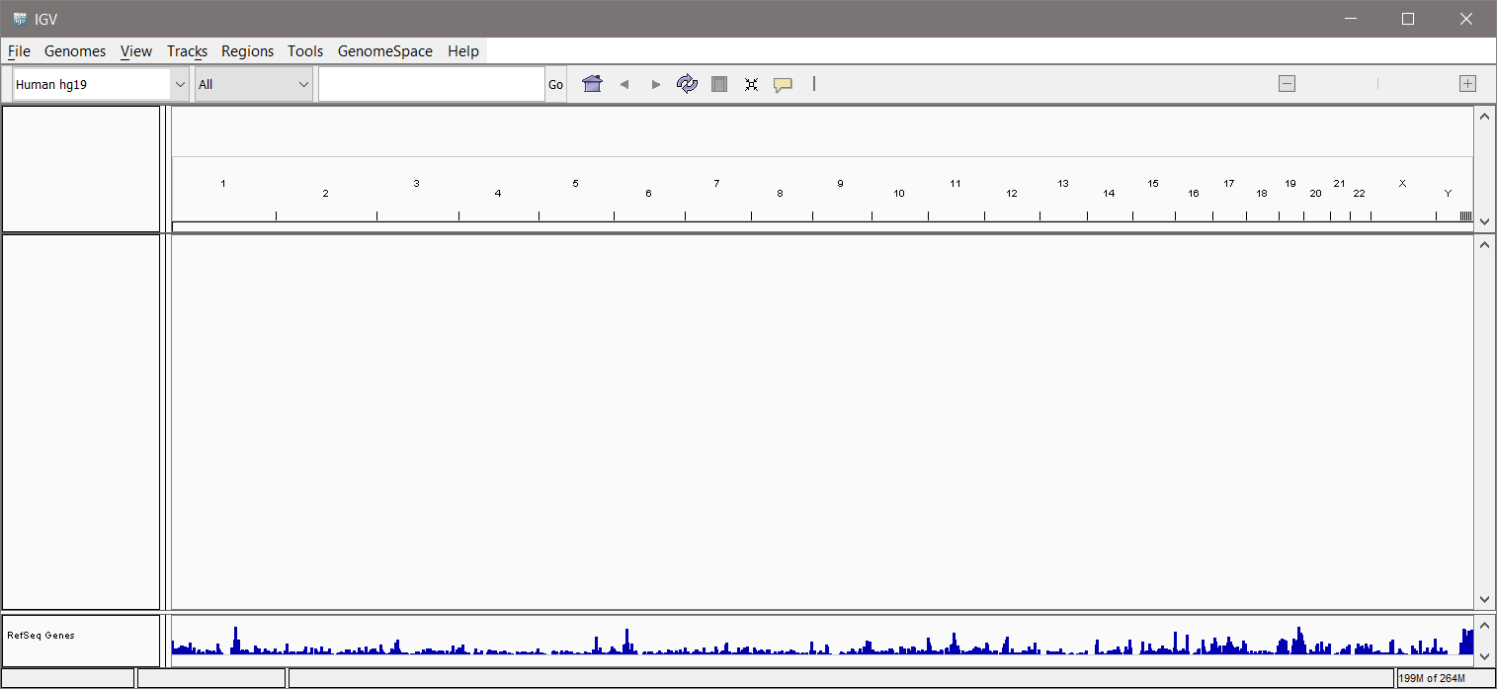
Visualization in IGV | FA
Make sure IGV is using the Human hg19 genome.

Slide 24
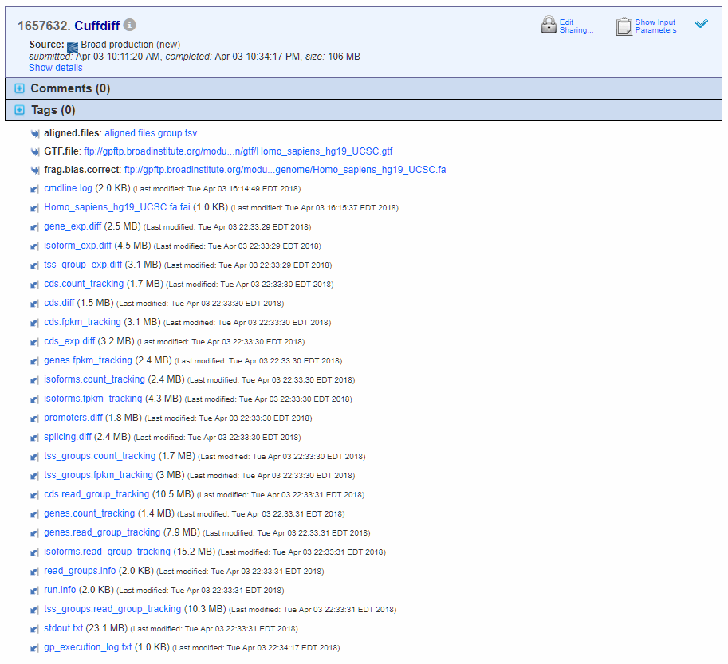

Visualization in IGV
If our CuffDiff job had run, we would have output like this:
And we would right-click to copy the URL of genes.fpkm.tracking.

Slide 25
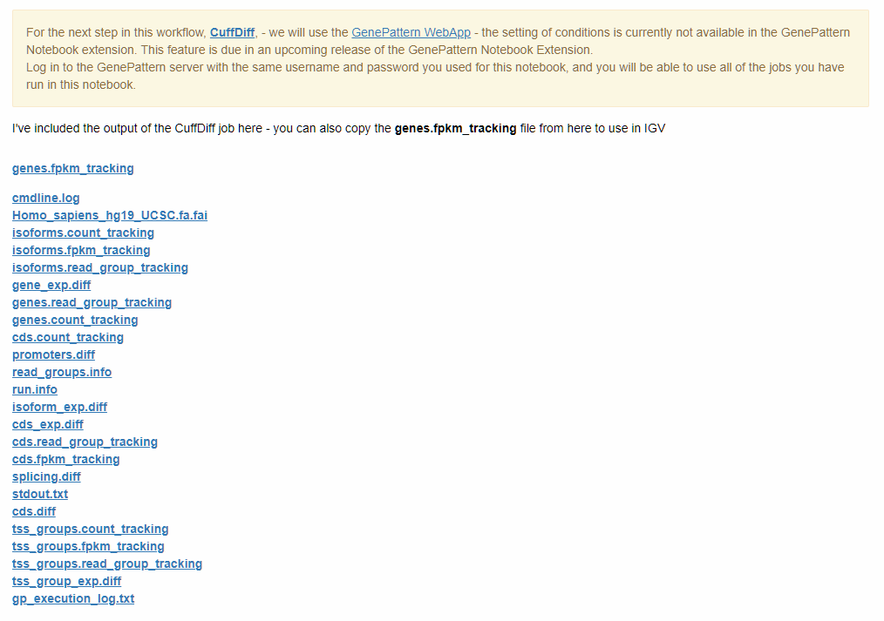
Visualization in IGV
Since it did not, go to the notebook for this class, and copy the URL of the genes.fpkm.tracking file found in the last cell of the notebook.

Slide 26
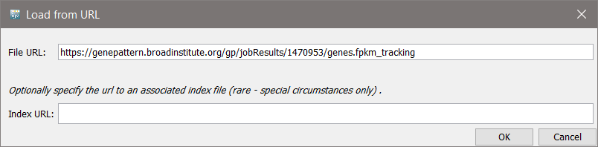
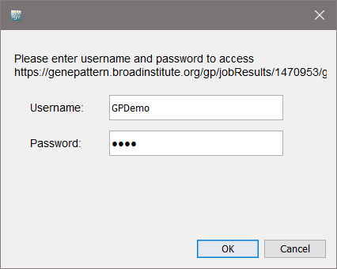
Visualization in IGV
From the IGV File menu, you would then paste in the genes.fpkm.tracking URL you just copied, click OK.
Then enter your GenePattern login and password.

Slide 27
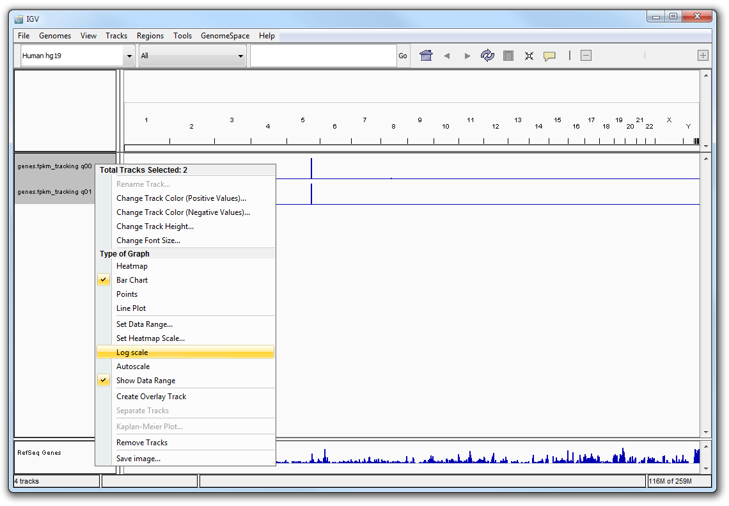
Visualization in IGV – scale matters
❶ Ctrl+Click the q00 and q01 tracks. ❷ Right-click and scroll down, then select log scale to correctly display the data.
1
2
Notes:
When visualizing in IGV, scale matters – for this kind of data be sure to set the scale correctly – which means you need to know a little bit about how your data.

Slide 28
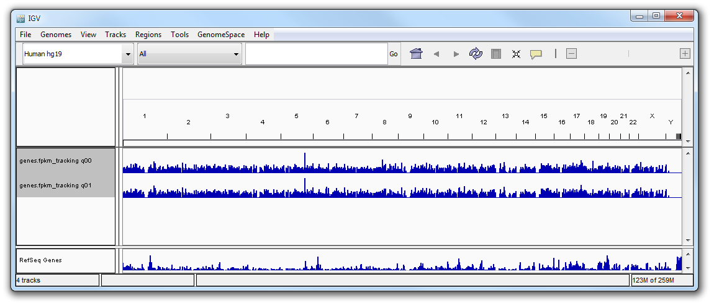
Visualization in IGV
Try looking for differences between untreated vs. dex gene expression.
❶ Search for C7 in the search bar.
1

Slide 29
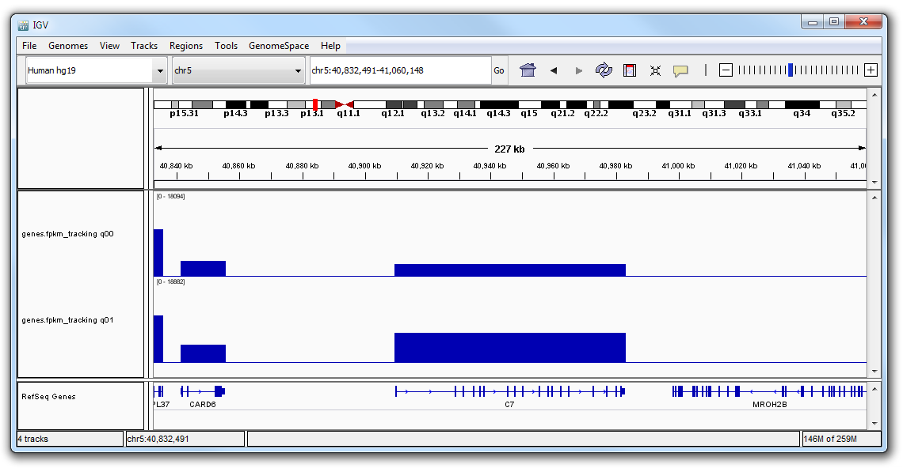
Visualization in IGV
Example genes: C7, CCDC69, DUSP1, FKBP5, GPX3, KLF15, MAOA, SAMHD1, SERPINA3, SPARCL3, TSC22D3, CRISPLD2, C13orf15, PER1
untreated
dex
similar expression
dex >>> untreated
low expression
Notes:
NOTE: type in C7 in search bar. Mention that the reads are at the gene level, also mention that you have to zoom out to see some other genes.

Slide 30
Visualization in IGV
In addition to looking at the gene expression in the genes.fpkm_tracking file, we can look at how the reads stack against transcripts by looking at the aligned reads.
Load the following two files into IGV:
SRR1039508.accepted_hits.sorted.bam untreated
SRR1039509.accepted_hits.sorted.bam dex
Steps:
Open a browser window to genepattern.datasets.org/?prefix=data/HASM_Asthma_RNA-seq_workshop_files/SortSam_Output/
Copy the URL for SRR1039508.accepted_hits.sorted.bam
In IGV, navigate to: File/Load from URL
Paste in the URL you just copied.
Click Open.
Repeat Steps 1-4 to load the second file.
Notes:
We won’t do this now – but this is something you can try later – the data referred to is publicly available from GenomeSpace> Load File from GenomeSpace.

Slide 31
