Slide 1

Data Preparation

Slide 2
GenePattern file formats
Each module specifies its input and output file formats
Modules may use common GenePattern file formats or their own unique formats
Most modules use the file formats described on the GenePattern website
There are many GenePattern modules that are specifically meant for importing data from other systems
Notes:
A file support library is available to Module Developers to help read and write the most common GP file formats. We will briefly talk about that some more this afternoon, or you can ask us at the breaks.

Slide 3
Example modules for data formatting
Data type | Input Format | Module
RNA-Seq | bed fpkm tracking Read group tracking Cufflinks Expr bed | BedToGtf Fpkm_trackingToGct Read_group_trackingToGct ExprToGct BedToGtf
DNA-seq | bam sam sam/bam | Picard.BamToSam Picard.SamToBam Picard.SamToFastQ
Gene expression chips | .cel | ExpressionFileCreator
SNP chips | .cel | SNPFileCreator
MAGE | Mage-ML Mage-tab | MageMLImportViewer MageTabImportViewer
To find, search modules for “to<format>” or “<format>To”
There are many more modules, for MS, FCS and other data types

Slide 4
Example data prep
We will do an example, importing RNA-Seq read count data from TCGA
Starting with read counts, one file per sample, ending with a standard GenePattern format for expression data and another file with phenotype definitions
We will use 3 standard GenePattern formats
  GCT (.gct)
  Sample Information or SampleInfo (.txt or .tsv)
  Class file (.cls)
Notes:
A file support library is available to Module Developers to help read and write the most common GP file formats. We will briefly talk about that some more this afternoon, or you can ask us at the breaks.

Slide 5
GCT file format
Tab delimited
Originally used for expression data
  Can be used for any matrix, not just expression
Represents a matrix
  Columns = Samples
  Rows = Genes
Notes:
Mention: Missing values are allowed , most modules do not accept missing values
Add Tab-delimited text to slide
The GCT file format is a tab delimited file format that describes a dataset.
Here’s a GCT file that has been opened up in excel.
The values are in a matrix starting in the fourth row and third column.
Each column represents one sample, and each row represents a probe set, gene, or feature.
The first column contains the feature identifier or probe set id. Must be unique
The second column contains a description for that id – this can be anything <CAN IT BE BLANK?>
The third row has column headings – including the sample names above the sample columns.
More specific info in doc

Slide 6
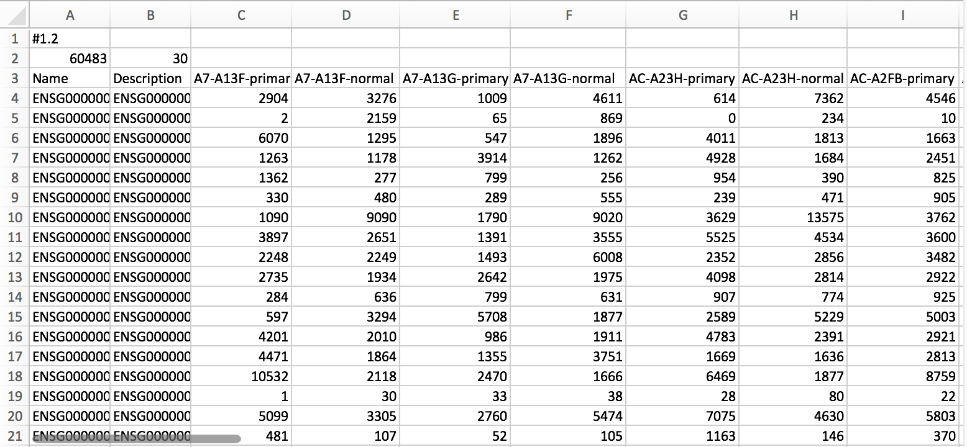
GCT file format
Always #1.2
Number of rows (ie gene ids)
Number of samples
Col 1: Row identifiers. Typically gene ids.
Col 2: Optional description
Col 3+: Sample names, must be unique.
Each column contains expression or count values from one sample.
Notes:
Mention: Missing values are allowed , most modules do not accept missing values
Add Tab-delimited text to slide
The GCT file format is a tab delimited file format that describes a dataset.
Here’s a GCT file that has been opened up in excel.
The values are in a matrix starting in the fourth row and third column.
Each column represents one sample, and each row represents a probe set, gene, or feature.
The first column contains the feature identifier or probe set id. Must be unique
The second column contains a description for that id – this can be anything <CAN IT BE BLANK?>
The third row has column headings – including the sample names above the sample columns.
More specific info in doc

Slide 7
Sample info file format
Tab delimited
  Essentially a spreadsheet
Used to record properties of samples
Represents a matrix
  Columns = properties
    Completely arbitrary columns, you can define anything you want
    Values can be anything that can be represented by text (except cannot use the tab character)
  Rows = Samples
Notes:
Mention: Missing values are allowed , most modules do not accept missing values
Add Tab-delimited text to slide
The GCT file format is a tab delimited file format that describes a dataset.
Here’s a GCT file that has been opened up in excel.
The values are in a matrix starting in the fourth row and third column.
Each column represents one sample, and each row represents a probe set, gene, or feature.
The first column contains the feature identifier or probe set id. Must be unique
The second column contains a description for that id – this can be anything <CAN IT BE BLANK?>
The third row has column headings – including the sample names above the sample columns.
More specific info in doc

Slide 8
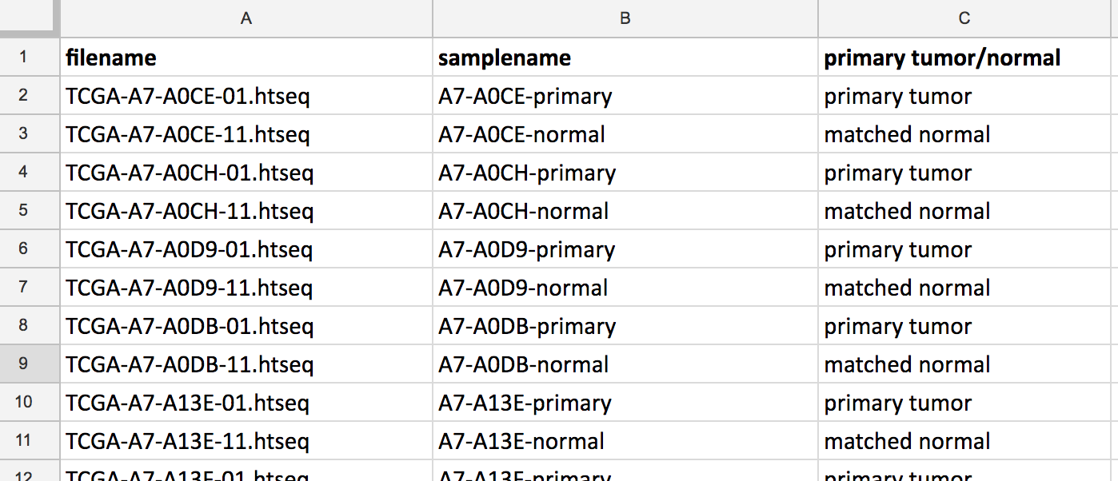
Sample details: sample info file
Tab-delimited, assumes the first row has column names
Any number of columns
Arbitrary column labels (i.e. whatever you want them to be)
One row per sample
Column Labels
One row
per sample
Sample info files are usually created from spreadsheets saved in tab-delimited format
Notes:
Some of the commonly used GenePattern modules will require a CLS file. This file simply defines phenotype (class or template) labels and associates each sample in the expression data with a label. It uses spaces or tabs to separate the fields. So you are using this file to label the phenotype or class of your samples.
The format looks like this:
(click)
16 samples (click)
The 4 classes are untreated, Dex, Alb and Alb_Dex, which correspond to 0, 1, 2 and 3 respectively (click)
The order of the classes in the cls file should match the order of the samples they are associated with in the data matrix. (click)
The one in the top line just has to be there.
More information about CLS files can be found on the file formats page.

Slide 9
Class (CLS) file format
Tab or space delimited
Used for defining class membership of samples
Essentially a representation of a single column from a SampleInfo file
Values are numeric (0,1,…)
Notes:
Mention: Missing values are allowed , most modules do not accept missing values
Add Tab-delimited text to slide
The GCT file format is a tab delimited file format that describes a dataset.
Here’s a GCT file that has been opened up in excel.
The values are in a matrix starting in the fourth row and third column.
Each column represents one sample, and each row represents a probe set, gene, or feature.
The first column contains the feature identifier or probe set id. Must be unique
The second column contains a description for that id – this can be anything <CAN IT BE BLANK?>
The third row has column headings – including the sample names above the sample columns.
More specific info in doc

Slide 10
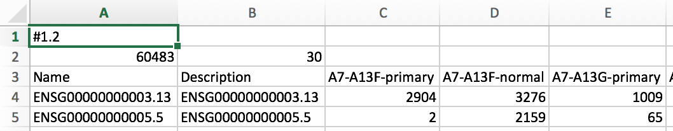
Sample labels: CLS file
30 samples
2 Classes
Start with 0
Space delimited
ClsFileCreator module can be used to generate a CLS file from a gct file. We will use MergeHTSeqCounts later which can also generate a cls file.
Notes:
Some of the commonly used GenePattern modules will require a CLS file. This file simply defines phenotype (class or template) labels and associates each sample in the expression data with a label. It uses spaces or tabs to separate the fields. So you are using this file to label the phenotype or class of your samples.
The format looks like this:
(click)
16 samples (click)
The 4 classes are untreated, Dex, Alb and Alb_Dex, which correspond to 0, 1, 2 and 3 respectively (click)
The order of the classes in the cls file should match the order of the samples they are associated with in the data matrix. (click)
The one in the top line just has to be there.
More information about CLS files can be found on the file formats page.

Slide 11
Data prep exercise
Starting with read counts and a sample info file for 40 RNA-seq samples, 20 breast cancer primary tumor and 20 matched normal using Ensembl Gene IDs.
  Merge the 40 files into one (gct) matrix and generate a cls file distinguishing tumor/normal samples
  Strip the versions from the Ensembl gene ids
  Replace Ensembl gene ids with HUGO symbols & collapse duplicate rows to a single row
  Normalize the data for downstream analysis
Ends with a GCT file using HUGO Gene Symbols, and a CLS file that distinguishes tumors from matched normals.
suitable to be used for differential gene expression.
Notes:
Mention: Missing values are allowed , most modules do not accept missing values
Add Tab-delimited text to slide
The GCT file format is a tab delimited file format that describes a dataset.
Here’s a GCT file that has been opened up in excel.
The values are in a matrix starting in the fourth row and third column.
Each column represents one sample, and each row represents a probe set, gene, or feature.
The first column contains the feature identifier or probe set id. Must be unique
The second column contains a description for that id – this can be anything <CAN IT BE BLANK?>
The third row has column headings – including the sample names above the sample columns.
More specific info in doc

Slide 12
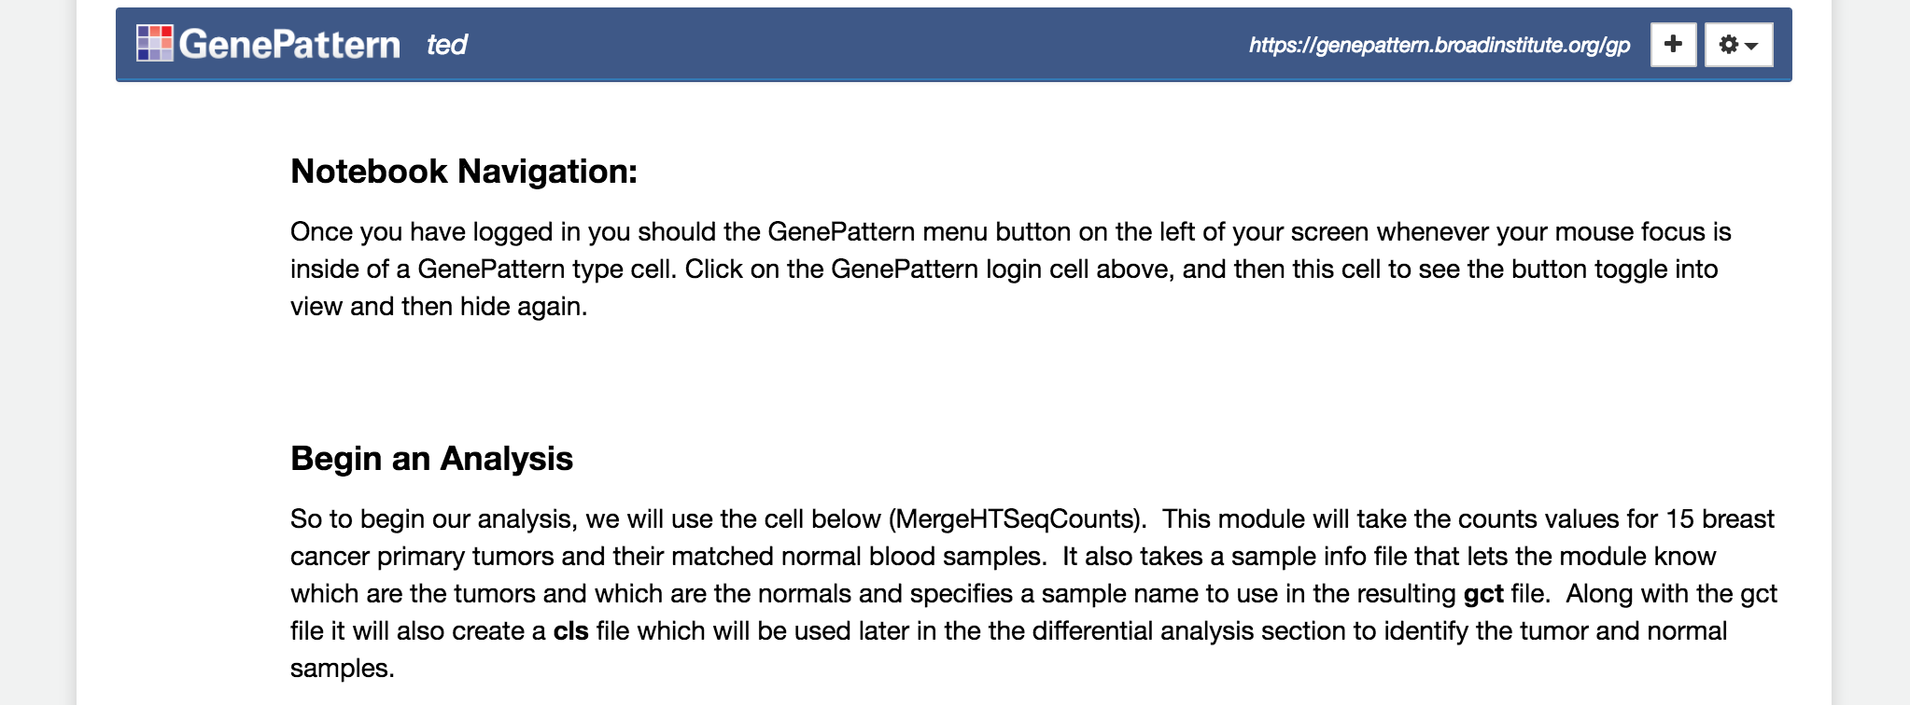
Data Prep Exercise
Let’s dive in! We’ll run a notebook to convert 40 seq counts files into gct and cls files we can use later.
Log into GenePattern Notebooks http://notebook.genepattern.org
Click on the “Public Notebooks” tab
Click on the notebook “2017-11-07_03_CCMI_3_DataPrep.ipynb” and then on the “Get a Copy” button.
Open your copy of the notebook and follow the instructions within
Notes:
We’re going to kick off our first job to get started in GenePattern.
What this module will do is take the output from HTSeq, which you ran previously in this workshop, and merge all of the count files into 1 matrix, in the GenePattern GCT format we just discussed. This GCT file will need 1 more processing step before we can use it for Differential Expression Analysis in GenePattern, but we’ll get to that in our next section.
Any questions so far?

