Slide 1

Differential Gene Expression
Notes:
Now we are transitioning to learning about some key bioinformatics analyses
First one is Differential Expression

Slide 2
Differential Gene Expression
The “basic units” of DNA are called genes
DNA → RNA → Protein
(Central dogma of molecular biology)
Quantifiable “expression” levels
https://genius.com/Biology-genius-the-central-dogma-annotated
Active, ongoing process
Notes:
Proteins are the most interesting of these three, however, they are particularly challenging to quantify at large scales. So we are looking at RNA.

Slide 3

Differential Gene Expression
Gene “A”, condition “1”
E.g., normal cell
Gene “A”, condition “2”
E.g., cancer cell

Slide 4
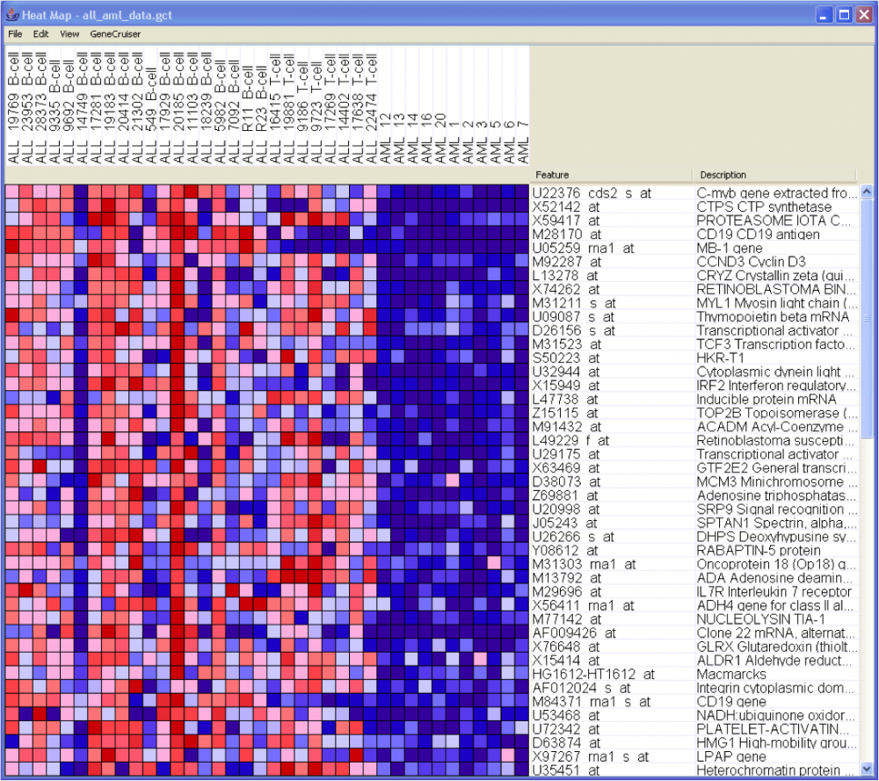

Data Representation and Visualization
Samples
Sample
annotations
Gene
annotations
Data visualized
using a heat map
Gene
Expression
Matrix
Genes
Red = genes are upregulated. Blue = genes are downregulated.
Notes:
Let’s go over one of the most common ways to represent and visualize data in GenePattern (and Bioinformatics in general)
The Gene Expression Matrix
Go over a heat map
What red and blue mean?

Slide 5
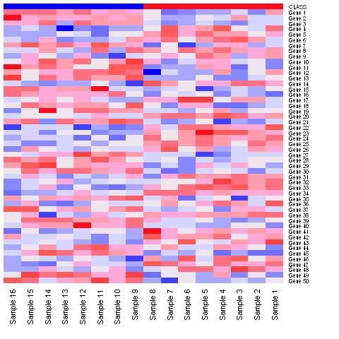
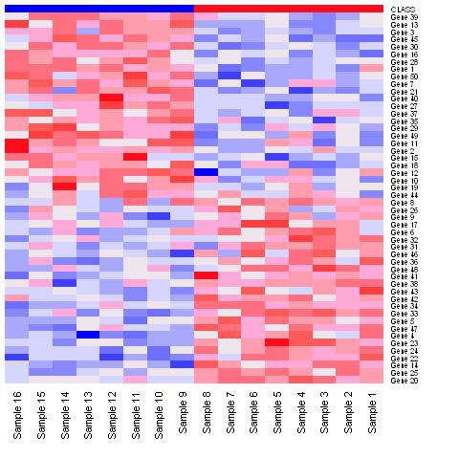
Goal of Differential Expression Analysis
Select “markers”: given two distinct “phenotypes” (classes), find markers (genes) that distinguish these classes from one another
→ Note that markers work both ways (up and down regulated)
Tumor
Normal
Tumor
Normal
Notes:
Marker selection is when given distinct classes, you want to find “markers” that distinguish between these classes.
The heatmap on the left show an unsorted heatmap, and on the right the genes are sorted by their ability to distinguish the two classes
Note that distinguishing the classes works both ways – up-and down-regulated in both classes.
Phenotype: fancy word for label
Markerselection is choosing the top/bottom genes as ”markers” of that ”phenotype” (i.e., representative rows of that label)

Slide 6
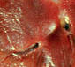
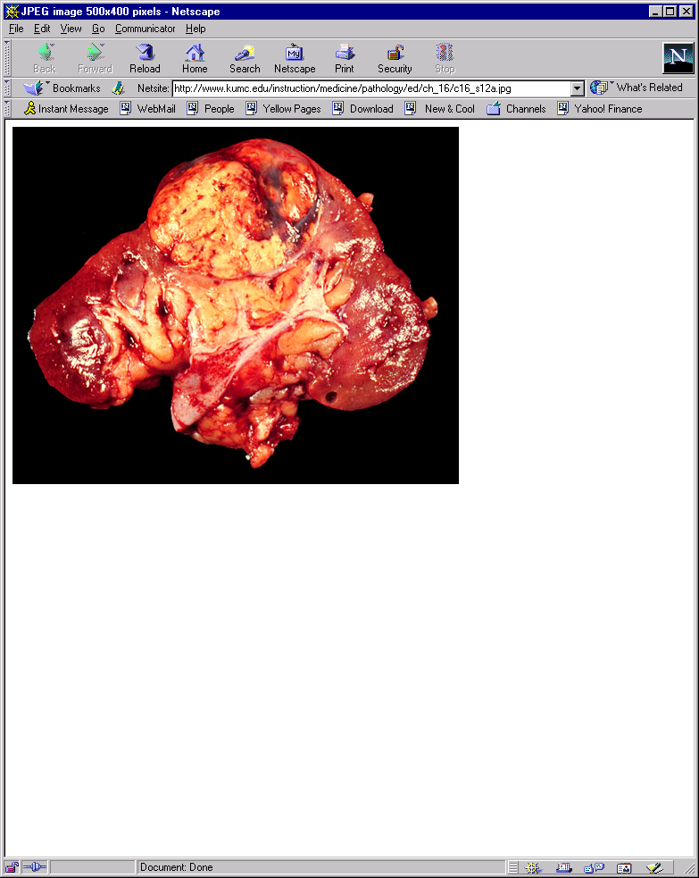
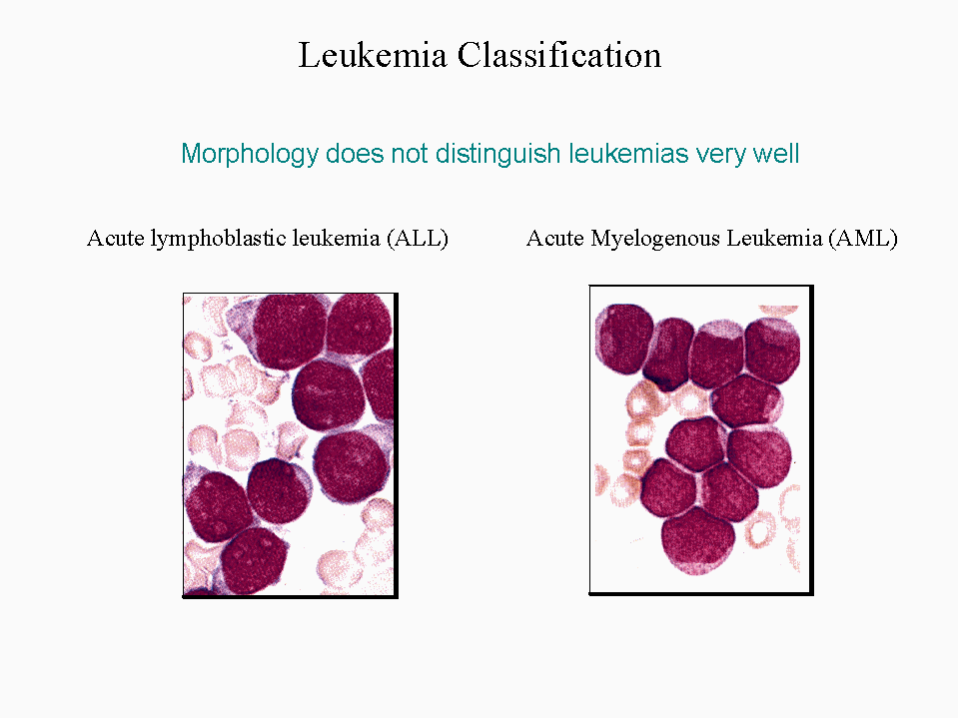
Gene Marker Selection
Hierarchy of difficulty
Problem Gene Markers Error Example
I. Tissue or Cell Type ~1000-2000 ~0% Normal vs. Renal carcinoma
Normal vs. Abnormal
II. Morphological ~200-500 ~0-5% Leukemia ALL vs. AML
Type
III. Morphological Subtype ~50-100 ~0-15% ALL B- vs. T-Cell
Multiclass Classification
IV. Treatment Outcome ~1-20 ~5-50% AML Treatment Outcome
Drug Sensitivity
Degree of Difficulty
adapted from P. Tamayo
Notes:
When doing marker selection there are several levels of difficulty
The first level is finding genes that distinguish between tissue or cell type
The second level is finding genes that distinguish between morphological types such as Leukemia ALL vs. AML

Slide 7
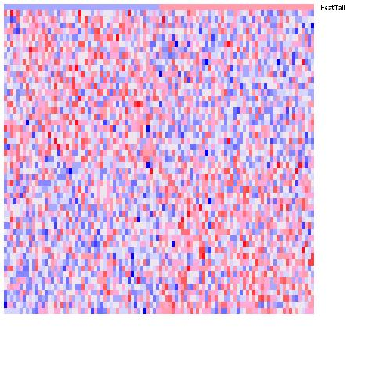
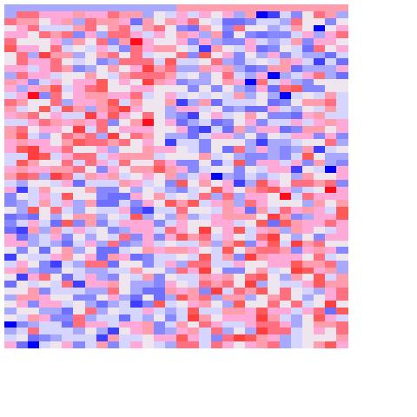
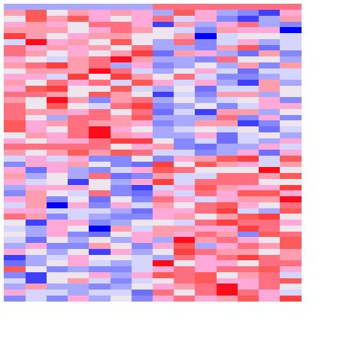
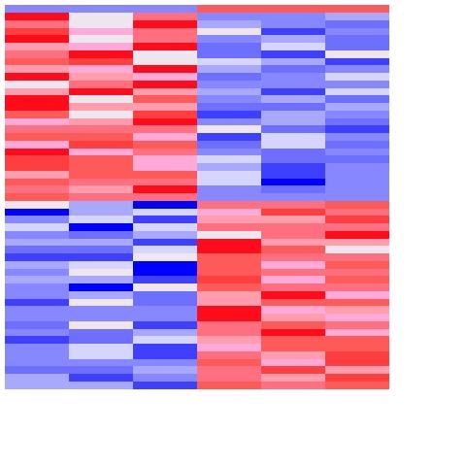
Effect of Sample Size
Exercise: select markers for random samples
Generate a 10,000x100 matrix of random data → N(μ=0, σ=0.5)
Pick n columns at random → n = [100, 30, 14, 6]
Assign label yellow (e.g., tumor) to half of samples (chosen at random) and green (e.g., normal) the rest
Select top 25 markers for yellow, top 25 markers for green
Yellow Green
Yellow Green
Yellow Green
Yellow Green
25
25
100 samples
30 samples
14 samples
6 samples
With small sample size it is easy to find genes considered significant by chance!
Notes:
Here we have 4 heatmaps with increasing sample size.
With small sample size, easy to find genes correlated w/ anything
Head/Tail example suggests a way of testing for the significance of the results: is the observed difference in expression bigger than what we can observe with respect to a random phenotype (head/tail)?
Fit the story you want to tell

Slide 8
Differential Analysis Exercise
Open notebook:
2018-01-23_05_UBIC_Differential Analysis
Notes:
8
Both raise the bar for calling something significant (i.e., smaller nominal p-values are required as the number of hypotheses tested increases)
In practical terms, the FDR is the expected false positive rate; for example, if 1000 observations were experimentally predicted to be different, and a maximum FDR for these observations was 0.10, then 100 of these observations would be expected to be false positives.

Slide 9
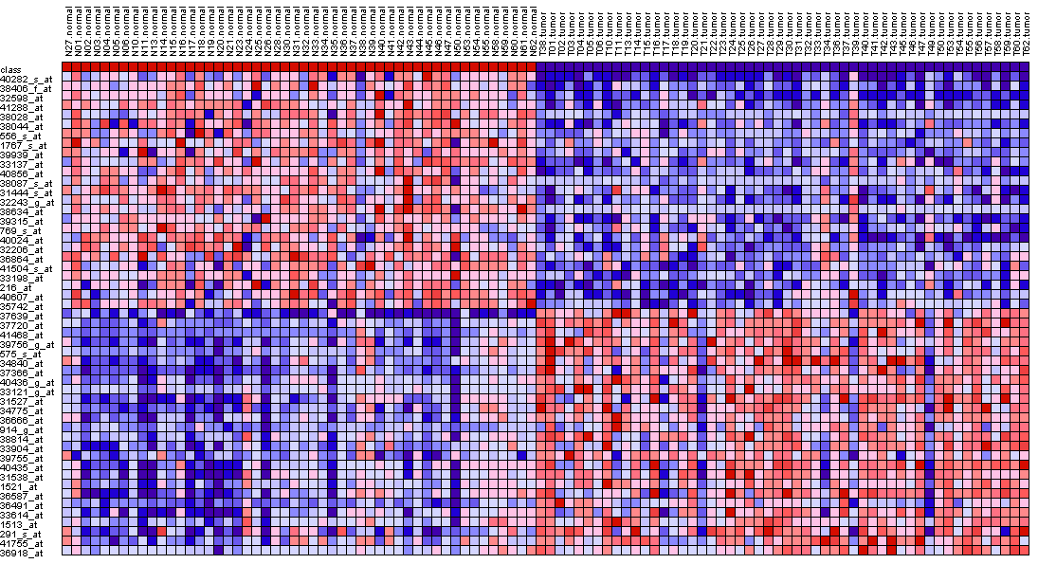
Gene Marker Selection
Compute score for each gene
Compute
score:
t-test,
SNR, etc.
Ranked gene list
Dataset
Score
Phenotype/
class labels
t-test
Signal-to-Noise
Ratio (SNR)
μ = class mean
σ = std deviation
n = # of samples
Hypothesis testing method:
Standardized mean difference between the two classes.
It is the difference between the mean expression of class A and class B divided by the variability of expression.
Similar to the t-test but takes the standard deviation of the two distributions into account which is more representative of the differences between classes when there may be differences between the SD of class A and the SD of class B.
Notes:
In DESeq2 we use the Wald statistic

Slide 10
Multiple Hypothesis Testing
Remember: Each gene/row is a hypothesis!
Reduce number of hypotheses/genes by variation filtering (attempt at reducing false negatives)
There are ways quantifying this such as False Discovery Rate
¿
?
¿
?
¿
?
¿
?
Notes:
Multiple Hypotheis. Testing: every time you test a gene, that’s a hypotesis you you increase the probability of getting ”false positive” results by chance.

