Slide 1



Using Python code and Dataframes
Notes:
12/11/17
1
1
In the last section Michael mentioned that every job you run in GenePattern is programmatically accessible in Python. Well now we’re going to take a look at some of that code and how we can use locally executing python with our remote GenePattern analysis results. I still won’t make you write any code if you don’t want to, but you might have to look at a little of it.
..
But I want to emphasize that if you are a coder, GenePattern is entirely accessible and compatible with writing your own code.
As with the last 2 sections, we’ll review a few features first, and then do an exercise so that you can try them yourselves.

Slide 2
GenePattern Python Library
Complete programmatic access
Automatic integration with GenePattern cell data
import gp
# Create a GenePattern server proxy instance
gpserver = gp.GPServer('http://localhost:8080/gp','myusername', 'mypassword')
# Obtain GPTask by module name
module = gp.GPTask(gpserver, "PreprocessDataset")
# Load module parameter data
module.param_load()
# Create a job specification
job_spec = module.make_job_spec()
# Upload a file to the server
uploaded_file = gpserver.upload_file("file_name", "/path/to/the/file/file_name")
job_spec.set_parameter("input.filename", uploaded_file.get_url())
# Submit the job to the GenePattern server
job = gpserver.run_job(job_spec)
Notes:
12/11/17
2
2
Under the cover, all GenePattern cells use the GenePattern Library. This library allows you to set analysis parameters, launch GenePattern jobs, retrieve the results and import the data in a way that can be used with other popular Python libraries.
For example, you can run an analysis in GenePattern, retrieve the results and then use that data with Python libraries such as matplotlib, scikit-learn or pandas.
.
GenePattern doesn’t put any limitations on you. If you can write code, you can use the library to perform whatever analysis you want or access the results from jobs you ran within GenePattern.
.
And here you can see a bit of example code up on the screen.

Slide 3
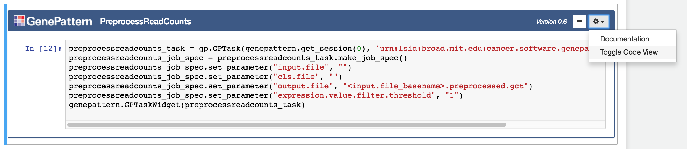
Toggle Code View
Under the cover, all GenePattern cells use the Python library.
Can view the code by selecting “Toggle Code View” in the gear menu in the upper right.
Notes:
Speaking of viewing the code, if you ever want to know exactly what a GenePattern cell is doing programmatically, there’s a way to see this.
.
Every GenePattern cell has the “Toggle Code View” open in the gear menu I the upper right. If you select this option, the cell’s view changes to display the code that the cell is executing behind the scenes.
.
If you’re trying to teach yourself Python, or trying to learn to use the GenePattern Python library, this is also a good way to view code examples and learn how the system works.

Slide 4
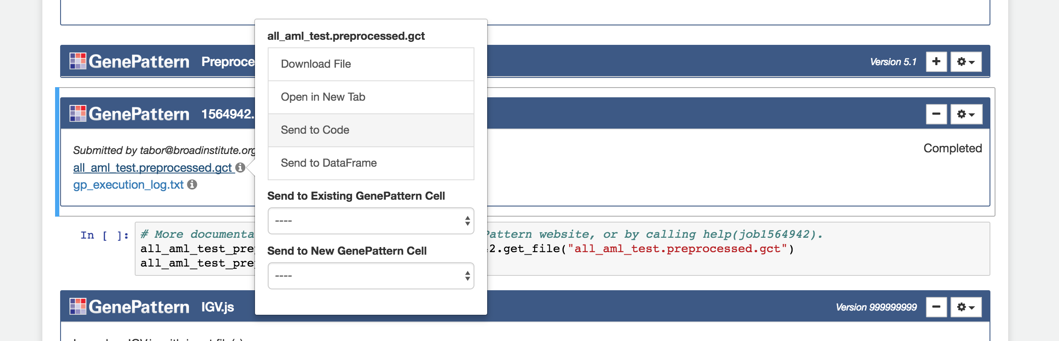
Send to Code
Example code showing how to programmatically access a GenePattern job result can be generated by clicking on the file and selecting “Send to Code.”
Notes:
12/11/17
4
4
And speaking of code examples, if you want to reference a particular job result in Python, the GenePattern Notebook environment will automatically generate code snippets for you.
.
To see a snippet, just click on a result file in a completed GenePattern job cell, and you’ll see the menu. In this menu, select “Send to Code.”
.
This will create a new code cell containing an example of how to reference that particular job result. Note that you will have to run this snippet yourself.

Slide 5
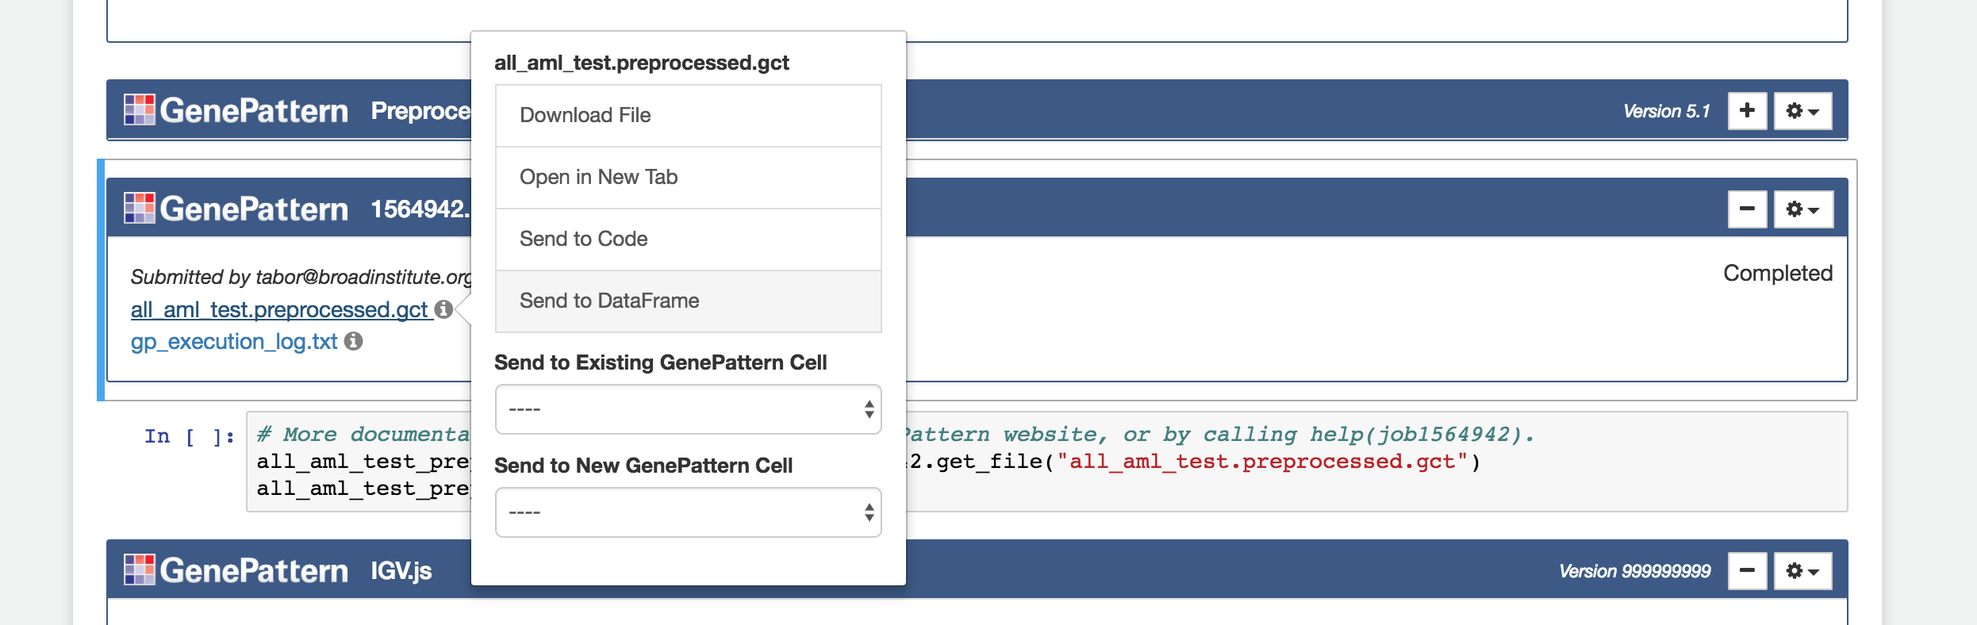
Send to Dataframe
Certain GenePattern file formats can be automatically imported into a pandas Dataframe by selecting “Send to Dataframe” in the menu.
Pandas is a popular Python library for working with data.
Notes:
12/11/17
5
5
For certain common GenePattern file formats—such as GCT and ODF—we go a step beyond the basic “send to code”, generating code snippets not just for referencing a file, but also importing and indexing that data in a Pandas Dataframe.
Dataframes are a structure used for many forms of tabular data in Python. They come with a large number of built-in functions to make it easy to analyze and visualize your data in python
Pandas is an extremely popular Python library for reading and working with large datasets and adds additional useful functions to dataframes. It’s a staple of doing most any sort of data science in Python
.
Pandas also integrates well with Jupyter and the GenePattern Notebook environment. For example, if you import a GenePattern job result into a dataframe and then return that dataframe in a code cell, the notebook will display a table containing your data. We’ll see this later in our exercise

Slide 6
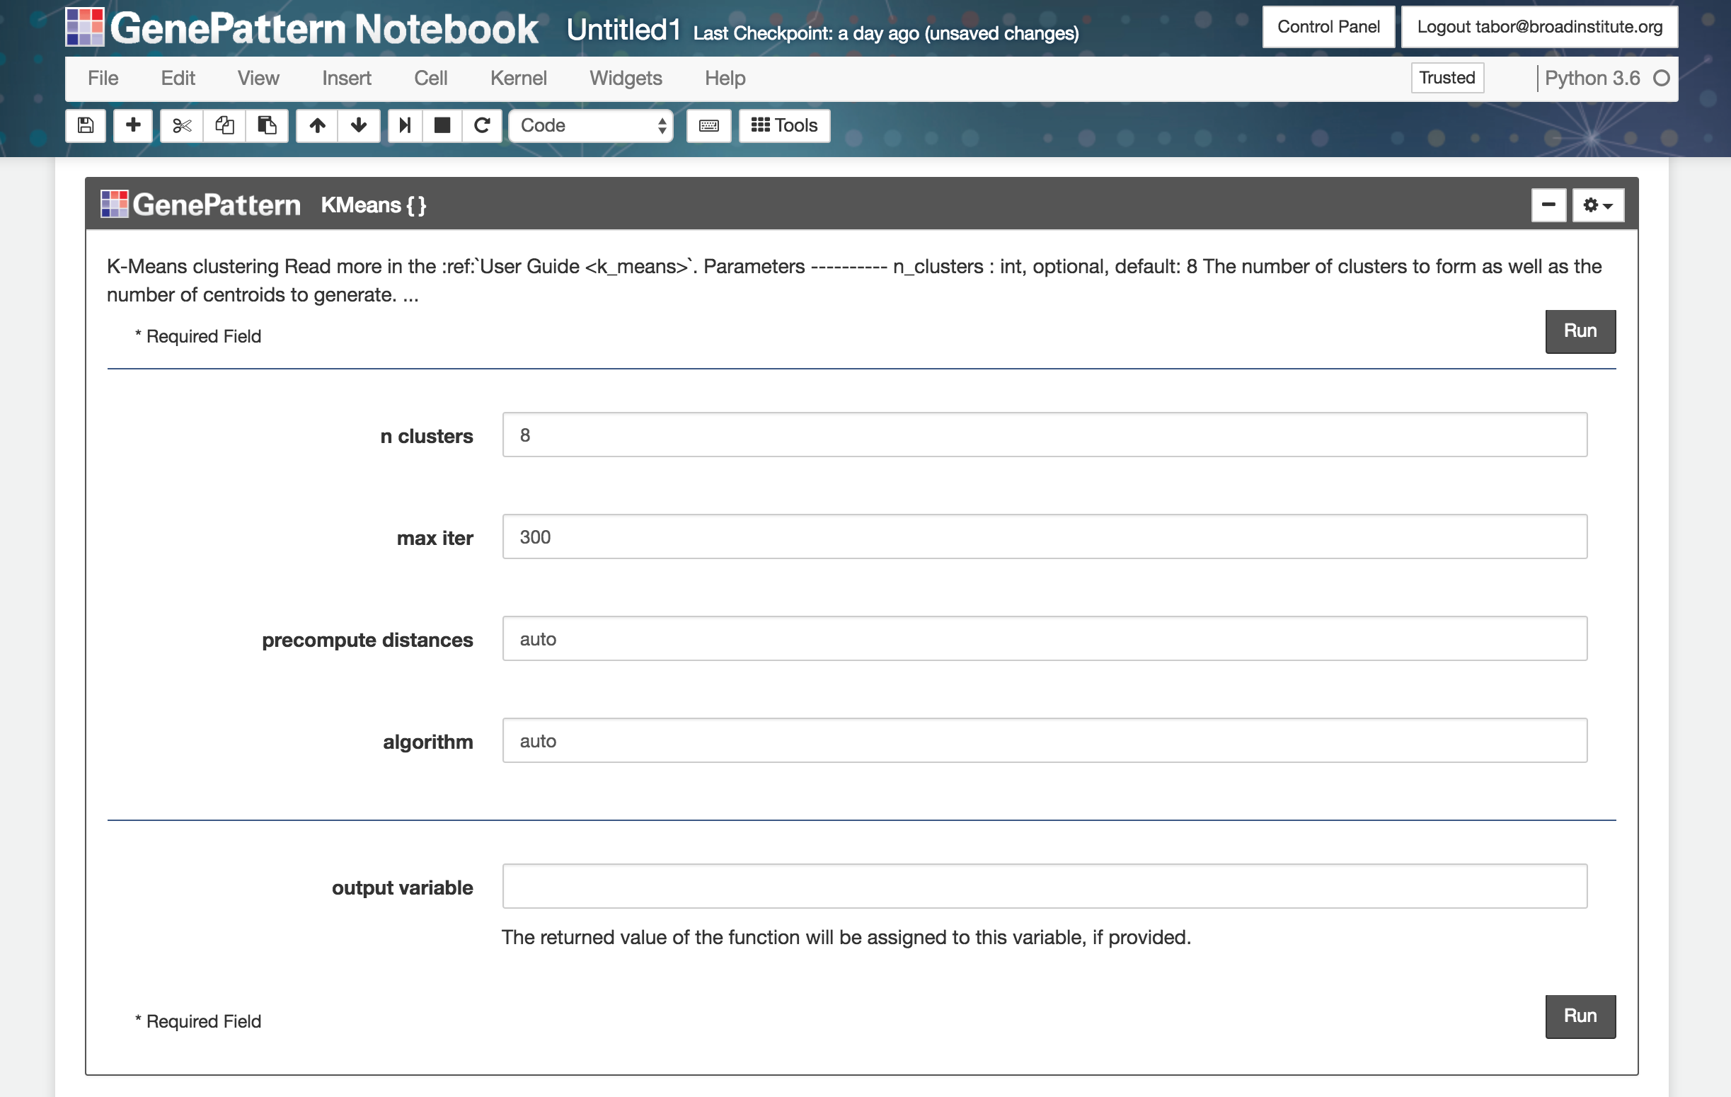
UI Builder
Turns any Python function into an interactive GenePattern widget.
Notes:
12/11/17
6
6
Next there is GenePattern’s UI Builder functionality.
By the way, UI stands for User Interface. Programmers like me will never use 5 syllables if we think we can get away using 2.
This is a way to turn any Python function call into an interactive GenePattern cell with just a single additional line of code. This is useful when you are making a function that you want someone else to use and you don’t want them accidentally editing the code itself

Slide 7
UI Builder - continued
Functions created with the UI Builder appear in the tool menu
UI parameters can be given types.
text, number, password, choice, boolean and file
for a “file”, it becomes available via the ‘Send to’ menu from GenePattern cells
UIBuilder cell inputs (and all GenePattern cell inputs) can accept Python variable names as inputs
Notes:
When you use the UI Builder you don’t just get the widget in a cell, you also get your function added to the GenePattern toolbar so you can re-use it again later.
You can also, optionally, specify a parameter type. If you make it a file type you can automatically send GenePattern results from other GenePattern cells to it
Finally you can also use python variable names as input to a GenePattern cell. This can be useful if you are switching back and forth between code cells and GenePattern cells in a notebook
text, number, password, choice, bool and file

Slide 8
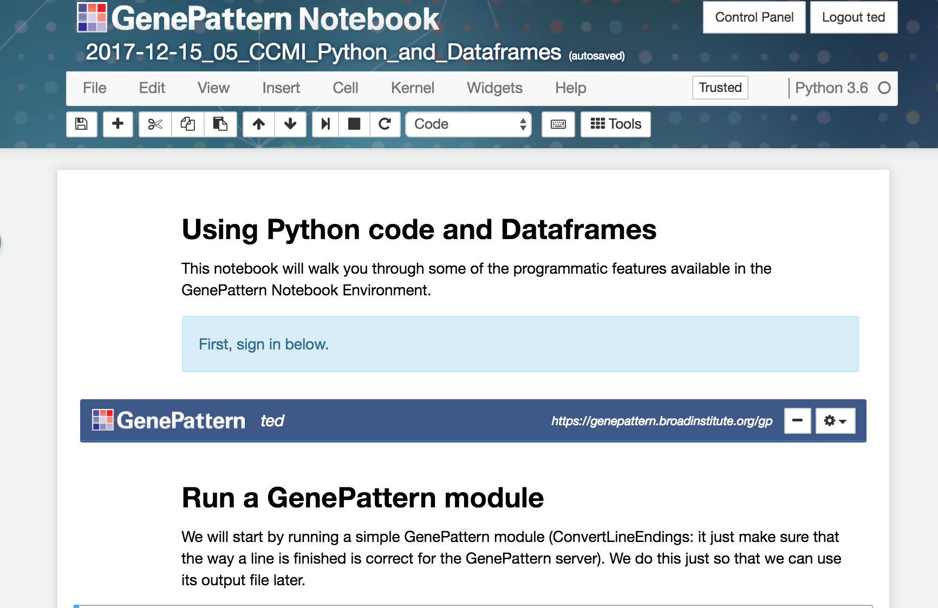
Follow along...
Copy and open the public notebook:
2018-01-23_03_UBIC_Python_and_Dataframes
Notes:
12/11/17
8
8
Now that you have had a quick review of some of these features, lets go into another example notebook so you can see how they work in practice
Open the notebook called “Python and Dataframes”
<start lead follow>

