Slide 1

Data Formats
Notes:
While we wait for your jobs to finish, let’s talk about some of the formats of RNA-Seq data

Slide 2
Supported Platforms
Platform | Data type | Module
Illumina | RNA-Seq | RNA-Seq Suite (Bowtie, TopHat, Cufflinks… etc)
 | Whole Genome Expression | IlluminaExpressionFileCreator
 | 6K DASL | IlluminaDASLPipeline
Affymetrix | Gene expression chips | ExpressionFileCreator
 | SNP chips | SNPFileCreator
 | SNP6 chips | CopyNumberInferencePipeline
Agilent (In development) | microRNA, GeneView | AgilentExpressionFileCreator
TODAY: | We will work with RNA-Seq data, sequenced using the Illumina platform
Notes:
Brief – just point out what we will be looking at today

Slide 3
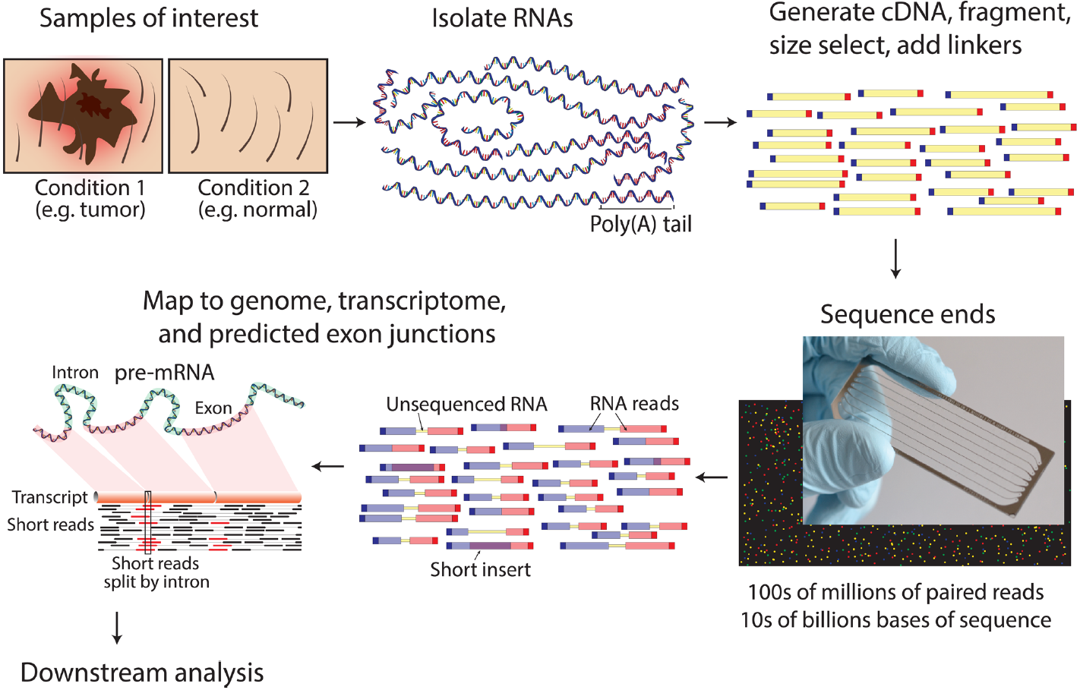
What is RNA-seq?
Snapshot of sequence/quantity of RNA being expressed in a genome.
Griffith et al. (2015) Doi:10.137/journal.pcbi.1004393.g002
Notes:
RNA-Seq gives us the sequence (A,T,C and G) and quantity of RNA being expressed in a genome at a given time. Given two phenotypes, e.g. tumor vs. normal, we can compare the expression of genes at a given time. First, we isolate and purify all the expressed RNA in these samples. Then, we convert the RNA to cDNA, and add flanking sequences called adapter sequences to help with generating the sequence. Then, we sequence the cDNA using a sequencing platform like Illumina. This generates short-read sequences which we can preprocess and use for down-stream analysis such as aligning to a genome or transcriptome, or generating a transcriptome de novo.
*reminder cDNA is complementary DNA

Slide 4
RNA-seq data types
Sequence data comes in many varieties. FASTQ/BAM files are common.
File format | Description | Human readable?
FASTA | Raw sequence data with identifier | Yes
FASTQ | Raw sequence data with identifier, and quality information about the sequence (Phred quality scores) | Yes
SAM | Identifies alignment of sequences with quality scores against a template | Yes
BAM | Compressed binary version of a SAM file. Can also be un-aligned sequences, e.g. compressed binary version of FASTQ | No
TODAY: | Starting with FASTQ files, we align raw reads against a reference genome.
Notes:
RNA-Seq data comes in several different forms. FASTA files are raw sequence reads with a simple identifier, FASTQ files also include a quality score (usually Phred quality scores). These are both human readable. Aligned sequences can be stored in SAM files, which indicate the location of the sequence alignment against a template. BAM files are binary forms of SAM files, or can also be compressed binary versions of FASTQ files. This binary format is not human readable. Today we will be using FASTQ files.

Slide 5
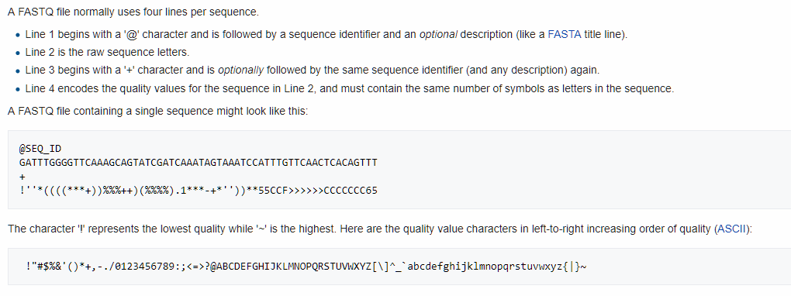
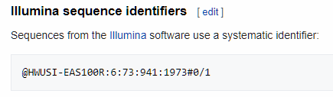
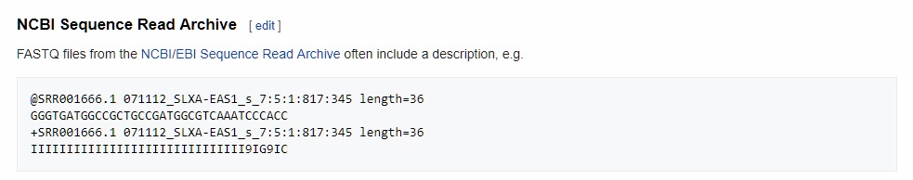
FastQ Format
https://en.wikipedia.org/wiki/FASTQ_format
Notes:
You don’t have to memorize this
But it’s good to know what your data looks like.

Slide 6
RNA-seq read types
Single-end reads
Paired-end reads
DNA
Fragment
Reads
Example
Size
100 bp
100 bp
500 bp
100 bp
Alignment
Alignment
Reference Genome
Reference Genome
TODAY: | We will use paired-end reads.
Notes:
In addition to data format types, there are read types.
Single-read sequencing involves sequencing DNA from only one end. Paired-end sequencing allows users to sequence both ends of a fragment and generate high-quality, alignable sequence data. Paired-end sequencing is more accurate because both ends of the fragment are sequenced, and the distance between fragments is known, so alignment over repetitive regions is more accurate. It can also resolve structural rearrangements (insertions, deletions, inversions, etc.).
Resolving insertions/deletions/etc.:
If your sample read, A---A’ is separated by 500bp, and the reference is separated by 500bp, there are no deletions or insertions.
If your sample read, A---A’ is separated by 500bp, and the reference is separated by 100bp, there is an insertion (of 400bp).
If your sample read, A---A’ is separated by 500bp, and the reference is separated by 700bp, there is a deletion (of 200bp).

Slide 7
Importing and Converting Data
Importing Data | Converting data
SraToFastQ GEOImporter MAGEMLImportViewer MAGETABImportViewer | Picard (BAM/SAM) BedToGtf (RNA-seq annotation) CsvToFcs (Flow Cytometry) FcsToCsv (Flow Cytometry) Read_group_trackingToGct (Cufflinks) MergeHTSeqCounts (HTSeq)
Other data formats
  Many others available
  Manually convert data to required format or post in our forum: genepattern.org/help
Notes:
If your data is not in the format required for the analysis you wish to run, we provide a variety of modules for the converting your data into the desired format.
We also provide a number of modules which will import data from common data repositories, such as GEO or Array Express.

Slide 8


Modules Supporting RNA-Seq Differential Expression Workflow in GenePattern
Raw sequence reads
(FASTQ format)
Quality Control Checking
FastQC
Trimming / Filtering
Trimmomatic
Read Alignment
TopHat
GenePattern modules
Summarization / Quantitation
Cuffdiff
Normalization
Differential Expression Analysis
Visualization
Notes:
These are just the modules we will be using today, to get the basic hang of an RNA-seq informatics workflow.

Slide 9
Modules Supporting RNA-Seq Differential Expression Workflow in GenePattern
Raw sequence reads
(FASTQ format)
Quality Control Checking
FastQC
Due to computational and time constraints, we will only demonstrate how to set up GenePattern jobs during the follow-along (FA) sections, and will not be running all of the jobs demonstrated today.
Trimming / Filtering
Trimmomatic
Read Alignment
TopHat
GenePattern modules
Summarization / Quantitation
Cuffdiff
Normalization
Differential Expression Analysis
Visualization

