Slide 1

Other GenePattern Features
Notes:
Make sure to walk people along with you when you use different job results

Slide 2
Managing Job Results
Notes:
Make sure to walk people along with you when you use different job results

Slide 3
Managing job results
Viewing job results
Saving and deleting job results
Sharing job results with others
Notes:
Another feature which is currently best implemented in the Web App is the managing of data and job results – I’ll just briefly show you these features.

Slide 4
Viewing job results
Where are my job results?
Notes:
Go over client server…etc

Slide 5
Will my jobs stay on the server?
Job details and result files are, by default, purged from GenePattern servers after 7 days – however this can be configured by the server administrator. Save result files and job information
to prevent them from being lost on purge
to share them with others
Notes:
RECENT Jobs, all Jobs – delete., share..etc

Slide 6
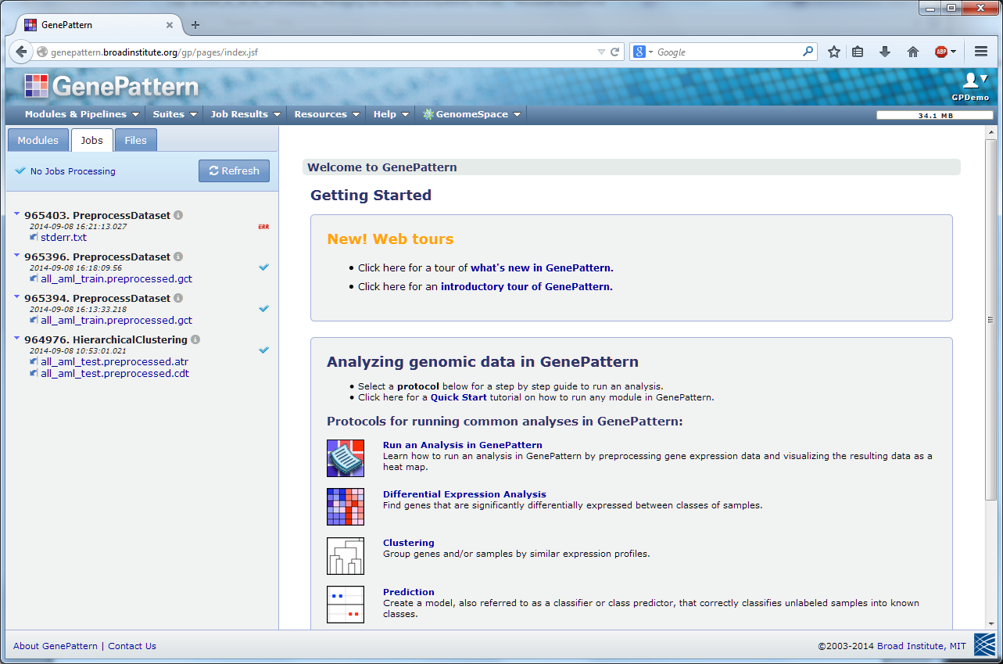
View recent jobs

Slide 7
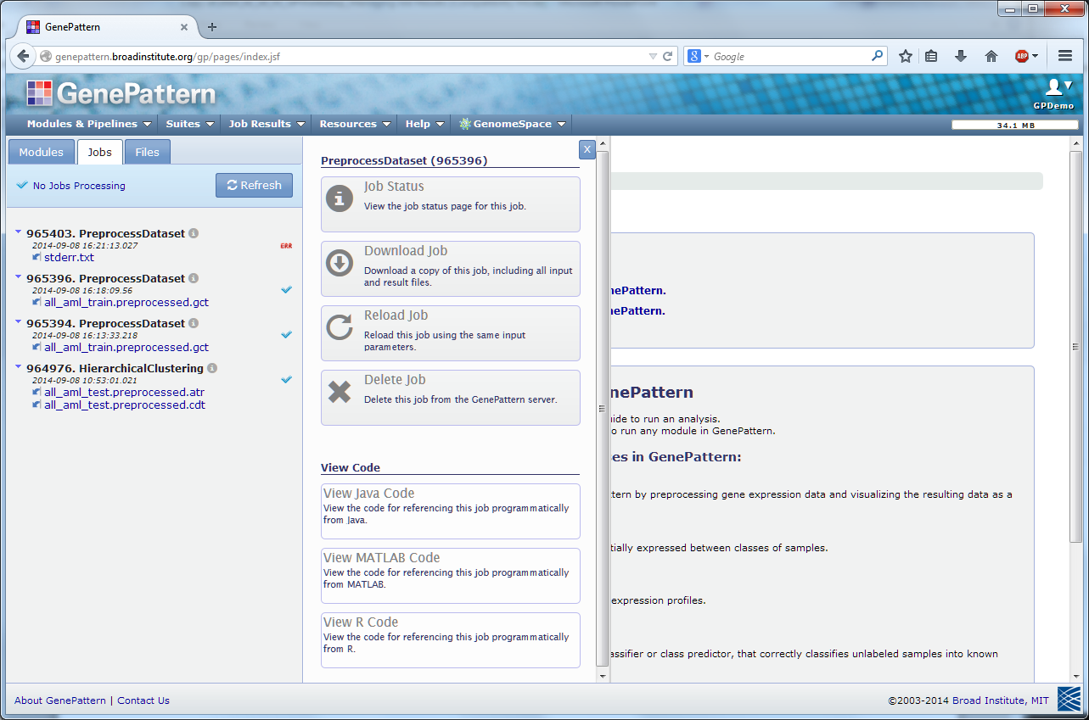
Action menus
Notes:
We’ve seen some of these before – but good to remember that these slide out menus are always available and contain the same sorts of actions
(delete, save, download are new – create pipeline later)
Make sure to mention reloading jobs and what they mean

Slide 8
Review job details
Notes:
You can always click on the job id to get back to your job status page.

Slide 9
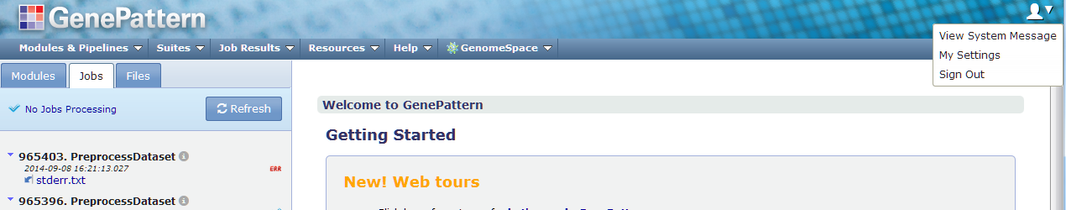
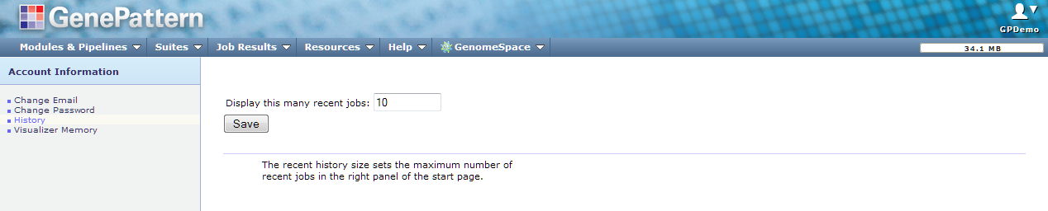
View recent jobs
Notes:
What if I want to see more of my jobs in the Recent jobs panel?
If you want to see more job in the recent jobs panel

Slide 10
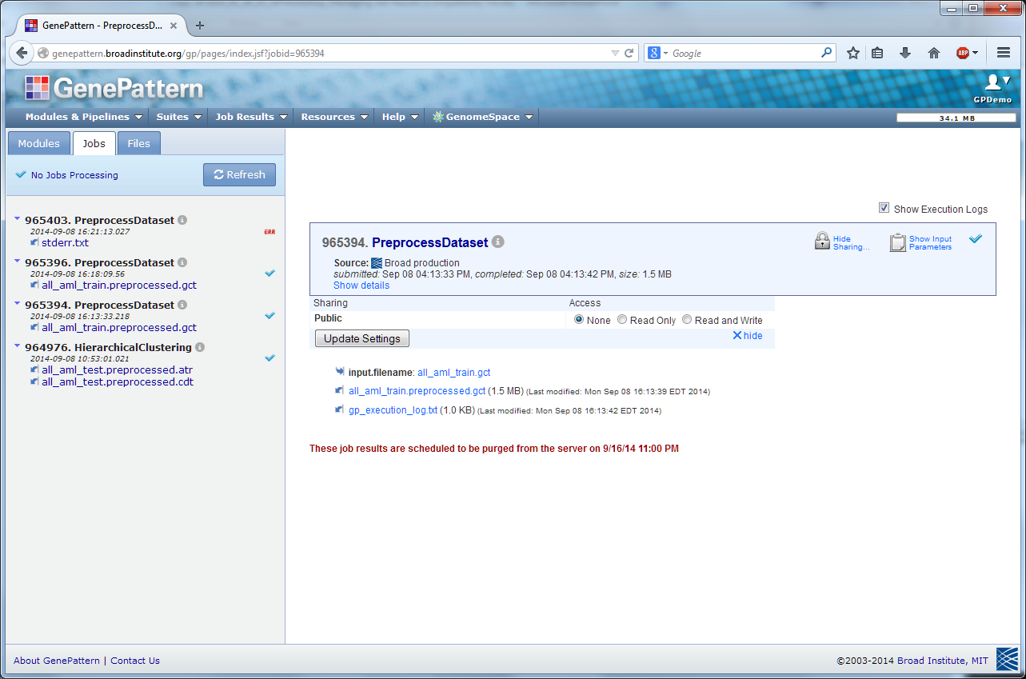
Share job results

Slide 11
Managing job access
By default all jobs are private (you + administrator)
Grant access to your jobs (input files + parameter values + result files).
Grant read-only access or read-write access
Share with members of your group, or share with everyone (group = Public)

Slide 12
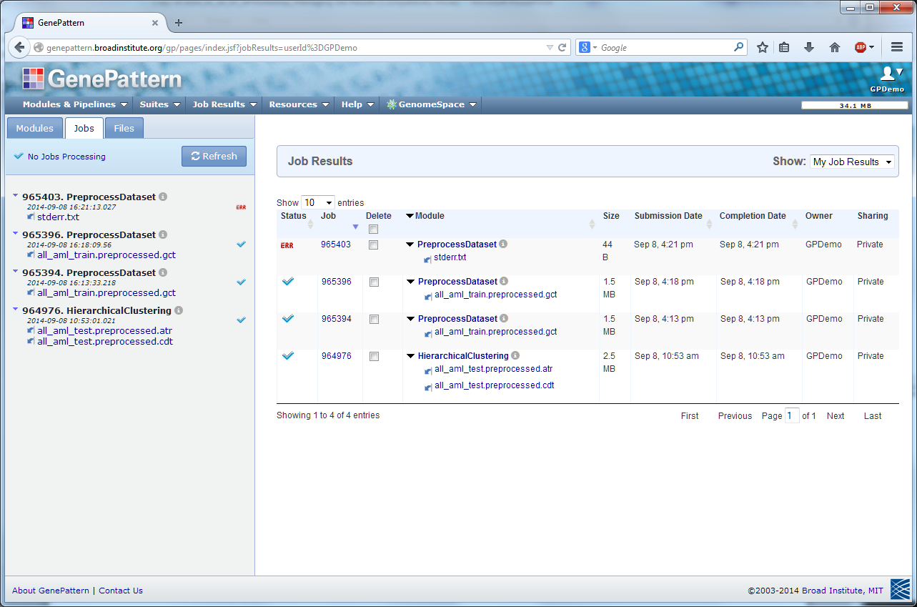
View all my jobs
Notes:
Again - make sure they are following
To see all job results not just those recently run– this page – briefly describe – sorting/filtering

Slide 13
Batching Jobs
Notes:
Make sure to walk people along with you when you use different job results

Slide 14
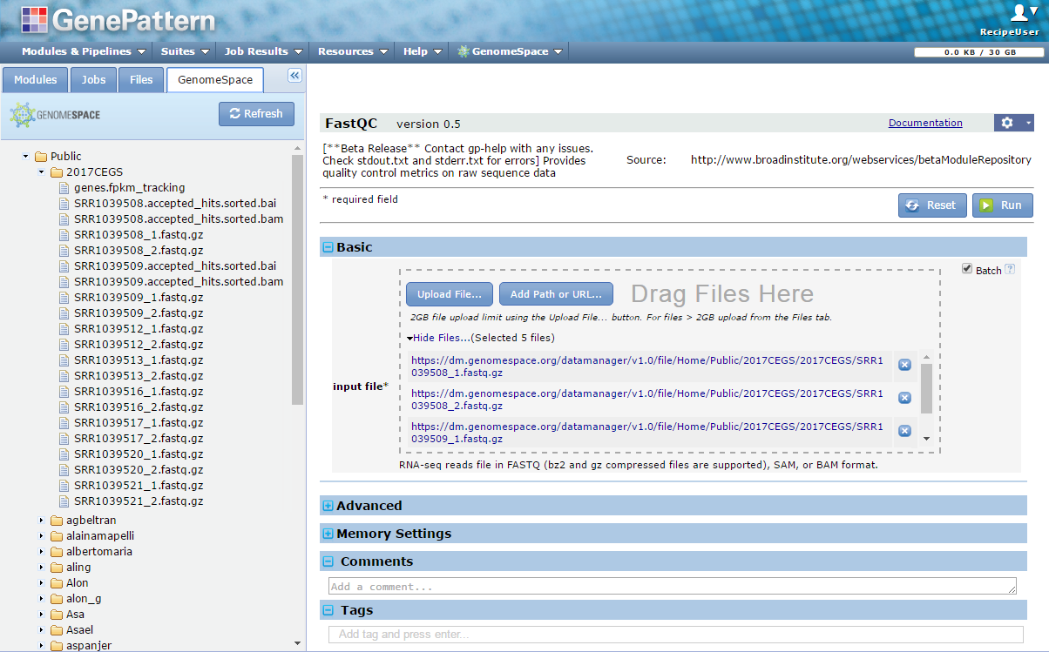
Example: run FastQC on all pairs of FASTQ files
Find the *.fastq.gz files in the your folder.
Then click and drag all *.fastq.gz to the input box.
Notes:
Before we move on –
Typically you may need to run QC checks on more than one file, and for this we provide the batch feature.
Remember how I said that the notebooks and the web ui have some different features? This is one of them. If you are looking to run a batch of jobs, it’s currently best to use the GenePattern WebApp, as this provides a simple solution. (If you are a Pythonista, you could write a simple batch loop in the notebook to do the same thing)
**LIVE DEMO IN WebApp**
In order to use this you simply click the batch check box, then drag in multiple files, or multi select files…etc. When you click run, a job is submitted for each file you provided.
To keep this all moving along we’re not doing this now.

Slide 15
Creating your own Notebooks
& Editing existing
Notes:
Edit Trimmomatic to have a more stringent cut off
Create new notebook and add FastQC as starting point – datasets.genepattern.org copy & paste inputs

Slide 16
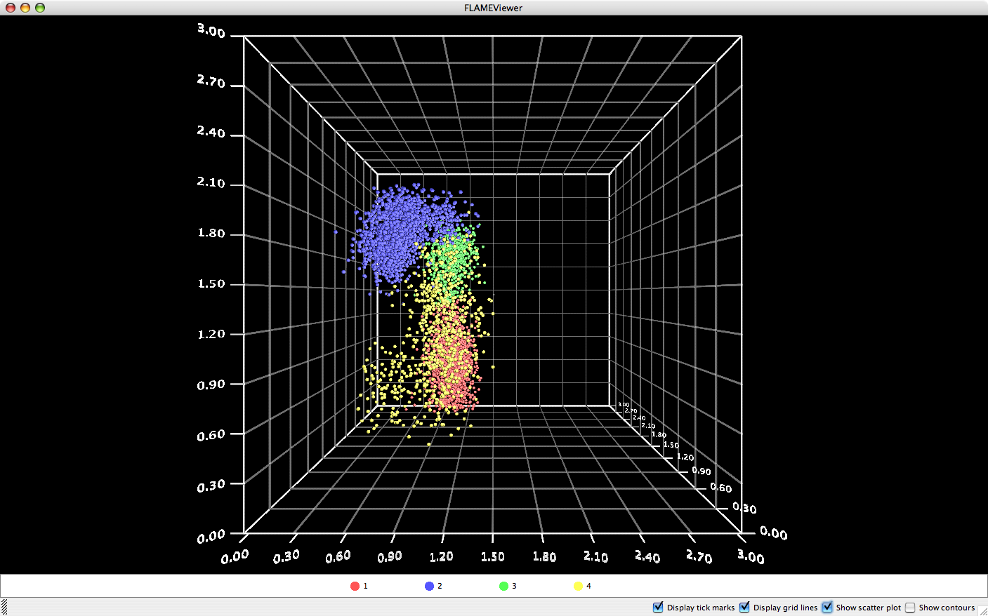
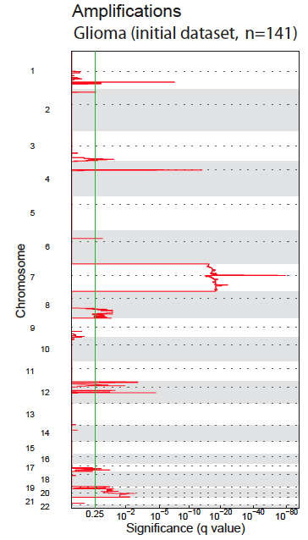
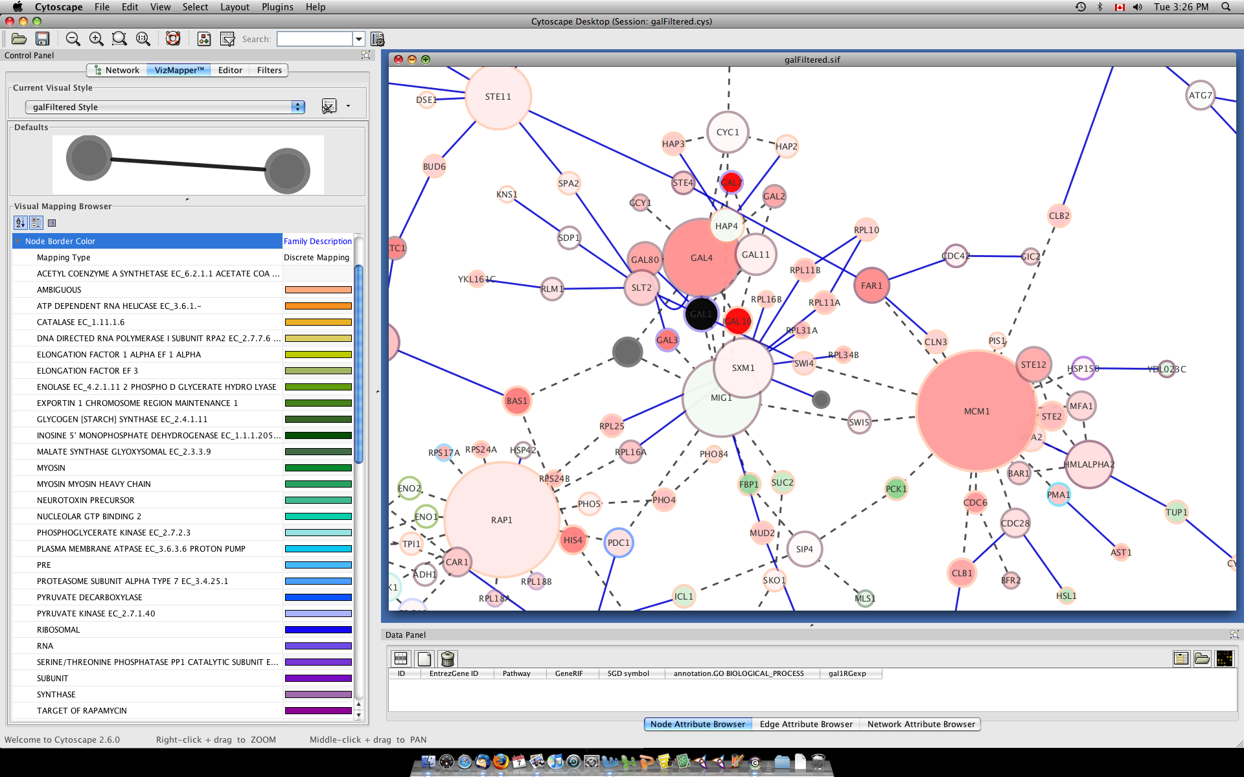
Other GenePattern Features
Flow Cytometry
Sequence Variation Analysis
Proteomics
Network Analysis
Notes:
16

Slide 17
SNP/Copy Number Analysis
Support for SNP chip formats
Affymetrix 10k, 50k, 500k, SNP6.0 chip sets
GISTIC: Identification of broad and focal chromosomal insertions/deletions (RAE)
Segmentation (GLAD, CBS)
Copy number estimation
Summarization
LOH determination
Notes:
Complete end-to-end SNP analysis pipeline, from preprocessing through segmentation to the identification of significantly aberrated chromosomal regions

