Slide 1

Data Preparation
Notes:
In this section we will go over data preparation, or how to get your data into GenePattern to begin an analysis

Slide 2
GenePattern file formats
Each module specifies its input and output file formats
Modules may use common GenePattern file formats or their own unique formats
Most modules use the file formats described on the GenePattern website
There are many GenePattern modules that are specifically meant for importing data from other systems

Slide 3
Example modules for data formatting
Data type | Input Format | Module
RNA-Seq | bed fpkm tracking Read group tracking Cufflinks Expr bed | BedToGtf Fpkm_trackingToGct Read_group_trackingToGct ExprToGct BedToGtf
DNA-seq | bam sam sam/bam | Picard.BamToSam Picard.SamToBam Picard.SamToFastQ
Gene expression chips | .cel | ExpressionFileCreator
SNP chips | .cel | SNPFileCreator
MAGE | Mage-ML Mage-tab | MageMLImportViewer MageTabImportViewer
To find, search modules for “to<format>” or “<format>To”
There are many more modules, for MS, FCS and other data types
Notes:
You don’t need to remember this – we’ll be sending links to all slides

Slide 4
Example data prep
We will do an example, importing RNA-Seq read count data from TCGA
Starting with read counts, one file per sample, using Ensembl gene ids and ending with a standard GenePattern format for expression data with HUGO symbols and a second file with phenotype definitions
We will use 3 standard GenePattern formats
GCT (.gct)
Sample Information or SampleInfo (.txt or .tsv)
Class file (.cls)

Slide 5
GCT file format
Tab delimited
Originally used for expression data
Can be used for any matrix, not just expression
Represents a matrix
columns = samples
rows = features such as genes

Slide 6
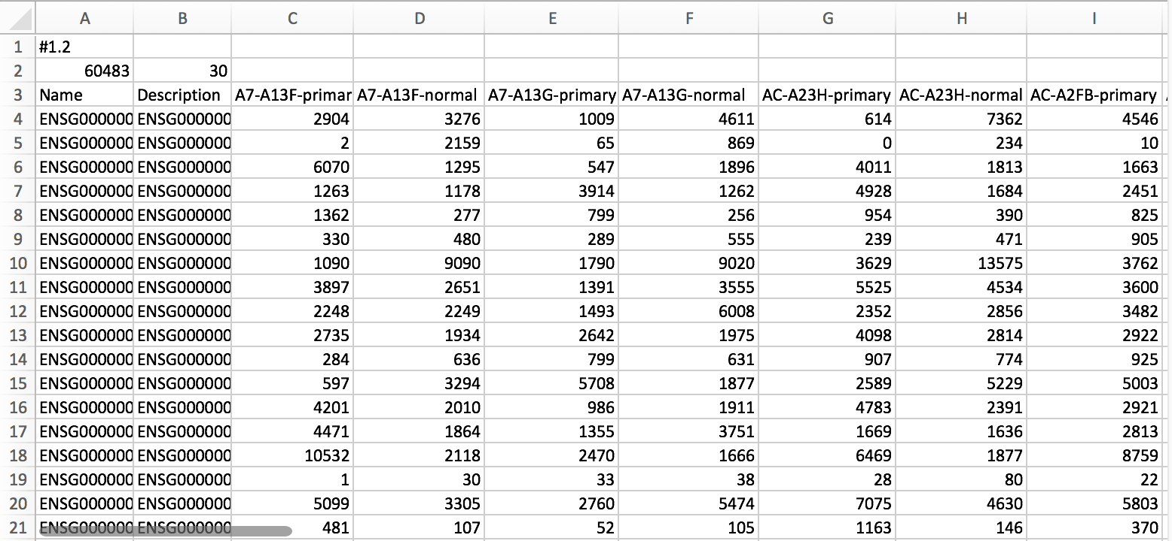
GCT file format
Always #1.2
Number of rows (ie gene ids)
Number of samples
Col 1: Row identifiers. Typically gene ids.
Col 2: Optional description
Col 3+: Sample names, must be unique.
Each column contains expression or count values from one sample.

Slide 7
Sample info file format
Tab delimited
Essentially a spreadsheet
Used to record properties of samples
Represents a matrix
Columns = properties
Completely arbitrary columns, you can define anything you want
Values can be anything that can be represented by text (except cannot use the tab character)
Rows = Samples

Slide 8
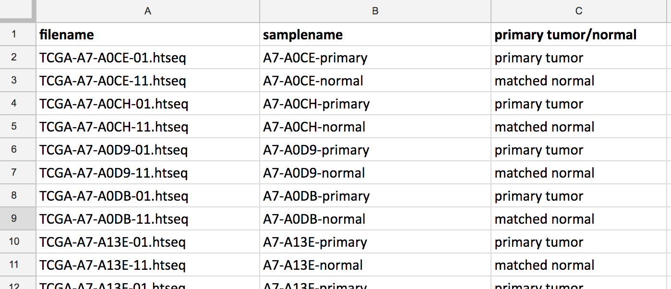
Sample details: sample info file
Tab-delimited, assumes the first row has column names
Any number of columns
Arbitrary column labels (i.e. whatever you want them to be)
One row per sample
Column Labels
One row
per sample
Sample info files are usually created from spreadsheets saved in tab-delimited format

Slide 9
Class (CLS) file format
Tab or space delimited
Used for defining class membership of samples
Essentially a representation of a single column from a SampleInfo file
Values are numeric (0,1,…)

Slide 10
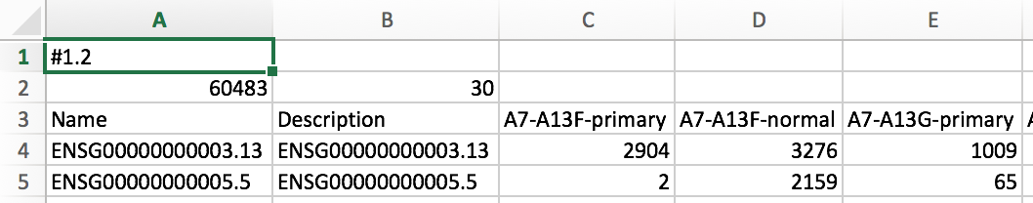
Sample labels: CLS file
30 samples
2 Classes
Start with 0
Space delimited
ClsFileCreator module can be used to generate a CLS file from a gct file. We will use MergeHTSeqCounts later which can also generate a cls file.

Slide 11
Data Prep Exercise
Starting with read counts and a sample info file for 40 RNA-seq samples, 20 breast cancer primary tumor and 20 matched normal using Ensembl Gene IDs.
Merge the 40 files into one (gct) matrix and generate a cls file distinguishing tumor/normal samples
Strip the versions from the Ensembl gene ids
Replace Ensembl gene ids with HUGO symbols & collapse duplicate rows to a single row
Normalize the data for downstream analysis
Ends with a GCT file using HUGO Gene Symbols, and a CLS file that distinguishes tumors from matched normals.
suitable to be used for differential gene expression.

Slide 12
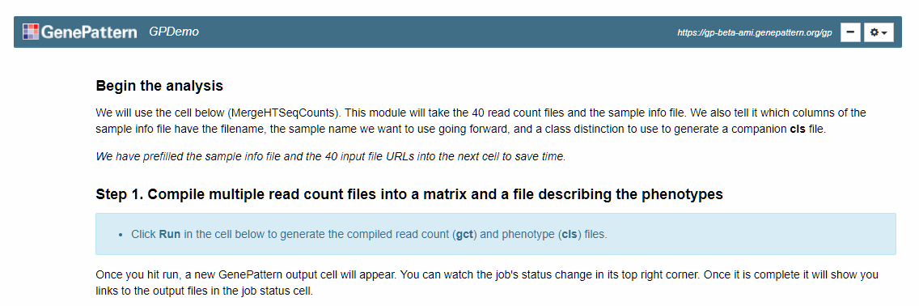
Data Prep Exercise
Let’s dive in! We’ll run a notebook to convert 40 seq counts files into gct and cls files we can use later.
Click on the “Public Notebooks” tab
Click on the notebook “2018-02-05_03_BroadE_DataPrep.ipynb” and then on the “Get a Copy” button.
Open your copy of the notebook and follow along
Notes:
Merge usually takes less than a minute – note that it can take a little bit for the cell to collapse, as it is connecting to all of the data.
Collapse - same
PreprocessReadCounts - same

Slide 13
Break (15 minutes)

