Slide 1
Interesting English Premier League Facts
P7439658 - Gene Phua Jing Hui
SEDDA2/CE/4110/1
Notes:
Hello Junie.
My continual assessment has to do with providing some interesting facts on the English Premier League.

Slide 2
Content
Sources
Nature of Dataset
Areas of Interest and Analysis Process
Insights
Notes:
Here’s how the flow of my presentation will look like.
I will first be sharing the sources of my datasets used. Next I will be sharing what kind of information it contains. Then I will touching on what forms of analysis I have done on the datasets and finally be sharing my takeaways.

Slide 3
Sources
2020/2021 Premier League Season Data:
https://www.kaggle.com/rajatrc1in705/english-premier-league202021
2020/2021 Premier League Table (Points):
https://www.premierleague.com/tables?co=1&se=363&ha=-1
Notes:
I have used two data sets for this project. The main data set was obtained from Kaggle and the second data set was obtained directly from the premier league website.

Slide 4
Nature of Dataset
2020/2021 EPL Season Data on every soccer player
League Profile
Age, Nationality, Position etc.
Performance Statistics
Goals Scored, Assists Recorded etc.
2020/2021 EPL Points Table
Notes:
The main dataset that I have used contains the 2020/2021 English Premier League season data on every soccer player in the league.
It covers their league profile which consists of attributes such as their Age, Nationality and position. The data set also covers their performance statistics such as each player’s goals scored, and assists recorded.
The second data set that I have used essentially contains the English Premier League points table.

Slide 5
Areas of Interest
Age Profile
National Diversity
Does fouling (playing dirty) give an advantage?
Notes:
So for this project, I have decided to explore and investigate on three areas of interest.
Firstly, I will be investigating the age profile of the league.
Secondly, I will be looking at how diverse nationally are the different soccer clubs.
Lastly, I will be answering the question of whether there is any beneficial payoff obtained by playing dirty on the pitch.

Slide 6
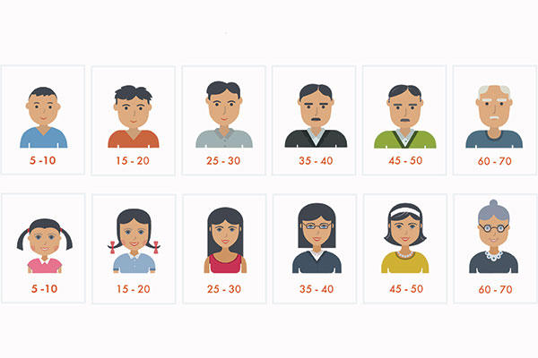
Age Profile
Notes:
So first up lets take a look at the age profile of the English Premier League players.

Slide 7
Premier League Age Profile
Data frame creation by Pandas
Histogram through matplotlib
Notes:
So, exactly how old are the premier league players? To answer this, I first used the Pandas library to create a data frame. Then I extracted all the data from the ‘Age’ column by sub setting by the column name ‘Age’. Thereafter, I used the matplotlib plot function plot a histogram as show by the code here.

Slide 8
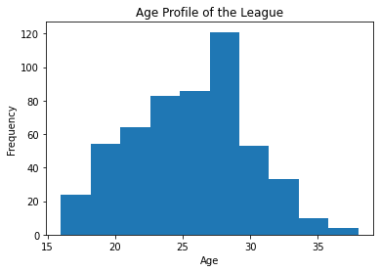
Age Profile of the Premier League
Notes:
And here is the histogram that I have gotten. Right off the bat, we can see that most of the players in the English premier league are aged between approximately 26-28 years old.
To make it clearer visually on how the spread of the players ages look like, a normal distribution curve could be plotted onto the same chart as the Histogram too and this is what I did next.

Slide 9
Premier League Age Profile
Axis of Histogram differed from Normal Distribution Curve
NDC Y axis normally only from 0 to 1
Scale axis of curve to histogram
Notes:
The first issue that I encountered in plotting a normal distribution curve onto the same chart as the histogram was that they had differing magnitudes of the Y axis. The Y axis of the normal distribution curve ranges between 0 and 1. However for the histogram plotted just now, the Y axis ranged between 0 to 120. By simply plotting the normal distribution curve onto the same chart as the histogram without doing any adjustment, visually the normal distribution curve would seem not to have been plotted.
So to address this I had to scale the Y axis of the normal distribution curve to match that of the Y axis of the histogram and this was the code that I used to perform the scaling.

Slide 10
Premier League Age Profile
Use of scipy.stats library
Normal function
Notes:
To plot a normal distribution curve, I must first calculate the mean and standard deviation of the population. In order to be able to do this, I had to import the SciPy.Stats library so that I could use the normal fit function to calculate these parameters. Thereafter I used Matplotlib to plot the normal distribution curve as shown by the code provided.

Slide 11
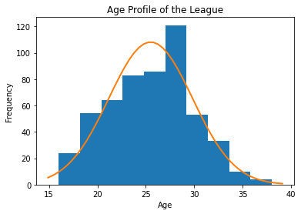
Age Profile of the Premier League
Notes:
And here is what I have obtained. The standard deviation of the normal distribution curve is approximately 4 which can be derived by running the info() on the age data frame.
As can be seen from the curve, it turns out that most of the players are aged between 20-30 years old. This is approximately one standard deviation from the mean age of 25.5 which is in line with the Empirical rule in statistics that 68% of the population falls within one standard deviation from the mean.

Slide 12

Diversity of Nationality
Notes:
Moving on let us examine how diverse nationally the English Premier League is.

Slide 13

Diversity of Nationality
Measure of diversity
No. of Non-English Players (Other Nationalities other than ENGLAND)
Notes:
The main data set that I have used is about the English premier league, so clearly most of the players’ nationality will be from England itself. For the purposes of quantifying diversity, my measure of diversity will simply be measuring the total no. of non-English players. In short this means that the more diverse a club is nationally, the more non-English players that they will have.
I will only be looking at the top 4 clubs in the English Premier League points table to get an approximate measure and feel of the diversity of nationalities of the clubs.

Slide 14
Diversity of Nationality
Use of Groupby multicolumn function to group by Club and Nationality
Index = Club
Notes:
The first step I took to begin my process of measuring the diversity of nationality was to use the Groupby multicolumn function to group two columns of data relating to ‘Club’ and ‘Nationality’.
I next set the index as the clubs and used the size function to count how many times each ‘Nationality’ appeared in the dataset.
A sample of the output is shown here where you can see that for each club, I can clearly see the club’s corresponding count of the different nationalities.

Slide 15
Diversity of Nationality
Extraction of Specific Club Data
Sub setting by specific club’s name, then by nationality
Used of Drop() to find Non-English
Notes:
Next for each club, I extracted the specific club data by sub setting the data frame by using the loc() function based on the club’s name as can be seen from the code provided.
I then did a further sub setting of the resulting data frame to extract only the number of English players also by using the loc() function, this time based on the nationality.
To calculate the number of non-English players, I merely needed to use the drop() function to drop the data relating to English players from the data frame and then to sum up the remaining nationalities. Repeating this process 4 times, I was able to get the total number of English players and Non-English players for the 4 specific clubs.
With these figures, I could then plot 4 pie charts using matplotlib.

Slide 16
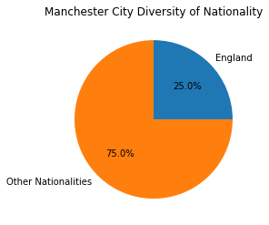
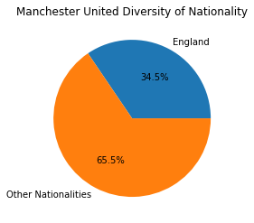
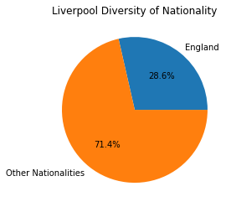
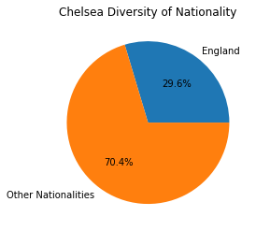
Piechart of Diversity of Nationality of TOP 4
Notes:
So here are the pie charts that I plotted to illustrate the diversity of nationality of the top 4 premier league soccer clubs.
Interestingly, this being the English premier league, we would have expected that at least more than half of the proportion of the clubs should be English players. However, this was far from the case, as the number of non-English players was overwhelmingly more.
It can be seen that the proportion of non-English players in the 4 clubs were pretty similar. The only notable slight exception is actually Manchester City which has the highest no of non-English players as compared to the rest. So were the observations here representative of the national diversity of the English Premier League? Let us take a look.

Slide 17
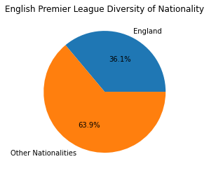
Piechart of Diversity of Nationality of EPL
Notes:
I have also plotted a pie chart for the diversity of nationality of the entire English Premier League. Comparing this pie chart to the pie charts of the top 4 soccer clubs, it can seen that the top 4 clubs are generally representative of the diversity of nationality profile of the league.

Slide 18

Does fouling give an advantage?
Notes:
For our last topic of interest, we will be examining if playing dirty on the pitch by committing fouls gives any advantage at all.

Slide 19
Does fouling give an advantage?
Fouls = number of yellow cards
2 Yellow Card = 1 Red Card
Two columns for Yellow and Red cards
Combine both into one column
Awarded Points when winning or drawing a match
No. of yellow cards vs points
Notes:
Yellow cards and red cards are both a measure of the number of fouls . On the pitch, if fouls are committed, receiving two yellow cards is equivalent to receiving a single red card which leads to a sending off. Therefore, to have a single measure of fouls, we could multiply the no of red cards in the red cards column by 2 and add these values to the total number of yellow cards received in the yellow cards column to get a new third column. As shown in the code provided, the new column is then added to the data frame.
So to reiterate, fouls can be represented by the total number of yellow cards received.
In soccer, when a club wins or draws a match they get awarded points in the English Premier League table. Advantage for the purposes of this exercise will be represented by having higher points in the league table.
Therefore, to be able to answer the question of whether fouling gives an advantage, we will be seeking to see there is a linear relationship between the number of yellow cards received and the corresponding points in the league table.

Slide 20
Does fouling give an advantage?
Groupby function to group data by club then aggregate all the yellow cards based on specific clubs
Notes:
So firstly, I used the Groupby function to group the data by club and then proceeded to aggregate all the yellow cards based on the clubs. A sample of the output is as shown in the mini table provided of the total yellow cards received by the different clubs.

Slide 21
Does fouling give an advantage?
Main data set does not have data on the premier league points table
Load in a second data set and run the merge function
Notes:
As the main data set does not have data on the premier leagues points table, I had to load a second data set that had the required points data and then merge this data set with the main data set. As shown in the code provided, this was done by using the pd.merge () function.

Slide 22
Does fouling give an advantage?
correlation_matrix = np.corrcoef(x_values, y_values)
correlation_xy = correlation_matrix[0,1]
r_squared = correlation_xy**2
Use matplotlib to plot scatter plot
X variable – Total Yellow Cards
Y variable – Points
Plot regression line through np.polyfit()
Notes:
So now that we have both the total no. of yellow cards and points received by the clubs in the same data set, we can define both the x variable and y variable to plot a scatter plot diagram.
The x variable will be defined as the total no of yellow cards and will be obtained by sub setting the data frame by the ‘Total Yellow Cards’ column name.
The y variable will be defined as the points of the clubs in the league table and similarly it will be obtained by sub setting the data frame by the ‘Points’ column name.
So with the x and y variables both being defined, I used matplotlib to plot a scatter plot diagram. I also plotted a linear regression line using the np.polyfit function to test if there is indeed a linear relationship between the total no of yellow cards obtained and the points obtained correspondingly by the respective clubs.

Slide 23
Does fouling give an advantage?
correlation_matrix = np.corrcoef(x_values, y_values)
correlation_xy = correlation_matrix[0,1]
r_squared = correlation_xy**2
np.corrcoef(X,Y) to get a correlation coefficient matrix between x and y
Extract [0,1] from matrix to get coefficient of correlation
Square this value to get R2
Notes:
Plotting a linear regression line alone only gives a visual feel of the linear relationship between the two variables. To be able to better quantify the strength of the linear relationship, we would have to also calculate the R2 value.
To calculate the R2 value, we will have to first use the np.corrcoef function to get a correlation matrix between the x and y variables. Then to get R which is the coefficient of correlation, we simply have to extract the figure denoted by [0,1] in the matrix. Squaring this figure will then get us the coefficient of determination which is R2.
Call numpy.corrcoef(x,y) with x and y as an array-like object of the same length to return a correlation coefficient matrix between x and y. Use the indexing syntax [0,1] to slice the array of the previous result to get the coefficient of correlation or R, and square this value to get the coefficient of determination, R squared.

Slide 24
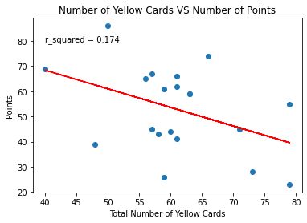
Scatter Plot of Fouls vs Points
Notes:
And here is how the regression line looks like on the scatter plot diagram. As you can see visually, there appears to be a negative relationship between the total number of yellow cards received and the points obtained by the club in the premier league points table. This means that the more fouls you commit as measured by the number of yellow cards received results in lesser points obtained in the overall premier league points table. One would think that you could cheat on the pitch by fouling to obtain an unfair advantage and thus result in the team winning or drawing to get more points. However, this is clearly not the case shown by the regression line.
However, one important thing to note is that the coefficient of determination R squared, is only 0.174 which implies that the strength of the linear relationship is actually very weak . This means that the number of yellow cards received which can be seen as the number of fouls committed only affects to a very small extent the total points total in the premier league table.

Slide 25
Insights
Limited Peak Lifespan
Extremely Cosmopolitan League
Playing dirty actually hurts
Notes:
To end off, let us take a look at my final take aways and insights from looking at the three broad areas of interest.
Firstly the age profile suggests soccer players only have a very limited peak lifespan. If you a soccer player are outside the age range of 20-30 , you are effectively deemed not to be in your prime.
Secondly, National Diversity profile suggest that the premier league is very cosmopolitan. Very evidently this is the case as approximately two thirds of the players in the league are non-English players.
Lastly, it does not pay to play dirty or commit fouls. As seen earlier, with more yellow cards received, a club is likely to have lesser points accumulated on the premier league points table. Therefore, soccer clubs might not want to play dirty as it actually penalizes them instead of giving them any unfair advantage.

Slide 26
THANK YOU!

