Slide 1
STAR POLYGONS TO POLYCONS
THE MATLAB PROGRAMS STARCON POLY2018 and POLY2017

Slide 2
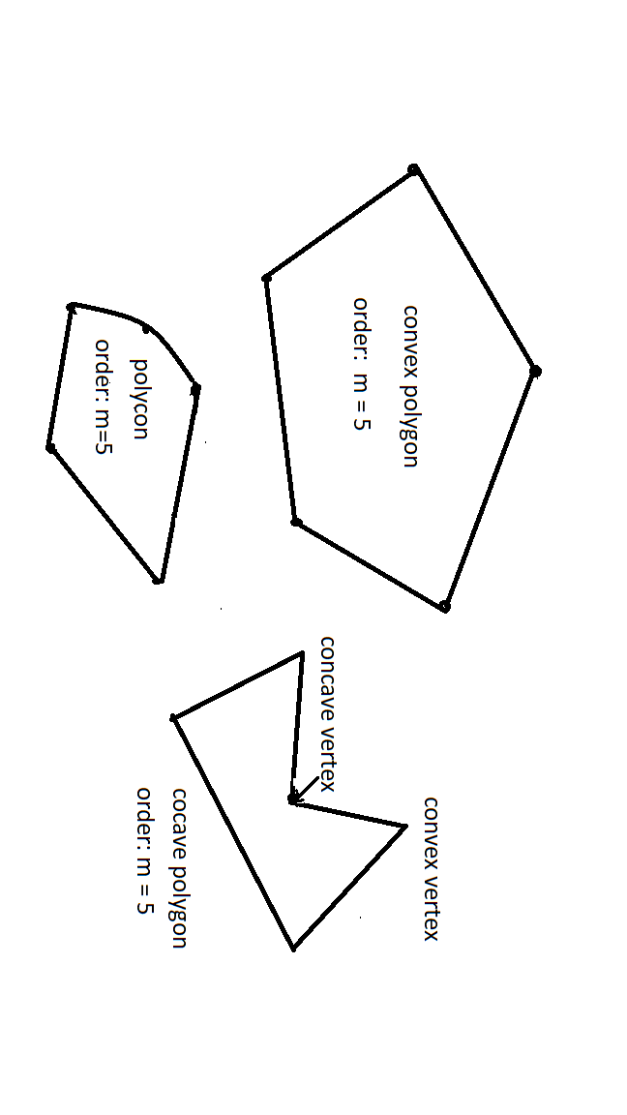
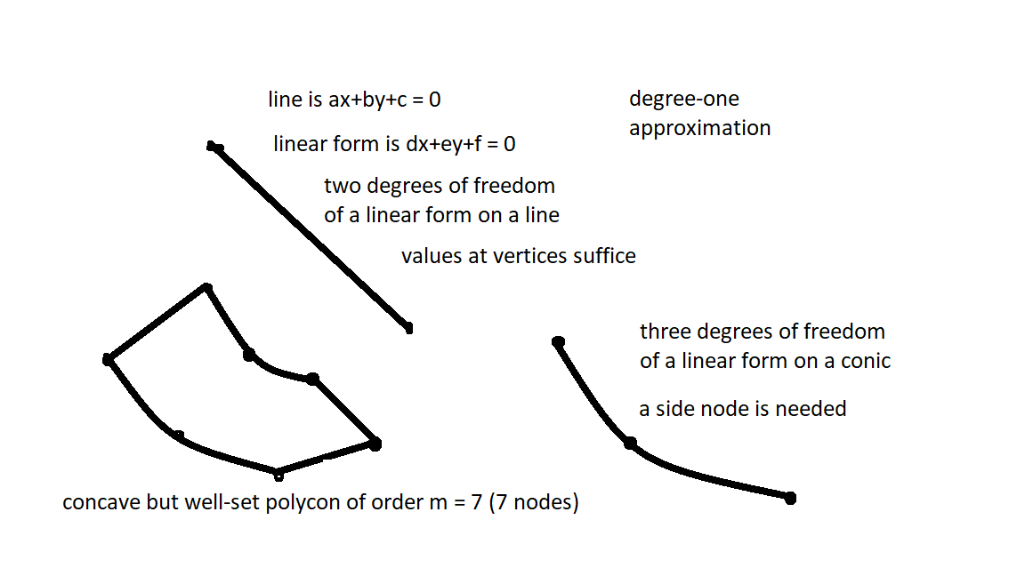

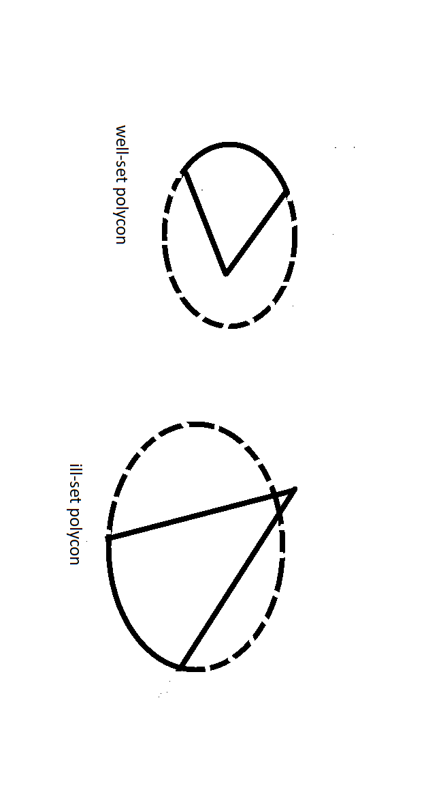
Polygons and polycons

Slide 3
2-D Barycentric Chronology
By early 1950s triangle and rectangle polynomial barycentrics were widely used as, for example, in the Finite Element Method.
The first rational barycentrics were the isoparametrics introduced in the 1960s. The isoparametric elements were 3-cons and 4-cons with linear and isoparametric parabolic sides.
Rational barycentrics for well-set rational algebraic elements were introduced in the 1970s.
Mean-value barycentrics were introduced for non-convex polygons in 2003.

Slide 4
Barycentrics for Curved Elements
THIS PRESENTATION IS AN ATTEMPT TO MOTIVATE APPLICATION OF ELEMENTS WITH CURVED SIDES AND ESPECIALLY CONICS.
Barycentric coordinates for convex polygons are easily generated.
Generation of barycentrics for elements with curved sides is far more complicated and this has restricted application.
Polycons have only linear and conic sides.
Barycentric coordinates are computed for well-set polycons with the MATLAB programs POLY2017 and POLY2018.
These are much more complex than programs for polygons, but have been programmed. The complexity can be transparent to users.

Slide 5
Star Polygons
A star polygon has concave vertices
Rational Barycentric coordinates do not exist
Mean-value coordinates are used
The barycentric derivatives are unbounded as the vertex angle approaches 180º

Slide 6
Star Polycons
One may replace a concave V with a conic to obtain a starcon
The concave vertex is replaced with a side node on the conic
The isoparametric parabola does not place the concave node at the parabola apex
An alternative construction yields a unique parabola through the three vertices of the V with the concave vertex at the parabola apex retained as the side node

Slide 7
The Parabola
The key to construction is finding the symmetry axis
If L1 is the length of the line from convex vertex 1 to concave vertex 2 and L3 is the length from vertex 2 to convex vertex 3 and A is the angle of the V, then the angle B between (1,2) and the symmetry axis satisfies:
L1[1/cos(B) - cos(B)] - L3[1/cos(A-B) - cos(A-B)] = 0
As the length ratio departs from unity, the axis moves toward the longer side. When L1 = L3, the axis bisects the V angle.

Slide 8
General Well-Set Polycons
The general well-set polycon has linear and conic sides which may be concave and convex. Although barycentric coordinates may be constructed for star polycons with simplified algorithms (as in the MATLAB program STARCON) the more general approach in the MATLAB programs POLY2017-18 will be discussed now.
A polycon is well-set when vertices are simple intersects of adjacent sides and side extensions do not cross the element boundary.
It has been conjectured that the barycentric denominator does not vanish at any point in the element or on its boundary.
No counter-example has ever been disclosed.

Slide 9
Barycentric Coordinates
Side node j+1/2 lies between vertices j and j+1 on side j
The product of the polynomials that vanish on all sides other than j and j+1 is the ``opposite factor” G_{j} . The product of sides other than j is the opposite factor G_{j+1/2} for side node j+1/2. Adjacent factors Padj (to be described) appear in the barycentric vertex numerators. Each numerator is normalized with a value r to be determined.
Thus, N_{j} = r_{j} G_{j} Padj _{j} and N_{j+1/2} = r_{j+1/2} G_{j+1/2} .
The coordinates have a common denominator, Q :
W_{j} = N_{j} /Q = r_{j} G_{j} Padj_{j} /Q , W_{j+1/2} = N_{j+1/2} /Q = r_{j+1/2} G_{j+1/2} /Q.

Slide 10
Adjacent Factors Padj
Adjacent factor Padj_{k} contains a) all exterior intersections (eip_{k}) of the sides k-1 and k adjacent to vertex k and b) side nodes on conic sides adjacent to vertex k.
At a line-line vertex k, Padj_{k} = 1.
At a line-conic k, Padj_{k} = (sino;eip_{k}) where sino is the conic side node and eip_{k} is the exterior intersection of the adjacent sides.
At a conic-conic k, Padj_{k} is determined by five points: 2 side nodes and 3 eip
eip coordinates are [w;x;y] where w = 1 in the affine plane and w = 0 on the absolute line
Padj_{k} is normalized to unity at vertex k

Slide 11
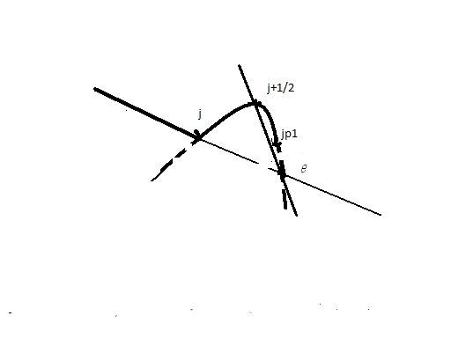
Padj_{j} at Line-Conic Vertex j

Slide 12
Adjacent Factors - 2
At a line-conic k, when the eip is on the absolute line Padj_{k} is the line parallel to the linear side through the conic side node.
The conic-conic Padj_{k} depends on w(eip) = 0 or 1.
Five discrete points (two side nodes and three eip) determine a conic Padj_{k}. Matrix M has 5 rows: [ 1 x y x² xy y² ] with (x,y) of the five points at which Padj_{k} = 0. Row 6 is with the vertex (x,y) values to set Padj_{k}(k) = 1. The vector r = [0 0 0 0 0 1].
When w_{k} = 0 the first three elements in row k are set to 0.
M c = r yield Padj_{k} = c₁ + c₂ x + c₃ y + c₄ x² + c₅ xy + c₆ y² .

Slide 13
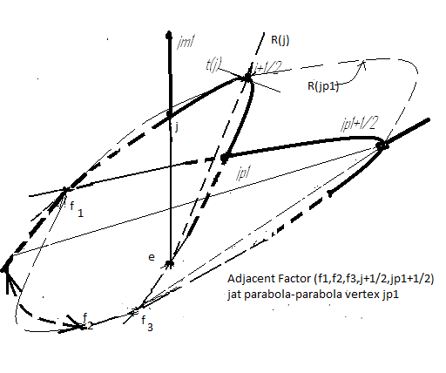
Padj_{jp1} at Conic-Conic Vertex jp1

Slide 14
Recursion Algorithm: GADJ
Barycentric coordinate W_{j} = N_{j}/Q where Q = sum_{j}(N_{j}).
The only numerators that do not vanish on side j are N_{j} , N_{j+1/2} and N_{j+1}. Thus, on side j: W_{j} = N_{j} /(N_{j} + N_{j+1/2} + N_{j+1}).
If P is the product of all the sides (S_{j}) and F_{j} = P/(S_{j-1}S_{j}S_{j+1} ) then on side j, N and Q may be divided by a common factor F_{j} to reduce W_{j} to:
W_{j} = r_{j} S_{j+1} Padj_{j} / (r_{j} S_{j+1}Padj_{j} + r_{j+1/2}S_{j+1}S_{j-1} + r_{j+1}S_{j-1} Padj_{j+1}).
Algebraic-geometry theory of divisors allows further reduction.

Slide 15
Divisor Theorem
The set of intersection points of plane algebraic curves P and Q are designated as P . Q. Bezout’s Theorem states that if P_{s} and Q_{t} are of orders s and t then there are st points in P . Q.
Bezout’s Theorem is adequate when all intersections are simple. The generalization is addressed in Noether’s Theorem by replacing P . Q with the set of divisors P o Q which separate multiple points into “neighborhoods”. A crucial algebraic-geometry theorem is:
If P o Q = R o Q then there is a b such that the polynomials P and R of least degree that vanish on P and R satisfy: P - b R = 0 on Q

Slide 16
Application of the Divisor Theorem
Let the barycentric coordinates for triangle (j , j+1/2, j+1) be B_{j} , B_{j+1/2} , and B_{j+1} . For example, B_{j} is the linear form (j+1/2 ; j+1) normalized to unity at j . Suppose S_{j-1} and S_{j+1} intersect with side S_{j} at divisor sets e and f, respectively.
Then S_{j+1}Padj_{j} o S_{j} = R_{j} B_{j} o S_{j} where R_{j} = (e , f).
It follows that S_{j+1}Padj_{j} = b_{j} R_{j} B_{j} on side S_{j}
Similarly S_{j+1/2}S_{j-1/2} = b_{j+1/2} R_{j} B_{j+1/2} on side S_{j} and
S_{j-1}Padj_{j+1} = b_{j+1} R_{j} B_{j+1} on side S_{j}

Slide 17
Barycentric W_{j} on Side j
Recall:
W_{j} = r_{j} S_{j+1} _{Padjj} / (r_{j} S_{j+1}Padj_{j} + r_{j+1/2}S_{j+1}S_{j-1} + r_{j+1}S_{j-1} Padj_{j+1}).
Dividing numerator and denominator of W_{j} on S_{j} by R_{j} :
W_{j} = r_{j} b_{j} B_{j} /(r_{j} b_{j} B_{j} + r_{j+1/2}b_{j+1/2}B_{j+1/2} + r_{j+1}b_{j+1}B_{j+1}) where
b_{j} = (S_{j+1}Padj_{j})/R_{j} at j, b_{j+1/2}= S_{j+1}S_{j-1} /R_{j} at j+1/2, b_{j+1} = S_{j-1} Padj_{j+1}/R_{j} at j+1.
Thus, since B_{j} + B_{j+1/2} + B_{j+1} = 1, W_{j} is linear on S_{j} when
r_{j} b_{j} = r_{j+1/2} b_{j+1/2} = r_{j+1} b_{j+1}
The GADJ recursion is r_{j+1/2} = r_{j} b_{j} /b_{j+1/2} and r_{j+1} = r_{j} b_{j} /b_{j+1} with r₁ = 1.
Note that for a convex polygon b_{j} = S_{j+1}(j) and b_{j+1} = S_{j-1} (j+1).

Slide 18
GADJ – 2 for Linear side j
When j-1, j and j+1 are all linear, R_{j} = 1. There are no eip.
When one of j-1 and j+1 is conic and the other is linear, R_{j} is linear and vanishes on the line determined by the side node and the one eip.
When both j-1/2 and j+1/2 are conic, there are two side nodes and two eip: R_{j} = (j-1/2,e_{j} ) (j+1/2,e_{j+1/2} ).
In all cases, on side j the polynomial of R_{j} and cPadj_{j} Padj_{j+1} have the same value for some c. Padj_{q} is normalized to unity at vertex q. The conics of R_{j} and of the Padj product both intersect side j at and only at all the eip.

Slide 19
GADJ on Conic Sides
On conic side j, Padj_{j} Padj_{j+1} is one degree higher than R_{j} since the adjacent factors vanish at side node j+1/2 as well as at the eip_{j} .
The unique linear factor with a double point at the side node is the tangent T_{j} to side j at side node j+1/2: R_{j} = Padj_{j} Padj_{j+1}/T_{j} .
R_{j} may be evaluated easily at j and j+1.
However, at side node j+1/2 both numerator and denominator have a double root and the indeterminate ratio must be found.
One can either apply L’Hopital’s rule twice or evaluate the limit as a point on side j approaches j+1/2

Slide 20
Padj at conic-conic side nodes
In STARCON and POLY2017, R is evaluated at the side node with the Padj product and the limit as both numerator and denominator approach zero along the side. Components of Padj due only to roundoff will contaminate the limit and lead to significant errors. They are eliminated in the computation of Padj.
The only source of these errors is at conic-conic vertices in the solution of a linear system of order six: Mc = r. All components of c less than 10⁻⁸ are set to zero.

Slide 21
L’Hopital’s Rule in POLY2018
L’Hopital’s rule was used to find R in POLY2018. Small components in Padj are not a source of error here as in POLY2017.
The coordinate which changes least in S_{j}(x,y) near j+1/2 is expressed as a function of the other `chosen’ coordinate to yield y(x) or x(y) on side S_{j}.
Let ’ denote the derivative with respect to the chosen x or y. Then (P_{j} P_{j+1})’’ = 2P_{j}’P_{j+1}’ at side node j+1/2.
R_{j+1/2} = 2P_{j}’P_{j+1}’/T_{j}’’ evaluated at j+1/2.
Results with POLY2017 and POLY2018 agreed to five significant places.

Slide 22
Barycentric Coordinates
After GADJ, the adjoint Q is computed easily as the sum of the numerators.
When small rounding-error terms are discarded, the degree of Q must be no greater than m – 3, where m is the order of the boundary curve: 2p+s where p is the number of conic sides and s of linear sides. This is a good measure of the validity of the program.
Another measure is that GADJ carried back to vertex 1 should return r_{n+1} = r₁ = 1.
Once Q is found, the barycentric coordinates are simply the numerators divided by Q.

Slide 23
Starcon Barycentrics
Generating barycentrics for star polycons is complicated.
The 600 line MATLAB program STARCON converts a star polygon into a polycon and generates the barycentric coordinates.
The user need only input the polygon vertices.
Availability of STARCON makes the complexity transparent to the user.
The star polycon barycentrics are rational functions.
Derivatives are bounded at vertex angles approaching 180º
Degree-two approximation is attained on the line (j,j+1/2,j+1) at 180º.

Slide 24
GitHub: genepol/ barycentrics
MATLAB programs here are poly2017, poly2018, starcon, polprint17 and stargen.
marcon.pdf describes these programs.
Stargen generates nodes input for starcon for regular stars.
Files st1-st9 are nodes input for a set of problems for starcon.
Poly2017 and -18 include input for seven test problems.
A full exposition is in my book on Rational Bases and Generalized Barycentrics, published by Springer in 2016.

Slide 25
Adjacent Concave Vertices
When there are adjacent concave vertices, one may replace the lines between the end vertices by a single conic.
One simple procedure is to least-squares fit the conic with a set of points which include the end convex vertices, the intermediate concave vertices, and the midpoints of the lines connecting these points along the curve.
An arbitrary weight p is given to each point. In the pilot program conpq, p is chosen as 10 at the vertices, 2 at the concave points and 1 at the line midpoints. The value of 10 leads to relatively small displacement of the convex vertices and of 2 to greater importance of concave vertices than line midpoints.
Let row r of matrix M be p_{r} [1 x y x² xy y²]_{r} for the points to be fit. The midpoint of the convex vertices is added (with p=1) for normalization to -1.

Slide 26
Adjacent Concave Vertices - 2
Matrix M has t rows and 6 columns where t – 1 (the number of points to be fit to a conic) is always greater than 6 for two or more concave vertices.
The column vector s has as its only nonzero element s_{t} = -1 .
The equation Mc = s is solved with the generalized inverse: (M^{T}M)c = M^{T}s . The conic is the curve on which [1 x y x² xy y²]c = 0.

Slide 27
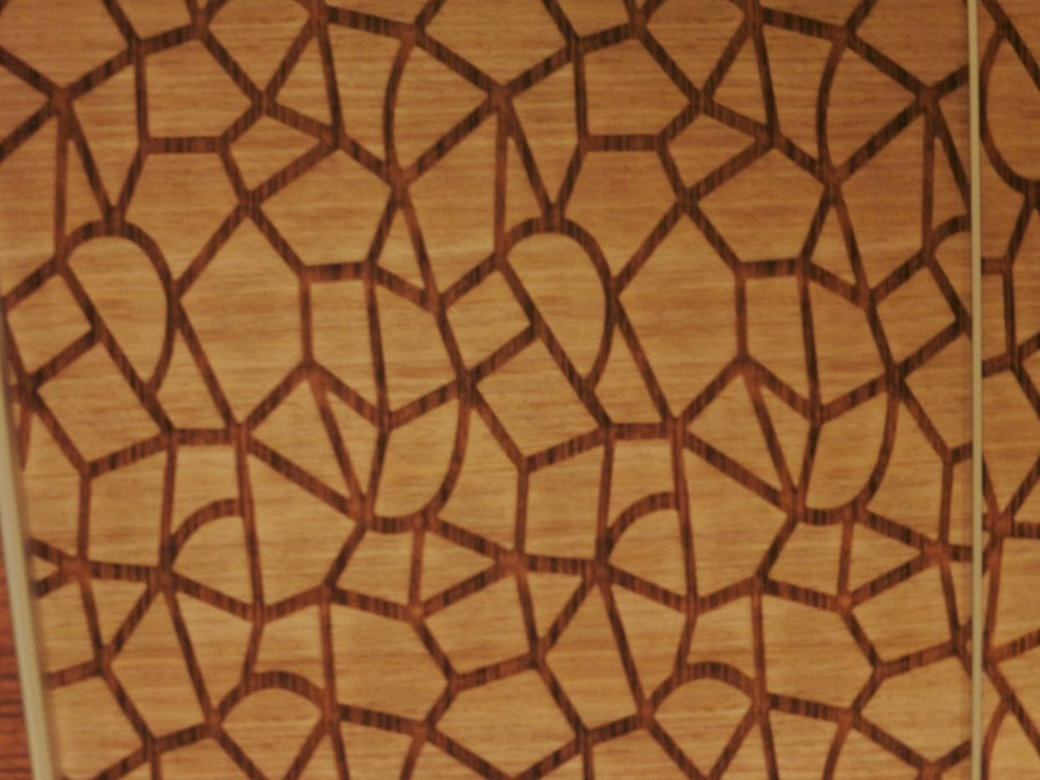
Ice Pattern
Example of need for polycons. Formations analysis with polygon restriction could be inadequate.

Slide 28
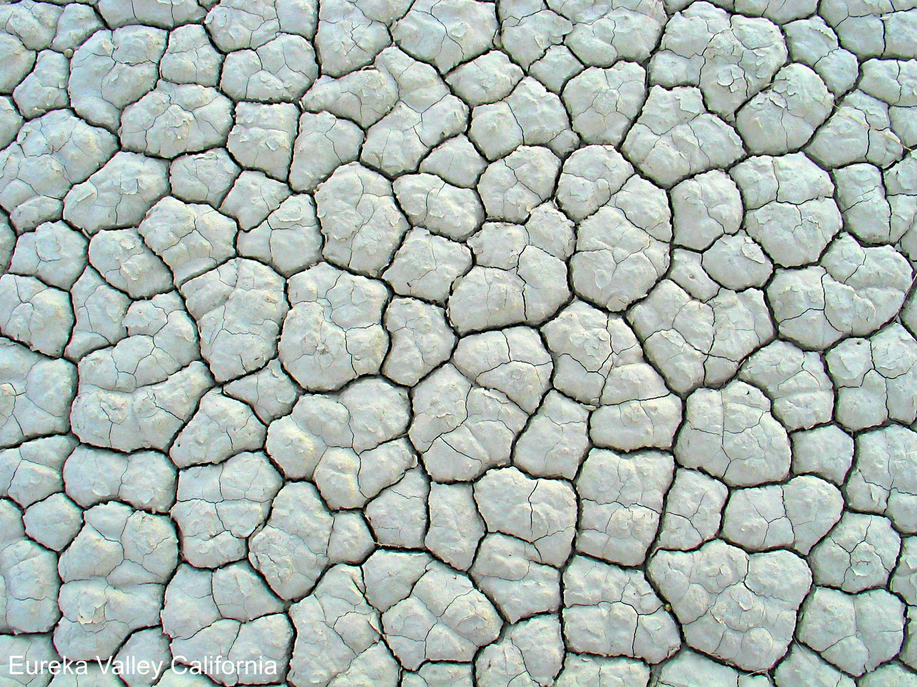
Eureka Dry Mud
Two-Level Grids with curved sides

Slide 29

Giraffe Pattern
Curved Sides

