Slide 1
COS 484, Precept 6
Adithya Bhaskar, Spring 2025

Slide 2
Agenda
Machine Translation – topics relevant to A3
The BLEU score
IBM Model 1
Seq2seq + Attention
How can we use RNNs for Seq2Seq?
A problem: the bottleneck
A solution: attention
1

Slide 3
Machine Translation: BLEU

Slide 4

Machine Translation: BLEU
How do we evaluate a machine translated sentence?
Reference
Source
Vinay likes programming in Python
A Vinay le gusta Python
Hypotheses
To Vinay it like to program in Python
Vinay likes Python
Vinay likes programming in his pyjamas
2

Slide 5


Machine Translation: BLEU
How do we evaluate a machine translated sentence?
Reference
Hypotheses
Vinay likes programming in Python
To Vinay it like to program in Python
BLEU-4 =
GeoMean(n-gram precision) × Length Penalty
1
2
Max n in n-gram precision
=
$$\sqrt[4]{p_{1}p_{2}p_{3}p_{4}}$$
1
#n-grams common to hyp. and ref.
where
$$p_{n}$$
=
#n-grams in hypothesis
3

Slide 6
Machine Translation: BLEU
Note: these counts are clipped to the reference(s)! For example, for n = 1, Reference: the cat sat on the mat
Hypothesis: the the the the mat Then, denominator = 5 but numerator = 3 (we only count two of the “the”s as common!)
How do we evaluate a machine translated sentence?
Reference
Hypotheses
Vinay likes programming in Python
To Vinay it like to program in Python
BLEU-4 =
GeoMean(n-gram precision) × Length Penalty
1
2
Max n in n-gram precision
=
$$\sqrt[4]{p_{1}p_{2}p_{3}p_{4}}$$
1
#n-grams common to hyp. and ref.
where
$$p_{n}$$
=
#n-grams in hypothesis
3

Slide 7
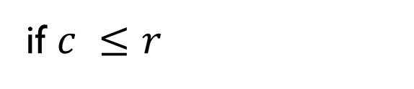
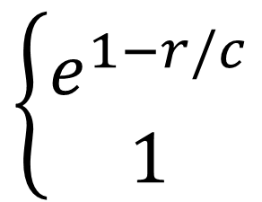
Machine Translation: BLEU
How do we evaluate a machine translated sentence?
Reference
Hypotheses
Vinay likes programming in Python
To Vinay it like to program in Python
BLEU-4 =
GeoMean(n-gram precision) × Length Penalty
1
2
$$\left\{\begin{aligned}e^{1−r/c} \\ 1\end{aligned}\right.$$
r = length of reference c = length of candidate
if $c ≤r$
=
2
otherwise
3

Slide 8




Machine Translation: BLEU
Practice: calculate BLEU-2 for the following pair!
Reference
Hypothesis
Vinay likes programming in Python a lot
Vinay likes Python programming too
$$p_{1}= \frac{4}{5}$$
$$p_{2}= \frac{1}{4}$$
$$\text{GM}= \frac{1}{\sqrt{5}}≈0.4472$$
$$\text{Length} \text{Penalty}\text{ = }\text{exp}\left(1−\frac{7}{5}\right) ≈0.6703$$
$$\text{BLEU}\text{−2 }≈0.4472 ×0.6703 =0.30$$
4

Slide 9
Machine Translation: IBM Model 1

Slide 10
Machine Translation: IBM Model 1
How do we calculate the likelihood of translation t given source s?
$$t^{∗}= \text{argmax} P\left(t \right| s)= \text{argmax} P\left(s \right| t) P (t)$$
n-gram LM for this (fluency)
How do we calculate this?? (translation score)
5

Slide 11
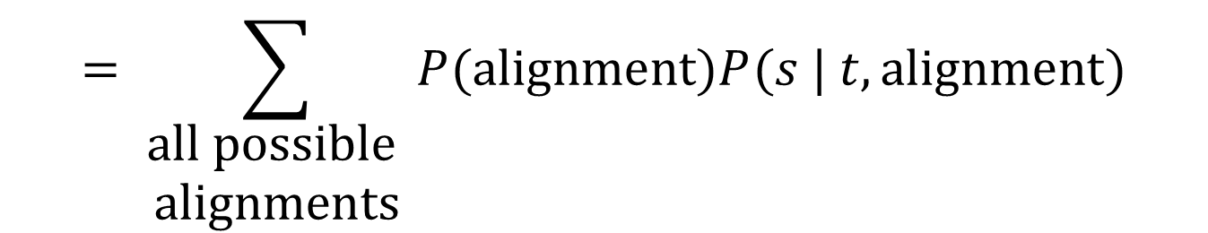
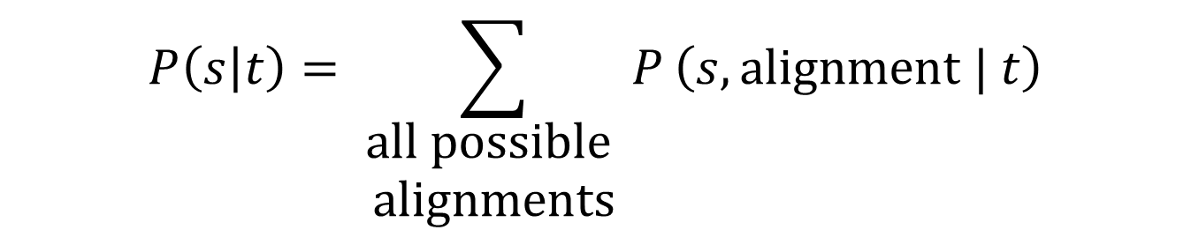
Machine Translation: IBM Model 1
$$P\left(s | t\right)= \sum_{\begin{aligned}\text{all} \text{possible} \\ \text{alignments}\end{aligned}}{P}\left(s, \text{alignment} | t\right)$$
$$= \sum_{\begin{aligned}\text{all} \text{possible} \\ \text{alignments}\end{aligned}}{P(\text{alignment}\text{)}P(s | t, \text{alignment})}$$
A Vinay le gusta Python
An alignment is a mapping that assigns each source word to exactly one target word (repetition allowed).
Vinay likes Python
6

Slide 12
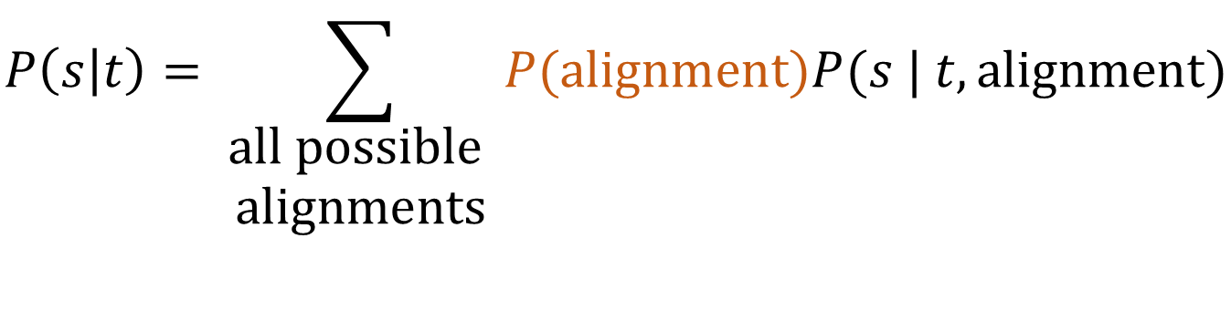
Machine Translation: IBM Model 1
$$P\left(s | t\right)= \sum_{\begin{aligned}\text{all} \text{possible} \\ \text{alignments}\end{aligned}}{P(\text{alignment}\text{)}P(s | t, \text{alignment})}$$
Assume all alignments are equally likely
A Vinay le gusta Python
Vinay likes Python
How many possible alignments here?
3⁵
7

Slide 13
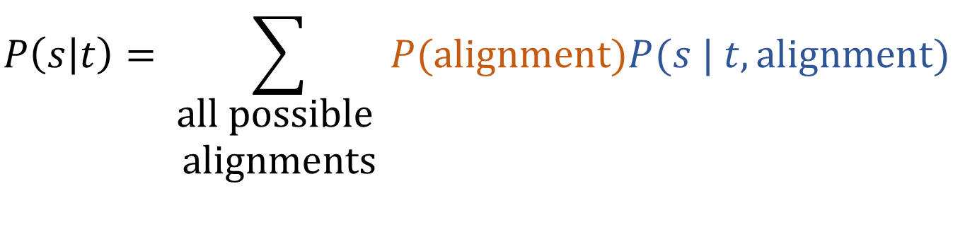
Machine Translation: IBM Model 1
$$P\left(s | t\right)= \sum_{\begin{aligned}\text{all} \text{possible} \\ \text{alignments}\end{aligned}}{P(\text{alignment}\text{)}P(s | t, \text{alignment})}$$
Decompose as (for the shown alignment):
A Vinay le gusta Python
P(A|Vinay) P(Vinay|Vinay)P(le|Vinay)P(gusta|likes)P(Python|Python)
Vinay likes Python
But how do we get this?
7

Slide 14
Machine Translation: IBM Model 1
$$P\left(s | t\right)= \sum_{\begin{aligned}\text{all} \text{possible} \\ \text{alignments}\end{aligned}}{P(\text{alignment}\text{)}P(s | t, \text{alignment})}$$
Decompose as (for the shown alignment):
A Vinay le gusta Python
P(A|Vinay) P(Vinay|Vinay)P(le|Vinay)P(gusta|likes)P(Python|Python)
EM Algorithm on the training corpus
Vinay likes Python
Estimate most likely alignments
Recalculate translation scores
7

Slide 15
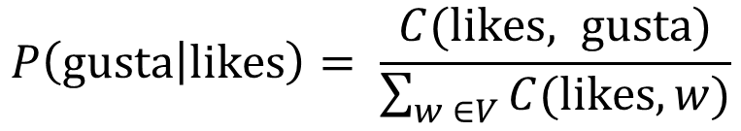
Machine Translation: IBM Model 1
$$P\left(s | t\right)= \sum_{\begin{aligned}\text{all} \text{possible} \\ \text{alignments}\end{aligned}}{P(\text{alignment}\text{)}P(s | t, \text{alignment})}$$
Decompose as (for the shown alignment):
A Vinay le gusta Python
P(A|Vinay) P(Vinay|Vinay)P(le|Vinay)P(gusta|likes)P(Python|Python)
How many times are these two words aligned (in the training corpus)?
Vinay likes Python
$$P\left(\text{gusta} | \text{likes}\right)= \frac{C(\text{likes}, \text{gusta})}{\sum_{w ∈V_{ }}{C(\text{likes}, w)}}$$
Source vocabulary (Spanish)
7

Slide 16
Machine Translation: IBM Model 1
$$P\left(s | t\right)= \sum_{\begin{aligned}\text{all} \text{possible} \\ \text{alignments}\end{aligned}}{P(\text{alignment}\text{)}P(s | t, \text{alignment})}$$
In A3 2(c), you are given the list of all alignments and have to just perform the M step (i.e. calculate this ratio)
Decompose as (for the shown alignment):
A Vinay le gusta Python
P(A|Vinay) P(Vinay|Vinay)P(le|Vinay)P(gusta|likes)P(Python|Python)
How many times are these two words aligned (in the training corpus)?
Vinay likes Python
$$P\left(\text{gusta} | \text{likes}\right)= \frac{C(\text{likes}, \text{gusta})}{\sum_{w ∈V_{ }}{C(\text{likes}, w)}}$$
Source vocabulary (Spanish)
7

Slide 17
Sequence-to-sequence LM

Slide 18

Seq2Seq LM
How do we use a neural network for, e.g., machine translation?
A Vinay le gusta Python
Vinay likes Python
RNNs to the rescue!
Initalize second RNN with “hidden state”
Vinay
likes
Python
<EOS>
A
Vinay
le
gusta
Python
<BOS>
Vinay
likes
Python
Encoder
Special start token
Decoder
8

Slide 19
Seq2Seq LM
How do we train the two networks?
Normal language modeling (NLL) loss
L = - log
Vinay
- log
likes
- log
Python
- log
<EOS>
Also backpropagated to the encoder!
A
Vinay
le
gusta
Python
<BOS>
Vinay
likes
Py…
Encoder
Decoder
9

Slide 20

Seq2Seq LM
What could go wrong here?
A bottleneck! The hidden state is the same-size vector even if the input is very long: it will struggle to capture long sequences.
Vinay
likes
Python
<EOS>
A
Vinay
le
gusta
Python
<BOS>
Vinay
likes
Python
Encoder
Decoder
10

Slide 21






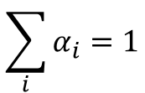








Attention
Idea: let each decoder position decide what information it needs How? Choose a linear combination of encoder states, where the coefficients are calculated using the decoder state
$$\sum_{i}{α_{i}=1}$$
softmax
$$[d_{1};s_{1}]$$
$$W_{O}$$
$$s_{1}=\sum_{i}{α_{i}h_{i}}$$
$$α_{1}$$
$$α_{2}$$
$$α_{3}$$
$$α_{4}$$
$$α_{5}$$
$$h_{1}$$
$$h_{2}$$
$$h_{3}$$
$$h_{4}$$
$$h_{5}$$
$$d_{1}$$
A
Vinay
le
gusta
Python
<BOS>
11

Slide 22

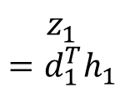
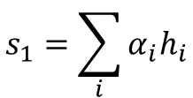


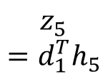

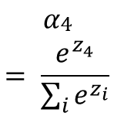

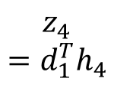

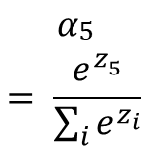
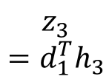

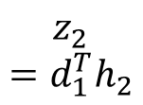
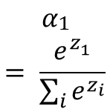
Attention
A simple form of attention:
Softmax to normalize!
$${ α}_{\begin{aligned}1 \\ \end{aligned}} \\ = \frac{e^{z_{1}^{ }}}{\sum_{i}{e^{z_{i}}}}$$
$${ α}_{\begin{aligned}4 \\ \end{aligned}} \\ = \frac{e^{z_{4}^{ }}}{\sum_{i}{e^{z_{i}}}}$$
$${ α}_{\begin{aligned}5 \\ \end{aligned}} \\ = \frac{e^{z_{5}^{ }}}{\sum_{i}{e^{z_{i}}}}$$
$$s_{1}=\sum_{i}{α_{i}h_{i}}$$
…
$${ z}_{1} \\ =d_{1}^{T}h_{1}$$
$${ z}_{2} \\ =d_{1}^{T}h_{2}$$
$${ z}_{3} \\ =d_{1}^{T}h_{3}$$
$${ z}_{4} \\ =d_{1}^{T}h_{4}$$
$${ z}_{5} \\ =d_{1}^{T}h_{5}$$
Just use dot products as importance scores!
$$h_{1}$$
$$h_{2}$$
$$h_{3}$$
$$h_{4}$$
$$h_{5}$$
$$d_{1}$$
A
Vinay
le
gusta
Python
<BOS>
12

Slide 23
Attention
A question for you to think about: In this form of attention, don’t we just boost those hidden states that are “closest” to ours? Why is it OK to use the same h_{i} to compute scores as well as for the linear combination?
12

Slide 24
Thank you
Next week:
Transformers!
A slightly more complicated version of attention
More…
12

