Slide 1
Minimum Edit Distance
Definition of Minimum Edit Distance
Notes:
Edit Distance is a metric for quantifying the similarity (or, inversely, the distance) between two strings or sequences by the number of edits it would take to turn one into the other. Why should we care about string similarity?

Slide 2
How similar are two strings?
Spell correction
The user typed “graffe”
Which is closest?
graf
graft
grail
giraffe
Which candidate would require the minimum number of letter changes?
Notes:
String similarity comes up in a lot of NLP tasks. For example in spell correction, imagine the user typed "g-r-a-f-f-e" and it's our job to pick which word they might have meant, maybe one of the followingOne simple metric is just to pick the word that is the most similar in letters. How to measure similarity in letters? Edit distance, The intuition of edit distance is that we are asking, "how many letters would I have to type differently to have gotten g-r-a-f-f-e instead of say "g-r-a-f" instead?" So the distance between graffe and graf is that we'd have to add an "f" and an "e", "grail" we'd need to swap an i and an L for the two fs, and then add an e. But getting g-r-a-f-f-e instead of giraffe just requires removing an i, a change of one letter, so we might hypothesize that's what the writer meant.

Slide 3
Similarity and Alignment in Computational Biology
We can compute similarity of two sequences of bases:
And we can compute an alignment between them:
I.e., given two sequences, align each letter to a letter or gap
AGGCTATCACCTGACCTCCAGGCCGATGCCC
TAGCTATCACGACCGCGGTCGATTTGCCCGAC
-AGGCTATCACCTGACCTCCAGGCCGA--TGCCC---
TAG-CTATCAC--GACCGC--GGTCGATTTGCCCGAC

Slide 4
Evaluating Automatic Speech Recognition (ASR) and Machine Translation (MT)
We want to know which hypothesis is closer to a "reference" transcript
Measure edit distance (in words, or tokens) between hypotheses and referent
The better hypothesis is closer (has a lower edit distance) to the referent
Reference Spokesman confirms senior government adviser was replaced
Hypothesis1 Spokesman confirms the senior adviser was replaced
I D
Hypothesis2 Spokesman said the older adviser was fired
S I S D S

Slide 5
Edit Distance
The minimum edit distance between two strings
Is the minimum number of editing operations
Insertion
Deletion
Substitution
Needed to transform one into the other

Slide 6
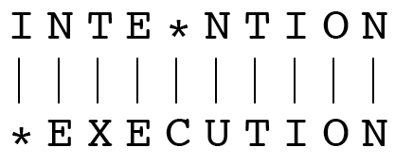
Minimum Edit Distance
Two strings and their alignment:
Given two sequences, an alignment is a correspondence between substrings of the two sequences, like the individual letters in this case
Notes:
Thus, we say I aligns with the empty string, N with E, and so on.

Slide 7
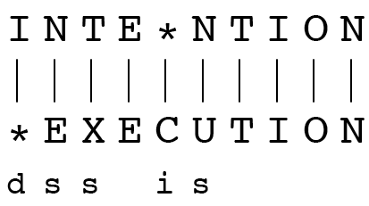
We can read off the edit distance from the alignment
If each operation has cost of 1
Distance between these is 5
If substitutions cost 2 (a version of Levenshtein distance)
Distance between them is 8

Slide 8
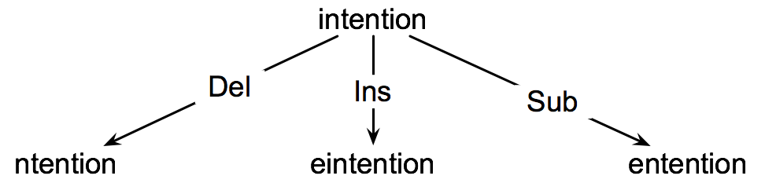
How to find the Min Edit Distance?
Searching for a path (a sequence of edits) from the start string to the final string:
Initial state: the word we’re transforming
Operators: insert, delete, substitute
Goal state: the word we’re trying to get to
Path cost: what we want to minimize: the number of edits

Slide 9
Minimum Edit as Search
But the space of all edit sequences is huge!
We can’t afford to navigate naively
Luckily:
Lots of distinct paths wind up at the same state.
We don’t have to keep track of all of them
Just the shortest path to each of those revisited states.
We'll see a dynamic programming solution in the next lecture

Slide 10
Defining Min Edit Distance
For two strings
X of length n
Y of length m
We define D(i,j)
the edit distance between X[1..i] and Y[1..j]
i.e., the first i characters of X and the first j characters of Y
The edit distance between X and Y is thus D(n,m)

Slide 11
Minimum Edit Distance
Definition of Minimum Edit Distance
Notes:
We've introduced the intuition and applications of edit distance. In the next lecture we'll see how it is computed.

Slide 12
Minimum Edit Distance
Computing Minimum Edit Distance

Slide 13
Dynamic Programming for Minimum Edit Distance
Dynamic programming: A tabular computation of D(n,m)
Solving problems by combining solutions to subproblems.
Bottom-up
We compute D(i,j) for small i,j
And compute larger D(i,j) based on previously computed smaller values
i.e., compute D(i,j) for all i (0 < i < n) and j (0 < j < m)

Slide 14
Defining Min Edit Distance (Levenshtein)
Initialization
D(i,0) = i
D(0,j) = j
Recurrence Relation:
For each i = 1…M
For each j = 1…N
D(i-1,j) + 1
D(i,j)= min D(i,j-1) + 1
D(i-1,j-1) + 2; if X(i) ≠ Y(j)
0; if X(i) = Y(j)
Termination:
D(N,M) is distance

Slide 15
The Edit Distance Table
N | 9
O | 8
I | 7
T | 6
N | 5
E | 4
T | 3
N | 2
I | 1
# | 0 | 1 | 2 | 3 | 4 | 5 | 6 | 7 | 8 | 9
 | # | E | X | E | C | U | T | I | O | N

Slide 16
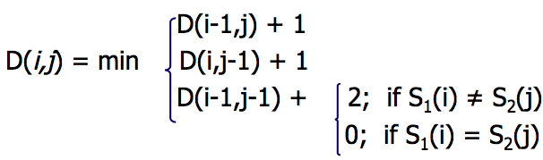
The Edit Distance Table
N | 9
O | 8
I | 7
T | 6
N | 5
E | 4
T | 3
N | 2
I | 1
# | 0 | 1 | 2 | 3 | 4 | 5 | 6 | 7 | 8 | 9
 | # | E | X | E | C | U | T | I | O | N

Slide 17
Edit Distance
N | 9
O | 8
I | 7
T | 6
N | 5
E | 4
T | 3
N | 2
I | 1
# | 0 | 1 | 2 | 3 | 4 | 5 | 6 | 7 | 8 | 9
 | # | E | X | E | C | U | T | I | O | N

Slide 18
The Edit Distance Table
N | 9 | 8 | 9 | 10 | 11 | 12 | 11 | 10 | 9 | 8
O | 8 | 7 | 8 | 9 | 10 | 11 | 10 | 9 | 8 | 9
I | 7 | 6 | 7 | 8 | 9 | 10 | 9 | 8 | 9 | 10
T | 6 | 5 | 6 | 7 | 8 | 9 | 8 | 9 | 10 | 11
N | 5 | 4 | 5 | 6 | 7 | 8 | 9 | 10 | 11 | 10
E | 4 | 3 | 4 | 5 | 6 | 7 | 8 | 9 | 10 | 9
T | 3 | 4 | 5 | 6 | 7 | 8 | 7 | 8 | 9 | 8
N | 2 | 3 | 4 | 5 | 6 | 7 | 8 | 7 | 8 | 7
I | 1 | 2 | 3 | 4 | 5 | 6 | 7 | 6 | 7 | 8
# | 0 | 1 | 2 | 3 | 4 | 5 | 6 | 7 | 8 | 9
 | # | E | X | E | C | U | T | I | O | N

Slide 19
Minimum Edit Distance
Computing Minimum Edit Distance

Slide 20
Minimum Edit Distance
Backtrace for Computing Alignments

Slide 21
Computing alignments
Edit distance isn’t sufficient
We often need to align each character of the two strings to each other
We do this by keeping a “backtrace”
Every time we enter a cell, remember where we came from
When we reach the end,
Trace back the path from the upper right corner to read off the alignment

Slide 22
Edit Distance
N | 9
O | 8
I | 7
T | 6
N | 5
E | 4
T | 3
N | 2
I | 1
# | 0 | 1 | 2 | 3 | 4 | 5 | 6 | 7 | 8 | 9
 | # | E | X | E | C | U | T | I | O | N

Slide 23
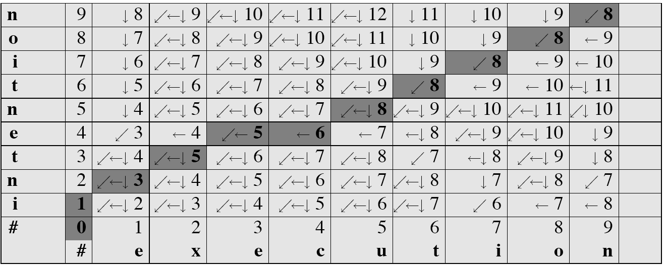
MinEdit with Backtrace

Slide 24
Adding Backtrace to Minimum Edit Distance
Base conditions: Termination:
D(i,0) = i D(0,j) = j D(N,M) is distance
Recurrence Relation:
For each i = 1…M
For each j = 1…N
D(i-1,j) + 1
D(i,j)= min D(i,j-1) + 1
D(i-1,j-1) + 2; if X(i) ≠ Y(j)
0; if X(i) = Y(j)
LEFT
ptr(i,j)= DOWN
DIAG
deletion
insertion
substitution
insertion
deletion
substitution

Slide 25
The Distance Matrix
Every non-decreasing path
from (0,0) to (M, N)
corresponds to
an alignment
of the two sequences
x₀ …………………… x_{N}
An optimal alignment is composed of optimal subalignments
y₀ ……………………………… y_{M}

Slide 26
Result of Backtrace
Two strings and their alignment:

Slide 27
Performance
Time:
O(nm)
Space:
O(nm)
Backtrace
O(n+m)

Slide 28
Minimum Edit Distance
Backtrace for Computing Alignments

