Slide 1
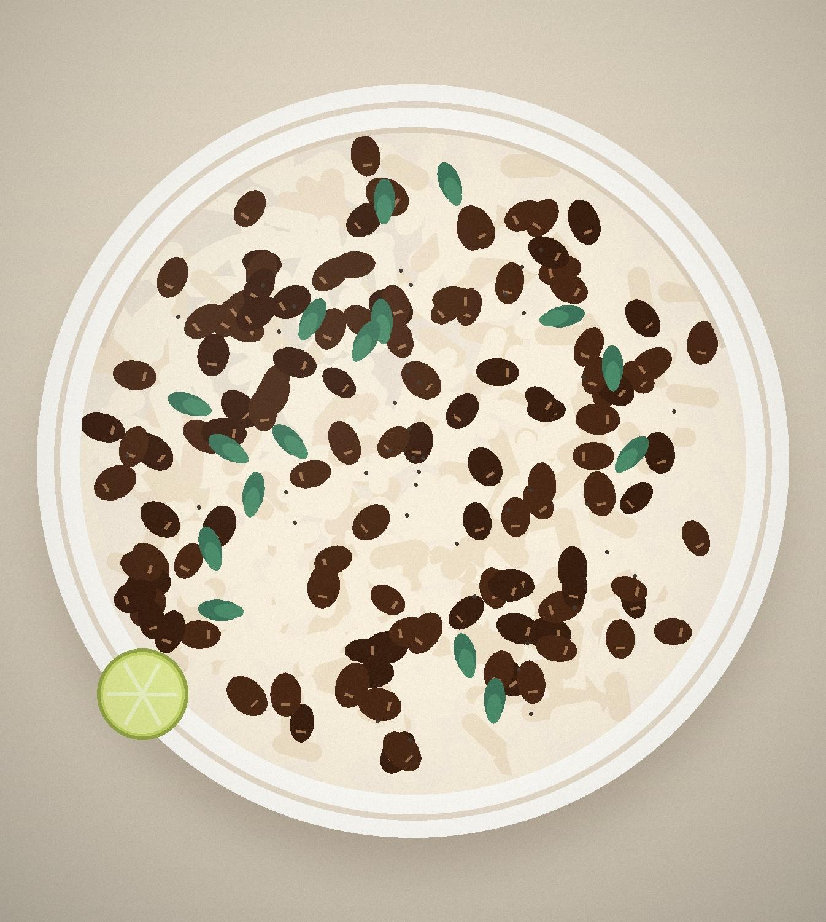
NUTRITION & HEALTH
Rice &
Beans
The everyday plate that delivers
complete, affordable nutrition.
15 g
fiber per cooked cup of beans
64%
of daily folate in one cup
0 mg
cholesterol — entirely plant-based
Rice & Beans · Nutrition & Health
01

Slide 2

WHY THIS PLATE
Two humble staples,
one complete plate.
Rice and beans is not a compromise on nutrition. It is one of the most efficient
food combinations ever built — for four reasons.
01
Affordable protein
One of the lowest cost-per-gram protein sources in almost every market.
02
Shelf-stable
Dried or canned, it keeps for months with almost zero waste.
03
Culturally familiar
A daily staple across Latin America, the Caribbean, Africa and Asia.
04
Low footprint
Pulses fix their own nitrogen and need a fraction of the water of meat.
Rice & Beans · Nutrition & Health
02

Slide 3
THE NUMBERS
What one cup of beans brings
Cooked black beans, 172 g. Figures compared with a 2,000 kcal daily reference intake.
227
15 g
15 g
64%
kcal
protein
fiber
folate
energy, with only 1.8 g of fat
plant protein, no cholesterol
half the daily target in one cup
of the daily reference intake
Beans carry the fiber, folate, iron and magnesium — rice supplies the energy and the amino acids beans lack.
Source: USDA FoodData Central, legumes, black, cooked.
Rice & Beans · Nutrition & Health
03

Slide 4
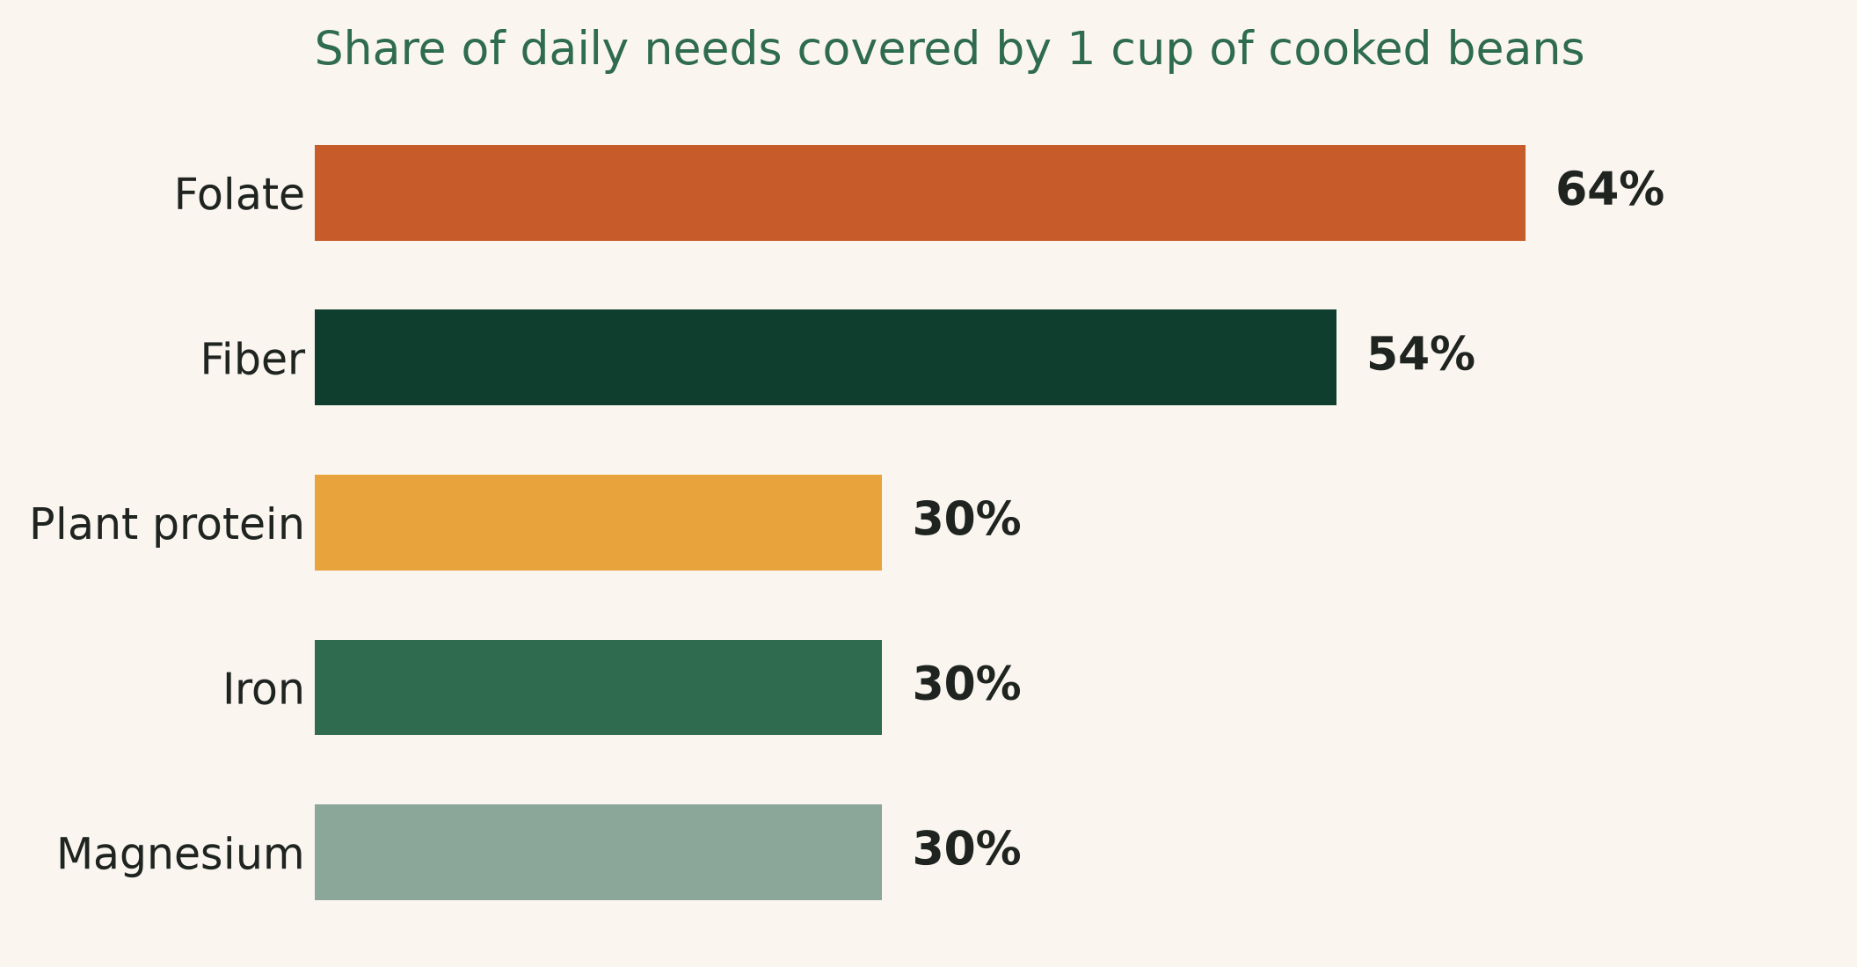
04
Beans do the
heavy lifting
A single cup of cooked beans covers most of the micronutrients that are typically
missing from refined-grain diets: folate, iron, magnesium and potassium.
Rice supplies the volume and the energy. Beans supply the density.
Percentage of daily value delivered by one cup of cooked beans.
Rice & Beans · Nutrition & Health
04

Slide 5
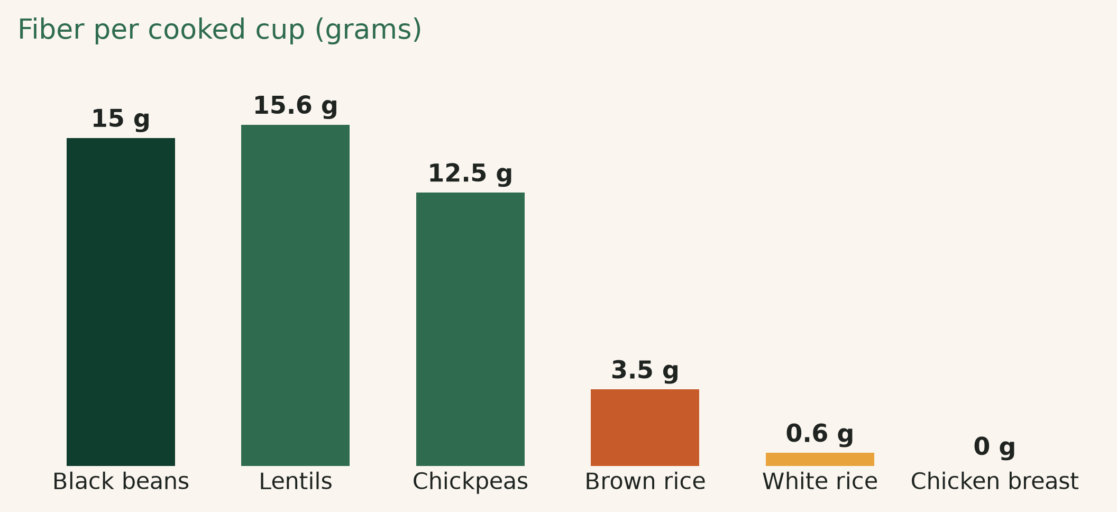
05
Fiber is the gap
most plates have
Most adults reach only 15 g of fiber a day against a 25–30 g recommendation. One cup of beans closes half that gap — white rice adds less than one gram.
Swapping half the rice for beans raises fiber without shrinking the portion.
Grams of fiber per cooked cup.
+24× more fiber than white rice, cup for cup
Rice & Beans · Nutrition & Health
05

Slide 6

PROTEIN QUALITY
Together they become complete
+
RICE
Low in lysine
BEANS
Low in methionine
Rice is limited in lysine, beans in methionine. Eaten together, the two
amino acid profiles complete each other — the classic complementary pair.
Result: a plant protein quality close to animal sources, at a fraction of the cost and with fiber attached.
No need for animal protein to make the meal complete.
Rice & Beans · Nutrition & Health
06

Slide 7
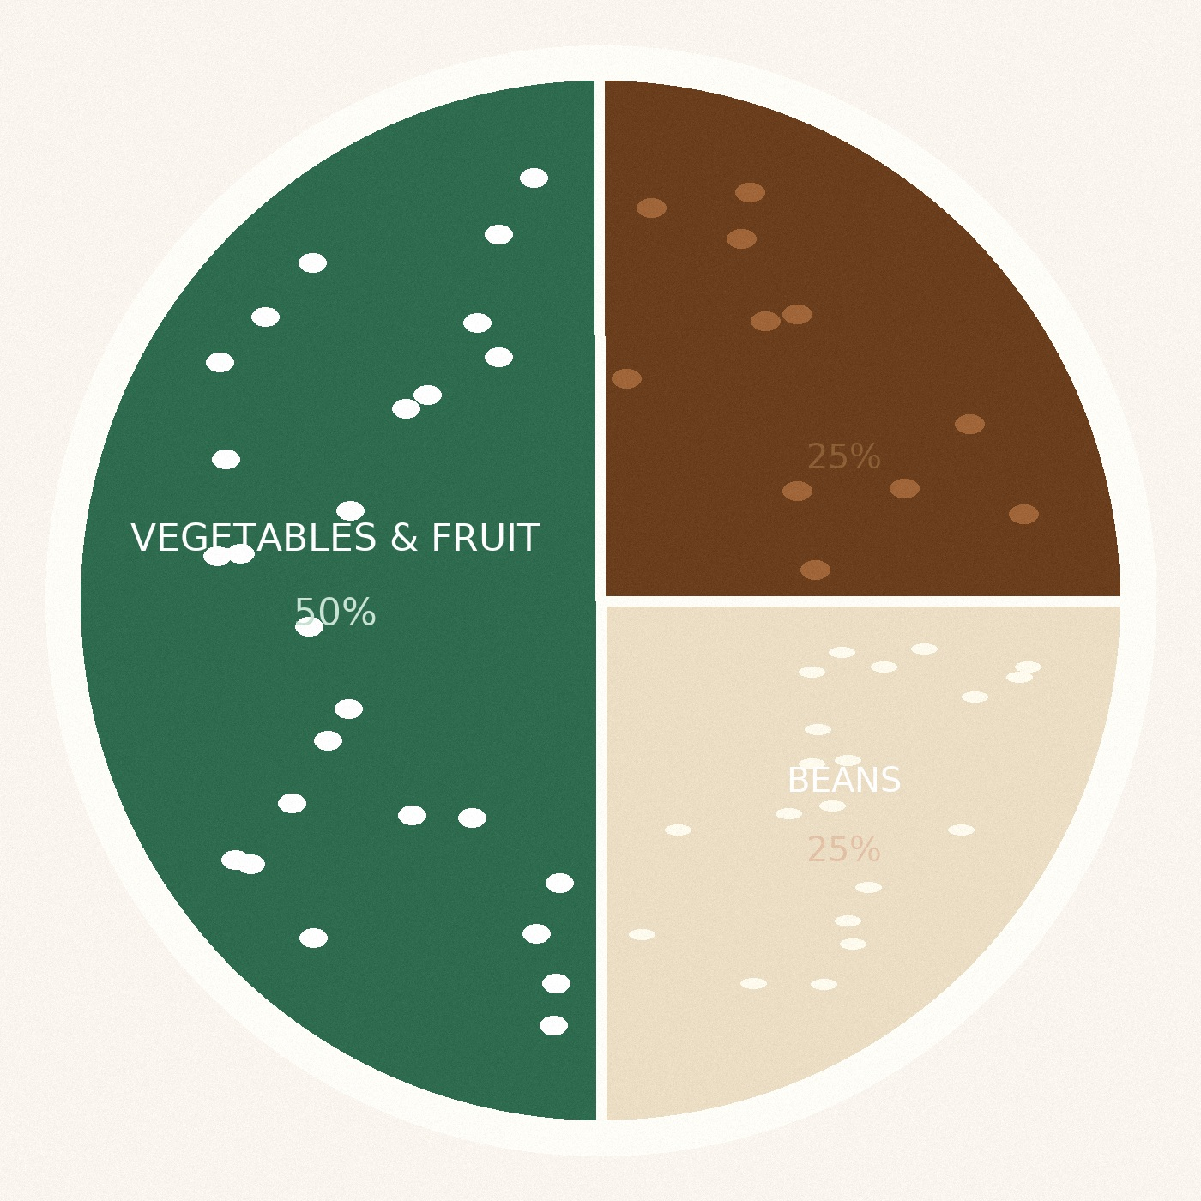
PORTIONING
Build the plate
in three blocks
50%
Vegetables & fruit
Volume, color, potassium and vitamin C — which also boosts iron absorption from the beans.
25%
Beans
The protein, fiber and mineral block. One cup per plate is the target.
25%
Rice
Energy. Whole-grain where texture allows; portion stays a quarter.
Rice & Beans · Nutrition & Health
07

Slide 8

BLOOD SUGAR
Steady energy,
not a spike
Beans sit at a glycemic index of roughly 25–30 — among the lowest of any carbohydrate food.
Their fiber and resistant starch slow digestion, softening the glucose rise of the whole meal.
Serving rice with beans lowers the glycemic load of that meal compared with rice alone.
The resistant starch that survives cooking also feeds gut bacteria.
Low GI · high satiety · no added sugar
Rice & Beans · Nutrition & Health
08

Slide 9



ON THE MENU
Three formats, one base
The same rice-and-bean foundation carries breakfast, lunch and the dinner plate.
The bowl
Soups & stews
Cold salads
Rice, beans, greens, lime. The default build for a fast, balanced main.
Bean-forward, rice on the side. Higher protein, lower cost per serving.
Chilled beans and whole-grain rice with herbs — high fiber, holds well.
Each format keeps the 50 / 25 / 25 plate logic — only the presentation changes.
Rice & Beans · Nutrition & Health
09

Slide 10
WHY IT WORKS COMMERCIALLY
Nutrition your
customer can afford
Lowest
cost per gram of protein among staple foods
Half
the water footprint of most animal proteins
Months
of shelf life, dried or canned
Zero
cholesterol, and naturally sodium-free when dried
Rice & Beans · Nutrition & Health
10

Slide 11
IN SUMMARY
Three things to take away
01
Complete
Rice and beans together deliver the amino acid profile neither has alone.
02
Dense
One cup of beans covers half the daily fiber and most of the folate.
03
Practical
Cheap, shelf-stable and familiar — it fits a plate the customer already eats.
Next step: a tasting session and a plate-card for your team.
Prepared for customer review · Nutrition & Health brief
11

