Slide 1
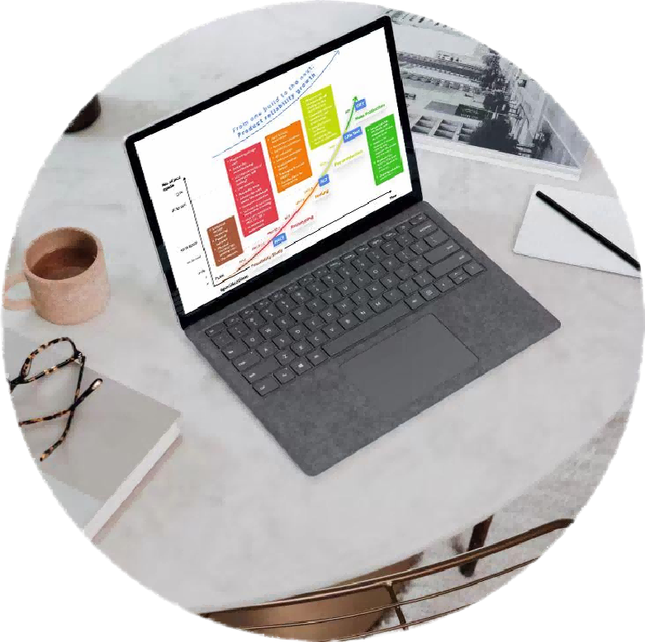



Design review report
Project Code ：DEMO
Designer : | Demo Designer
Reviewer : | Demo Reviewer
Review date : | 20261103

Slide 2
BOM · resistors
R2 is outside the E96 resistor series.
Replace R2 4.7 kΩ with an E96 4.75 kΩ ±1% part. R1 10 kΩ stays on-grid.
Value | References | Recommended
4.7 kΩ | R2 | 4.75 kΩ
10 kΩ | R1 | on-grid

