Slide 1
Machine Learning for Small Business Merchandising Team Member(s): Sephora Jean-Mary, Charlie Ramirez Product Owner(s): Joe Garner, Ali Zaidi Professor: Masoud Sadjadi School of Computing and Information Sciences Florida International University
VIP/Senior Project Final Presentation Spring 2020
4/22/2020
Notes:
Greet your audience, thank them for attending your presentation, introduce yourself, introduce your project, introduce your team members, and quickly indicate what each of you did in a high-level manner, and put more emphasis on your part/contribution.

Slide 2
Problem definition
As technology rapidly advances, we find ourselves in the midst of a new industrial revolution, one powered by artificial intelligence. As our everyday lives (including our jobs) become more and more dependent on high end technological concepts such as machine learning, being prepared for the changes is crucial.
Our aim is to give people the ability to be prepared for these changes by giving them the tools they need to reach an understanding of concepts they may deem impossible to understand.
Additionally, we will be showing the value behind putting these concepts into practice by providing an opensource product (composed of a web scraper, a website, and a web app) that will serve as both a teaching tool and a practical tool for data analysis.
There exists no previous system; our project serves as version 1.0
Notes:
Introduce the problem that the whole project tackles and stay focused on the parts that you have been working. Indicate if there is an existing previous system, enumerate its problems/limitations, etc.

Slide 3
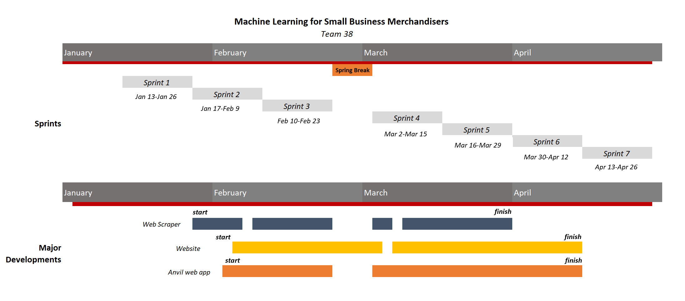
Project Management
Machine Learning for Small Business Merchandising
Notes:
Project Management (schedule for entire semester) (one slide; Gantt Chart).

Slide 4
Requirements: User Stories
User Story 1: As a developer, I need to come up with a viable lesson plan for a machine learning lesson.
User Story 2: As a developer, I need to learn the necessary technologies required for effective machine learning programming.
User Story 3: As a developer, I want to code the web scraper that we will use to collect data from Amazon web pages.
User Story 4: As a User, I want to be able to see product information of various Amazon products.
Notes:
4. Requirements:
4.1. User stories implemented (one or more slides).
4.2. UML use cases and the use case diagram for the implemented use cases (one or more slides).
4.3. UML sequence diagrams for the implemented use cases.

Slide 5
Requirements: User Stories
User Story 5: As a developer, I need to refine the web scraper so that it will scrape amazon for more product information.
User Story 6: As a developer, I need to fix the web scraper so that it will skip over tags that are not available.
User Story 7: As a developer, I need to start a website to display information from the web scraper.
User Story 8: As a developer, I need to have a front page to the website explaining what the purpose of this project is.
Notes:
4. Requirements:
4.1. User stories implemented (one or more slides).
4.2. UML use cases and the use case diagram for the implemented use cases (one or more slides).
4.3. UML sequence diagrams for the implemented use cases.

Slide 6
Requirements: User Stories
User Story 9: As a developer, I need to incorporate a navigation bar onto the website.
User Story 10: As a developer, I would like to create a search engine functionality within the web scraper such that it allows a user to search for a term of their choice.
User Story 11: As a developer, I would like to allow the web crawling spider to be flexible and find multiple attributes of products.
User Story 12: As a developer, I would like to use the bootstrap library to help set up a responsive and beautiful website.
Notes:
4. Requirements:
4.1. User stories implemented (one or more slides).
4.2. UML use cases and the use case diagram for the implemented use cases (one or more slides).
4.3. UML sequence diagrams for the implemented use cases.

Slide 7
Requirements: User Stories
User Story 13: As a developer, I would like to include multiple pages in the website that allow the user to see and experience our product.
User Story 14: As a User, I want to be able to experience the product in a way that captures my attention and keeps me interested.
User Story 15: As a developer, I want to be able to clean the data that we scrape from the web.
User Story 17: As a developer, I want to complete the development of a web scraper that allows me to crawl the web.
Notes:
4. Requirements:
4.1. User stories implemented (one or more slides).
4.2. UML use cases and the use case diagram for the implemented use cases (one or more slides).
4.3. UML sequence diagrams for the implemented use cases.

Slide 8
Requirements: User Stories
User Story 19: As a developer, I want to code the website to display the results of our project through visual representations.
User Story 20: As a developer, I would like to complete the website layout so that it has interactive html and css.
User Story 21: As a developer, I would like to set up flask framework.
User Story 22: As a developer, I would like to transfer all files to flask framework.
Notes:
4. Requirements:
4.1. User stories implemented (one or more slides).
4.2. UML use cases and the use case diagram for the implemented use cases (one or more slides).
4.3. UML sequence diagrams for the implemented use cases.

Slide 9
Requirements: User Stories
User Story 24: As a user, I want to be able to access the Anvil web app in various ways from the website.
User Story 25: As a developer, I would like to upload data from csv files into anvil web app.
User Story 27: As a developer, I would like to implement the web scraper into the anvil web app so that a user can see the web scraper in action.
User Story 28: As a developer, I would like to scrape more fields from the amazon website page.
Notes:
4. Requirements:
4.1. User stories implemented (one or more slides).
4.2. UML use cases and the use case diagram for the implemented use cases (one or more slides).
4.3. UML sequence diagrams for the implemented use cases.

Slide 10
Requirements: User Stories
User Story 29: As a developer, I would like to create multiple datasets for the website.
User Story 31: As a developer, I would like to create a search functionality in the Anvil App that runs the scraper from the local host.
User Story 32: As a developer, I would like to return scraped data directly from web scraper into Anvil database after clearing previous data.
User Story 33: As a developer, I would like to display the data (from select attributes) on the same page as the product search box in the Anvil web app.
Notes:
4. Requirements:
4.1. User stories implemented (one or more slides).
4.2. UML use cases and the use case diagram for the implemented use cases (one or more slides).
4.3. UML sequence diagrams for the implemented use cases.

Slide 11
Requirements: User Stories
User Story 34: As a developer, I would like to complete functionalities in the flask app so that the website runs smoothly for users.
User Story 35: As a developer, I would like to host the flask app on the Heroku platform.
User Story 36: As a developer, I would like to create visualizations using seaborn and matplotlib.
User Story 37: As a user, I would like to be able to view these visualizations on the web app in a clear and easy to work with interface.
Notes:
4. Requirements:
4.1. User stories implemented (one or more slides).
4.2. UML use cases and the use case diagram for the implemented use cases (one or more slides).
4.3. UML sequence diagrams for the implemented use cases.

Slide 12
Requirements: User Stories
User Story 38: As a developer, I would like to create real time bar, pie, and scatter plot visualizations on anvil.
User Story 39: As a developer, I would like to create a correlation matrix using z scores with the use of plotly package on anvil.
User Story 40: As a developer, I would like to host the anvil web app on a web server from git so that the user can access the link.
Notes:
4. Requirements:
4.1. User stories implemented (one or more slides).
4.2. UML use cases and the use case diagram for the implemented use cases (one or more slides).
4.3. UML sequence diagrams for the implemented use cases.

Slide 13
Use Case
Use Case ID: learn-web-scraper
Use Case Level: System-level end-to-end
Details:
Actor: Student or User who wants to learn
Pre-conditions:
Original user must be on aiforall heroku web app
Description: The user will learn about web scraping and become exposed to spyders and web crawlers
Trigger:
User will click ‘Menu’ link in website
User will click on ‘Web Scraper’ tab in ‘Menu’ dropdown
Post-conditions:
User will be able to read through the page and learn valuable information about
The data collection process
The benefits of using a web scraper
How web crawling works with a web scraper
User will be be able to choose viewing scraped data displays of
Shoes, Pants, Shirts, or Hats
Notes:
4. Requirements:
4.1. User stories implemented (one or more slides).
4.2. UML use cases and the use case diagram for the implemented use cases (one or more slides).
4.3. UML sequence diagrams for the implemented use cases.

Slide 14
Use Case
Use Case ID: explore-website
Use Case Level: System-level end-to-end
Details:
Actor: Student or User who wants to learn
Pre-conditions:
Original user must be on http://aiforall.herokuapp.com/product
Description: The user will be able to explore the website
Trigger:
User will click ‘Menu’ link in website
User will click on ‘Web Scraper’ tab in ‘Menu’ dropdown
Post-conditions:
User will be able to read through the page and learn valuable information about
The data collection process
The benefits of using a web scraper
How web crawling works with a web scraper
User will be be able to choose viewing scraped data displays of
Shoes, Pants, Shirts, or Hats
Notes:
4. Requirements:
4.1. User stories implemented (one or more slides).
4.2. UML use cases and the use case diagram for the implemented use cases (one or more slides).
4.3. UML sequence diagrams for the implemented use cases.

Slide 15
Use Case
Use Case ID: explore-dynamic-visualizations
Use Case Level: System-level end-to-end
Details:
Actor: Student or User who wants to learn
Pre-conditions:
Original user must be on aiforall heroku web app
Description: The user will learn machine learning
Trigger:
User will click ‘Menu’ link in website
User will click on ‘Dynamic Visualizations' tab in ‘Menu’ dropdown
Post-conditions:
User will be able to read through the Visualizations page and learn valuable information about
artificial intelligence (ai) and machine learning
User will be be able view and interact with Anvil Web App embed into page
Notes:
4. Requirements:
4.1. User stories implemented (one or more slides).
4.2. UML use cases and the use case diagram for the implemented use cases (one or more slides).
4.3. UML sequence diagrams for the implemented use cases.

Slide 16
Use Case ID: learn-machine-learning
Use Case Level: System-level end-to-end
Details:
Actor: Student or User who wants to learn
Pre-conditions:
Original user must be on aiforall heroku web app
Description: The user will learn machine learning
Trigger:
User will click ‘Menu’ link in website
User will click on ‘Machine Learning’ tab in ‘Menu’ dropdown
Post-conditions:
User will be able to read through the Machine Learning page and learn valuable information about
Training AI with train and test
Cleaning Data
Different Kinds of Machine Learning Including :
Supervised Learning
Unsupervised Learning
Reinforcement Learning
Visualizing the Data
User will be be able to click from a dropdown with different visualizations to learn about them and what they signify
Heatmap
Positive Correlation ScatterPlot
Positive Correlation JointPlot
Negative Correlation ScatterPlot
Negative Correlation JointPlot
No Correlation ScatterPlot
No Correlation JointPlot
Notes:
4. Requirements:
4.1. User stories implemented (one or more slides).
4.2. UML use cases and the use case diagram for the implemented use cases (one or more slides).
4.3. UML sequence diagrams for the implemented use cases.

Slide 17
Use Case ID: create-dynamic-visualizations-anvil
Use Case Level: System-level end-to-end
Details:
Actor: Student or User who wants to learn
Pre-conditions:
Original user must be on aiforall heroku web app
User will click ‘Menu’ link in website
User will click on ‘Dynamic Visualizations' tab in ‘Menu’ dropdown and scroll down to embedded web app
Description: The user will be able to create dynamic visualization by using the scraper in the app
Trigger:
User will click ‘Web Scraper’ tab in app and enter in the amazon product that they wish to scrape
User will be able to click through several tabs of visualizations about the items in the database that they just scraped
Post-conditions:
User will be displayed a table containing the scraped and clean product data for the amazon product they are scraping. The scraped attributes include:
Product Name, Product Rating, Rating Count, Low Price, High Price, rank category, Sales Rank, percent_5_stars, percent_4_stars, percent_3_stars, percent_2_stars, percent_1_stars, Number of Answered Questions, dimension length, dim_width, dimension, first_listed=first_listed, Fit_As_Expected, Days_Since_First_Listed, asin number
User will be able to view several diagrams including
Scatter Plot : Low Price vs. Rating Count
Scatter Plot : Low Price vs. Product Rating
Bar Graph: Category vs. Rating
Pie Chart: Percentage of rating 1 - 5 star rating
Correlation Matrix
Length of Product Title vs Rating
Word Cloud: Product Descriptions
Notes:
4. Requirements:
4.1. User stories implemented (one or more slides).
4.2. UML use cases and the use case diagram for the implemented use cases (one or more slides).
4.3. UML sequence diagrams for the implemented use cases.

Slide 18
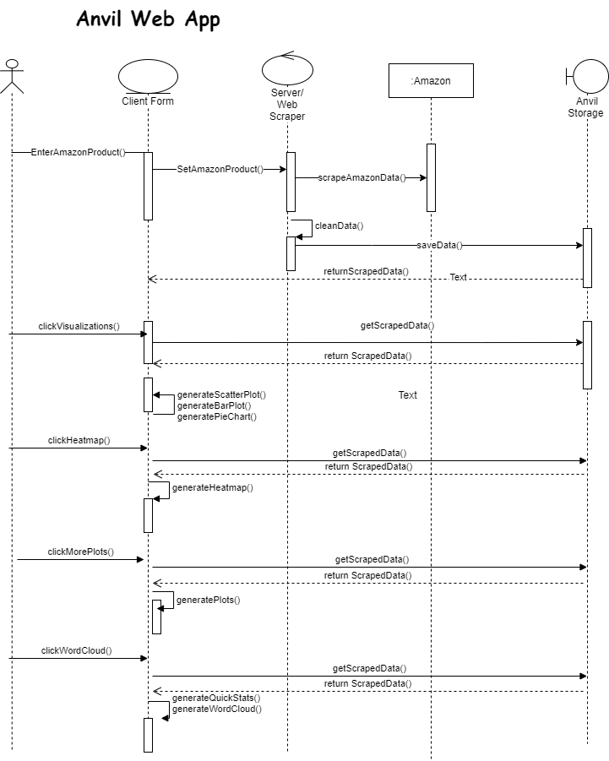
Requirements: Sequence Diagrams
Show the sequence diagram of the most significant use case.
Notes:
4. Requirements:
4.1. User stories implemented (one or more slides).
4.2. UML use cases and the use case diagram for the implemented use cases (one or more slides).
4.3. UML sequence diagrams for the implemented use cases.

Slide 19
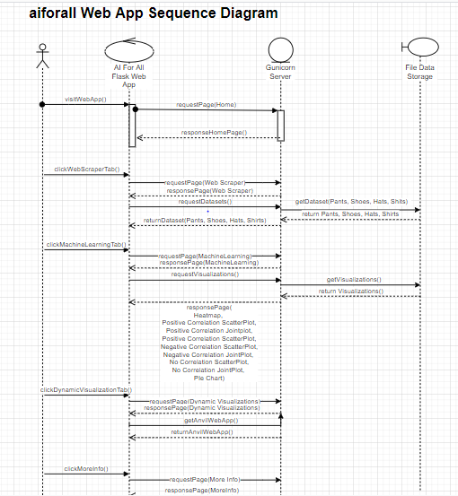

Slide 20
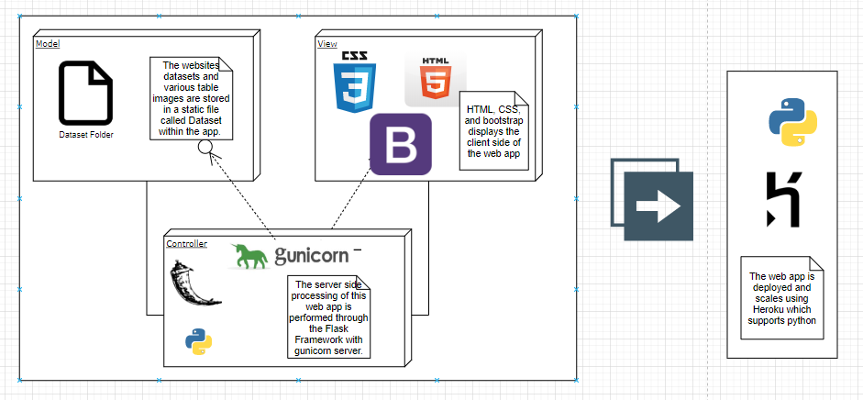
System Design: Architecture
System decomposition
Identify the architecture patterns used
Highlight the parts that you contributed to them
Notes:
5. System design:
5.1. System decomposition; identify the architecture patterns used (one slide).
5.2. System deployment – h/w and s/w requirements (one slide).
5.3. Persistent data design (one slide).
5.4. Security/Privacy (one slide).

Slide 21
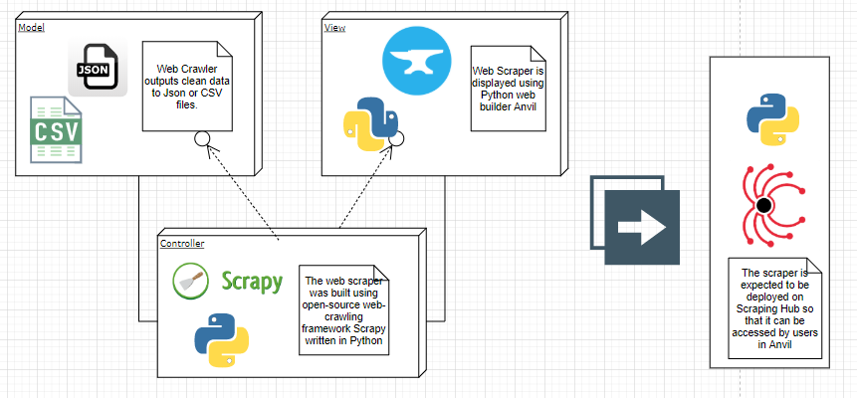
System Design: Architecture
Dynamic Visualizations

Slide 22
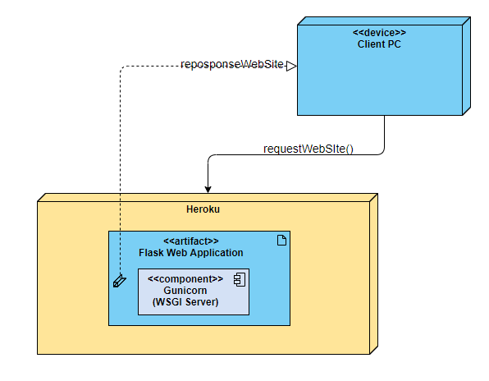
System Design: Deployment
System Deployment Diagram
Highlight the parts that you contributed to them
Notes:
5. System design:
5.1. System decomposition; identify the architecture patterns used (one slide).
5.2. System deployment – h/w and s/w requirements (one slide).
5.3. Persistent data design (one slide).
5.4. Security/Privacy (one slide).

Slide 23
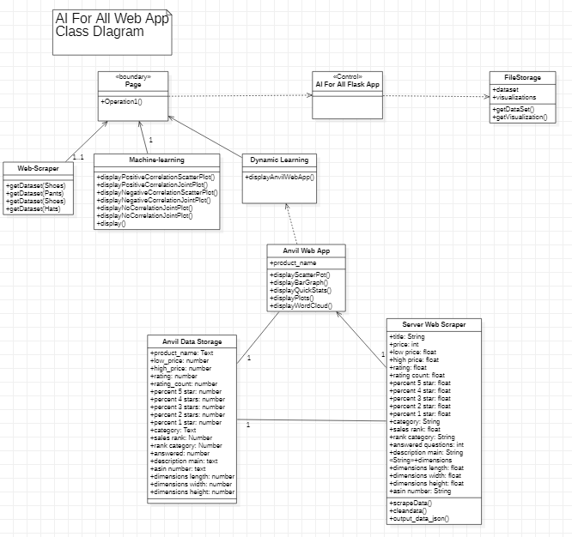
Minimal Class Diagram
Identify the design patterns used
Highlight the classes that you created/modified
Notes:
6. Detailed design:
6.1. Minimal class diagram. Identify the design patterns used (one or more slides).
6.2. State machine for the main control object or the most important object of the implemented uses cases (one or more slides).
6.3. Main algorithm used related to an implemented use case described above (one or more slides).

Slide 24
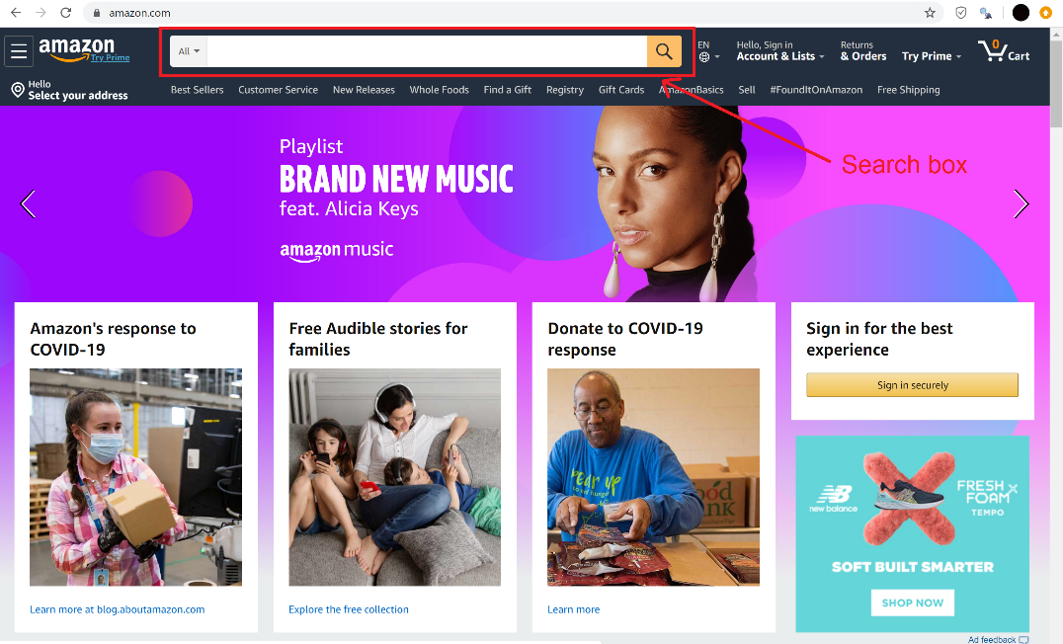
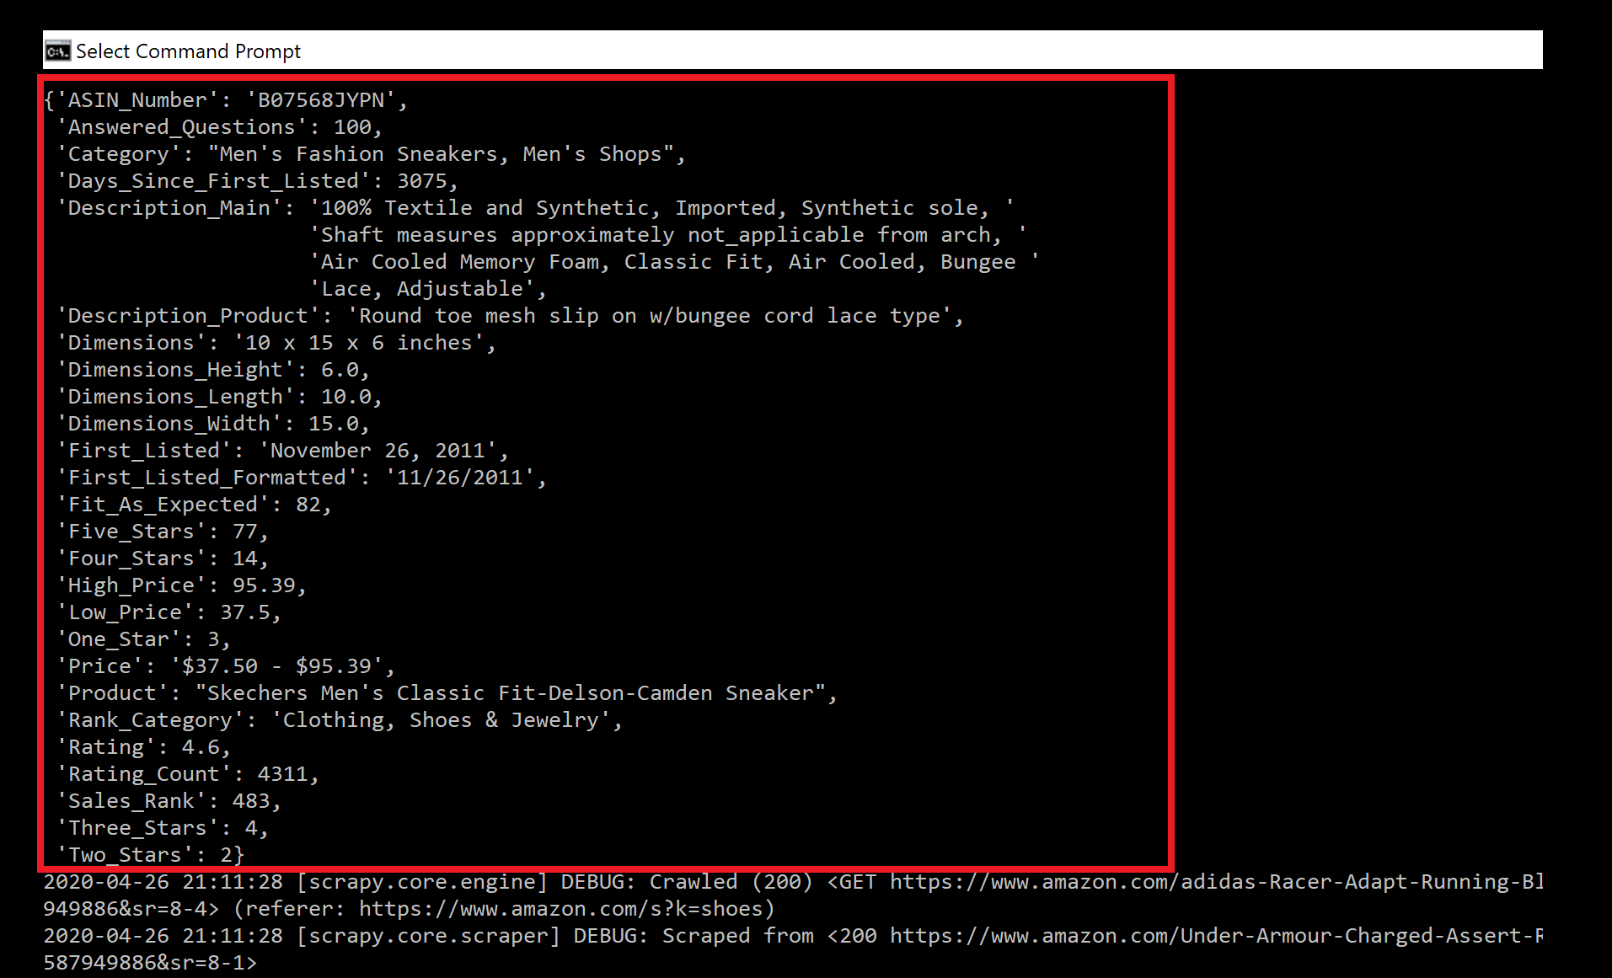
Test Suites and Test Cases
Sunny and Rainy Day
The program is designed to accept any search input that amazon itself accepts.
Notes:
7. Test Suites and Test Cases (one sunny day and one rainy day) for the use case represented in part (5) above (2 slides).
7.1 One sunny day and one rainy day for the implemented use cases (one or more slides).
7.2 Automated test scripts for the implemented use cases (one or more slides).

Slide 25
Summary
Our project serves as a useful resource people can use to learn about some seemingly difficult concepts as well as a valuable open source tool for merchandisers and consumers.
Sephora Jean-Mary
sjean149@fiu.edu
Charlie Ramirez
crami097@fiu.edu
Notes:
Summarize your contribution
Include your contact information
Ask if anyone has any questions for you.
Thank your audience

Slide 26
Thank you!
Notes:
Summarize your contribution
Include your contact information
Ask if anyone has any questions for you.
Thank your audience

