Slide 1

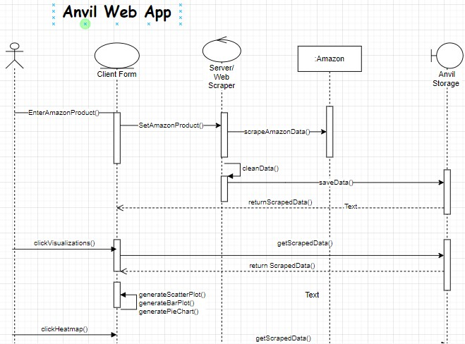
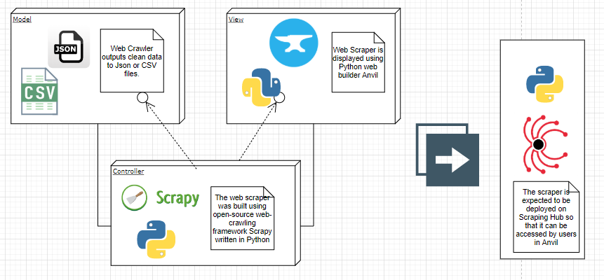
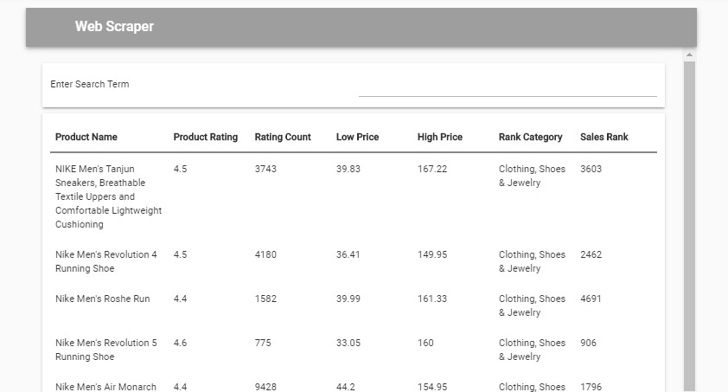
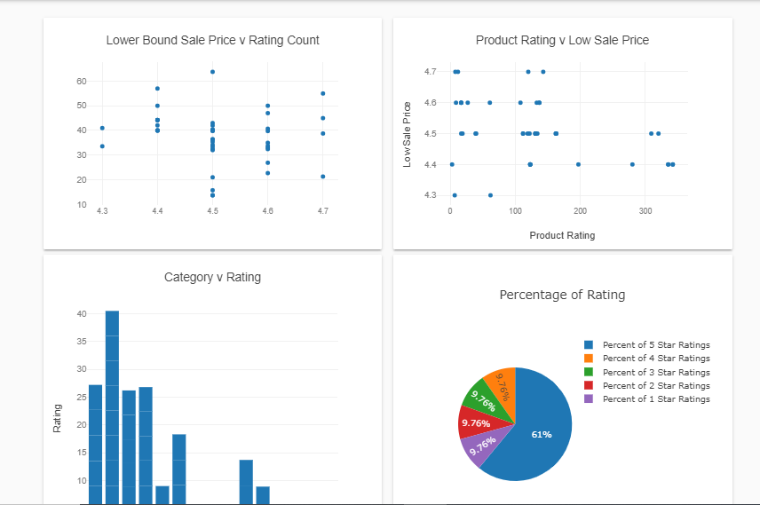
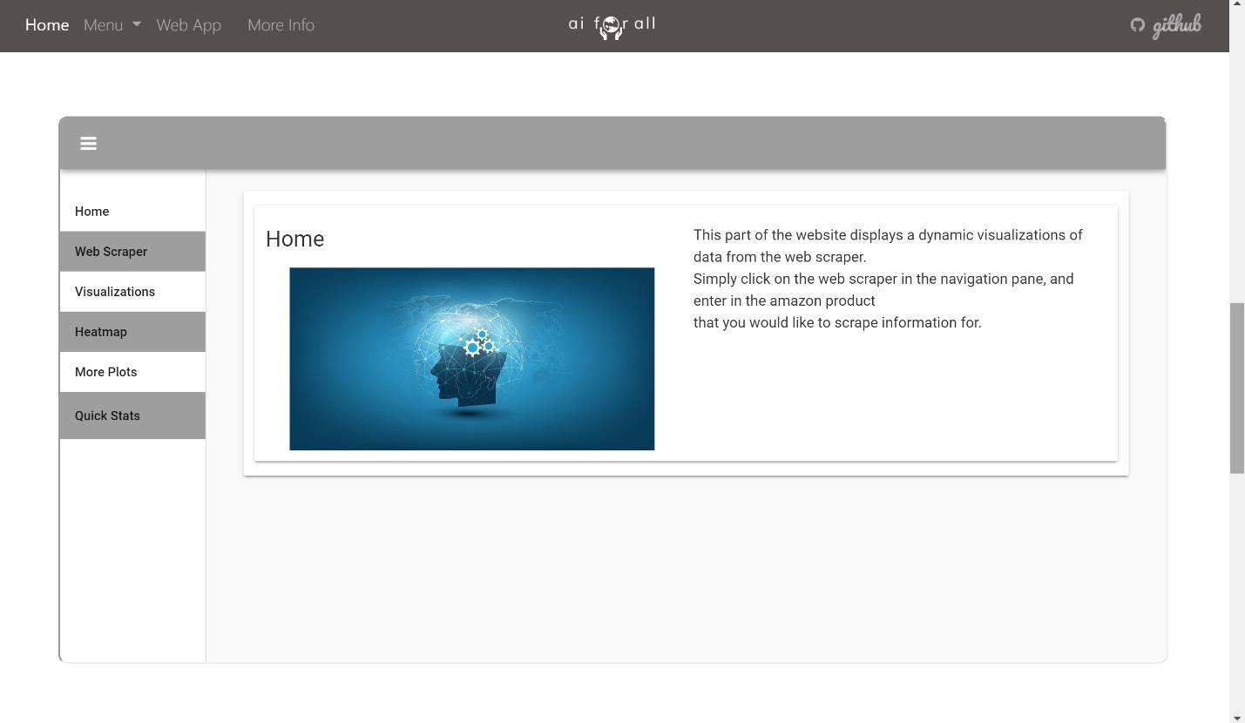
School of Computing & Information Sciences
Spring 2020 Senior Design Project
Machine Learning for Small Business Merchandising
Sudents: Sephora Jean-Mary
Mentor: Joe Garner, Ali Zaidi, <Affiliation> Product Owners
Instructor: Dr. Masoud Sadjadi, Florida International University
Problem
Current System
Requirements
Machine Learning and AI is best understood when there is a visual representation.
The main objective of this web app is to connect provide a front end so that users can interact with the web scraper. It provides a connection to the scraper so that users can look up their desired product and view the data attributes scraped from that.
The Anvil App also serves as a dynamic visualization tool to help users understand machine learning. The App creates several graphs, plots, and charts, as well as aggregated data statistics out of the scraped data to demonstrate a dynamic version of the static visualizations in the aiforall web application.
Generation AI contains a collection of similar projects which all help people understand AI and Machine Learning better.
Our project is the first of its kind. Though the idea of helping others become more familiar with AI is not new, this project is original.
Hardware:
- Computer, Laptop, or Phone
The Anvil requires dynamic visualization to help users better understand visualizations from Amazon Scraped Data.
Object Design
Implementation
System Design
This client side for the web scraper was implented with the drag-and-drop web app builder ANVIL. The entire app was implemented using Python.
Data attributes were uploaded directly from the scraper to the built-in anvil data tables by using the Anvil.works anvil- uplink software package.
The visualizations (including bar charts, heatmaps, pie charts, and statistics) were implemented in the client side of the app using plotly.
Click
to add text
Verification
Screenshots
Summary
This web app built using Anvil serves the function of allowing our tool to be dynamic and adapt to the needs of individual users.
The goal of this project is to help
students become more familiar with AI and Machine Learning.
The system is Validated when the data from the web scraper server is uploaded into the Anvil Data Tables.
The web scraper tab in Anvil displays new scraped data every time the 'Enter' key is pushed which means it has been validated.
Acknowledgement
The material presented in this poster is based upon the work supported by FIU and the Mitre Corporation. I would like to thank Ali Zaidi and Joe Garner for assistance, cooperation and mentorship that I received throughout this process.

