Slide 1
Notes:
Data Science Pipeline! Explain, specifically focus on Modeling and Evaluation of data, using visualizations and statistical methods

Slide 2
Data Science and Statistics
Goal of Data Science: Extract knowledge from data
Statistical methods are used to understand and interpret quantitative data

Slide 3
What is Criminology?
“An interdisciplinary profession built around the scientific study of crime and criminal behavior, including their manifestations, causes, legal aspects, and control”
Notes:
Criminology is a science
Science requires quantifiable evidence
The data science pipeline can be used as scientific evidence for the theories that make up the basis of criminology

Slide 4
Power BI
Data visualization tool that requires no coding
Exercise: On the dashboard, filter the data to see knife-based crime in the Northwest district
https://app.powerbigov.us/view?r=eyJrIjoiNTM0NTQwMjctZmIwOC00M2JkLTkzNzAtNmExM2U2MzU2NzRlIiwidCI6IjMxMmNiMTI2LWM2YWUtNGZjMi04MDBkLTMxOGU2NzljZTZjNyJ9
Notes:
Visualization Tool – Power BI
Easy to learn
Check out this dashboard!
Don’t Forget to Explain Dashboard!

Slide 5
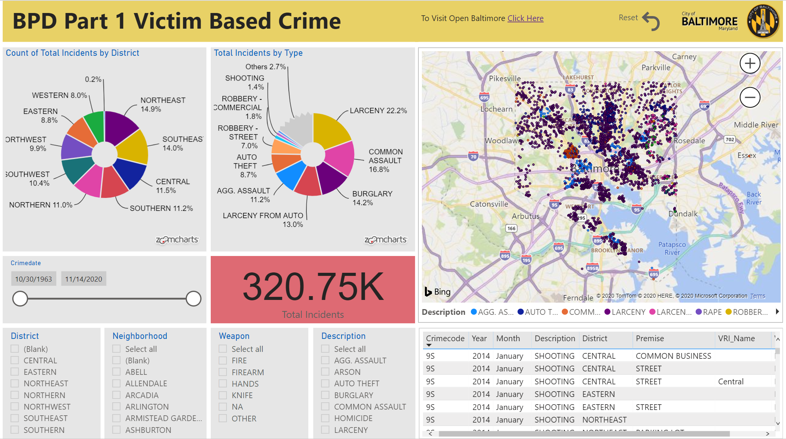

Slide 6
Importance of Modeling
What other ways could interactive dashboards like this one be used to visualize data with respect to criminology?
How can data modeling be used to solve Criminology-based problems?
Notes:
Visualization Tool – Power BI
Easy to learn
Check out this dashboard!
Other Ways: Real time crime reports in my neighborhood, larger area, etc.
If someone says ‘motivation’ or something like that, the data has to come from somewhere

Slide 7
Importance of Modeling
How can data modeling be used to solve Criminology-based problems?
By creating data visualizations, it is easier to breakdown data and understand what effective measures can be taken
Notes:
Visualization Tool – Power BI
Easy to learn
Check out this dashboard!

Slide 8
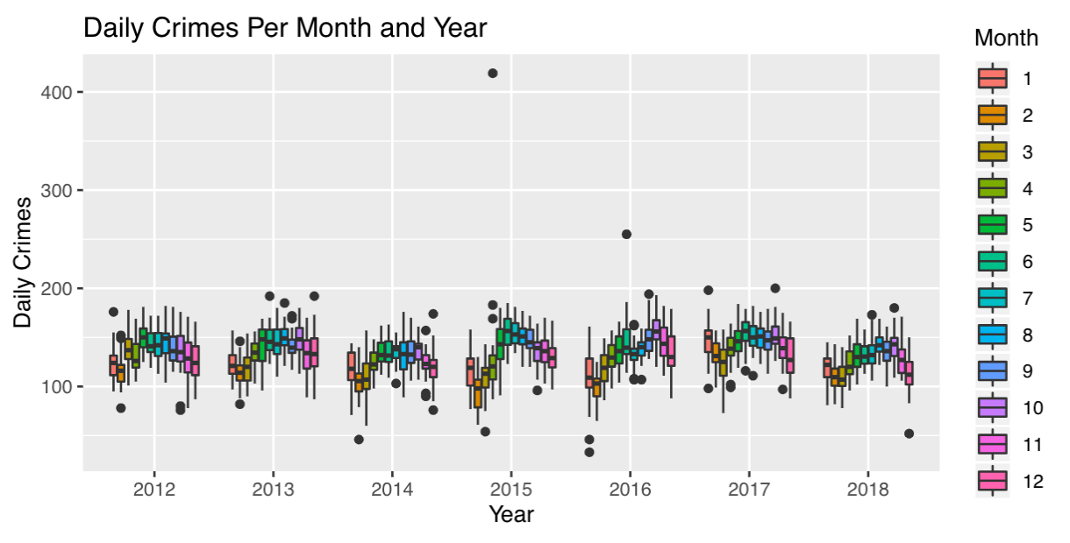
What can be done with this knowledge to decrease crime?
Notes:
Increasing policing during the summer months, creating neighborhood watches in the summer, etc.

Slide 9
Criminology Theories
Social Learning Theory: People learn from each other
How does seeing crime all around you affect your outlook?
Strain Theory: Certain factors or stressors can lead people to commit criminal acts
What stressors would you expect that may cause individuals to commit crimes?
Notes:
Read questions as thought questions: think about this?
Or add these questions if it looks like I’m running short on time

Slide 10
Rodney Stark’s Deviant Places Theory
Theory that identifies five characteristics of neighborhoods that have high rates of crime:
High Population Density
Poverty
Mixed Use of Buildings for Residential and Commercial Purposes
Transience
Dilapidation
Notes:
Chose this theory to try and evaluate using statistical methods
Highlight theories, but don’t assume they have background on statistical elements
Spend more time talking about linear regression – currently, 60% theory 40% data science -> switch to 25% theory 75% data science/linear regression

Slide 11
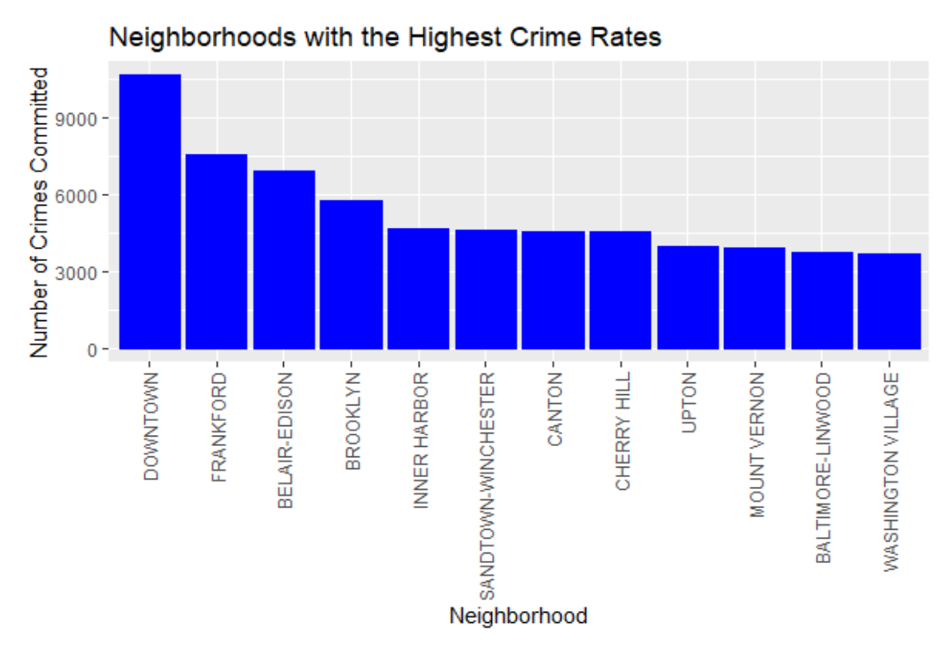

Slide 12
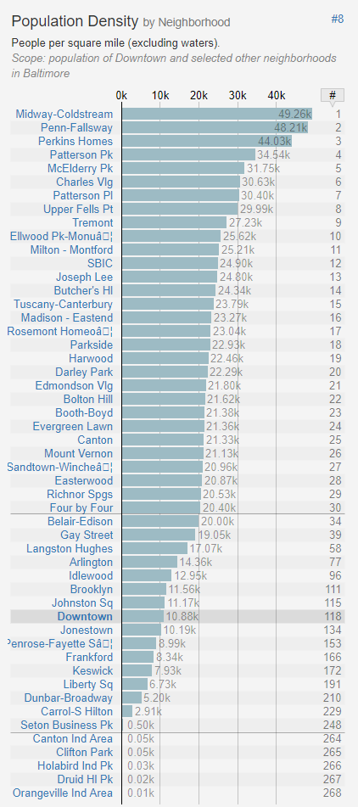
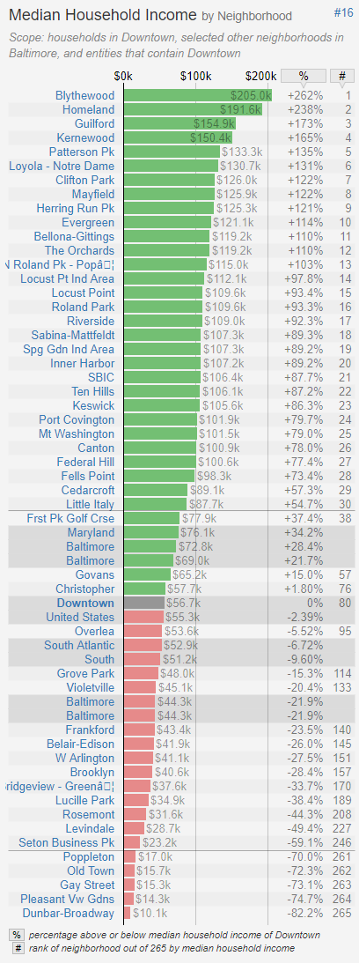

Slide 13
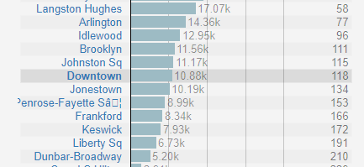
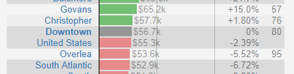

Slide 14
Linear Regression
y = mx + b
crime = β₁*population density + β₀
Most common machine learning method
Used to evaluate linear relationships between variables

Slide 15
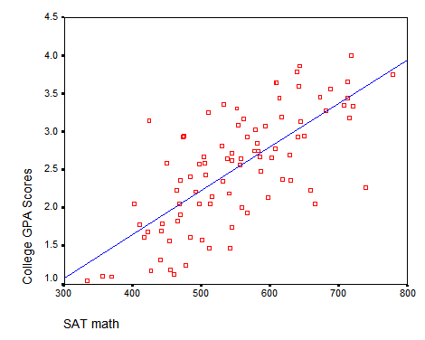

Slide 16
Linear Regression Results
y = mx + b
p value: significance of the relationship between two variables (<0.05)
R² value: strength of the correlation between the variables being examined

Slide 17
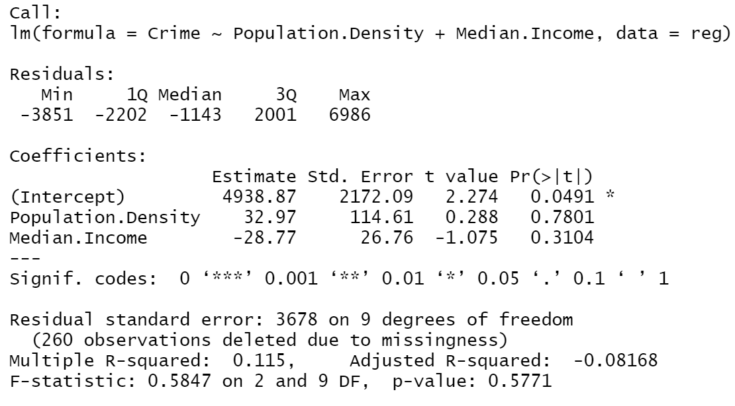
If both of these variables (population density and median income) have a significant relationship with crime, what would we expect the formula to look like?
crime = β₂*population density +
β₁*median income + β₀

Slide 18
Notes:
How could someone use this data to say whatever they want?
How are these variables related? Is the crime rate higher because it’s per capita and people are more spread out in less populous areas?
Maayyybe also remind them of the null hypothesis of linear regression or ask it as a question on the polls if you want another interaction point!

Slide 19
crime = β₂*population density +
β₁*median income + β₀
What are the values of β_{2,} β_{1,} and β₀?
Do either the Population Density or the Median Income have a significant effect on the Crime Rate?

Slide 20
If you only included the variables with a significant relationship, what would the crime formula look like?
crime = β₀
Is this a good mathematical representation of crime?

Slide 21
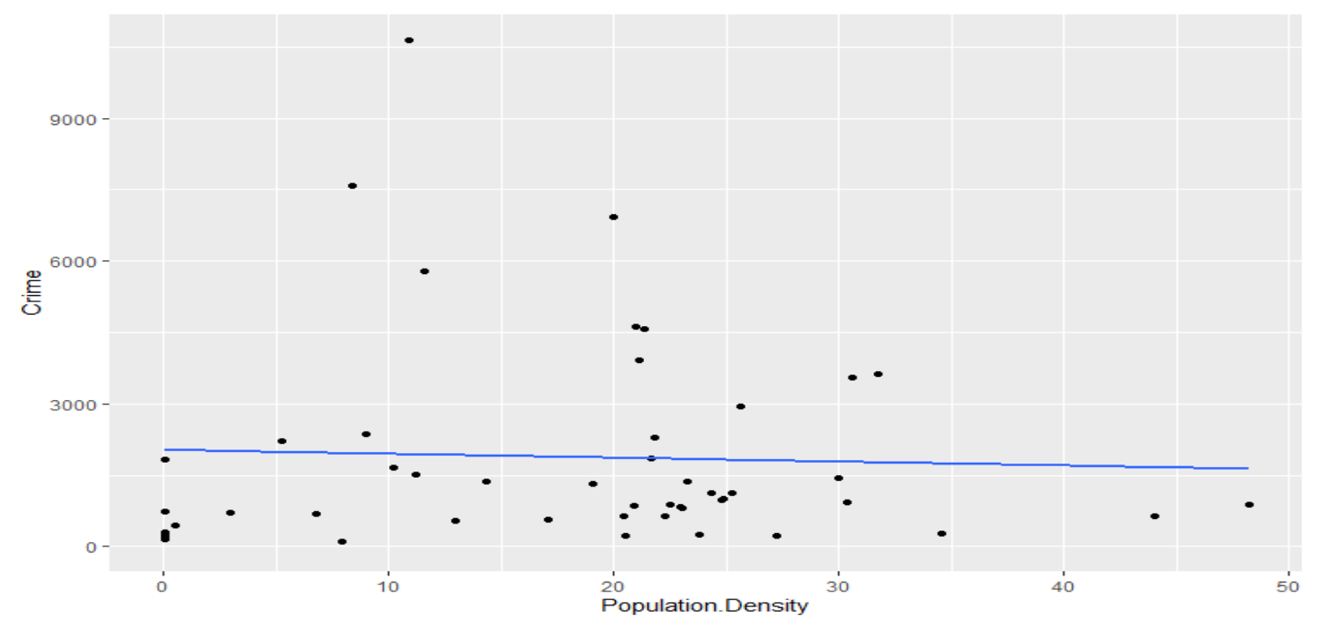

Slide 22
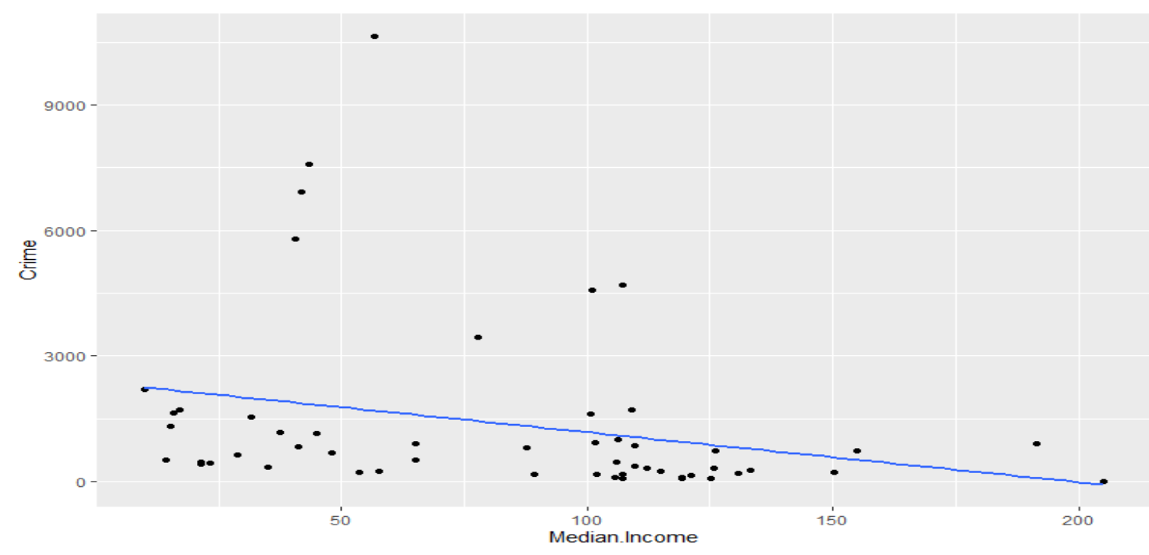

Slide 23
Relevance
How can people use data to ‘validate’ any point?
How can the results of machine learning models be used to validate (or not) the Rodney-Stark Theory?
Notes:
Mention: Trying to use linear regression on seasonal data is difficult, maybe a time series would be more useful
If we had done some different feature engineering, it may fit better to a linear model
If we had played around more -> data transformations -> we may find a stronger relationship
Final Point: Lots of models would be evaluated, not just one
Just because a model doesn’t validate a theory, doesn’t mean that the model invalidates a theory
Once we have a more robust model

