Slide 1
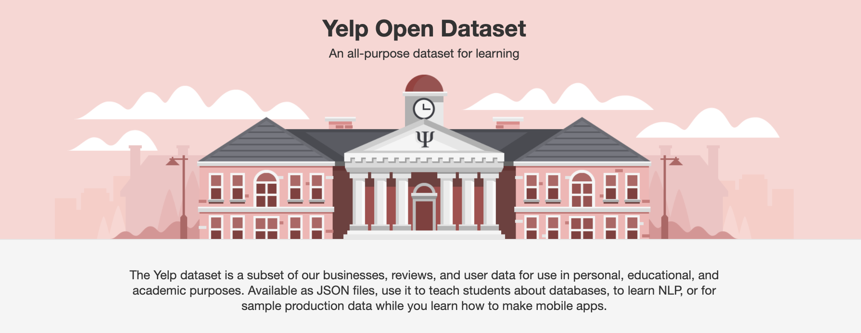
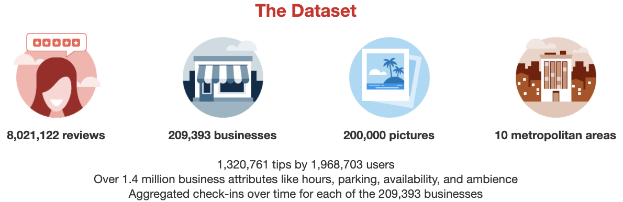

Slide 2
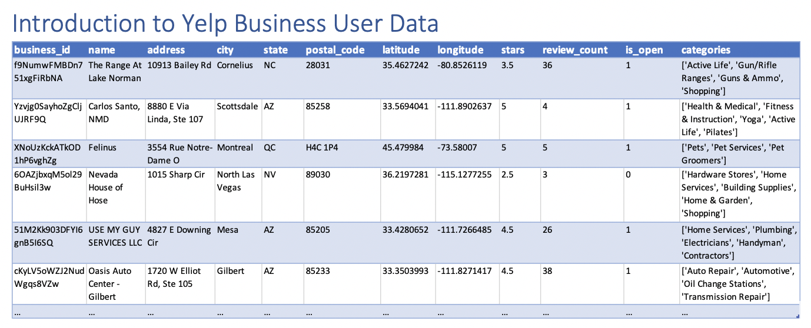

Slide 3
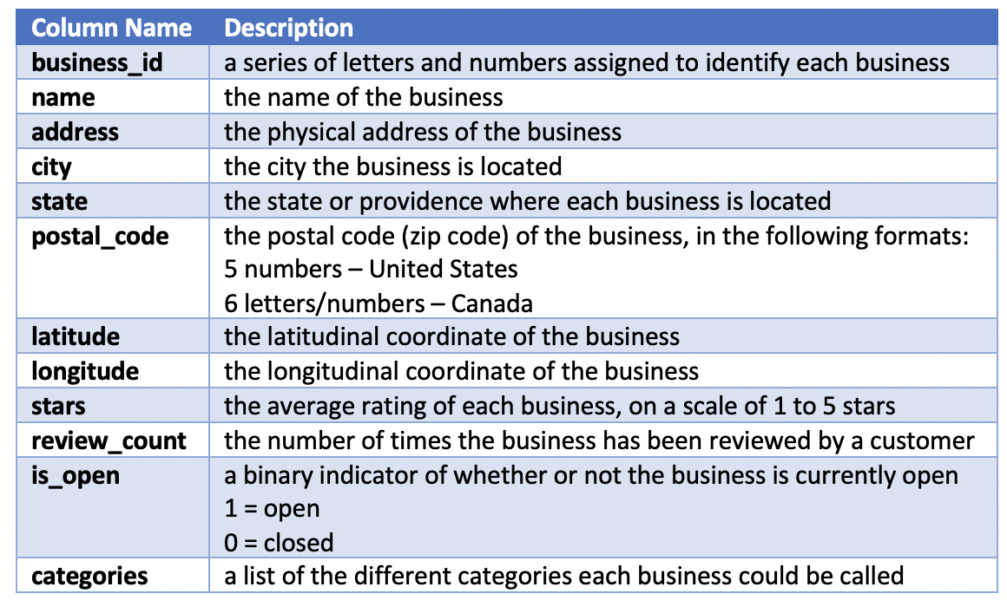

Slide 4
POLL 1: Which of these problems could be avoided by understanding your data, perhaps by using a data dictionary?
There is a sudden uptick in customers calling about problems with a specific unit your company makes. Your quality engineering team discovers a problem with a batch that was shipped out, and now you may have to consider a product recall.
By analyzing historical data, you project that Betty’s Bakeries across the U.S. each go through roughly 60 eggs per day. After budgeting and placing orders for the next month, you realize the bakeries actually go through 60 dozen eggs each per day.

Slide 5
Be prepared to join your breakout rooms to answer questions in coming slides.
You will be asked to answer one question per group.
Select one person as team liaison who will answer on behalf of your group when we return to the main room.

Slide 6
Breakout Room 1:
1. What are some of the ways that you might group similar businesses, based on the columns in the data dictionary?
2. How might businesses take advantage of the user data that Yelp collects? Try thinking about this question from a marketing perspective.
3. If you could collect any user data from Yelp, what new data might you want to collect? What kinds of questions could you answer with this data?

Slide 7
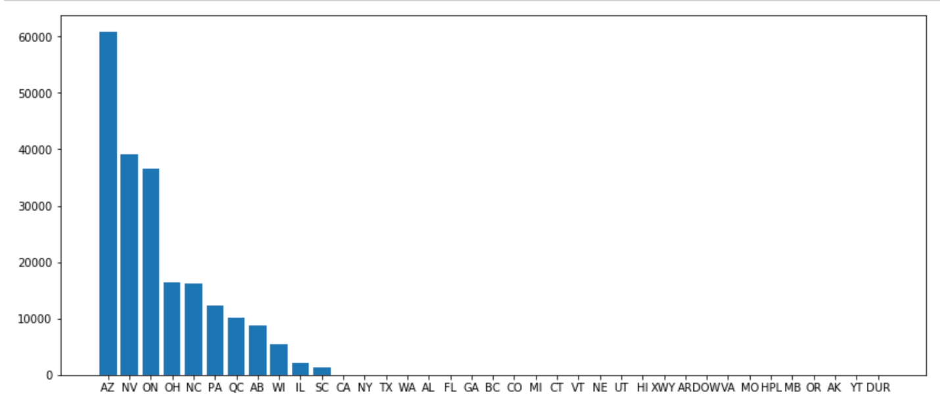
Number of Businesses per State
POLL 2: If you wanted to move to a state that seems to have the most saturated market (i.e., the most businesses) based purely on this graph, which state would you move to?
ON
NV
AZ
SC

Slide 8
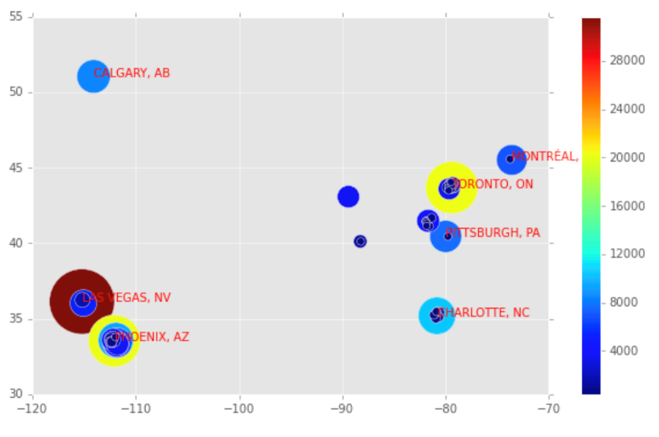
POLL 3: Which city on the heat map appears to have the highest concentration of businesses? Is this surprising given your answer to the last question (POLL 2)?
Number of Businesses by City
Latitude
A. Las Vegas, NV
B. Phoenix, AZ
C. Ontario, ON
D. Calgary, AB
Longitude

Slide 9
Breakout Room 2:
Think back to what new data might you want to collect, from question 3. If you had collected that kind of data, what kind of visual representation could you create to understand the results?
For guidance and inspiration, check out: https://www.data-to-viz.com/
What might you infer if you mistook this data set to be representative of all businesses in the US?

Slide 10
Breakout Room 3:
Is Yelp’s data collection a violation of privacy, or is it necessary to provide the best possible service to its users?
What other types of applications are keeping track of your data?

