Slide 1
PCA for Images Using Distributed Computing

Slide 2
MOTIVATION
Motivation — Why PCA Is Expensive
High time complexity in covariance computation: (O(N * d^2))
Large (d) makes covariance matrix size (d^2) extremely large which requires memory + heavy computation for covariance calculation
Single-node PCA becomes infeasible for large images due to compute + memory limits
Motivation — Why Our MPI Solution Is Feasible
Perfect data parallelism: images can be partitioned across ranks
Distributes the (N * dot d^2) covariance computation across MPI processes
Each rank computes local covariance contribution independently
Only two collective communications: mean reduction and covariance reduction
Very low communication overhead relative to compute cost
Achieves high compute-to-communication ratio → good scalability
Related work
Parallelization of Principal Component Analysis (using Eigen Value Decomposition) on scalable multi-core architecture https://ieeexplore.ieee.org/document/5423039
https://github.com/arneish/parallel-PCA-openmp
Hybrid MPI/OpenMP implementation of PCA https://ieeexplore.ieee.org/document/8260048

Slide 3
MOTIVATION
Related work
Parallelization of Principal Component Analysis (using Eigen Value Decomposition) on scalable multi-core architecture https://ieeexplore.ieee.org/document/5423039
https://github.com/arneish/parallel-PCA-openmp
Hybrid MPI/OpenMP implementation of PCA https://ieeexplore.ieee.org/document/8260048

Slide 4
PCA –Principal component analysis
PCA takes high-dimensional data, like images, and tries to find patterns that capture the most important information while reducing the dimensionality.
The steps are:
Flatten the images into vectors
Compute the mean vector
Center the data by subtracting the mean
Compute the covariance matrix, which shows how pixels vary together
Perform eigen decomposition on the covariance matrix
Select the principal components, which represent directions of maximum variance
Project the images onto these new directions, reducing dimensionality

Slide 5
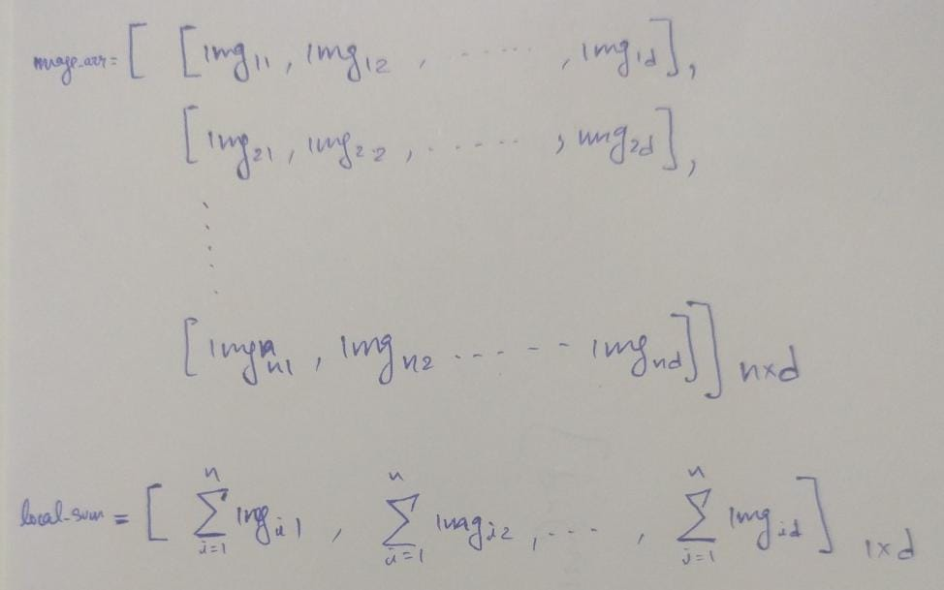
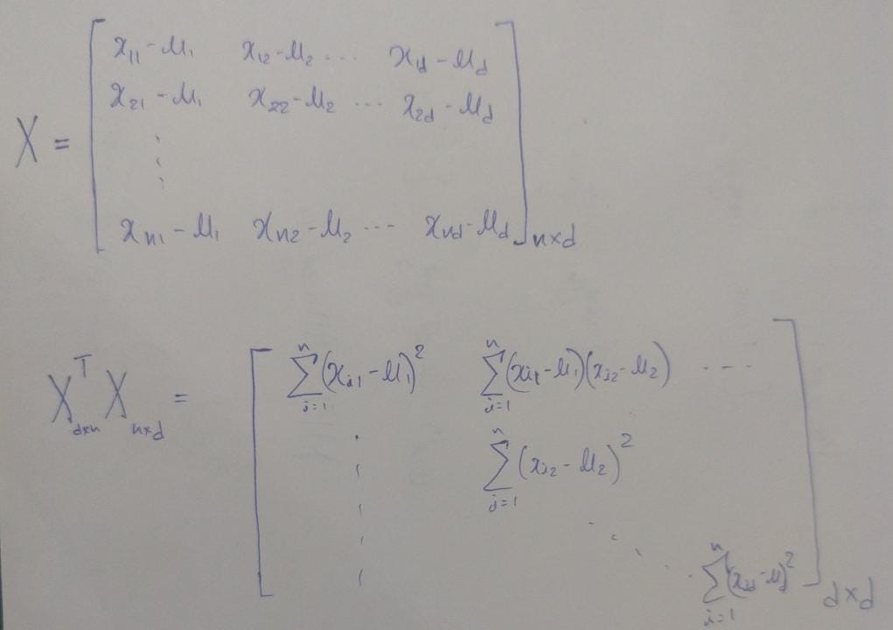
PCA Parallelization strategy
Dataset split across processes, each loads its image batch into memory.
Mean computation:
  Each process computes local mean sum.
  MPI_Allreduce with MPI_SUM to obtain global sum.
  Divide by total number of images to get global mean.
Covariance computation:
  Each process builds a partial covariance matrix.
  Loop ordering optimized to reduce cache misses.
  MPI_Allreduce used again to combine partial results into the global covariance matrix.

Slide 6
OBservations
Multi-core speedup (500 images): single-core local covariance = 25.299 s → 4 cores = 6.412 s (≈3.95× faster) → 8 cores = 5.934 s (≈4.26× faster vs single-core).
Multi-core speedup (4000 images): single-core local covariance = 230.491 s → 4 cores (with MO) = 52.531 s (≈4.39× faster) → 8 cores = 34.663 s (≈6.65× faster vs single-core).
Matrix-mul optimization impact (4 cores, 4000 images): without matrix opt local cov = 114.677 s vs with MO = 52.531 s → ~2.18× speedup (≈54% reduction in local covariance time).
More cores reduce total runtime (4→8): 500 images total: 9.917 s → 6.699 s (≈32.4% reduction, 1.48× speedup); 4000 images total: 76.407 s → 49.317 s (≈35.5% reduction, 1.55× speedup).
Low computation→communication overhead (examples): 8-core 4000: local cov 34.663 s vs global cov reduce 0.180 s → global is 0.52% of local (≈192× more local work); 4-core 500: local cov 6.412 s vs global cov 0.104 s → global is 1.62% of local (≈62×).
Image count vs runtime (8 cores): local covariance scales roughly with N — 500 → 4000 images: 5.93 s → 34.66 s (≈5.84× increase for 8× images); 4000 → 13232: 34.66 s → 157.24 s (≈4.54× increase for 3.308× images), indicating near-linear scaling with N and extra overheads at large sizes.
Global mean reduction negligible: example single-core 500: local mean 0.00410 s vs global mean 0.000004 s (global << local); 8-core 4000: local mean 0.00861 s vs global mean 0.00018 s (global ≈2% of local).
I/O & other stage improvements with parallelism: load time drops with cores (single-core 500 0.0528 s → 4-core 0.0215 s → 8-core 0.0128 s), showing multi-core I/O/overlap benefits as well.

Slide 7
OBservations
Scenario | Stage | Time (sec) | Observation
Single Core — 500 images | Local Covariance | 25.299 | Baseline for comparison
4 Cores — 500 images | Local Covariance | 6.412 | ≈3.95× faster than single core
8 Cores — 500 images | Local Covariance | 5.934 | ≈4.26× faster than single core
Single Core — 4000 images | Local Covariance | 230.491 | Shows scaling cost with large N
4 Cores — 4000 (with MO) | Local Covariance | 52.531 | ~4.39× faster vs single core
4 Cores — 4000 (without MO) | Local Covariance | 114.677 | MO gives ~2.18× speedup
8 Cores — 4000 images | Local Covariance | 34.663 | ~6.65× faster than single core
8 Cores — 13232 images | Local Covariance | 157.239 | Demonstrates near-linear scaling with data size
8 Cores — 4000 images | Global Covariance Reduce | 0.180 | Only 0.52% of local compute

Slide 8
What we have done so far
Set up distributed mean calculation
Implemented the local mean computation on each process and used MPI_Allreduce to combine everything into a global mean.
Parallel covariance computation
Each process computes its part of the covariance matrix, and we merge the results using another MPI_Allreduce.
Implemented key performance metrics
Added timing and measurement utilities to track the time taken for loading, mean calculation, covariance computation, and eigenvector processing.

Slide 9
What WE Plan To Do AHEAD?
Parallelize Eigenvector Computation
- Explore distributed eigensolvers
Simulate a Multi-Node Cluster
- Connect laptops over LAN/WiFi
- Measure real network communication performance
Optimize Image Writing
- Use MPI-IO / collective I/O
- Reduce file system bottlenecks
Expand Datasets & Metrics
- Test larger image sets
- Generate detailed speedup & scaling graphs

Slide 10





Thank YOu
Example images from dataset
( Our Mean calculated Image says thank you )

