Slide 1
Overview of Operating Systems OR Where is the OS ?

Slide 2
Overview objective
Understand how an operating system fits in the larger scheme of things
What does an operating system provide
What are the main parts of a typical operating system
Some hands on to get a concrete feel of some concepts
Understand the OS from a systems programmer perspective.
Familiarize yourself with some tools available on Linux, as an example.
A historical note

Slide 3
RAM
DDR3/…
8085/
Snapdragon/ Corei5/…
Connectors to the outside peripherals.. * Serial – KBD
* HDMI – Monitor
* Audio Jack – speaker
* USB – Many options
Hard Disk
PCH
Controllers…
SATA
controller

Slide 4
Architecture course focuses on ALU, interrupts, pipelines, ISA, etc etc.
RAM
DDR3/…
Digital design course focusses on digital circuits, gates, flipflops, registers, adders, etc.
8085/
Snapdragon/ Corei5/…
Connectors to the outside peripherals.. * Serial – KBD
* HDMI – Monitor
* Audio Jack – speaker
* USB – Many options
Hard Disk
PCH
Controllers…
SATA
controller

Slide 5
Architecture course focuses on ALU, interrupts, pipelines, ISA, etc etc.
RAM
DDR3/…
Digital design course focusses on digital circuits, gates, flipflops, registers, adders, etc.
OPERATING SYSTEMS
8085/
Snapdragon/ Corei5/…
Connectors to the outside peripherals.. * Serial – KBD
* HDMI – Monitor
* Audio Jack – speaker
* USB – Many options
Hard Disk
PCH
Controllers…
SATA
controller

Slide 6


















GUI
Commands – cd, ls, cat, rm, ...
Terminal &
Shell
vi , gedit, atom, nano
Where is the OS ?
gcc, g++, python ...
Bridges
GPU
CPU(s)
RAM
Hardware

Slide 7



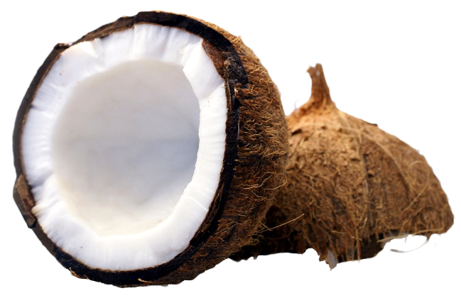





















GUI
?
ls
Shell
ls
l
s
MON
Bridges
GPU
CPU(s)
RAM
Hardware
KBD

Slide 8
So what is the OS doing?
Virtualizing the resources – CPU, RAM, Disks, Peripherals
Dealing with multiple access to the resources
Saving our programs and data to a (permantent) storage
Doing all this efficiently & securely
OS API / system call – e.g. POSIX
Scheduling – CPU, RAM, I/O
Storage and filesystems
Permissions, Access control, kernel/use modes etc.

Slide 9







Application programs Word processors, games, email, payroll, your own, C, python, “./a.out”...
OS independent
Systems Programming
OS Utilities, “libraries”, compilers, debuggers, other systems programs, OS manager utilities, interface to the Kernel
OS dependent
Hardware Dependent
OS
IPC
Kernel
Protected Execution
Sig
Device dependent
Device Drivers
DISK
BIOS
HARDWARE
Process Management
Memory Management
Filesystem

Slide 10
Some questions
The booting process – How does a system boot ? EFI vs BIOS
Kernel vs OS vs distribution
Is the int C type the same size on all hardware?
What is OS dependent – why cant I simply run a program for windows on Linux… on the same hardware?
Executable format (ELF/ PE and cross compilation)
Portable vs unportable code ( in “C” say)
Eg. Make assumptions about sizes of types, Uninitialized variables
OS dependent code
Simply different OS APIs/Libraries. Eg POSIX/ Linux /Win32 / other APIs

Slide 11

Things to explore and understand
gcc –E …
look for stdio.h from above
Other stuff pstree -p
child and parent processes
Look for the man pages
man man?
What is man section 1,2,…. ?
Simple C program and pre-processor
Include files and libraries: stdio.h vs libc.a/libc.so..
Processes from the terminal; busy looping vs sleeping; piping programs ; PIDs
Man pages

Slide 12

Interesting facts
Data structures used by the kernel
Linked Lists – DLL, FIFOs
Bitmaps
hashing
Balanced BSTs (rbtree)

Slide 13
Terminology – do you know what these are?
OS
Kernel
OS Utilities
man pages
shell – bash
gcc, header files, libraries(.so, .a), executables, object files(.o)
gdb #see disassemble options
od –cx a.out
# please see: date, who, ls, du, ps, top, …
cat myprog.c | sort
ls > testexample
sort < myprog.c
cat myprog.c | grep printf | sort

Slide 14
Summarizing concepts learnt so far
The OS virtualizes the systems – the hardware, the CPU(s), memory, devices, etc.
Makes using it easy
Ensure user isolation
Ensures efficient resource usage
OS comprises
Utilities (or commands) like ls, ps, cat, man, …
Libraries
System call interface , or APIs
The kernel and drivers
Executables are CPU and OS dependent. E.g., ELF (linux) , EP (Windows).
Writing in C, python etc, enables programs to be portable.
The memory is also virtualized, it means that printf(“%p”,&x) prints a virtual addresses (not physical memory (RAM) address
Modern operating systems time-share between programs. The timer interrupt is essential for this.

Slide 15
Linux utilities of interest for the curious to know more about the system
od –cx <filename> to see the dump of the file.
objdump –d <executable file or object file> to see assembly of a file
gdb <executable file with path> to step by step follow the file execution
strace <executable file with path> to see the list of system calls made when the program executes
ltrace <executable file with path> to see the list of library calls made when the program executes
man <command or call> to see manual page information, eg man ls, man 2 printf, man 3 printf, man ps
Other useful tools include ps,

Slide 16
Build a repertoire of Linux commands.
Disk and directories: ls, du
Processes: ps, top, pstree, strace
File content: file, objdump
Debugger: gdb
Manual: man man
Some good (bash) shell features to pickup
Piping: $ cat loopy.c | grep ’printf’ | sort
I/O redirection:
$ ls >tempfile
$ sort < tempfile
Note: As you progress through the course you will pick up more form the activities we do in the classroom. At the end of every lecture / lab class try to add to this list. You must use them!

Slide 17
More fun stuff to explore in Linux
You can do very interesting text processing from the command line if you know these:
Search for something: grep
Edit text: awk, sed, tr
For example
$ tr [:lower:] [:upper:] < loopy.c will print the file loopy.c with all lower case converted to upper case.
bash can also do interesting stuff, for fun try this at the command prompt:
$ for i in *.c ; do grep getpid $i >/dev/null if [ $? -eq 0 ] ; then echo $i fi done
This will print the names of all files in the current directory containing the word getpid.

Slide 18
A bit of history
How we got here ☺

Slide 19
OS and Arch are related and have a shared history

Slide 20
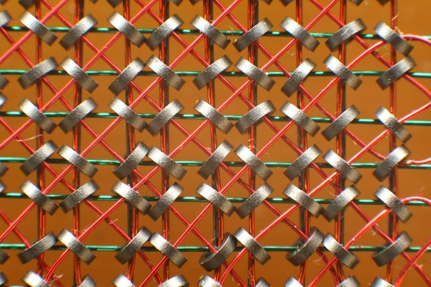

Early Digital Computers – Eg ENIAC – an approximate visualization
Accumulators – ie registers,
Counters + arithmetic unit
Program here →
By setting up control wires plugged up
Includes looping etc.
No stored program
No OS
Control Unit

Slide 21
Business
GP, Mainframes, multiprocessor
Scientific Calc
Codebreakers
Mini Comp
PC
Laptops
Phones, Embedded
NW Comp
HPC
Monitor DM2, unitask
Timeshared MTS
No OS, stored program
No OS, single app
Mini Co UNIX
PC DOS
Windows/ Linux
Android, RTOS
Cluster OS
Linux, HPC Commun Lib

Slide 22
Single Task
Multitask
Timeshared
Multiprocessor
Distributed
IoT: Miniaturization
Ubiquity, real-time?
Single Task
Job scheduling
Paging, safety, multiprocessing
High performance communication and storage
Distributed processing, cloud schedlung and storage
Low footprint, power efficient
Communication capable
Secure

