Slide 1
Memory Management

Slide 2
Everything needs memory-RAM
Processes live in the memory when they are executed
They access data in the memory
Before processes read data from disk, they need it to be in memory
The kernel is in the memory
...
But memory is limited space, so memory management is important
We start by asking how to allocate memory to a new process

Slide 3
Allocating memory to the process-Flat
Why not allocate the whole RAM to a single process?
We could just keep the current active process’s memory in the RAM, the rest on the disk
So, works with time slices too
Absolute address code with compile-time binding
Single contiguous address space (Flat) same for all processes
We could compile programs to this address spaces
BTW, the kernel too resides in the same physical memory!
P1
Kernel

Slide 4
Allocating memory to the process: Partitioning the physical memory available
Different address spaces
Makes compiling difficult with absolute addresses
Allocate a set of contiguous areas to each process
Possibly allocate in blocks
ALTERNATELY -
Provide relocatable code
Actual address determined by combination of compile time address and starting location, say.
Need address translation support from CPU
We wish to support multiple process in memory at the same time.
We need to provide protection.
First step to separate physical address from compile time address
P1
P2
P3
Kernel
Starting address
(base)

Slide 5
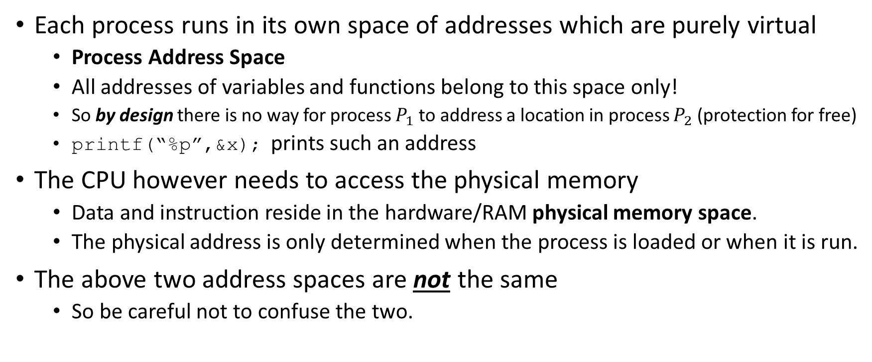
Core concept: Separation of Process address space and physical memory
Each process runs in its own space of addresses which are purely virtual
Process Address Space
All addresses of variables and functions belong to this space only!
So by design there is no way for process $P_{1}$ to address a location in process $P_{2}$ (protection for free)
printf(“%p”,&x); prints such an address
The CPU however needs to access the physical memory
Data and instruction reside in the hardware/RAM physical memory space.
The physical address is only determined when the process is loaded or when it is run.
The above two address spaces are not the same
So be careful not to confuse the two.

Slide 6
Virtual (Process) Address Spaces and Physical Memory
00000
P1
The physical RAM could be smaller than the virtual address space.
The virtual address space of one process has nothing to do with the virtual address space of another process.
We need to somehow do a mapping.
We need to account for proc address spaces adding up to more than physical memory on the machine.
…FFFFF
00000
P2
ADDRESS SPACES
Physical Memory - Hardware
…FFFFF
00000
P3
…FFFFF

Slide 7
Goals of supporting virtual address spaces
Transparent (needs no modification to the way the user uses it)
Efficient (should not cause system to slow down significantly)
Protection (should provide protection against wrong access – isolation)
All these are the goals of Address Translation…

Slide 8
Address translation: Core mechanism for to support virtual address spaces
CPU
Fetch “Load ax, varA” Decode Execute “address for varA(0x777a) should go onto the bus to to access physical memory”
P1
Translate an address
from
process address space
to
physical memory
Load ax, varA (0x777a)
Store varB, ax
.
..
…
Address Translation
0x4000
varA
Hardware supported mechanism to translate address from process space (virtual) to the RAM(physical memory) space for successful access. Not just hardware translation - it also need a bunch of other activity – Memory management

Slide 9
The (per process) Base and Bound method: Simple address translation hardware support
P1 (0-64K)
10K
(Virtual) Address Space
74K
va always in {0..64K}
pa=va+base (relocation) protection check pa <74K
Address Translation
Physical Memory
CPU
MMU
Base=10K
Bound=64K
va: virtual address pa: physical address

Slide 10
Support needed
MMU with base and bound registers
MMU need to do the translation each time an address is sent out on the wire
Protected instructions to updated “base” & “bound”
“OOB” Exception support/handler
Also need to store “base” and “bound” in process context during context-switch
Need management code to do allocation and track free/ allocated physical memory.

Slide 11
Contiguous Memory allocation strategies for base and bound translation scheme
P1
Models: Either contiguous or fixed size blocks
Over times we have many free ‘holes’ (contiguous chunk of free space)
When a new request comes we need to find a free ‘hole’ of the right size.
First fit
Best fit
Worst fit
…
May become difficult –
We may not have a single big enough hole
The fragmentation problem!
P2
P3
New-1
P4
New-2
P5
KERNEL

Slide 12
A Commentary on the simple solution
+ simple
+ provides Transparency, Efficiency and Isolation(protection)
+ Is actually dynamically relocatable (ie the process can be remapped as it is executing).
+ can support multiple processes (by loading new MMU regs when doing context switch.
+ Isolation among processes provided
+ Compiler can assume a simple address space starting at zero.
- it assumes the address space is contiguously used
- it causes fragmentation
- it maps all of the address space to the physical memory
- can go ‘out of memory’ if we have lots of large process address spaces
- it doesn’t allow protection within the processes (process can overwrite its own code, by mistake)
HOWEVER, this is the core idea on which other methods are built

Slide 13
Concept: Segmenting the process address space (1/2)
CS
Consider a process as composing of “Code”, “Data”, “Heap” and “Stack” logical segments/regions (each contiguous in itself) (each is a small sub address space)
Providing each with its own mapping register pair (base & bound) in the MMU. “Segmenting” of the address space.
Translation Method:
First two bits of va can identify the segment
Remaining va bits are offset inside the segment
Needs Base bound for each segment
Additionally
Associate special attributes with a segment eg r,w,x
Enables protection and sharing between processes
Can be generalized to more than four segments
DS
(Virtual) Address Space
ES
reg pair per segment
SS
SEG PABase Bound Perms
00 Code 10000 400 r,x
01 Data 20000 200 r,w
10 Heap 30000 100 r,w
11 Stack 40000 600 r,w
MMU
va
S_{n}S_{n-1}……………offset bits ……………
pa= PABase+va-offset
Physical memory (RAM)

Slide 14
Concept: Segmenting the process address space (2/2)
Each segment is independently relocatable, dynamically
We could limit the size of each and thus not allocate physical space to all the address space in between
Set of segment registers (we may call that segment table) now become part of the context.
Compiler needs to flag each segment (in the executable file) so that the loader can the right thing at run time.
Look at pmap [-X] <PID> ; readelf –e a.out or objdump –hj a.out
These are not really segments, but VMAs … see next slide

Slide 15
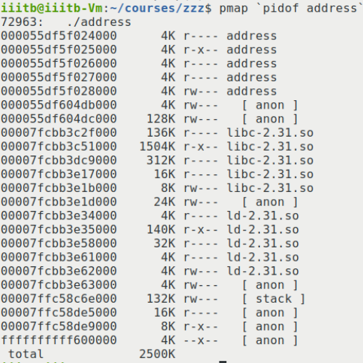
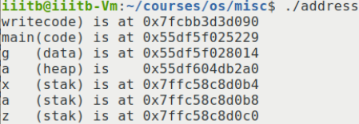
Virtual address space and pmap on linux x86-64
0
Text (Code)
Data
Heap
128TiB
Shared Libraries
Stack
00007ffffff… (48th bit and above, all 0s)
Unused(Reserved)
ffff80000… (48th bit and above, all 1s)
Kernel
Design choice to map all the kernel into the same address space
ffff… (64bit, all 1s)

Slide 16
OS Memory management for segments
New processes will ask for segments to be created.
We may need to increase a segment’s span/size for a process when its segment grows( eg it mallocs a lot of memory)
Track the memory space available – free vs used parts.
Assuming each segment has one base & bound, it must be allocated contiguously
Each segment is smaller than the whole contiguous code, so we may be able to find the right ‘holes’.
External fragmentation. Continues to be a problem.
Thus we can have situations where we have available memory , but cannot accommodate a segment because of contiguity issues
Remember: Memory management is not just about hardware support for translation

Slide 17
Dealing with external fragmentation in segmentation
Do allocations carefully to make sure contiguous spaces remain
First-fit, best-fit, worst-fit, buddy algorithms are example of the effort in this direction
Compact the segments
Move the segments so that it creates contiguous free memory.
CPU and memory operation intensive, too much time
But fragments continue to be a problem with segmentation
Further more if a segment is used sparsely (because of a lot of mallocs and frees), that creates wastage within the logical segment!

Slide 18
Paging: Solving the external fragmentation problem

Slide 19
Concept: “page frames” in the RAM
Suppose we change the model of physical memory(RAM)
it is considered to be chopped into equal size chunks, say 4K bytes each
These are called page frames.
Thus the RAM is a sequence of page frames.
For example if we have 64MiB bytes of RAM. How many page frames to we have ?
64MiB = 2^6*2^10KiB =2^16 KiB
4KiB = 2^2 KiB
Thus 64MiB/4KiB = 2^14 page frames = 16384 page frames
Core idea: Each allocation is an integer number of frames.
A segment or VMA gets a number of frames
The frames even inside a segment need not be contiguous
Aside: KB or KiB, MiB or MB …?

Slide 20
Concept: “Pages” in the address space
Consider any virtual address space, perhaps with regions or segments.
We may consider this address space as consisting of pages of fixed size… eg 4KB pages.
Each of these is one page each in size
32 pages
34 pages
376 pages

Slide 21
Mapping pages in address space to RAM page frames
Internal fragmentation is unavoidable
When an executable is loaded it’s segments/regions are each broken into units equal in size to a frame, i.e., the address space is split into (virtual) pages. And each page is allocated a page frame in the RAM.
(Virtual) Page → Page Frame …. Each page has its own “base address”=Frame No+…
This eliminates the external fragmentation problem.
The mapping or translation information is preferably done in the MMU. Where should the page table be?
A simplified translation scheme is to use the lower order bits as offset in the (virtual) page and the higher order bits as (virtual) page number in the address space, the next slide illustrates. (recall seg)
Question: Are large pages good or small ones?

Slide 22
Address translation with frames
PS: In x86-64 the top 16 bits are reserved (so it is actually not 64bit long addresses)
Virtual address 64bit = 8byte address
………………………………………………
Virtual page # 52bits
(VPN)
Address Translation
Offset 12bits
Virtual Page Number
Physical Frame #
(PFN)
………………………………………………
Page table (PT)
Physical Frame Number
Physical address 64 bit

Slide 23
An example translation – VPN and PFN
movb %al, 0x409892 # A byte from al to 0x409892 in RAM
00000
offset
vpn
PFN
107
1 0 7 8 9 2
0x409
PAGE TABLE
Physical address

Slide 24
Sample view of frames allocated to processes
P1
P2
P3

Slide 25
Example partial mapping of our example virtual address space
RAM
74
107
213
0x55df5f024
1090
0x55df5f025
213
0x55df5f026
107
0x55df5f027
406
0x55df5f028
327
326 327
400
406
0x55df604db
0x55df604dc
74
0x55df604dd
400
0x55df604de
326
.. 32 such entries for this vma
501
501
1090
PAGE TABLE
1090

Slide 26
Page table – where ? What does it contain?
PFN
Attributes
Clearly the MMU would be a good place
However, there are just too many(howvmany?) Page Table Entries (PTEs).
So we often keep it in the OS in the RAM like many other pieces of per process information in the kernel
PT Structure & Translation:
A simple scheme: PT is indexed by the VPN
“Linear Page Table”
Page Table Entry (PTE)
Some special bits
Is it valid?
Permission bits
Present or swapped?
Dirty?
…
Page Table(PT)
… Sitting in the RAM, too big to fit in MMU
PTE for Linux x86-64: https://www.kernel.org/doc/Documentation/vm/pagemap.txt

Slide 27
Invalid pages
Note that not all pages (ie VPNs) are used by a processes
In our mapping example (using pmap) we saw a small fraction of the possible pages of the address spaces is actually used.
The PTE tracks this by using an invalid bit for the corresponding VPN.
Accessing an invalid page causes an illegal address exception

Slide 28
Translation with paging can be slow
Since the PT is somewhere in the RAM, each translation requires somehow indexing it, then pulling out the PTE, and then doing the appropriate checks, followed by creating the new address, which finally goes out on the memory bus.
This is to be done for each instruction.
Latency – to access one memory location (say some variable in the program x) we need to access another memory table called the PTE, in that we need to pickup the element at a certain index, etc.
That would be exceedingly slow, right?
This is where TLBs (Translation Lookaside Buffers) come in handy!

Slide 29
TLB’s to the rescue
Virtual address
………………………………………
VPN
The idea of the MMU was to be able to do translation in hardware immediately.
We can do that if we have the just the right PTEs in the MMU a cache for PTEs.
The hardware support for that in the MMU – “Translation Look-aside buffer”.
TLBs are crucial to making paging work.
Why not have all the PTEs in the TLB?
How does the TLB work?...
PFN with other PTE special bits
VPN PTE

Slide 30
An example translation – VPN and PFN from TLB
movb %al, 0x409892 # A byte from al to 0x409892 in RAM
offset
vpn
403
162
205
PFN
305
0x409
132
105
1 0 7 8 9 2
409
107
TLB
Physical address
VPN PTE
176
102

Slide 31
What does a TLB entry look like?
A TLB entry has both the VPN and the PFN in it in addition to other bits in the PTE
This is because each PTE can be in any position in the TLB.
TLB entries are not address accessed
TLB entries are entries are all searched at the same time for a given VPN and the appropriate PFN is got if available
Special hardware –fully associative caches, content addressable memory.
Since TLB is a cache it is small, TLB misses are not uncommon
Replacement policy kicks in when the TLB is full
LRU? Random ? …

Slide 32
TLB Misses are costly!
It only works if TLB misses (can they be avoided?) are few and far in between
Works where there is
Temporal locality (the same variables are reused over time)
Spatial locality (variables physically close by are accessed together)
It would help to layout variables so that there is spatial and temporal locality… job of the compiler and linker.
TLB misses are a special exception to be handled like other exceptions. The handler makes sure to populate the right PTE in the TLB.
Some architectures allow the hardware to do that by putting the starting point of the page table in a special page table base register.

Slide 33
Simple TLB operation
Virtual address
………………………………………………
VPN
Offset
Start Instr execution
Extract VPN
Get PTE;
Translate using PFN and offset
Check: PTE in TLB?
Yes (TLB hit ☺)
Physical address
No (TLB miss ☹)
Fetch PTE from the PT in the RAM
(extra memory accesses)
Check: Page Valid?
No, Illegal address exception “Segmentation Fault”
Update the TLB “Replacement”
Yes, valid page

Slide 34
Demand paging
Most modern OS’s don’t bring all the pages of the process into the memory at the beginning.
This means some of the VMAs may not be in the RAM
They are brought in only when there is a need i.e., when the page is referenced
This is called demand paging
This idea allows more processes to have useful pages in the RAM at the same time.
It also means sometimes we wont find pages of a process in the RAM
So the PTE will also track this using a ‘present’ bit

Slide 35
Page Table with demand paging showing two unloaded pages
RAM
74
213
0x55df5f024
1090
0x55df5f025
213
0x55df5f026
XXXXX
0x55df5f027
406
0x55df5f028
XXXXX
326
400
406
0x55df604db
0x55df604dc
74
0x55df604dd
400
0x55df604de
326
.. 32 such entries for this vma
501
501
1090
PAGE TABLE
1090
These two pages are somewhere on the disk and will be loaded when referenced
Access to pages which are valid but not in RAM causes a page fault

Slide 36
Page Table
PTE attributes/ information bits and Page faults
PTE
PFN
Info
TLB-Miss Handler Operation:
If PTE is invalid:
An Illegal address exception,
What if it is valid, but not present ?
Means the page not in RAM
Must be on the disk!
A page fault exception
VPN
Some information bits
valid vpn entry?
Permission bits
Present in RAM?
Modified/Dirty?
Page Fault Handler Operation:
Finds a free frame (frame allocation)
Loads the frame with the page from the disk
What if there are no free frames?
Free up a frame (frame replacement)
Puts its contents on disk - “swap out”
Load the frame with the page from the disk
“swap in”

Slide 37
Combined TLB-Miss and Page-Fault operations
VPN
Start Instr execution
Extract VPN
Get PTE;
Translate using PFN and offset
Check: PTE in TLB?
Yes (TLB hit ☺)
Physical address
No (TLB miss ☹)
Fetch PTE from the PT in the RAM
(extra memory accesses)
Check: Page Valid?
No, Illegal address exception “Segmentation Fault”
Yes, valid page
Check: Page Present?
Update the TLB “Replacement”
Yes
No, page fault exception
Find a frame
Maybe swap out a page
Swap in the required page
update the PTE
This involves a disk operation !
So it blocks the current process

Slide 38
Page Table
Where are all the pages?... The page fault.
PFN
What if the PTE bit is invalid ?
Illegal address!
BTW, we don’t have to load all pages of a process at once.
Demand paging
What if it is valid, but not present ?
This generates a page fault
Page fault handler deals with it.
In response the handler:
Finds a free frame (frame allocation)
Loads the frame with the page
What if there are no free frames?
“Swap” out some page onto the disk
VPN
Some special bits
valid vpn entry?
Permission bits
Present in RAM?
Modified/Dirty?
…
Remember the page table could be very large, that problems is address by using other schemes for page tables….. Back to this soon!

Slide 39
Finding a frame in the RAM
When a page fault occurs… (of course triggered by a TLB miss)
Where is the (virtual) page to bring in?
Where is the (physical) frame to accommodate it?
Where is the page
If not in RAM, then on disk ☺
Mapped files
Swap
Find the frame
List of free frames (all frames are equal)
If no free frames…

Slide 40
1/3 Find a frame for a accessed page
Pick a frame from the list of free frames (all frames are equal)
If all the frames are full…
You need to replace a frame holding a page – a “victim page”
Algorithms for picking the “victim page”:
Random
FIFO
LRU and its variants…. With some hardware support

Slide 41
Laszlo Belady’s anomaly
More RAM is usually a good thing, would cause fewer page faults. So we would expect -
Belady showed that is not always the case
It depended on
The access pattern of the frames
The replacement algorithm
In particular FIFO could create a problem
The anomaly is that for some algorithms and some access patterns it is not a simple trend:
Increasing frames may increase faults!
An example page access sequence where FIFO displays this anomaly:
3 2 1 0 3 2 4 3 2 1 0 4
Note: This is with just one process
Try with #frames=3 vs #frames=4
Good news: Does not happen with LRU
# page faults
# Page Frames

Slide 42
1.1/3 Swap-out the “victim page”
The “victim” page may be needed later on, so save it on disk (“swap out”) if needed
usually in an area called ‘swap area’.
On Linux see: swapon --show
This is a disk write – so will be slow.
This means it causes blocking
Thus an opportunity to context switch.
The corresponding PTE has to be updated
Not ‘present’ anymore
Must save information on where to find the swapped out page
Victim
RAM
Disk

Slide 43
2+3/3 Swap in the accessed page from the disk
We have an empty frame now.
The accessed (“faulted”) page is somewhere on disk
Usually in the `swap area’
Sometimes in a normal file.
The PTE has this information
Read in the contents of this page from the disk – “swap in”
Again a slow operation, and an opportunity to context switch
Update the PTE
The page is now present and has a new PFN
Empty frame
RAM
Disk

Slide 44
The PTE and frames information on Linux:
Run a program or choose one that is already running, like bash
pmap PID shows you the vma map
/proc/PID/pagemaps file has the pagetable as if it were a linear page table.
The data is not in ASCII, but in binary
Each PTE indexed by the VPN is 8 bytes long (64 bits)
It is possible to read it if you are root
See http://fivelinesofcode.blogspot.com/2014/03/how-to-translate-virtual-to-physical.html for one code example of how to extract PFN.
Remember to run it with sudo else reading will fail.
You can also read more about the page frames themselves by looking at /proc/kpageflags which is indexed by the PFN
See example on github: memory/frameit.c
These /proc/PID files are documented here: https://www.kernel.org/doc/Documentation/vm/pagemap.txt
Notes:
Try clearing the dirty bit in the PTE and see what happens. cat 4 > clear_flags

Slide 45
Reducing the Swap-out time – “Dirty bit”
Swapping out is
A time consuming process (involves disk IO)
Sometimes there is no need to swap out
Maybe the page is as on the disk – i.e., it was not modified at all, only read
Therefore the PTE has a “Modified” bit, also called “dirty” bit.
This is ‘clean’ when a page is loaded from the disk
This is set whenever a page is written to.
Swap-out only happens when the “Dirty” bit is set.
Thrashing is when you have too much swap-in swap-out. Process makes very slow progress.
Aside - Why it makes sense to match page size with disk block size.

Slide 46
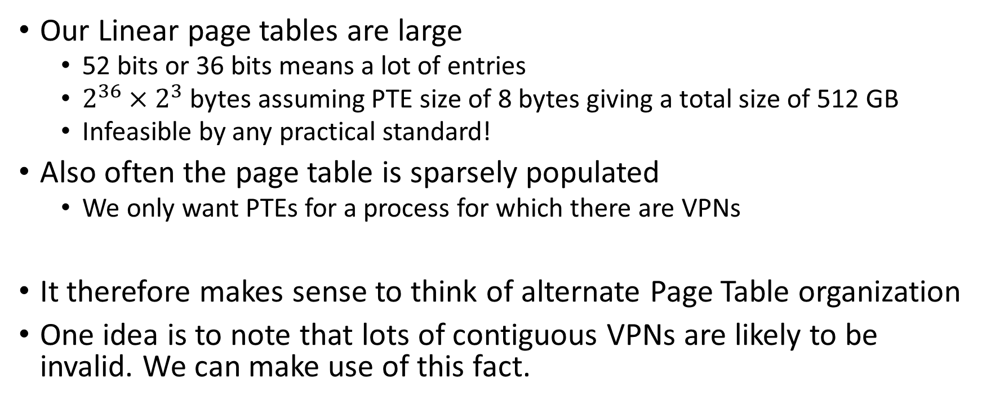
Dealing with large Page Tables in RAM
Our Linear page tables are large
52 bits or 36 bits means a lot of entries
$2^{36}×2^{3}$bytes assuming PTE size of 8 bytes giving a total size of 512 GB
Infeasible by any practical standard!
Also often the page table is sparsely populated
We only want PTEs for a process for which there are VPNs
It therefore makes sense to think of alternate Page Table organization
One idea is to note that lots of contiguous VPNs are likely to be invalid. We can make use of this fact.

Slide 47
How to deal with large page tables - Directory
Recall that the Page Table is in the RAM
So it occupies a number of frames.
If a whole frame worth of PTEs are invalid, we just don’t have to keep a frame reserved for that.
We can use the address splitting idea to split the VPN for this purpose
And our PTEs will only be contiguous within a frame.
X
X
X
X
Page Table in the RAM is spread over multiple frames

Slide 48

How to deal with large page tables - Directory
VPN
If a whole frame worth of PTEs are invalid, we just don’t have to keep a frame reserved for that.
We can use the address splitting idea to split the VPN for this purpose
X
X
X
X
H I D D E N
X
X
X
We can maintain a “directory” of which pages of PTEs are useful. For the others there is no page for PTEs allocated!
X
X
X
X
Page Table is itself in memory, spread over pages
X

Slide 49
Towards Page Table Hierarchy on x86-64
VPN
VPN
OFFSET
0
9 bits
12 bits
In a small world we just have a PTE which is one page big
Happens if our VFN is small, say 9 +12=21 bits.
The 9 bits then index into the PTE as shown
In reality we have a lot more than 9 bits in our VPN
512 entries
4096 byte
PTEs
page table
page

Slide 50
Towards Page Table Hierarchy on x86-64
VPN
PDE
PTE
OFFSET
0
va :
9 bits
9 bits
12 bits
We could use the next 9 bits as an index to a Page holding pointers to a page worth of PTEs
We could thus point to multiple pages of PTEs.
This definitely appears as a complicated way to do a linear table.
However, we could play a trick: if a page worth of PTEs is going to be invalid, just dont allocate a page!
We can further extend this idea…
512 entries
512 entries
4096 byte
PTEs
PTEs
PTEs
PTEs
page directory
page table
page

Slide 51
Page Table Hierarchy on x86-64
M O D I F I E D
63
47
PML4E
PDPTE
PDE
PTE
OFFSET
0
RESERVED
9 bits
9 bits
9 bits
9 bits
12 bits
512 entries
512 entries
512 entries
512 entries
4096 byte
OLD
PTEs
PTEs
PTEs
PTEs
page global directory
Page middle directory
page directory
page table
page
36 bits
%cr3

Slide 52
Page Table Hierarchy on x86-64
VPN
63
47
PML4E
PDPTE
PDE
PTE
OFFSET
0
va :
RESERVED
9 bits
9 bits
9 bits
9 bits
12 bits
512 entries
512 entries
512 entries
512 entries
4096 byte
PTEs
PTEs
PTEs
PTEs
page global directory
Page middle directory
page directory
page table
page
36 bits
CR3
X86-64 understands this hierarchy and ‘walks’ through it
(as a hardware operation) when a TLB miss occurs!

Slide 53
Page Table Hierarchy on x86-64 – another visualization
VPN
63
47
PML4E
PDPTE
PDE
PTE
OFFSET
0
va :
RESERVED
9 bits
9 bits
9 bits
9 bits
12 bits
CR3
index
index
Frame with the physical location
index
pa
PTEs with the PFNs are here!
index
PFN
Offset

Slide 54
As an aside
Most modern Intel processors support something called
Program Context ID (also called address space ID)
This is inside CR3
It may be used to allow multiple processes' PTEs to exist in the TLB at the same time.
Linux uses this to support PTE’s from multiple processes to be in the TLB at the same time. Reduces TLB flushing.

Slide 55
Copy on write – Avoiding “duplicate pages”
Some pages like the code for executables, especially libraries, are heavily shared among processes. This saves a lot of duplicate frames.
Further when a process forks, not only the code, but the data pages also initially stay the same
A copy is only made when it is actually written to.
This is called copy on write (COW) page usage.

Slide 56
Memory allocation from a contiguous memory pool (part of address space)
malloc() … usually gets a chunk of memory from the OS (in pages) and manages itself.
How to track free memory pieces
(a) split (b) coalesce
Maintain a linked list of free pieces
The buddy method
In the kernel another trick is also used – slab allocation
Basically pre-create a number of typically used small structures and keep them available for immediate allocation, even pre-initialized.
See /proc/slabinfo

Slide 57
Summary – Memory Management
AIM: Support(TEP) multiple programs to be resident at the same time
Translation is the key
Base and bound is a core idea – with HW Support – MMU
Segmentation provides more protection, more flexibility
Introducing page frames: Paging - removes external fragmentation, Page Tables in RAM
Paging is slow, because it needs too many “PTEs” in the MMU – wont happen.
TLBs are to our rescue
Caches a small set of PTEs in the MMU
Dealing with TLB-Miss and Page-fault and the role of swapping
But the PT can become large too
Hierarchical PTs
We saw a couple of tools along the way to explore how this happens in Linux/x86-64

Slide 58
Ends the section on Memory Management

