Slide 1
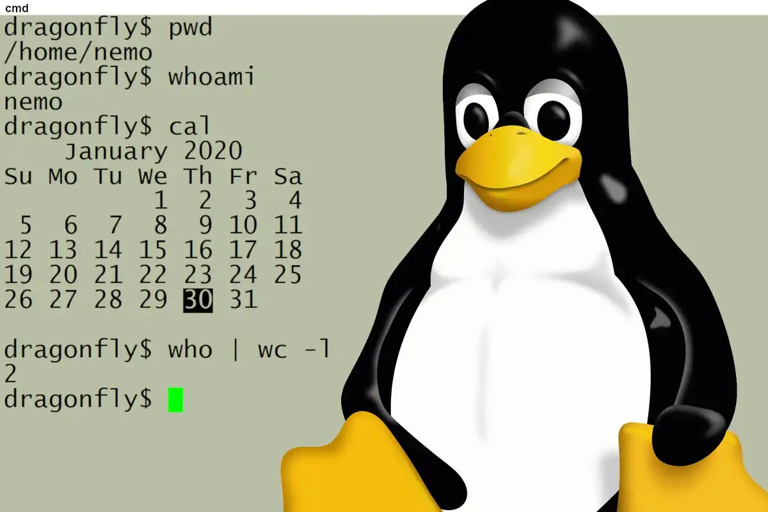
EGC 301P Operating Systems

Slide 2
Marks Distribution
Submission Date | OS Lab Evaluation (1 credit) | Marks (%)
Feb 2024 | Hands-on List 1 (1-30 lab exercises) | 30
March 2024 | Hands-on List 2 (31-64 lab exercises) | 30
April 2024 | Mini Project | 40
 | Total | 100

Slide 3
File Management

Slide 4
File Types
File Types
$lsof - List open files
regular
Directory
Special
Device
Link
Socket
FIFO
Character
Soft
Block
Hard

Slide 5
$ ls -l
Identification of File types
? r w - r- - r- -
?-specifies a type of a file
Regular (-)
Directory (d)
Special Files
Special Files
FIFO (p)
Socket (S)
Link File
Soft Link (l)
Hard Link (inode numbers are same)
Device File
Character (c)
Example: Monitor, Keyboard, Mouse, Tape
Block (b)
Example: Hard disk, CDROM, Floppy

Slide 6
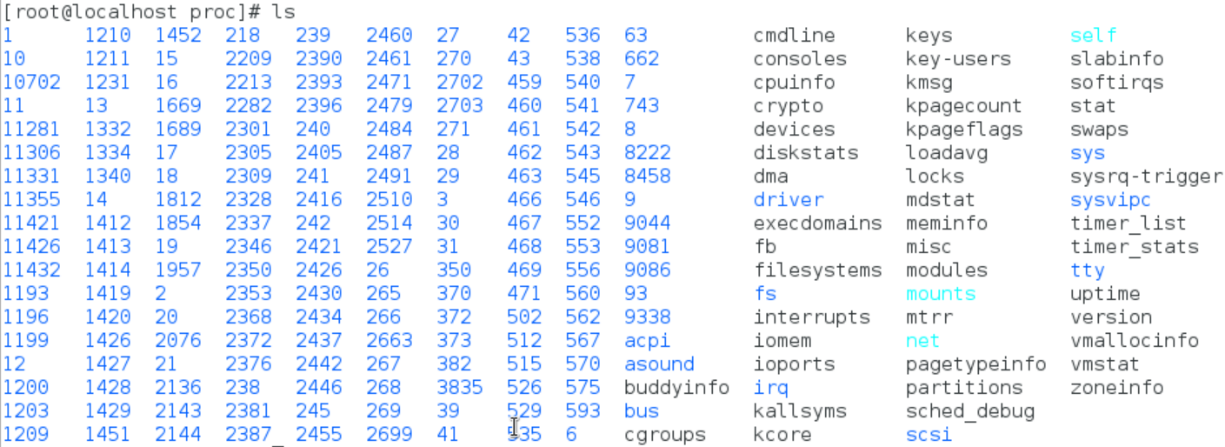
procfs
To store necessary information about currently running processes, system information and limitations. Size of /proc is zero. Created on the fly.

Slide 7
Interaction between fd and Data Block

Slide 8
System Calls
File descriptor table (fd, process specific)
File table (offset, mode, permission, pointer to inode table)
Inode Table (inode number, pointer to Data Block).
Switch table (only for device special files)
Data Block (where a file is stored)
The system call code is physically located in the kernel. The kernel itself is stored in a separate area of memory - which is normally not accessible to the process.
Therefore, the first thing that is required to execute a system call is to change to Kernel Mode - so that the kernel memory can be accessed - this is what the “int 0x80” instruction in system call wrapper function (on Intel) does.
Library Functions (Application Programs)
fopen, fwrite, fread, fclose
System Calls (System Programs)
open, write, read, close
Entry Points (Kernel Programs)
my_open, my_write, my_read, my_release

Slide 9
read(fd, &buff, sizeof(buf))
creat / open
read, write
lseek
close, unlink
dup / dup2
fcntl
stat
select
sync
Return to caller - 10
Library procedure
read
Trap to the kernel - 6
Put code for read in register
5
Increment stack pointer -11
User Space
User program calling read
Call read - 4
Push fd - 3
Push &buf - 2
Push sizeof(buf) -1
9
7
Dispatch
System call
handler
Kernel Space
8
System Call vector table

Slide 10
System Calls
int creat (char *file_name, mode_t mode)
int open(char *file_name, int flags);
int open (char *file_name, int flags,mode_t mode);
Ex: fd = open(“temp”, O_RDWR|O_CREAT, 0744);
dup or dup2 copies the oldfd into the newfd.
int new_fd = dup (old_fd);
int dup2 (int new_fd, int old_fd);
new_fd and old_fd shares: locks, file position and flags.
int write ( int fd, const void *buf, int count); it writes count bytes to the file from the buf.
On success return with: Number of bytes written
0 - indicates nothing was written or -1 on error.

Slide 11
System Calls
int write ( int fd, const void *buf, int count);
it writes count bytes to the file from the buf.
On success return with: Number of bytes written
0 - indicates nothing was written or -1 on error.
int read ( int fd, void *buf, int count);
It reads count bytes from the file and store the data into the buf.
On success return with: Number of bytes read
0 - indicates end of the file or -1 on error.
int lseek (int fd, long int offset, int whence);
whence: SEEK_SET, SEEK_CUR or SEEK_END – from the end of file
On success the system call returns with any one of the following value:
Offset value or 0 or -1

Slide 12
System Calls
int stat (“file_name”, struct stat *);
int fstat (fd, struct stat *);
int lstat (“file_name”, struct stat *);
Select is a system call used to handle more than one file descriptor in an efficient manner.
int select (int n, fd_set *readfds, fd_set *writefds, fd_set *exceptfds, struct timeval *timeout);
fd_set is the file descriptor set, which is an arrays of file descriptors.
FD_CLR (int fd, fd_set *myset); FD_ISSET (int fd, fd_set *myset);
FD_SET (int fd, fd_set *myset); FD_ZERO (fd_set *myset);

Slide 13
Types of Locking
Two Types
Mandatory locking
Lock an entire file
Advisory (or ) Record locking
Lock to specific byte range
Granularity
Improve Performance

Slide 14
Mandatory Vs Record Locking
p1
p4
p1
p4
READ
WRITE
READ
WRITE
1 Sec
1 Sec
1 Sec
1 Sec
READ
FILE
p2
p2
READ
WRITE
Processes
Operating
on different
Records
1 Sec
WRITE
p5
1 Sec
READ
p5
READ
1 Sec
1 Sec
p3
1 Sec
p3
1 Sec
Total Time = 1 + 1 +1= 3 sec
Total Time = 1 sec

Slide 15
flock Structure
struct flock {
short l_type;
/* lock type: read, write or unlock */
short l_whence;
off_t l_start;
off_t l_len;
pid_t l_pid;
};
Read lock: allows many readers but not a single writer
Write lock: allows only one writer but not a single reader
Lock or unlock is performed by fcntl function.
int fcntl (int fd, int cmd, struct flock &);
Command may be:
F_SETLKW
F_SETLK
F_GETLK

Slide 16
Process Management

Slide 17
Process States
$ls -> fork() -> child process-> exec(“ls”)-> ret. Parent
Running
(User Mode)
Run Queue
Running
(Kernel)
Zombie
fork ( )
exit
TASK_RUNNING
TASK_INTERRUPTIBLE
TASK_UNINTERRUPTIBLE
TASK_STOPPED
TASK_ZOMBIE
Wake up
Sleeping
or
Stopped

Slide 18
Linux Scheduling Priority
Real Time
Non - Real Time
SCHED_FIFO
SCHED_RR
SCHED_OTHER
0
99
139
FIXED
DYNAMIC
Non - Real Time Process
Priority
-20
0
+19
Priority
300 ms
150 ms
10 ms
Time Slice

Slide 19
Linux Scheduling Priority
HIGER PRIORITY
LOWER PRIORITY
0
1
50
70
88
98
100
139
138
139
SYSTEM PRIORITY
99
98
3
0
REAL TIME PRIORITY
-20
0
19
NICE LEVEL
RT
-98
-80
-55
-5
0
38
39
$top OUTPUT

Slide 20
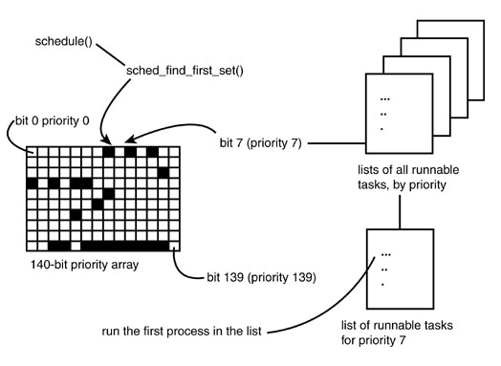
O(1) Scheduler
Ref: Linux Kernel Development by Robert Love

Slide 21
nice and chrt –Manipulate Scheduling Priorities
Command Priority nice
$nice -19 ./a.out 39 19
$nice -10 ./a.out 30 10
$nice -20 ./a.out
$renice –n 5 –p <pid>
xyz (process ID) old priority 19, new priority 5
$renice –n -20 –p <pid>
Old priority 5, new priority -20
In top command: PR – 0; NI = -20
Command Priority nice
$chrt -r –p -1 <pid> < NOT VALID COMMEND>
$chrt -r –p 0 <pid> 20 0
$chrt -r –p 1 <pid> -2 0
$chrt -r –p 5 <pid> -6 0
$chrt -r –p 50 <pid> -51 0
$chrt -r –p 90 <pid> -91 0
$chrt -r –p 98 <pid> -99 0
$chrt -r –p 99 <pid> RT 0
$chrt -r –p 100 <pid> < NOT VALID COMMEND>

Slide 22
Process Scheduling Commands
$nice -19 ./test.sh; top ;
r -> pid to renice; renice value: 10
$man chrt (1)
$chrt –m
Show minimum and maximum valid priorities.
$chrt -p <pid>
To display scheduling attributes of an existing task
$chrt -r -p 99 <pid>
Set scheduling policy to SCHED_RR
$ top -p <pid>
$chrt -f -p 99 <pid>
Set scheduling policy to SCHED_FIFO
$chrt -o -p 0 <pid>
Set scheduling policy to SCHED_OTHER
man 2 sched_setscheduler

Slide 23
System Calls for Scheduling
nice() Set a process's nice value
sched_setscheduler() Set a process's scheduling policy
sched_getscheduler() Get a process's scheduling policy
sched_setparam() Set a process's real-time priority
sched_getparam() Get a process's real-time priority
sched_get_priority_max() Get the maximum real-time priority
sched_get_priority_min() Get the minimum real-time priority
sched_rr_get_interval() Get a process's timeslice value

Slide 24
Daemon Process
Daemon process starts during system startup
They frequently spawn other process to handle services requests
Mostly started by initialization script /etc/rc
Waits for an event to occur
perform some specified task on periodic basis (cron job)
perform the requested service and wait
Example print server
executed as the background process
Orphan process
No controlling terminal
run with super user privileges
process group leaders
session leaders

Slide 25
Daemon Process Creation
Process Types
Parent
Child
Orphan
Daemon
int init_daemon ( void ) {
if ( ! fork ( ) ) {
setsid ( ) ;
chdir ( " / " ) ;
umask ( 0 ) ;
/* Specify Your Job */
return ( 0 );
}
else
exit ( 0 );
}
Process States
Running (R)
Stopped (T)
Sleep
Interruptible (S)
Uninterruptible (D)
Zombie (Z)

Slide 26
System V IPC Mechanisms

Slide 27
pipe (or unnamed pipe “|”)
On command line pipe is represented as “|”
It can be used in the shell to link two or more commands
For example ls –Rl | wc
Two ends of a pipe is represented as a set of two descriptors.
A pipe is used to communicate between related processes.
Half duplex
Data is passed in order.
Pipe uses circular buffer and it has zero buffering capacity
The read and write system calls are blocking calls.

Slide 28
Pipe – half duplex
read
fd[0]
write
fd[1]
int fd[2];
pipe(fd);
-returns with fd[0], fd[1];
write(fd[1], …………);
read(fd[0], ……….);
Create a pipe.
Call fork.
Parent can send data and child can read the data or vice versa.
Unused ends (descriptors) should be closed.

Slide 29
One way data transfer from related process
One-way communication from parent to child
fd[0] fd[0]
read
Close read end
Child
process
pipe
Parent
process
write
Close write end
fd[1]
fd[1]

Slide 30
Two Way Communication
Create two pipes say fd1, fd2.
Four descriptors for each process (fd1[0], fd1[1], fd2[0], fd2[1]).
Parent closes read end of fd1 and write end of fd2 close(fd1[0], fd2[1]);
child closes read end of fd2 and write end of fd1 close(fd2[0], fd1[1]);
Child
Parent
fd1[1]
fd1[0]
pipe1
pipe2
fd2[0]
fd2[1]

Slide 31
Execution of command: $ ls –Rl | grep ^d | wc -l
Ls –Rl
grep ^d
wc -l
Stdin
Stdout
Stdin
Stdout
Process
kernel
Pipe advantages:
Simplest form of IPC
Persistence in process level
Can be used in shell
Disadvantages:
Cannot be used to communicate between unrelated processes
Pipe1
Pipe2
Flow of data
Flow of data

Slide 32
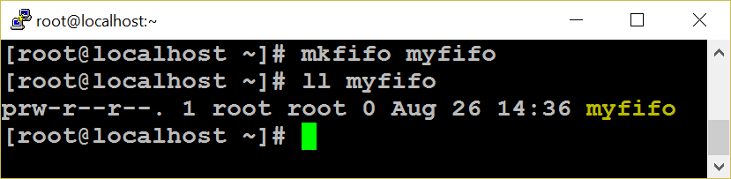
FIFO -Introduction
FIFO can be created in a shell by using mknod or mkfifo command.
mknod myfifo p
mkfifo a=rw myfifo
In a C program mknod system call or mkfifo library function can be used.
int mkfifo ( char *file_name, mode_t mode);
int mknod (char *file_name, mode_t mode, dev_t dev);
mknod(“./MYFIFO", S_IFIFO|0666, 0);
FIFO works much like a pipe
Half duplex, data passed in FIFO order, circular buffer and zero buffering capacity.
FIFO is created on a file system as a device special file
It can be used to communicate between unrelated processes
It can be reused.
Persist till the file is deleted.

Slide 33
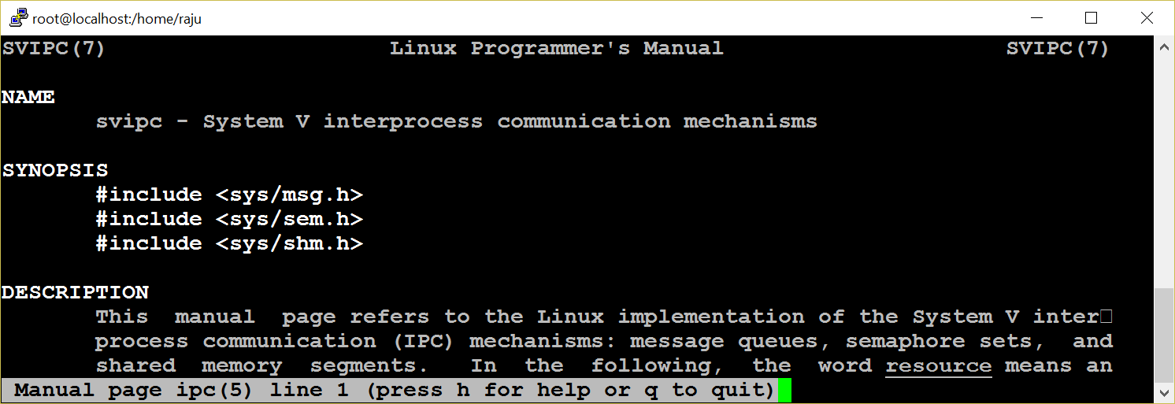
System V IPC
Pipe and FIFO do not satisfy many requirements of many applications.
Sys V IPC is implemented as a single unit
System V IPC Provides three mechanisms namely : MQ, SHM and SEM
Persist till explicitly delete or reboot the system

Slide 34
Attributes
Each IPC objects has the following attributes.
key
id
Owner
Permission
Size
Message queue – used-bytes, number of messages
Shared memory – size, number of attach, status
Semaphore – number of semaphores in a set
The ipc_perm structure holds the common attributes of the resources.
Key:
the first step is to create a shared unique identifier.
The simplest form of the identifier is a number
the system generates this number dynamically by using the ftok library function.
Syntax: key_t ftok (const char *filename, int id);

Slide 35
ID
The syntax for a get function is:
int xxxget (key_t key, int xxxflg);
(xxx may be msg or shm or sem)
If successful, returns to an identifier; otherwise -1 for error.
The key can be generated in three different ways
from the ftok library function
by choosing some static positive integer value
by using the IPC_PRIVATE macro
flags commonly used with this function are IPC_CREAT and IPC_EXCL.
The syntax for the control function is:
int xxxctl (int xxxid, int cmd, struct xxxid_ds *buffer); (xxx may be msg or shm or sem);
If successful, the xxxctl function returns zero, otherwise it returns -1.
The command argument may be
IPC_STAT
IPC_SET
IPC_RMID

Slide 36
Message Q
Message queue overcomes FIFO limitation like storing data and setting message boundaries.
Create a message queue
Send message (s) to the queue
Any process who has permission to access the queue can retrieve message (s).
remove the message queue.
Stuct
msgqid_ds
p
p
Message read from head
New Messages added at tail
msg
msg
msg
p
p

Slide 37
Message Q
struct msgbuf {
long mtype;
char mtext [1];
}; Standard structure
msqid xxx
mtype x₁
msg text
mtype x₂
msg text
mtype x₃
msg text
struct My_msgQ {
long mtype;
char mtext [1024];
void * xyz;
}; Our own structure
mtype x₄
msg text
mtype x₅
msg text
---------
mtype x_{n}
msg text

Slide 38
MQ System Calls
int msgget (key_t key, int msgflg);
The first argument key can be passed from the return value of the ftok function or made IPC_PRIVATE.
To create a message queue, IPC_CREAT ORed with access permission is set for the msgflg argument.
Ex: msgid = msgget (key, IPC_CREAT | 0744);
msgid = msgget (key, 0);
syntax of the function is:
ssize_t msgrcv (int msqid, struct msgbuf *msgp, size_t msgsz, long msgtype, int msgflg);
msgtype argument is used to retrieve a particular message.
0 -retrieve in FIFO order
+ve - retrieve the the exact value of the message type
–ve - first message or <= to the absolute value.
on success, msgrcv returns with the number of bytes actually copied into the message text
The syntax of the function is:
int msgsnd (int msqid, structu msgbuf *msgp, size_t msgsz, int msgflg);
Arguments:
message queue ID, address of the structure.
size of the message text
message flag = 0 or IPC_NOWAIT

Slide 39
MQ System Calls
syntax of the function is:
ssize_t msgrcv (int msqid, struct msgbuf *msgp, size_t msgsz, long msgtype, int msgflg);
msgtype argument is used to retrieve a particular message.
0 -retrieve in FIFO order
+ve - retrieve the the exact value of the message type
–ve - first message or <= to the absolute value.
on success, msgrcv returns with the number of bytes actually copied into the message text
key = ftok (“.“, ‘a‘);
msqid = msgget (key, IPC_CREAT|0666);
msgsnd (msqid, &struct, sizeof (struct), 0);
msgrcv (msqid, &struct, sizeof (struct), mtype, 0);
msgctl (msqid, IPC_RMID, NULL);
$ipcrm msg msqid

Slide 40
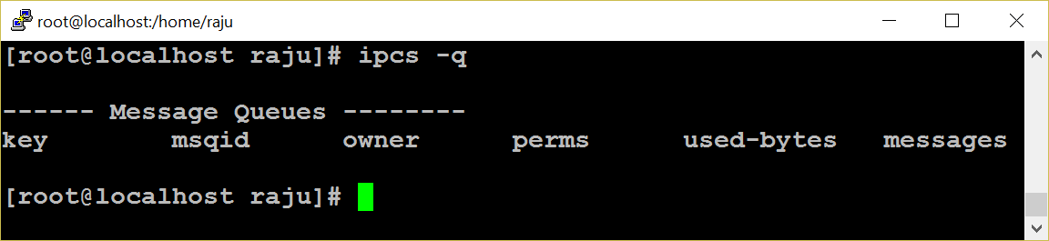
MQ Limitations
Message queues are effective if a small amount of data is transferred.
Very expensive for large transfers.
During message sending and receiving, the message is copied from user buffer into kernel buffer and vice versa
So each message transfer involves two data copy operations, which results in poor performance of a system.
A message in a queue can not be reused

Slide 41
Shared Memory - Introduction
Very flexible and ease of use.
Fastest IPC mechanisms
shared memory is used to provide access to
Global variable
Shared libraries
Word processors
Multi-player gaming environment
Http daemons
Other programs written in languages like Perl, C etc.,
Kernel
shmid
shmid
pointer
Shared Memory Size
Shm size
Physical Memory
shmget( )
shmat( )

Slide 42
Shared Memory
Shared memory is a much faster method of communication than either semaphores or message queues.
Does not require an intermediate kernel buffer
Using shared memory is quite easy. After a shared memory segment is set up, it is manipulated exactly like any other memory area.
The steps involved are
Creating shared memory
Connecting to the memory & obtaining a pointer to the memory
Reading/Writing & changing access mode to the memory
Detaching from memory
Deleting the shared segment

Slide 43
shm – system calls
shmget system call is used to create a shared memory segment.
The syntax:
int shmget (key_t key, int size, int shmflg);
key: the return value of ftok function.
size: size of the shared memory.
shmflg: IPC_CREAT|0744
On success the shmget returns the shared memory ID or else it returns -1.
used to attach the created shared memory segment onto a process address space.
void *shmat(int shmid,void *shmaddr,int shmflg)
Example: data=shmat(shmid,(void *)0,0);
A pointer is returned on the successful execution of the system call and the process can read or write to the segment using the pointer.

Slide 44
shm – system calls
Reading or writing to a shared memory is the easiest part.
The data is written on to the shared memory as we do it with normal memory using the pointers
Example -
Read:
printf (“SHM contents : %s \n”, data);
Write:
printf (“”Enter a String : ”);
scanf (“ %[^\n]”,data);
The detachment of an attached shared memory segment is done by shmdt to pass the address of the pointer as an argument.
Syntax: int shmdt (void *shmaddr);
To remove shared memory call:
int shmctl (shmid,IPC_RMID,NULL);
These functions return –1 on error and 0 on successful execution.

Slide 45
shm –system calls
shmid = shmget (key, 1024, IPC_CREAT|0744);
void *shmat (int shmid, void *shmaddr, int shmflg); if the shm is read only pass SHM_RDONLY else 0
(void *)data = shmat (shmid, (void *)0, 0);
int shmdt (void *shmaddr);
int shmctl (shmid, IPC_RMID, NULL);
Data can either be read or written only. Append ?
Race condition
Since many processes can access the shared memory, any modification done by one process in the address space is visible to all other processes.
Since the address space is a shared resource, the developer should implement a proper locking mechanism to prevent the race condition in the shared memory.

Slide 46

Semaphore
Synchronization Tool
An Integer Number
P ( ) And V ( ) Operators
Avoid Busy Waiting
Types of Semaphore
Used in :
shared memory segment
message queue
file

Slide 47
Types of Semaphore
Semaphore
User Level
Kernel Level
POSIX
Sys V
Semaphore Set/array of semaphore
Read Semaphore
Write Semaphore
Named
Unnamed
Binary
Counting
Binary
Counting
Binary
Counting

Slide 48
p and v operations
Incrementing Operations:
int v (int i)
{
i = i + 1; (unlock)
return i;
}
If a process wants to use the shared object, it will “lock” it by asking the semaphore to decrement the counter
Depending upon the current value of the counter, the semaphore will either be able to carry out this operation, or will have to wait until the operation becomes possible
The current value of counter is >0, the decrement operation will be possible. Otherwise, the process will have to wait
Decrementing Operations:
int p (int i) {
if (i > 0)
then
i--; (lock)
else
wait till i > 0;
return i;
}
System V semaphore provides a semaphore set - that can include a number of semaphores. It is up to user to decide the number of semaphores in the set
Each semaphore in the set can be a binary or a counting semaphore. Each semaphore can be used to control access to one resource - by changing the value of semaphore count

Slide 49
Semaphore Implementation
union semun {
int val; // value for SETVAL
struct semid_ds *buf; // buffer for IPC_STAT, IPC_SET
unsigned short int *array; // array for GETALL, SETALL
};
union semun arg;
semid = semget (key, 1, IPC_CREAT | 0644);
arg.val = 1;
/* 1 for binary else > 1 for Counting Semaphore */
semctl (semid, 0, SETVAL, arg);
struct sembuf {
short sem_num; /* semaphore number: 0 means first */
short sem_op; /* semaphore operation: lock or unlock */
short sem_flg; /* operation flags : 0, SEM_UNDO, IPC_NOWAIT */
};
struct sembuf buf = {0, -1, 0}; /* (-1 + previous value) */
semid = semget (key, 1, 0);
semop (semid, &buf, 1); /* locked */
-----Critical section--------
buf.sem_op = 1;
semop (semid, &buf, 1); /* unlocked */

Slide 50
Socket Programming - TCP/IP Protocol Stack
A socket is used to communicate between different machines (different IP addresses). Socket of type SOCK_STREAM is full-duplex byte streams.
Application (telnet/ftp)
Application details
User process
Sockets
Transport Layer
TCP
UDP
Kernel
Network Layer
IP
Device Driver and Hardware
Communication details

Slide 51


Socket Programming – Client Server Model
Client x
Concurrent Server
A socket is a communication endpoint and represents abstract object that a process may use to send or receive messages.
The two most prevalent communication APIs for Unix Systems are Berkeley Sockets and System V Transport Layer Interface(TLI)
Socket Program
Client 1
Server
Client y

Slide 52
socket ( ) system call
The typical client -server relationship is not symmetrical
Network Connection can be connection-oriented or connectionless
More parameters must be specified for network connection, than for file I/O
The Unix I/O system is stream oriented
The network interface should support multiple communication protocol
int socket (int domain,int type,int protocol);
Domain (AF – Address Family)
AF_UNIX for UNIX domain
AF_INET for Internet domain
Socket type
SOCK_STREAM for TCP (Connection Oriented)
SOCK_DGRAM for UDP (Connectionless)
Protocol
Protocol number is used to identify an application. List of the protocol number and the corresponding applications can be seen at /etc/protocols.
The socket system call returns a socket descriptor on success and -1 for failure.

Slide 53
Socket Functions
TCP Server
socket( )
bind( )
listen( )
socket( )
accept( )
connect( )
Connection establishment
Blocks until connection from client
3 way hand shake
write( )
read( )
Request
read( )
write( )
Reply
close( )
read( )
End of file notification
close( )

Slide 54
sock structure
struct sockaddr_in {
short int sin_family;
unsigned short int sin_port;
struct in_addr sin_addr;
}
sin_family - address family
sin_port - port number
sin_addr - internet address (IP addr)
The in_addr structure used to define sin_addr is as under
struct in_addr {
unsigned long s_addr;
/* refers to the four byte IP address */
}
Little endian byte order : example: Intel series
High order byte low order byte
Address A+1
00 01 64 C1
Address A
Increasing memory address
Big endian byte order : example: IBM 370, Motorola
High order byte low order byte
Address A+1
C1 64 01 00
Address A
Increasing memory address
Byte ordering ex: 91,329 hex: 00 01 64 C1

Slide 55
Socket system calls
Internet protocols use big endian byte ordering called network byte order
The following functions allow conversions between the formats.
#include <netinet/in.h>
htons() – "Host to Network Short"
htonl() – "Host to Network Long"
ntohs() – "Network to Host Short"
ntohl() – "Network to Host Long"
h stands for host n stands for network
s stands for short l stands for long
int bind (int sockfd, struct sockaddr *my_addr,int addrlen);
sockfd - the socket file descriptor returned by socket().
my_addr - a pointer to a struct sockaddr that contains information about IP address and port number.
addrlen - set to sizeof (struct sockaddr)

Slide 56
Socket system calls
int connect (int sockfd, struct sockaddr *serv_addr, int addrlen);
sockfd - the socket file descriptor returned by socket().
serv_addr - is a struct sockaddr containing the destination port and IP address.
addrlen - set to sizeof (struct sockaddr).
int listen (int sockfd,int backlog);
sockfd - the socket file descriptor returned by socket().
backlog - the number of connections allowed on the incoming queue.
Backlog should never be zero as servers always expect connection from client.
The listen function converts an unconnected socket into a passive socket,
On successful execution of listen is indicating that the kernel should accept incoming connection requests directed to this socket.

Slide 57
Socket system calls
int accept (int sockfd, void *addr, int *addrlen);
sockfd
the socket file descriptor returned by socket().
addr
a pointer to a struct sockaddr_in. The information about the incoming connection like IP address and port number are stored.
addrlen
a local integer variable that should be set to sizeof (struct sockaddr_in) before its address is passed to accept().
Socket descriptor can be closed like file descriptor.
close (sockfd);
Close system call prevents any more reads and writes to the socket. For attempting to read or write the socket on the remote end will receive an error.

Slide 58
Socket system calls
int shutdown (int sockfd, int how);
sockfd - socket file descriptor of the socket to be shutdown.
how – if it is
0 - Further receives are disallowed
1 - Further sends are disallowed
2 - Further sends and receives are disallowed.
The shutdown system call gives more control (than close (sockfd) over how the socket descriptor can be closed.

Slide 59
Socket Programming
SERVER
struct sockaddr_in serv, cli;
sd = socket (AF_INET, SOCK_STREAM, 0);
serv.sin_family = AF_INET;
serv.sin_addr.s_addr = INADDR_ANY;
serv.sin_port = htons (portno);
bind (sd, &serv, sizeof (serv));
listen (sd, 5);
nsd = accept (sd, &cli, &sizeof (cli));
read / write (nsd, ….);
CLIENT
struct sockaddr_in serv;
sd = socket (AF_INET, SOCK_STREM, 0);
serv.sin_family = AF_INET;
serv.sin_addr.s_addr = inet_addr (“ser ip”);
serv.sin_port = htons (portno);
connect (sd, &server, sizeof (server));
read / write (sd, ….);

Slide 60
Iterative Vs Concurrent Server
Many clients requests can be serviced concurrently
while (1) {
nsd =(accept (sd, &cli, ….);
if (!fork( )) {
close(sd);
read/write(nsd, …..);
exit();
} else
close(nsd);
}
One client request at a time.
nsd = accept (sd, &cli,…);
while (1) {
read/write(nsd, …);
}

Slide 61
Timers, Resource Limits, Multithreading and Signals

Slide 62
Alarm and Timers
unsigned int alarm (unsigned int seconds);
It is used to set an alarm for delivering SIGALARM signal.
On success it returns zero.
Three interval timers.
ITIMER_REAL
This timer counts down in real (i.e., wall clock) time. At each expiration, a SIGALRM signal is generated.
ITIMER_VIRTUAL
This timer counts down against the user-mode CPU time consumed by the process. (The measurement includes CPU time consumed by all threads in the process.) At each expiration, a SIGVTALRM signal is generated.
ITIMER_PROF
This timer counts down against the total (i.e., both user and system) CPU time consumed by the process. At each expiration, a SIGPROF signal is generated.

Slide 63
get and set timer
get value of an interval timer
int getitimer ( int which, struct itimerval *val);
On success it returns zero and the timer value is stored in the itimverval structure.
Example: ret = getitimer (ITIMER_REAL, val);
Set value for a interval timer
int setitimer (int interval_timers, const struct itimerval *val, struct itimvferval *old_value);
On success it returns zero.
Example: ret = setitimer(ITIMER_REAL, &value, 0);

Slide 64
Time Stamp Counter
System can provide very high resolution time measurements through the time-stamp counter which counts the number of instructions since boot.
To measure Time Stamp Counter (TSC)
# include <sys/time.h>
unsigned long long rdtsc ( )
{
unsigned long long dst;
_ _asm_ _ _ _volatile_ _ (“rdtsc”:”=A” (dst));
return dst;
}
main ( )
{
long long int start, end;
start = rdtsc();
/* Give your job; */
end = rdtsc();
printf (" Difference is : %llu\n", end - start);
}
/* This is the most accurate way of time measurement */

Slide 65
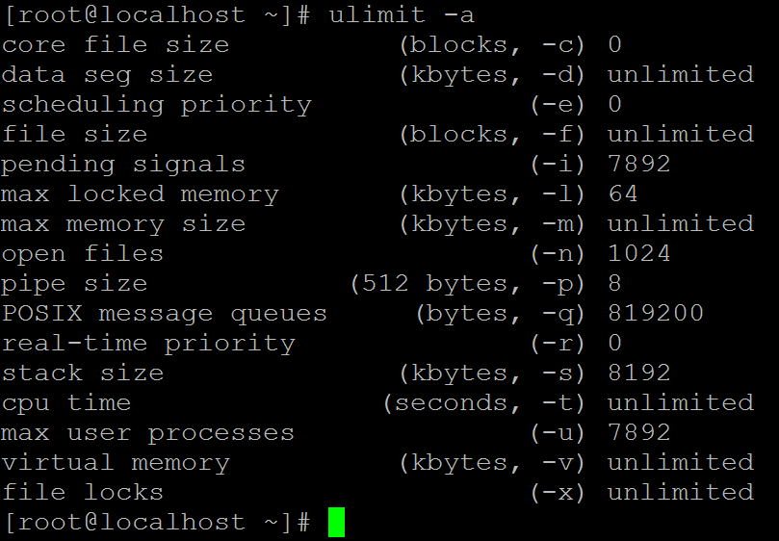
Resource Limits
The OS imposes limits for certain system resources it can use.
Applicable to a specific process.
The “ulimit” shell built-in can be used to set/query the status.
“ulimit –a” returns the user limit values

Slide 66
Hard and Soft Limits
-c → Maximum size of “core” files created.
-f → Maximum size of the files created.
-l → Maximum amount of memory that can be locked using mlock() system call.
-n → Maximum number of open file descriptors.
-s → Maximum stack size allowed per process.
-u → Maximum number of processes available to a single user.
Each resource has two limits –Hard and Soft
Hard Limits
Absolute limit for a particular resource. It can be a fixed value or “unlimited”
Only superuser can set hard limit.
“ulimit” command has –H or –S option to set hard/soft limits. Default is soft limit.
Hard limit cannot be increased once it is set.
Soft Limits
User-definable parameter for a particular resource.
Can have a value of 0 till <hard limit> value.
Any user can set soft limit.
Limits are inherited (the new values are applicable to the descendent processes).

Slide 67
Resource Limitation
getrlimit()/setrlimit() are system-call interfaces for getting and setting resource limits.
Syntax
getrlimit(<resource>, &r)
setrlimit (<resource>, &r)
where r is of type “struct rlimit”
int getrlimit(int resource, struct rlimit *rlim);
int setrlimit(int resource, const struct rlimit *rlim);
int prlimit(pid_t pid, int resource, const struct rlimit *new_limit, struct rlimit *old_limit);
struct rlimit {
rlim_t rlim_cur; /* Soft limit */
rlim_t rlim_max; /* Hard limit (ceiling for rlim_cur) */
};

Slide 68
Resource Usage
struct rusage {
struct timeval ru_utime; /* user CPU time used */
struct timeval ru_stime; /* system CPU time used */
long ru_maxrss; /* maximum resident set size */
long ru_ixrss; /* integral shared memory size */
long ru_idrss; /* integral unshared data size */
long ru_isrss; /* integral unshared stack size */
long ru_minflt; /* page reclaims (soft page faults) */
long ru_majflt; /* page faults (hard page faults) */
long ru_nswap; /* swaps */
long ru_inblock; /* block input operations */
long ru_oublock; /* block output operations */
long ru_msgsnd; /* IPC messages sent */
long ru_msgrcv; /* IPC messages received */
long ru_nsignals; /* signals received */
long ru_nvcsw; /* voluntary context switches */
long ru_nivcsw; /* involuntary context switches */
};
int getrusage(int who, struct rusage *usage);
getrusage() returns resource usage measures
for who, which can be one of the following:
RUSAGE_SELF
RUSAGE_CHILDREN
RUSAGE_THREAD
sysconf - get configuration information at
run time:
long sysconf(int name);
Example: ret= sysconf(_SC_CLK_TCK);
On success it returns the value of the given system limits.

Slide 69
Multi Threading
Thread is a sequential flow of control through a program.
If a process is defined as a program in execution then a thread is defined as a function in execution.
If a thread is created, it will execute a specified function.
Two type of threading: 1. Single Threading and 2. Multi threading
The created threads within a process share 1. instructions of a process 2. process address space and data 3. open file descriptors 4. Signal Handlers 5. pwd, uid and gid
The created threads maintain it’s own
1. thread identification number (tid); 2. pc, sp, set of registers 3. stack
4. priority of the threads
5. scheduling policy
Advantages of Threads:
Takes less time for creation of a new thread, termination of a thread and communication between threads are easier.

Slide 70

Advantages
Improve application responsiveness
Use multiprocessors more efficiently
Improve program structure
use fewer system resources
Specific applications in uniprocessor machines
Applications
A file server on a LAN
GUI
web applications
Display on monitor
Kernel
Auto Saving
Input from keyboard

Slide 71
Thread Creation
#include <pthread.h>
void thread_func(void) { printf(“ Thread id is %d”, pthread_self()); }
main ( ) {
pthread_t mythread; pthread_create ( &mythread, NULL, (void *) thread_func, NULL);
}
This needs to be compiled as follows...$gcc pthread.c –lpthread
pthread_t is type-defined as unsigned long int. It takes the thread address as the first argument, the second argument is used to set the attributes for the thread-like stack size, scheduling policy, priority; if NULL is specified, then it takes default values for the attributes.
The third argument is the function that the thread should execute when created. The fourth argument is the argument for the thread function. If that function has a single argument to be passed, we can specify it here. If it has more than one argument, then we have to use a structure and declare all the arguments and pass the address of the structure.

Slide 72
Signals - Introduction
Signals are a fundamental method for inter process communication and are used in everything from network servers to media players.
A signal is generated when
an event occurs (timer expires, alarm, etc.,)
a user quota exceeds (file size, no of processes etc.,)
an I/O device is ready
encountering an illegal instruction
a terminal interrupt like Ctrl-C or Ctrl-Z.
some other process send ( kill -9 pid)
Each signal starts with macro SIGxxx.
Each signal may also specifies with its integer number
For help: $ kill –l , $ man 7 signal
When a signal is sent to a process, kernel stops the execution and "forces" it to call the signal handler.
When a process executes a signal handler, if some other signal arrives the new signal is blocked until the handler returns.

Slide 73
signal System Call
How a process receives a signal, when it is
executing in user mode
executing in kernel mode
not running
in interruptible sleep state
in uninterruptible sleep state
When a signal occurs, a process could
Catch the signal
Ignore the signal
Execute a default signal handler
Two signals that cannot be caught or ignored
SIGSTOP
SIGKILL
signal system call is used to catch, ignore or set the default action of a specified signal.
int signal (int signum, (void *) handler);
It takes two arguments: a signal number and a pointer to a user-defined signal handler.
Two reserved predefined signal handlers are :
SIG_IGN
SIG_DFL

Slide 74
Thank You

