Slide 1

Linux Basics and Shell Scripting Prof. B. Thangaraju
Course Materials are available at: https://drive.google.com/drive/folders/1ulyZmk4Zvg0yXp98lJzlAvhwL7-OleO2?usp=sharing

Slide 2
Name History
UNIX
The multitasking operating system PDP-7 supported two simultaneous users and Brian Kernighan humorously called it UNICS for the uniplexed Information and computing system. The name was changed to UNIX in 1970.
Linux
Started in 1991 by Linux Torvalds as a personal project to create a free OS Kernel.
Published under GPL
You can download the kernel sources code from kernel.org.
You can check your running kernel version in Linux system by executing the command: $ uname -r
UNIX Variants: Linux, Solaris, AIX, HP-UX
Notes:
In 1960 , MIT, AT&T Bell Labs and GE worked on an experimental Operating system called MULTICS. MULTICS (multiplexed information and computing system) was an OS for the GE 645 mainframe computer. It allowed information sharing and security.
Thomson, Ritchie and their colleagues created a multitasking OS, with file system, shell and some features for the PDP-7.
Since the new multitasking OS for the PDP-7 supported two simultaneous users it was called UNICS.

Slide 3
Unix features
Written in a high level language
Provides a simple user interface
Uses hierarchical file system
Gives File protection
Provides a simple and consistent interface to peripheral devices.
Is a multi-user, multi-process system.
Notes:
Written in a high level language (portability) - easy to read,understand, change and move to other operating systems.
Provides a simple user interface for example shell
Uses hierarchical file system: easy maintenance and efficient implementation.
Provides a simple and consistent interface to peripheral devices. User need not to worry about the intricacies of hardware details. The user can use the device as a file and perform all the file operations on a device. It hides the machine architecture from the user making it easier to write programs that run on different hardware implementations.

Slide 4
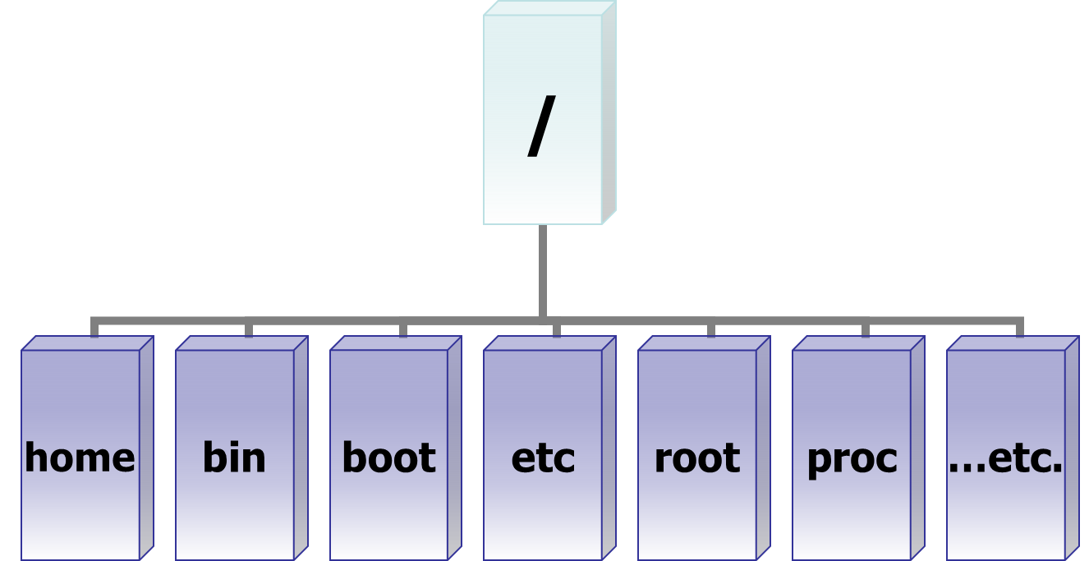
Layered Architecture
...
banner
ls
cp
kernel
sort
comp
sh
hardware
as
who
ld
a.out
User
vi
date
Inverted File Structure
ed
grep
wc
$man hier
hier - description of the filesystem hierarchy

Slide 5
Basic Commands – $man man
pwd - Print Working Directory
cd - Change Directory
mkdir - Make a Directory
rmdir - Remove Directory
ls - List Directory Contents
Permission settings use octal numbers. 0744 <file name>
r = 4; w = 2; x = 1; none = 0
cp - Copy a file
mv - Move a file
rm Remove a file
-r recursively delete the entire contents of the dir including directory as well
-i confirm delete ( rm –ir *)
chmod - Change file Permissions
-R recursively
chown - Change Ownership
chgrp - Change Group

Slide 6
Basic Commands - $wheris, $which
echo - Echo a statement
cat - Concatenate a file
more & less - page through a file
head - display the start of a file
tail - display the end of a file
find – To search the given file
du – To estimate file space usage
df – To report filesystem disk space usage
cmp - Compares two files, reports the location of first difference between them.
diff - Compares two files, reports all differences between them.
alias – to built own command (alias ‘rm=rm –i’)
!vi – to execute the last command
cal, date – to print the calendar and, date and time.
passwd – to change the existing pass word.
$find /home/raju/ -name fork.c

Slide 7
Basic Commands
File Compression
tar cvf backup.tar *
gzip backup.tar (-v give ratio)
gunzip backup.tar.gz
tar xvf backup.tar
ifconfig - configure a network interface
uptime - show current uptime
w -display who is online
whoami - who you are logged in as
uname -a -show kernel information
uname -r -show kernel version
free - show memory information
mount - mount a filesystem
umount – un mount a filesystem
ps - display all currently active processes
top - display all running processes
htop - interactive process viewer
kill pid - kill process id pid
background and foreground processes

Slide 8
UNIX File Types
File Types
regular
Directory
Special
Device
Link
Socket
FIFO
Character
Soft
Block
Hard

Slide 9
Shell Scripting
A Unix shell is a command language interpreter, the primary purpose of which is to translate command lines typed at a terminal into system actions.
The shell itself is a program through which other programs are invoked.
One handy thing you can do with the shell is to use standard UNIX commands as building blocks to create your own new commands.
To do this, you write a `shell script', which can contain a number of commands, and then the file can be executed as one command.
You can write shell script if you want to execute some automated, periodic and complex tasks.

Slide 10
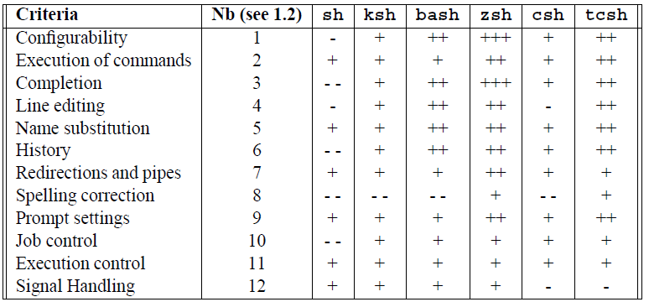
Comparison of Different Shells
$cat /etc/shells
+++ very good
++ good
+ existing
- weak
– absent

Slide 11
Variable
Variables are a way of passing information from the shell to programs when you run them.
Standard UNIX variables are split into two categories:
environment variables
shell variables
shell variables apply only to the current instance of the shell and are used to set short-term working conditions.
environment variables set at login are valid for the duration of the session.
By convention, environment variables have UPPER CASE and shell variables have lower case names.

Slide 12
Environment Variable
To set normal variable
i=5
echo $i
To set environment variable (Bash)
export i
To check environment variables : $env
For C shell: $setenv var value

Slide 13
I/O Redirection
$ ls –l > file_list
$ wc –l < file_list
$ ls –Rl >> file_list
$ ./a.out 2 > error.txt
What does 2&1 mean in shell script?
You use &1 to reference the value of the file descriptor 1 ( stdout ). So when you use 2>&1 you are basically saying “Redirect the stderr to the same place we are redirecting the stdout ”.
$ cat foo.txt > output.txt 2>&1
$ cat output.txt
foo
bar
baz
$ cat nop.txt > output.txt 2>&1
$ cat output.txt
cat: nop.txt: No such file or directory
$ cat a.c a.cc > outfile 2>&1
$ cat foo.txt
foo
bar
baz
$ cat nop.txt > output.txt
cat: nop.txt: No such file or directory

Slide 14
Pipe
The symbol | is the Unix pipe symbol that is used on the command line.
The standard output of the command to the left of the pipe gets sent as standard input of the command to the right of the pipe.
ls –Rl | grep ^d – Single Pipe
ls –Rl | grep ^d | wc –l – two pipes
Two types of pipes: named and unnamed (|)

Slide 15
Grep - Global Regular Expression Print
The basic usage of grep command is to search for a specific string in the specified file.
The syntax for the grep command is: grep [options] pattern [files]
Option | Description
-c | Display the number of matched lines.
-i | Ignore case sensitivity.
-l | Display the filenames, but do not display the matched lines.
-n | Display the matched lines and their line numbers.
-v | Display all lines that do NOT match.

Slide 16
Text Processing Tools
diff command is used to compare the contents of two files for differences. ex: $ diff <file1> <file2>
diff can also creates patch file that can synchronize changes to many files. ex:$ diff –Naur file1 file2 > patchfile
patch – it takes a patch file patchfile containing a differences listing produced by diff and apply those differences to one or more original files producing patched versions. ex: $ patch issue patchfile
cut – is used to cut fileds or columns of text from a file and display. ex: $ cut -f3 -d: /etc/passwd
head, tail, wc, tr, sort. uniq commands
Examples
$ head /etc/passwd; $ head –n 5 /etc/passwd
$ tail –n 5 /var/log/messages; $ tail -f /var/log/messages
$ ls /tmp | wc –l
$ cat input | tr a-z A-Z

Slide 17
Command Line Argument
Accepting arguments to your script can allow you to make a script more flexible.
The variables $1, $2, $3 etc. Refer to the arguments given in the order
The variables $@ refers to the complete string of arguments
The variable $# will give the number of arguments given

Slide 18
Language Constructs
The shell script language, like other programming languages, has constructs for
Conditional execution (if-then-else; while)
Iterative execution (for loop)
A switch statement
Debug Mode
-X Displays the line after interpreting meta characters and variables
-V Displays the line before interpreting meta characters and variable

Slide 19
Conditional Statement
The simplest flow control statement is the if statement
#!/bin/bash
age=29
if [$age –lt 30 ]
then
echo “you are still under 30”
fi
$ ./if.sh
$ you are still under 30

Slide 20
if, elseif and else
Initially this if condition is checked and, if true, the code in the then section executed.
#!/bin/sh
age=39
if [$age –lt 30]
then
echo “you ‘re still under 30”
elif [ $age –ge 30 –a $age –le 40]
then
echo “you are in your 30’s”
else
echo “you are 40 or over”
fi
Only if the initial condition has failed the elif will be considerde.
Finally if the if condition and all elif conditions have failed, the else, if present, will be executed.
Comparator | Evaluates to true if
-a | Each side of the comparator are both true
-o | One or both of the expression are true
! | The following expression is false

Slide 21
while loop
The while loop enables you to execute a set of commands repeatedly until some condition occurs. It is usually used when you need to manipulate the value of a variable repeatedly.
Syntax
while command
do
Statement(s) to be executed if
command is true
Done
#!/bin/sh
a=0
while [ $a -lt 10 ]
do
echo $a
a=`expr $a + 1`
done
Comparator | Evaluates to true if
-eq or = | The values on each side of comparator are equal
-ne or != | The two values are not equal.
-gt | The first value is greater than the second
-ge | The first value is greater than or equal to the second
-lt | The first value is less than to the second
-le | The first value is less than or equal to second

Slide 22
for loop
The for loop operate on lists of items. It repeats a set of commands for every item in a list.
Syntax
for var in word1 word2 ... wordN
do
Statement(s) to be executed for every word.
done
#!/bin/sh
count=0
for i in 2 4 6
do
echo “i is $i”
count=‘expr $count + 1’
done
echo “The loop was executed $count times”

Slide 23
Switch – case : Decision Making
case value in
pattern 1)
command
command
;;
pattern 2)
command
command
;;
pattern *)
command
;;
esac

Slide 24
Functions
Bash shell functions are a way to group several UNIX commands for later execution using a single name for the group.
Bash shell function can be executed just like a regular Unix command.
Functions allow you to define shortcuts for longer or more complicated commands.
Syntax to create a function
function functionname ( ) {
commands
. ……
}
function is a keyword which is optional.
functionname is the name of the function
commands – List of commands to be executed in the functions.

Slide 25
Function - Example
$ function mach() {
echo -e "\nMachine information:" ; uname -a
echo -e "\nUsers logged on:" ; w -h
echo -e "\nCurrent date :" ; date
echo -e "\nMachine status :" ; uptime
echo -e "\nMemory status :" ; free -m
echo -e "\nFilesystem status :"; df -h
}
$ mach
Taking backup

Slide 26
SED & AWK
Ref:
1. Bash Guide for Beginners by Machtelt Garrels, Garrels BVBA.
2. http://www.thegeekstuff.com/2010/01/awk-introduction-tutorial-7-awk-print-examples/

Slide 27
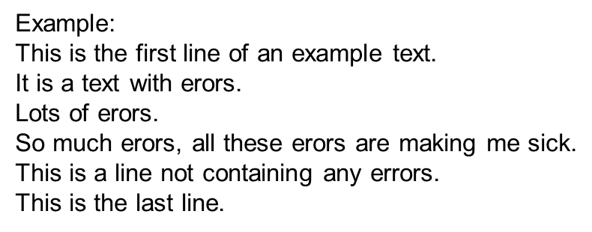
Introduction
A Stream EDitor is used to perform basic transformations on text read from a file or a pipe.
The editor does not modify the original input.
If you are facing replacement of text in a large number of files, sed is a great help.
The sed program can perform text pattern substitutions and deletions using regular expressions
Sed editing commands :
a\ - Append text below current line.
c\ - Change text in the current line with new text.
d - Delete text.
i\ - Insert text above current line.
p - Print text.
r - Read a file.
s - Search and replace text.
w - Write to a file

Slide 28
SED - Examples
1. To find all the lines containing our search pattern, in this case "erors". We use the p to obtain the result.
$sed –n '/erors/p' example
2. Now we only want to see the lines not containing the search string
$sed '/erors/d' example
3. Matching lines starting with a given pattern and ending in a second pattern
$sed -n '/^This.*errors.$/p' example
4. we want to take out the lines containing the errors. Specify this
range to address, together with the d command
$sed '2,4d' example
To print the file starting from a certain line until the end of the file
$sed '3,$d' example

Slide 29
SED - Examples
5. The following command prints the first line containing the pattern "a text", up to and including the next line containing the pattern "a line":
$sed -n '/a text/,/This/p' example
6. search and replace the errors instead of only (de)selecting the lines containing the search string.
$sed 's/erors/errors/g' example
7. To insert a string at the beginning of each line of a file, for instance for quoting
$sed 's/^/> /' example
8. Insert some string at the end of each line
$sed 's/$/EOL/' example
9. Multiple find and replace commands are separated with individual -e options
$sed -e 's/erors/errors/g' -e 's/last/final/g' example

Slide 30
AWK (Aho, Weinberger and Kernighan)
The basic function of awk is to search files for lines or other text units containing one or more patterns. When a line matches one of the patterns, special actions are performed on that line.
# $1 is field #1, $2 is field #2, etc.
echo one two | awk '{print $1}‘ - # one
echo one two | awk '{print $2}‘ - # two
echo one two | awk '{print $0}‘ - # one two
awk '{print $3}' $filename - # Prints field #3 of file $filename
awk '{print $1 $5 $6}' $filename - # Prints fields #1, #5, and #6 of file $filename.
awk '{print $0}' $filename - # Prints the entire file!

Slide 31
AWK- Examples
$cat employee.txt
100 Thomas Manager Sales $5,000
200 Jason Developer Technology $5,500
300 Sanjay Sysadmin Technology $7,000
400 Nisha Manager Marketing $9,500
500 Randy DBA Technology $6,000
By default Awk prints every line from the file.
$ awk '{print;}' employee.txt
Print the lines which matches with the pattern
awk '/Thomas/
> /Nisha/' employee.txt
Print only specific field
$ awk '{print $2,$5;}' employee.txt
$ awk '{print $2,$NF;}' employee.txt
where $NF represents last field

Slide 32
AWK- Examples
Awk has two important patterns which are specified by the keyword called BEGIN and END.
Syntax: BEGIN { Actions} {ACTION} END { Actions }
$ awk 'BEGIN {print "Name\tDesignation\tDepartment\tSalary";}
> {print $2,"\t",$3,"\t",$4,"\t",$NF;}
> END {print "Report Generated\n--------------";
> }' employee.txt
Find the employees who has employee id greater than 200
$ awk '$1 >200' employee.txt
Print the list of employees in Technology department
$ awk '$4 ~/Technology/' employee.txt
Print number of employees in Technology department
$ awk 'BEGIN { count=0;}
$4 ~ /Technology/ { count++; }
END { print "Number of employees in Technology Dept =",count;}' employee.txt
Number of employees in Technology Dept = 3

Slide 33
Hands-on List
1. Write a shell script to count the number of block device files in /dev directory.
2. Write a shell program that checks the number of command line arguments and echoes an error message if there are not exactly three arguments or echoes the arguments themselves if there are three.
3. Write a shell program called new_files that will accept a variable number of command line arguments. The shell program will create a new file associated with each command line argument and echo a message that notifies the user as each file is created.
4. Create a directory called .recyclebin in your home directory. Write a shell program called myrm that will move all of the files you delete into the .recyclebin directory, your wastebasket. This is a useful tool which will allow restoration of files after they have been removed. Remember, the UNIX system has no undelete capability.
5. Write a script that uses find to look for a file and echo a suitable message if the file is not found. You must not store the output of the find to a file.
6. Write a script which will give 4 choices to the user 1. ls 2. pwd 3. who 4. exit and execute the command as per the users choice.
7. Write an interactive file-handling shell program that offers the user choice of copying, removing, rename. Once the user has made a choice, the program ask user for the necessary information, such as the file name, new name.

Slide 34
Hands-on List
8. Write shell script that takes a login name as command – line argument and reports when that person logged in.
9. Write a shell script that accepts a file name starting and ending line numbers as arguments and displays all the lines between the given line numbers.
10. Write a script to backup a given directory to a given file name in your home directory. Both, the directory name and the backup file has to be passed as command line input. Design the script with suitable exception handling.
11. Write a script to check how much space is used by each directory of a given file system. The name of the file system has to be provided from the command line parameter.
12. Write a script in /root/myscript.sh according to the following criteria:
If you search for the IIT the output is NIT
If you search for NIT the output is IIT
If you search any other keyword or not give any input, the output is STDERR should be displayed.
13. Write a shell script to print a multiplication table.
14. Write a shell script to print, “Good Morning/Afternoon/Evening based on the current system time.

Slide 35
Hands-on List
15. SED - Write a shell script to perform the following (input file “example” will be given).
For a given file, find all the lines containing our search pattern.
List the lines not containing the search string
Matching lines starting with a given pattern and ending in a second pattern
Print a file starting from a certain line until to the end of file.
Search a given pattern in a file and replace with a new pattern and display the file.
Insert a given string at the beginning of each line of the file.
Insert a given string at the end of each line of the file
16. AWK – Write a Shell script to (The input file “employee.txt” will be given)
Display a given file.
Print the lines which match with a given pattern.
Print only a specific field in the file.
Format a given file with Name, Designation, Department and Salary headings and at the end of a file print Report Generated.
Find the employees, who has id > 200
Find the list of employees in a Technology Department.
Print the number of employees in Technology Department.

Slide 36
THANK YOU

