Slide 1
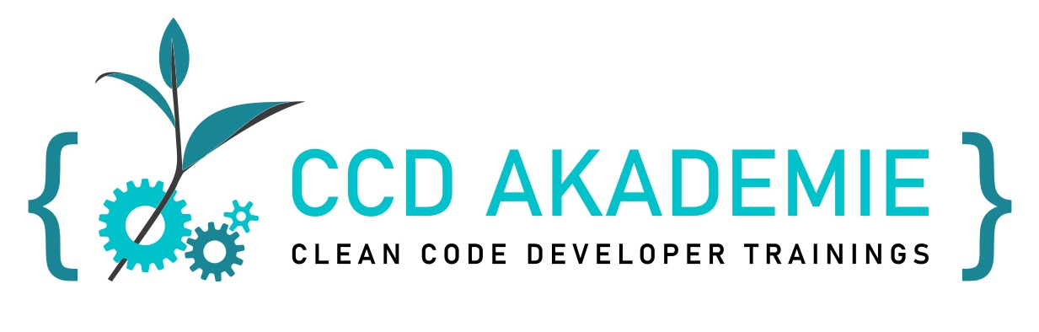
SOLID principles
F. Ruthenberg, T. Fröhle, eduCamp 2022

Slide 2
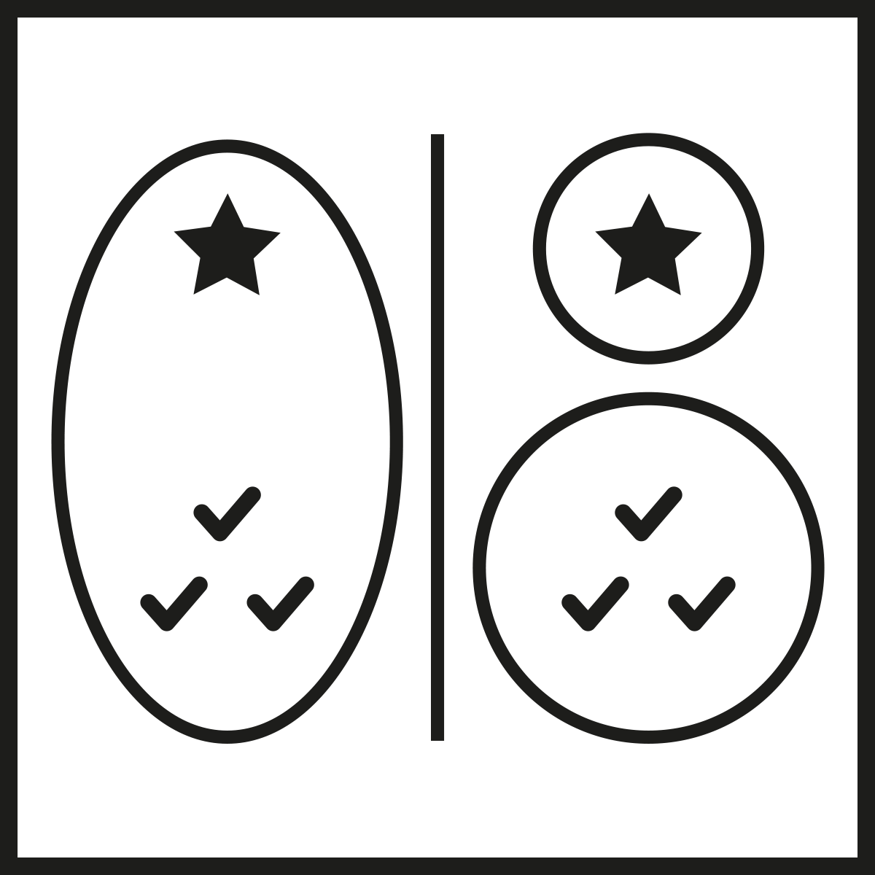
SRP
Single Responsibility Principle
A functional unit must have only one reason to change
Fundamental for evolvability
If multiple aspects are mixed:
Hard to understand
High risk when changing
Hard to test

Slide 3
SRP - Single Responsibility Principle
public class CsvReader
{
public IEnumerable<Record> ReadCsvFile(string filename) {
var lines = File.ReadLines(filename);
foreach (var line in lines) {
var values = line.Split(";");
var record = new Record(values);
yield return record;
}
}
}
public record Record(string[] Values);

Slide 4
SRP - Single Responsibility Principle
public class CsvReader
{
public IEnumerable<Record> ReadCsvFile(string filename) {
var lines = ReadFile(filename);
var records = CreateRecords(lines);
return records;
}
private static IEnumerable<string> ReadFile(string filename) {
return File.ReadLines(filename);
}
private static IEnumerable<Record> CreateRecords(IEnumerable<string> lines) {
foreach (var line in lines) {
var values = line.Split(";");
var record = new Record(values);
yield return record;
}
}
}

Slide 5
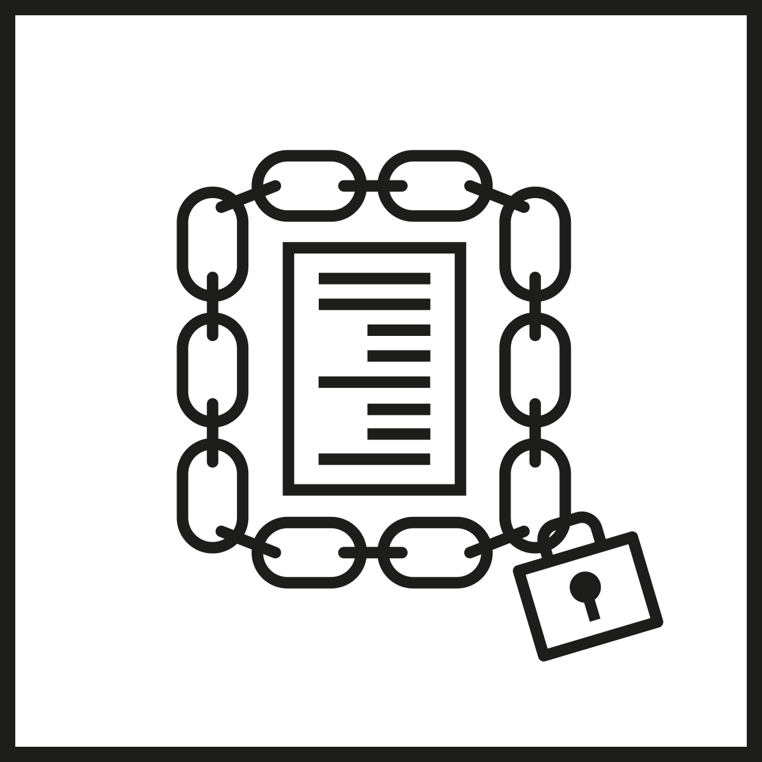
OCP
Open Closed Principle
A functional unit should be open for extensions, but closed for modification
Caution: Can easily lead to generic code
Keep it simple, stupid!
Beware of premature optimization

Slide 6
OCP - Open Closed Principle
public IEnumerable<Record> HandleInput(char keyPressed) {
switch (char.ToLower(keyPressed)) {
case 'f':
return FirstPage();
case 'p':
return PrevPage();
case 'n':
return NextPage();
case 'l':
return LastPage();
default:
throw new ArgumentException("Unrecognized key", nameof(keyPressed));
}
}

Slide 7
OCP - Open Closed Principle
public abstract class KeyPressedHandler {
public abstract bool CanHandleKey(char keyPressed);
public abstract IEnumerable<Record> GetRecords();
}
public class CsvViewer
{
private readonly List<KeyPressedHandler> _keyPressedHandlers = new();
public void AddHandler(KeyPressedHandler keyPressedHandler) {
_keyPressedHandlers.Add(keyPressedHandler);
}
public IEnumerable<Record> HandleInput(char keyPressed) {
foreach (var keyPressedHandler in _keyPressedHandlers) {
if (keyPressedHandler.CanHandleKey(keyPressed)) {
return keyPressedHandler.GetRecords();
}
}
throw new Exception($"No handler found for key '{keyPressed}'");
}
}

Slide 8
OCP - Open Closed Principle
public class FirstPageHandler : KeyPressedHandler
{
public override bool CanHandleKey(char keyPressed) {
return char.ToLower(keyPressed) == 'f';
}
public override IEnumerable<Record> GetRecords() {
yield break; // return records for first page
}
}

Slide 9
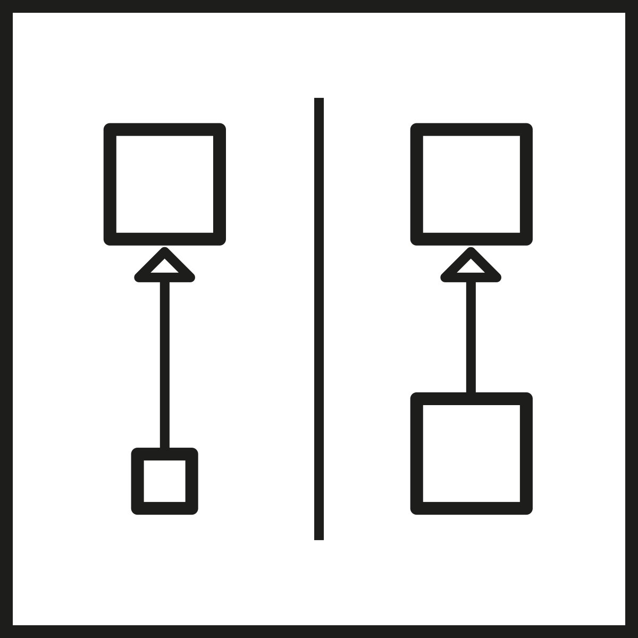
LSP
Liskov Substitution Principle
Functions that use base classes must be able to use objects of derived classes without knowing it

Slide 10
LSP - Liskov Substitution Principle
public class Calculator
{
public virtual int Magic(int x) {
return x + 42;
}
}
public class MagicalCalculator : Calculator
{
public override int Magic(int x) {
if (x < 0) {
throw new Exception("Too much magic needed");
}
return base.Magic(x) * 42;
}
}

Slide 11
LSP - Liskov Substitution Principle
public class Magician
{
private void DoTheTrick(Calculator calculator) {
var magicResult = calculator.Magic(-42);
Console.WriteLine(magicResult);
}
public void Trick1() {
DoTheTrick(new Calculator());
}
public void Trick2() {
DoTheTrick(new MagicalCalculator());
}
}

Slide 12
LSP - Liskov Substitution Principle
Favour Composition over Inheritance!

Slide 13
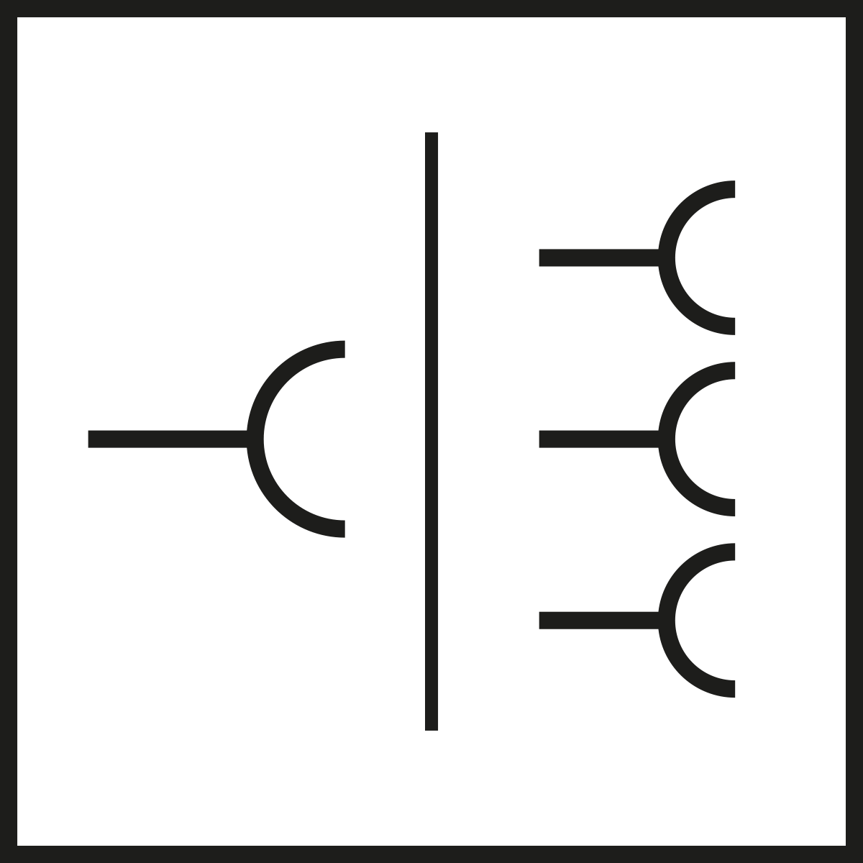
ISP
Interface Segregation Principle
Two ways to look at it:
Consumer
Implementation
Consumers of an interface shouldn’t be dependent on details that they don’t need

Slide 14
ISP - Interface Segregation Principle
public interface IEmail
{
public void Send(string from, string to, string message);
public string Receive(string smtpServerName, string username, string password);
}

Slide 15
ISP - Interface Segregation Principle
public interface IEmailSender
{
public void Send(string from, string to, string message);
}
public interface IEmailReceiver
{
public string Receive(string smtpServerName, string username, string password);
}

Slide 16
ISP
Interface Segregation Principle
Implemnting classes shouldn’t know details, that they don’t need/can’t provide

Slide 17
ISP - Interface Segregation Principle
public abstract class MessageBase {
public string From { get; set; }
public string To { get; set; }
public string Subject { get; set; }
public string Message { get; set; }
public abstract void Send();
}
public class MailMessage : MessageBase {
public override void Send() {
// send the message as an email via SMTP
}
}
public class SmsMessage : MessageBase {
public override void Send() {
// send the message as an SMS
// Subject property is ignored :-(
}
}

Slide 18
ISP - Interface Segregation Principle
public abstract class MessageBase {
public string From { get; set; }
public string To { get; set; }
public string Message { get; set; }
public abstract void Send();
}
public class MailMessage : MessageBase {
public string Subject { get; set; }
public override void Send() {
// send the message as an email via SMTP
}
}
public class SmsMessage : MessageBase {
public override void Send() {
// send the message as an SMS
}
}

Slide 19
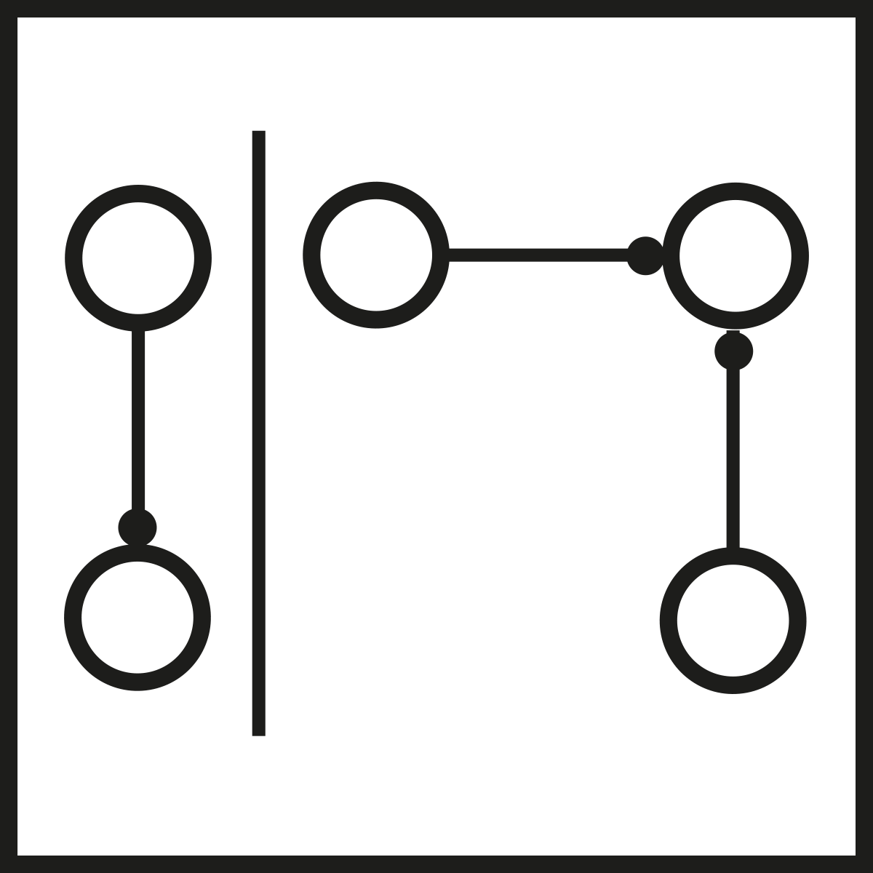
DIP
Dependency Inversion Principle
Depend upon abstractions, not concretions
A class should not be dependent on another class but on an interface

Slide 20
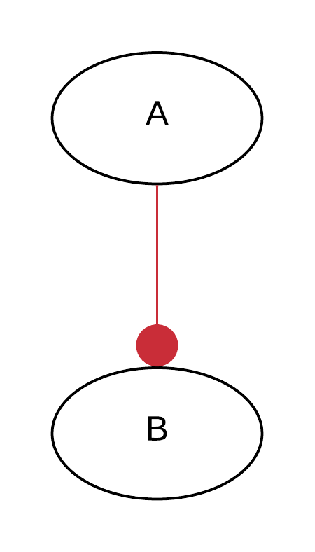
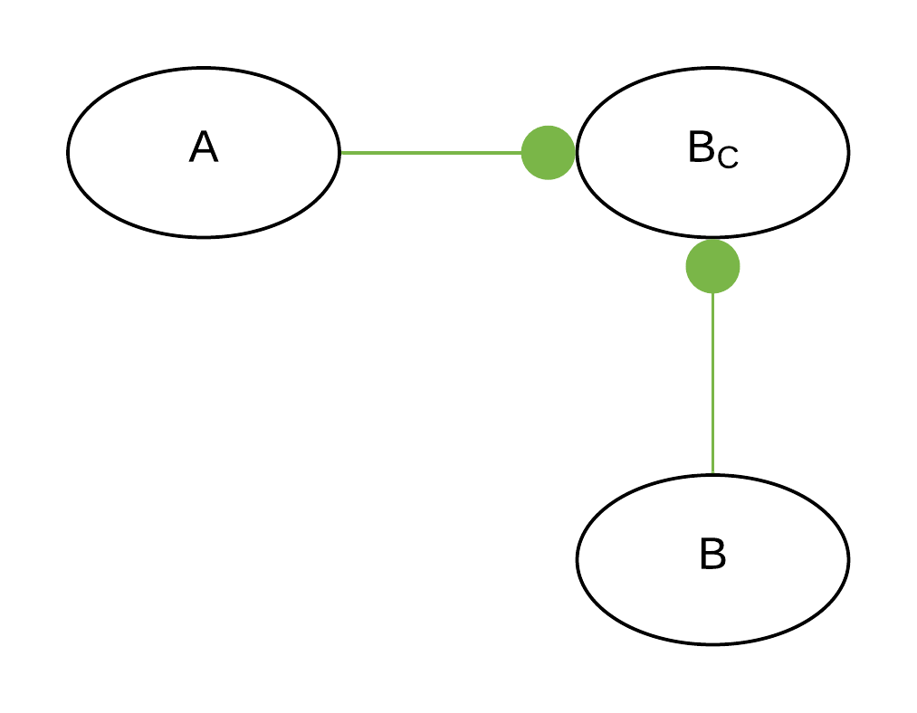
DIP
Dependency Inversion Principle

Slide 21
DIP - Dependency Inversion Principle
public class NewCustomer
{
public void HandleUseCase(Customer customer) {
if (customer.Name == "") {
throw new Exception("Customer name must not be empty");
}
customer.Id = Guid.NewGuid().ToString();
var customerRepository = new CustomerRepository();
customerRepository.Insert(customer);
}
}

Slide 22
DIP - Dependency Inversion Principle
public class NewCustomerDIP
{
private readonly ICustomerRepository _customerRepository;
public NewCustomerDIP(ICustomerRepository customerRepository) {
_customerRepository = customerRepository;
}
public void HandleUseCase(Customer customer) {
if (customer.Name == "") {
throw new Exception("Customer name must not be empty");
}
customer.Id = Guid.NewGuid().ToString();
_customerRepository.Insert(customer);
}
}

Slide 23
IOSP - Integration Operation Segregation Principle
+ DIP
public void HandleUseCase(Customer customer) {
PrepareCustomerForInsert(customer);
_customerRepository.Insert(customer);
}
private static void PrepareCustomerForInsert(Customer customer) {
if (customer.Name == "") {
throw new Exception("Customer name must not be empty");
}
customer.Id = Guid.NewGuid().ToString();
}

Slide 24
IOSP - Integration Operation Segregation Principle
public void HandleUseCase(Customer customer) {
PrepareCustomerForInsert(customer);
new CustomerRepository().Insert(customer);
}

Slide 25
Relevance
Which SOLID principles are most important?
SRP - VERY important! Fundamental for evolvability
OCP - Not irrelevant, but not fundamental
LSP - More or less irrelevant
ISP - Useful
DIP - Useful, combine with IOSP!
Not enough!

