Slide 1
DEVELOPMENT OF POINT-OF-SALE AND INVENTORY MANAGEMENT SYSTEM FOR TROY-DEAN MOTORPARTS

Slide 2
INTRODUCTION
CHAPTER 1
Troy-Dean Motor Parts, a small shop in Poblacion, Tagoloan run by the owner Mike Rosa, sells motorcycle parts like a convenience store. Right now, everything is done manually from listing items to tracking sales and expenses which often leads to errors and missing records, especially when things get busy.
To help fix this, a Point of Sale (POS) and Inventory Management System is being developed. It will automate sales, update stock in real-time, and generate reports, making things faster, more accurate, and easier for Mike.

Slide 3
OBJECTIVES
The main goal of this project is to develop a system that automates sales and inventory management for a motorparts store in Poblacion, Tagoloan. Specifically, the system will monitor product stocks with restock alerts, record and compute sales accurately, and generate detailed sales and inventory reports. It will also include process and data models for better understanding of the store’s operations, and feature a user-friendly admin interface to make managing everything easier.

Slide 4
SCOPE AND LIMITATION
SCOPE:
This study aims to design and develop a Sales and Inventory System for TROY-DEAN Motorparts in Poblacion, Tagoloan to improve the accuracy, efficiency, and reliability of managing sales and inventory with real-time tracking. Key features include Item management, product categorization, real-time inventory monitoring with alerts, automatic price calculations, customer record keeping, sales tracking, a user-friendly interface, and secure access controls.
LIMITATION:
  Limited Access: Only the admin can use the system.
  Needs Maintenance: The system needs regular updates to keep it working well.
  Offline Limits: Only basic features may work without internet.
  Internet Needed: A stable internet connection is required for full use.

Slide 5
REVIEW RELATED LITERATURE
CHAPTER 2
  Hasan et al. (2022)
  It highlights how using technology improves efficiency and helps solve common problems in stock and sales management.
  The research shows that tech tools play a key role in streamlining operations in motor parts businesses.
  Rahman et al. (2022)
  These systems help reduce human errors, improve inventory tracking, and support better decision-making in real-time.
  The use of technology is shown to improve operations and customer satisfaction.
  Khalid Shah, (2023)
  This study presents a POS (Point of Sale) system as a better option than manual methods for managing stores.
  It is web-based with a user-friendly design, so even users without computer experience can use it easily.

Slide 6
Rodriguez and Hernandez (2020)
Developed a web-based system with a dashboard to monitor sales and inventory.
The dashboard shows real-time sales trends, inventory issues, and key performance indicators to support better decision-making and improve organizational efficiency.
Bulawin et al. (2024)
Emphasizes using inventory systems tailored to specific business needs.
Accurate and flexible inventory systems reduce manual errors, maintain proper stock levels, and boost business performance and customer satisfaction.
Smith et al. (2023)
Created a sales and inventory system to better organize and manage inventory items.
Included detailed item categorization and tracking, which improved inventory control and operational accuracy.

Slide 7
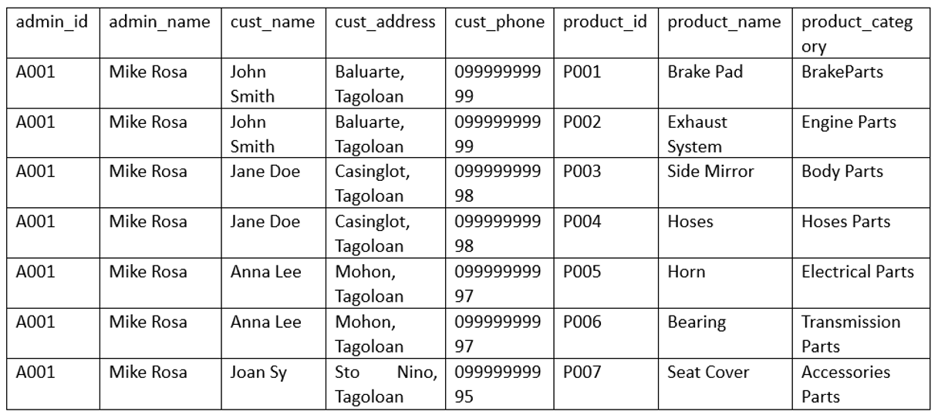
CHAPTER 3
NORMALIZATION DATA MODELING
TABLE 1. 1ST NORMAL FORM

Slide 8
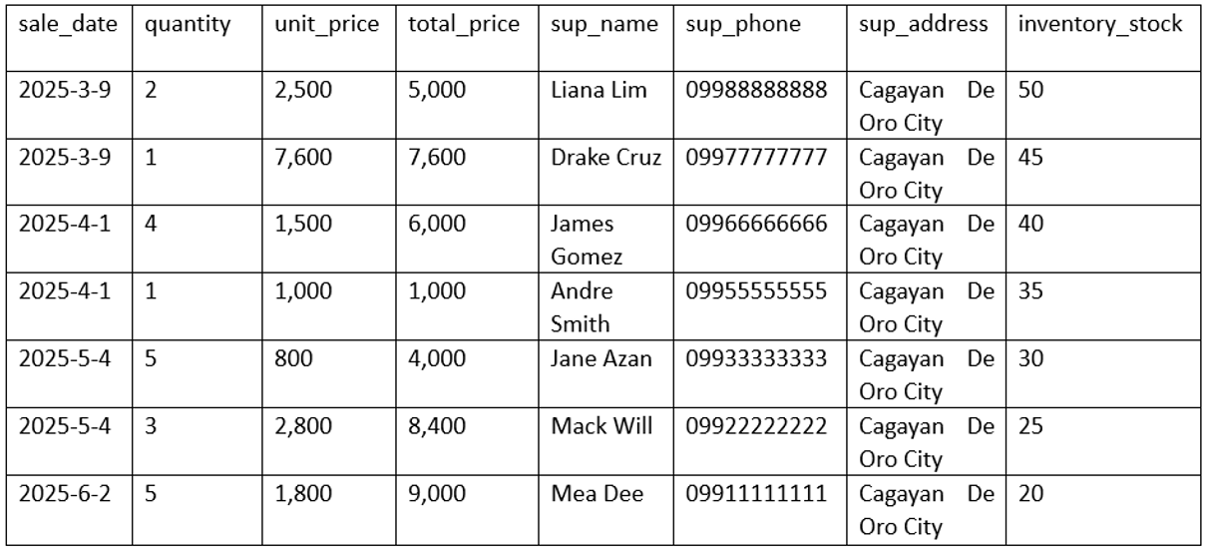

Slide 9
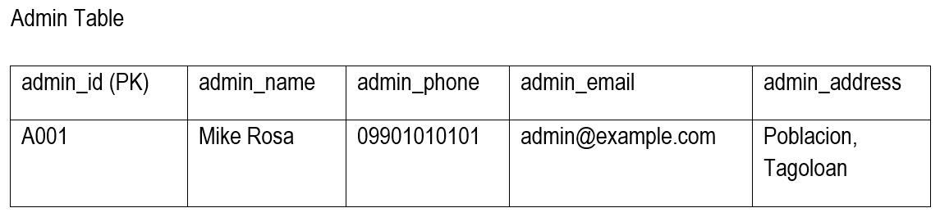
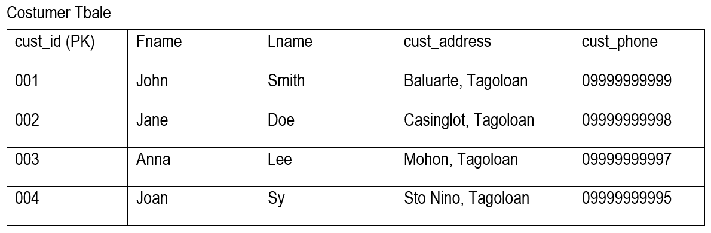
TABLE 2. 2ND NORMAL FORM

Slide 10
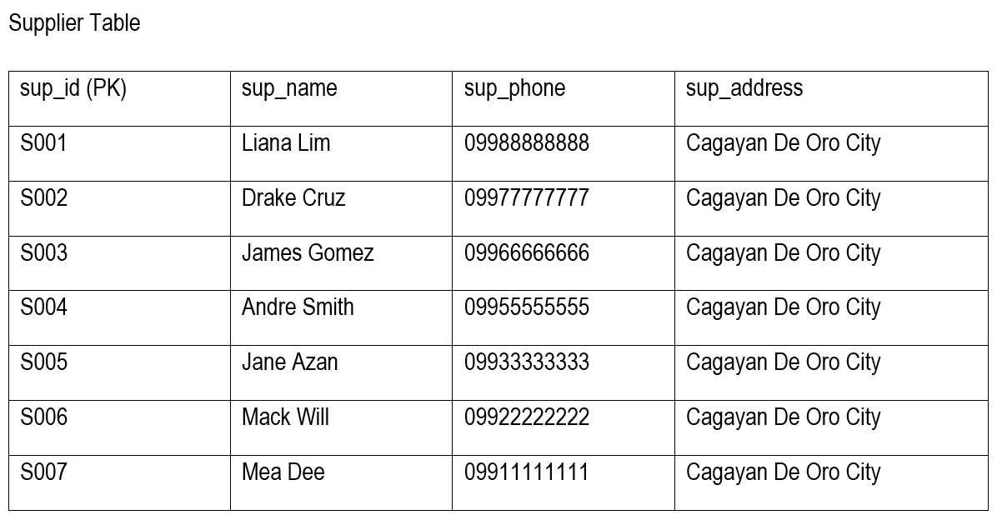

Slide 11
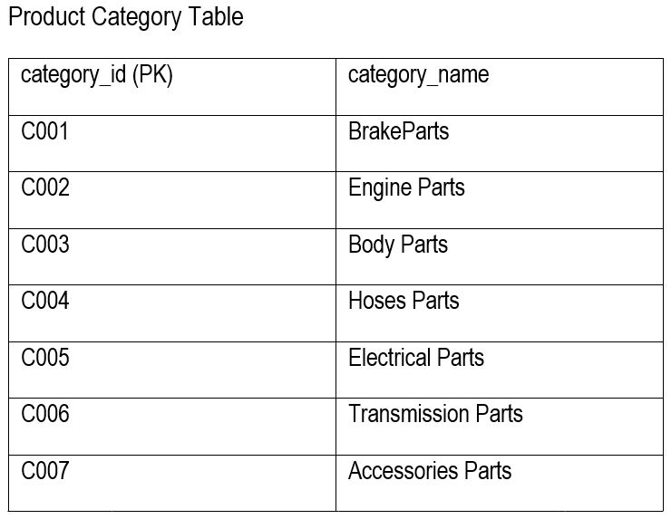

Slide 12
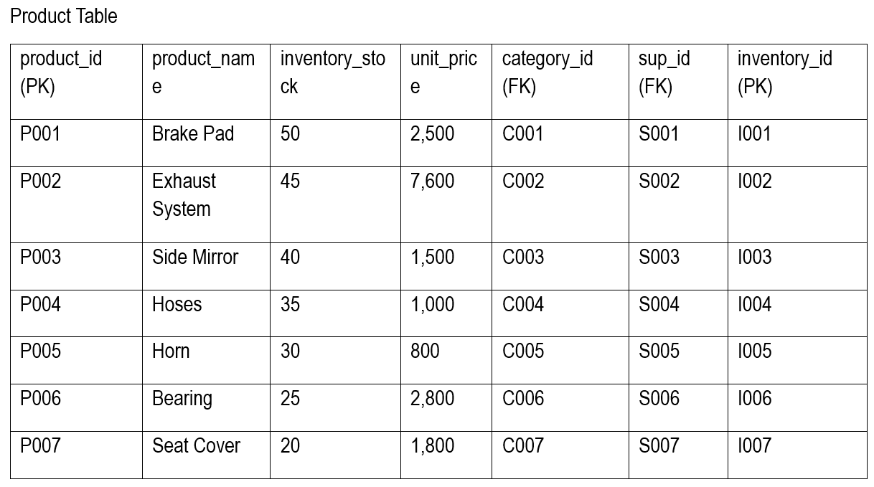

Slide 13
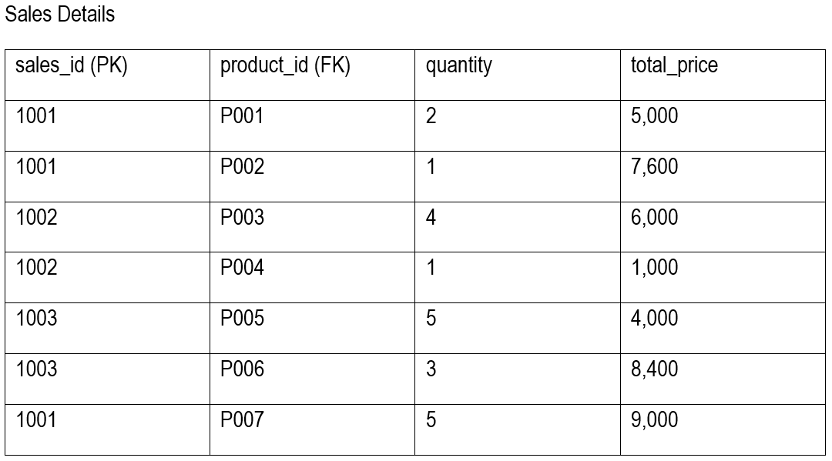

Slide 14
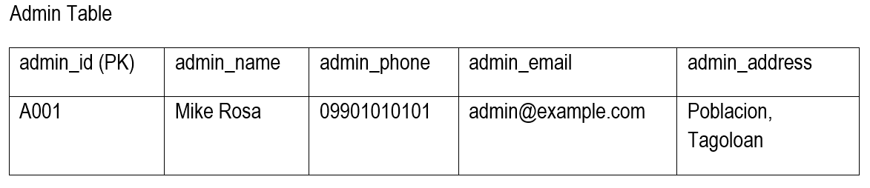
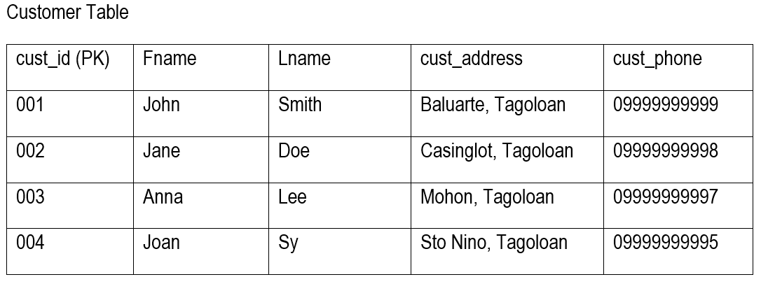
TABLE 3. 3rd NORMAL FORM

Slide 15
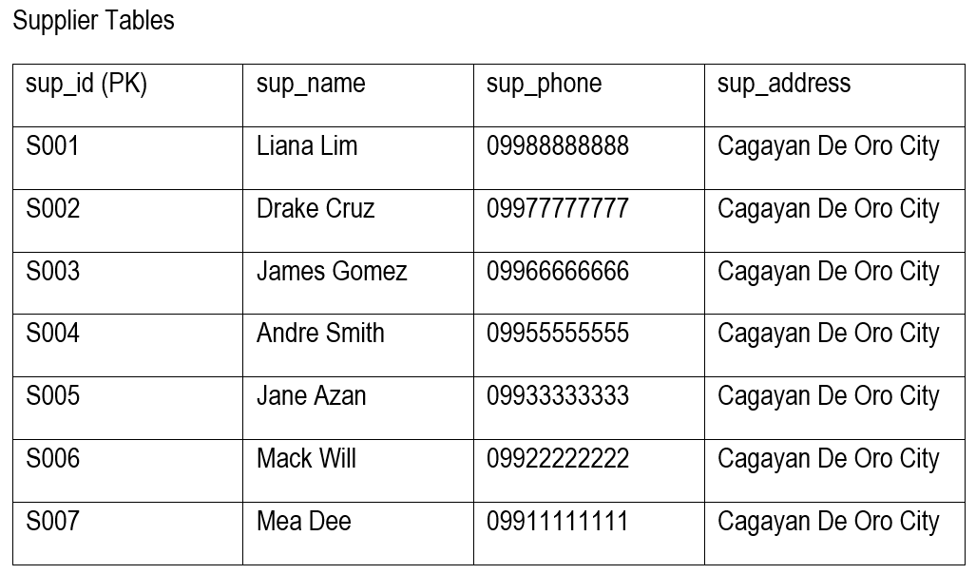

Slide 16
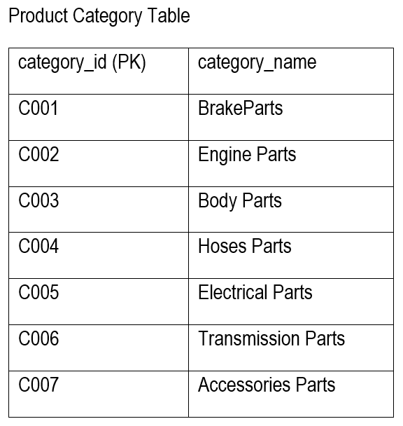

Slide 17
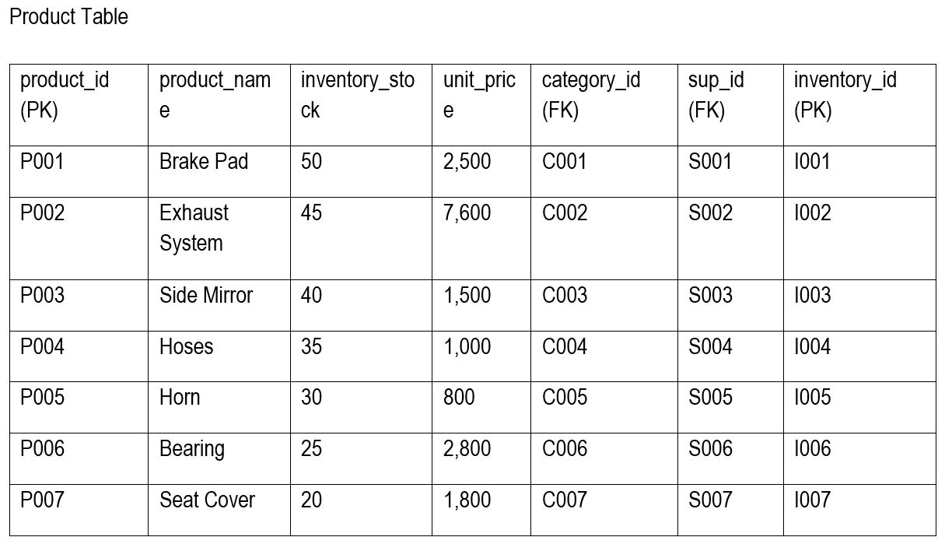

Slide 18
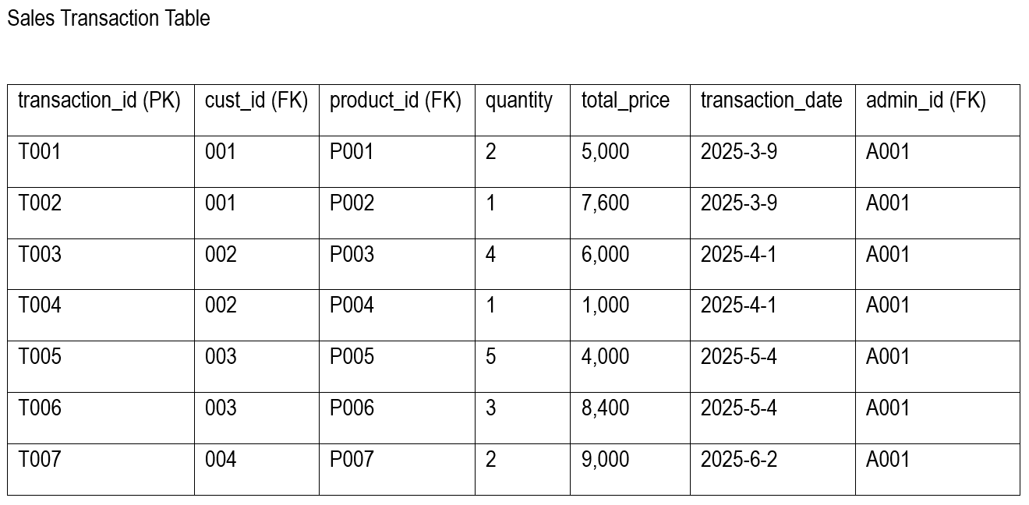

Slide 19
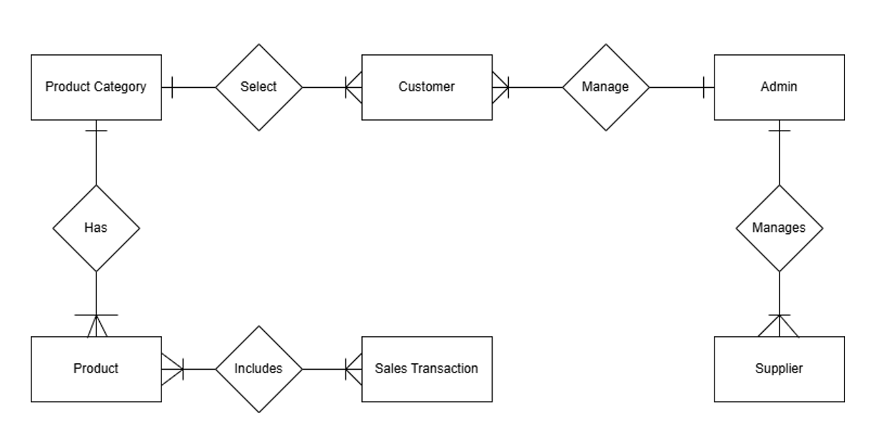
CONCEPTUAL DATA MODEL

Slide 20
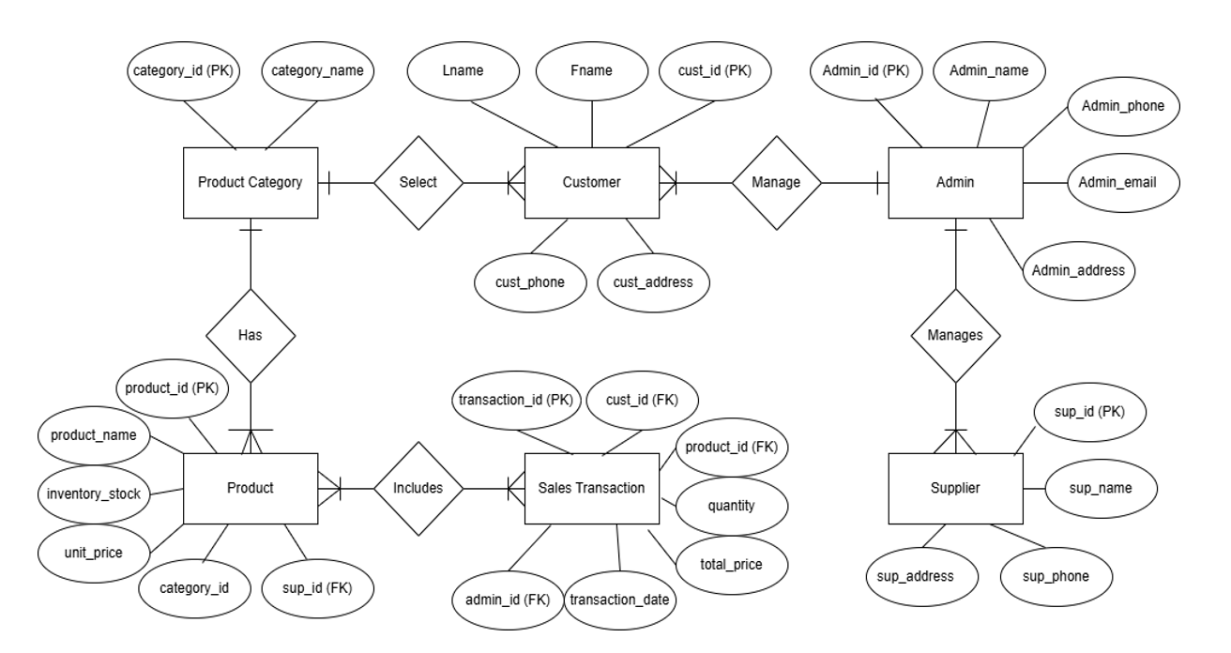
LOGICAL DATA MODEL

Slide 21
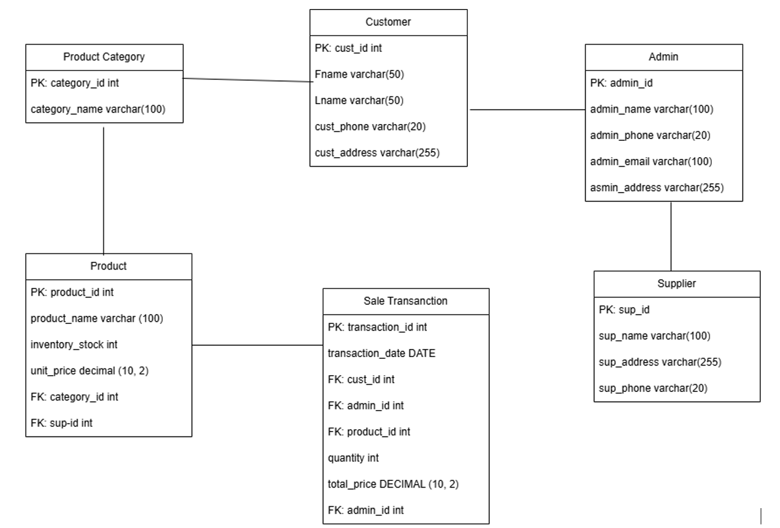
PHISICAL DATA MODEL

Slide 22
THANK YOU!

