Slide 1
Parallel Quicksort and Combinatorial Algorithms
The CMSE course project
Chang Liu

Slide 2
Project Structure
Sequential Quicksort
HDF5 data arrays
Verify Function
MPI binary tree Quicksort
Create hdf5 arrays
Strong Scaling
OMP partition Quicksort
Get hdf5 arrays
Weak Scaling
Main Algorithms
HDF5 data application
Experiments

Slide 3
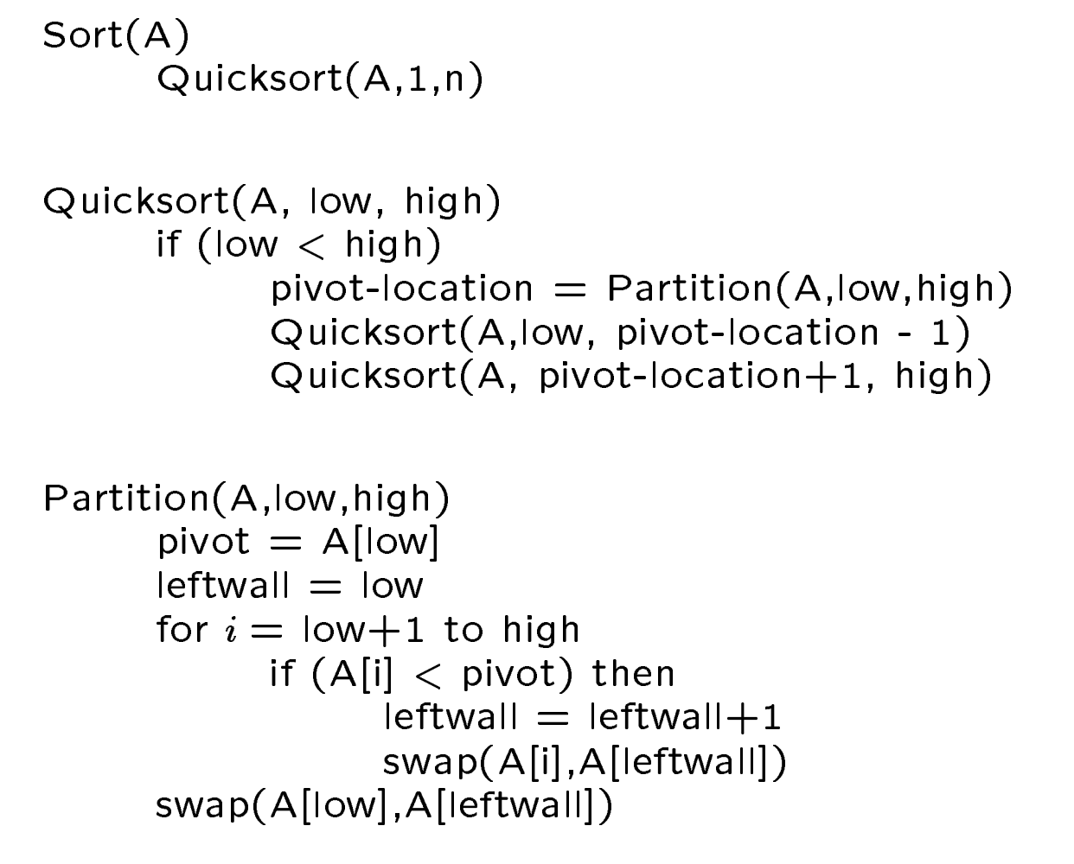
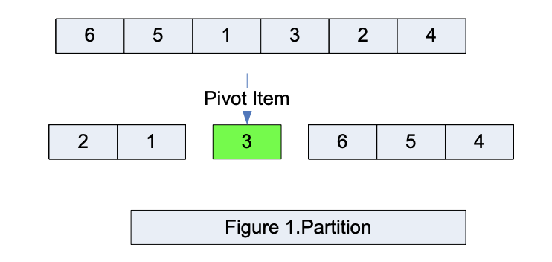
Sequential Quicksort
Basic partition structure

Slide 4
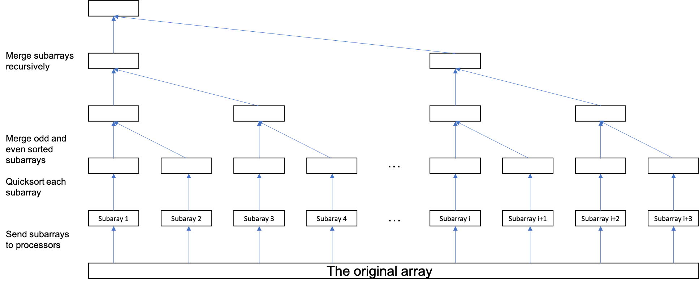
MPI binary tree Quicksort

Slide 5

MPI binary tree Quicksort
Advantages:
This algorithm is quite robust, run time no more than 2 times the Seq one needs
Don’t need too many processors but can achieve best performance.
Disadvantages:
There are some idle processors during subarray merge.

Slide 6
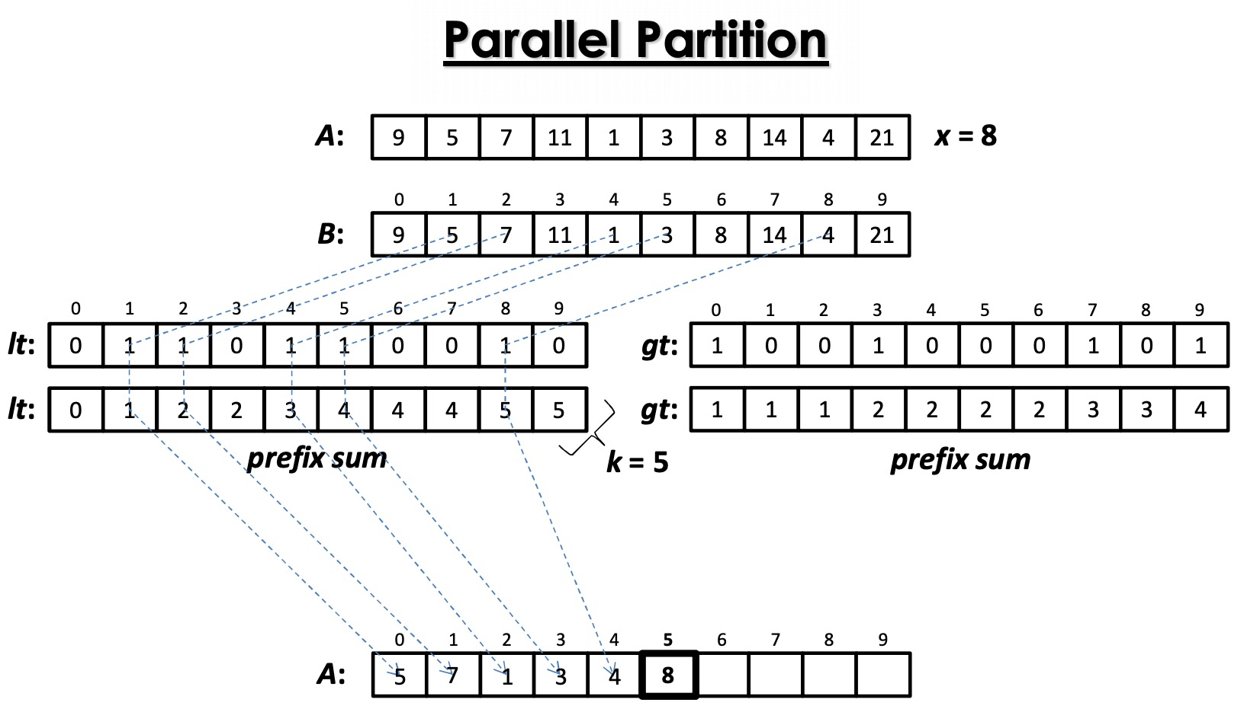
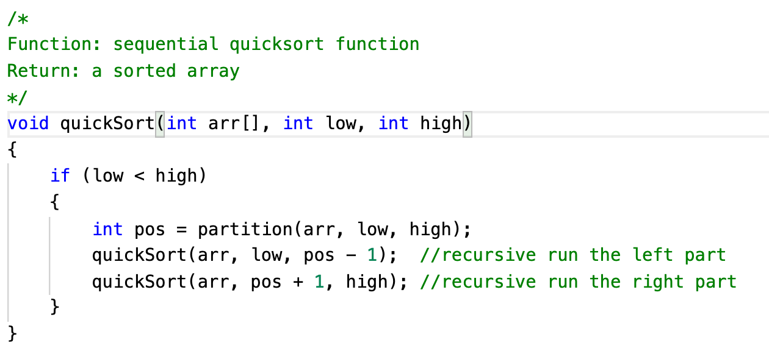
OMP Partition Quicksort
Need a parallel Prefix Sum Algorithm

Slide 7
OMP Partition Quicksort
Advantages:
This algorithm ideally can achieve O(log^2N) speed up.
It will not require extra memory usage than Seq one.
Disadvantages:
1. Perform very bad for very short array sorting

Slide 8
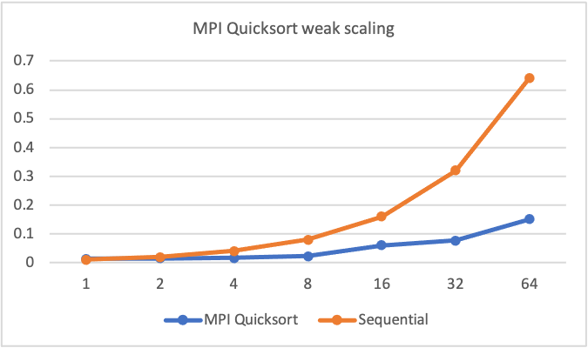
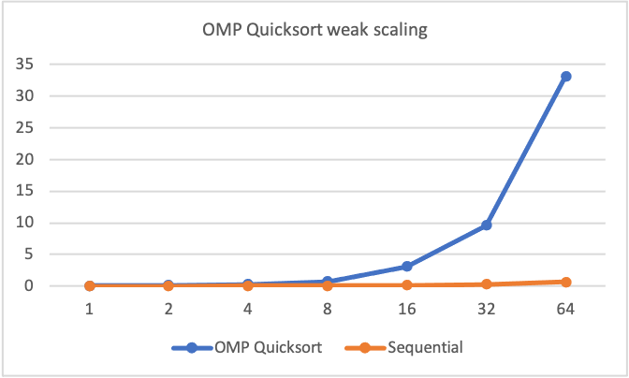
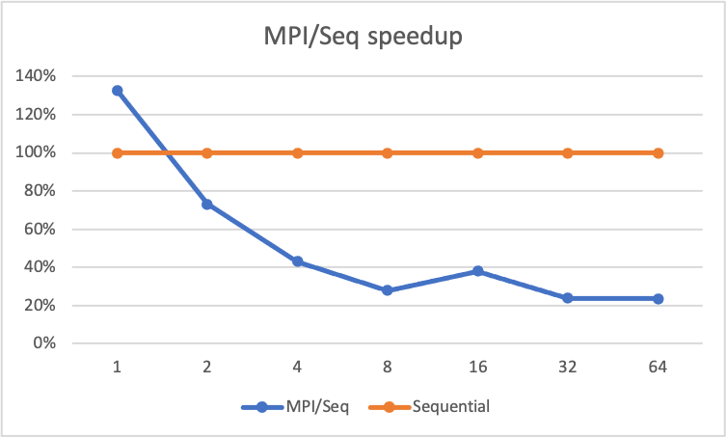
Experiments results: weak scaling

Slide 9
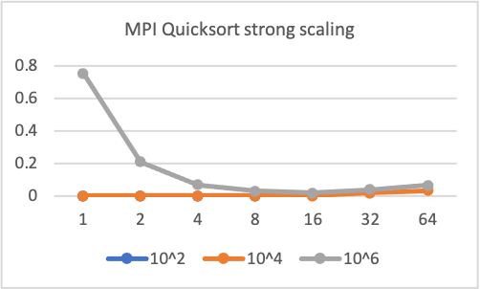
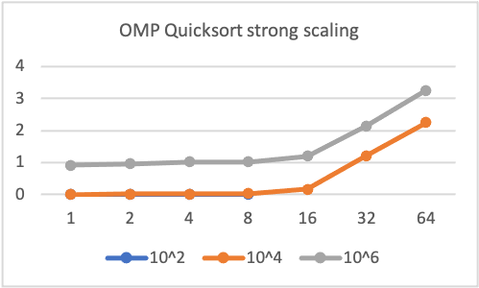
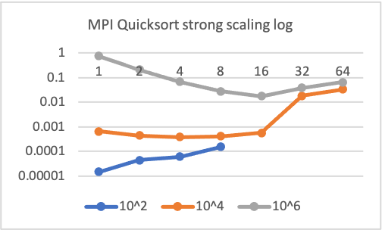
Experiments results: strong scaling

Slide 10
Conclusion
Both algorithms don’t require too many processors.
The MPI algorithm is quite robust (weak scaling and boundary cases)
Not too many extra memory usage.

