Slide 1
CSE 220 – C Programming
C Programming in IoT

Slide 2

Wireless Sensor Networks

Slide 3
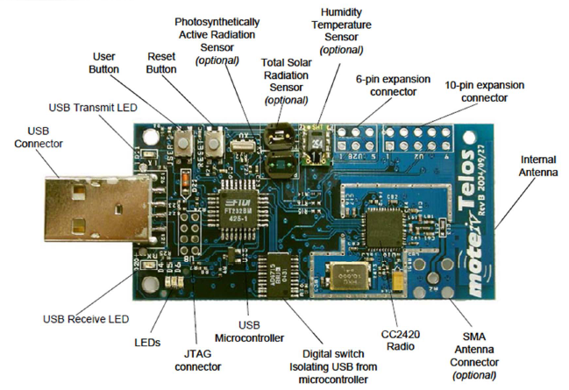
Wireless Sensors - TelosB

Slide 4

nesC/TinyOS
nesC
Split-phase Execution
Command, active function calls
Event, passive function calls
www.tinyos.net

Slide 5
nesC/TinyOS
Modules/Components
Uses and provides interfaces.
Interface declares commend and event.
Call sendMsg(msg)
App
Networking
Uses Send
Provides Send
signal sendDone()

Slide 6

nesC/TinyOS
Configuration
Component binding
Configuration nesting
nesC preprocessor
Top Configuration
Component A
Configuration B
TinyOS

Slide 7
Example
Printf_to_Radio
Local variable counter, increasing periodically
Each counter change, print counter value, then broadcast a message that contains ID and counter
Print received ID and counter.

Slide 8

Print-to-Radio
Components
Timer
TinyOS Timer library
Radio
TinyOS Point-to-point communication library
Active Message interface duplicates radio recourse
TCP/UDP port
Print

Slide 9
Timer Interface
Milli-sec(TMilli)、Micro-sec(TMicro) or 32KHz(T32Khz)
interface Timer <precision>{
command void startPeriodic (uint32_t dt);
command void startOneShot (uint32_t dt);
event void fired();
// …
}
Periodic or One-shot timer
Triggered when timer expired.

Slide 10
Timer
#include <Timer.h>
module PrintToRadioC {
uses interface Boot;
uses interface Timer<TMilli> as Timer0;
} implementation {
uint16_t counter = 0;
event void Boot.booted() {
call Timer0.startPeriodic(1000);
}
event void Timer0.fired() {
counter++;
}
}
Tmilli Timer
Triggered when MCU is booted.

Slide 11
Communication Interface
Radio sends message.
interface AMSend {
command error_t send(am_addr_t addr,message_t* msg,uint8_t len);
event void sendDone(message_t* msg,error_t error);
// …
}
Triggered when msg is successfully transmitted.
interface Packet {
command void* getPayload(message_t* msg, uint8_t len);
// …
}
Return a pointer pointing to the payload of the message.

Slide 12
Receive Interface
interface Receive {
event message_t* receive(message_t* msg,void* payload, uint8_t len);
// …
}
Triggered when a message is received.

Slide 13
Radio Initialization
module PrintfToRadioC {
uses {
// …
interface SplitControl as AMControl;
interface Packet;
interface AMSend;
interface Receive;
}
}
implementation {
//…
event void Boot.booted() {
call AMControl.start();
}
event void AMControl.startDone(error_t err) {
if (err == SUCCESS)
call CountTimer.startPeriodic(1000);
else
call AMControl.start();
}
//…
}
Initialize a radio
Retry after a failure

Slide 14
Send and Receive
typedef nx_struct {
nx_uint16_t nodeid;
nx_uint16_t counter;
} PrintToRadioMsg;
#include “printf.h”
//…
implementation {
bool busy = FALSE; message_t pkt;
//...
event void Timer0.fired() {
//...
if (!busy) {
BlinkToRadioMsg* btrpkt = (PrintToRadioMsg*)(call Packet.getPayload(&pkt, sizeof (PrintToRadioMsg)));
btrpkt->nodeid = TOS_NODE_ID;
btrpkt->counter = counter;
if (call AMSend.send(AM_BROADCAST_ADDR, &pkt, sizeof(PrintToRadioMsg)) == SUCCESS) {
busy = TRUE;
}
}
}
event void AMSend.sendDone(message_t* msg, error_t error) { if (&pkt == msg) { busy = FALSE;} }
event message_t* Receive.receive(message_t* msg, void* payload, uint8_t len) {
if (len == sizeof(PrintToRadioMsg)) {
PrintToRadioMsg* btrpkt = (PrintToRadioMsg*)payload;
printf(“%d,%d\n”, btrpkt->nodeid, btrpkt->counter);
printfflush();
}
return msg;
}
}
Sending status, message buffer
Payload pointer
Change sending status
Change sending status
Print and return msg.

Slide 15
Configuration
enum {
AM_PRINTTORADIO = 6,
};
configuration PrintfToRadioAppC {
}
implementation {
components MainC;
components PrintToRadioC as App;
components new TimerMilliC() as Timer0;
components ActiveMessageC;
components new AMSenderC(AM_PRINTTORADIO);
components new AMReceiverC(AM_PRINTTORADIO);
App.Boot -> MainC;
App.Timer0 -> Timer0;
App.Packet -> AMSenderC;
App.AMControl -> ActiveMessageC;
App.AMSend -> AMSenderC;
App.Receive -> AMReceiverC;
}
Network port

Slide 16
Makefile
Radio Tx Power (1 – 31)
Radio Channel (11 – 26)
COMPONENT=PrintToRadioAppC
CFLAGS += -DCC2420_DEF_RFPOWER=1
CFLAGS += -DCC2420_DEF_CHANNEL=20
CFLAGS += -DTOSH_DATA_LENGTH=110
CFLAGS += -I$(TOSDIR)/lib/printf
include $(MAKERULES)
Max Packet Size
Printf library

Slide 17
Program Organization
Components
Timer
AMSend
Configuration
interface connection
Makefile
AMReceive
Packet
Boot
SplitControl
Message size
Tx Power
Tx Channel

