Slide 1
CSE 220 – C Programming
Linked lists

Slide 2
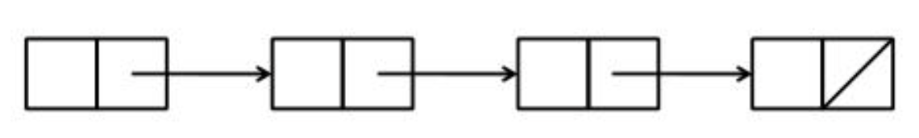
Linked List
A liked list is a chain of structures (nodes), with each node containing a pointer to the next node in the chain.
The last node in the list contains a null pointer.

Slide 3
Declaring a Node Type
struct point {
double x, y;
}
struct vertex {
struct point element;
struct vertex *next;
}
struct node {
int value;
struct node *next;
}

Slide 4

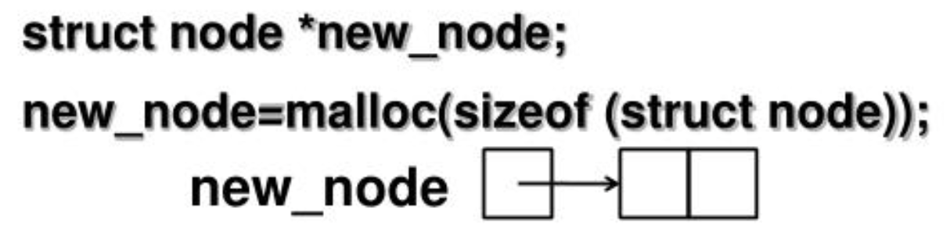

Building Linked List
First, create an empty list
Then create nodes one by one:
Allocate memory for the node
Store data into the node
(*new_node).value = 10;
new_node->value = 10;
Insert the node into the list

Slide 5
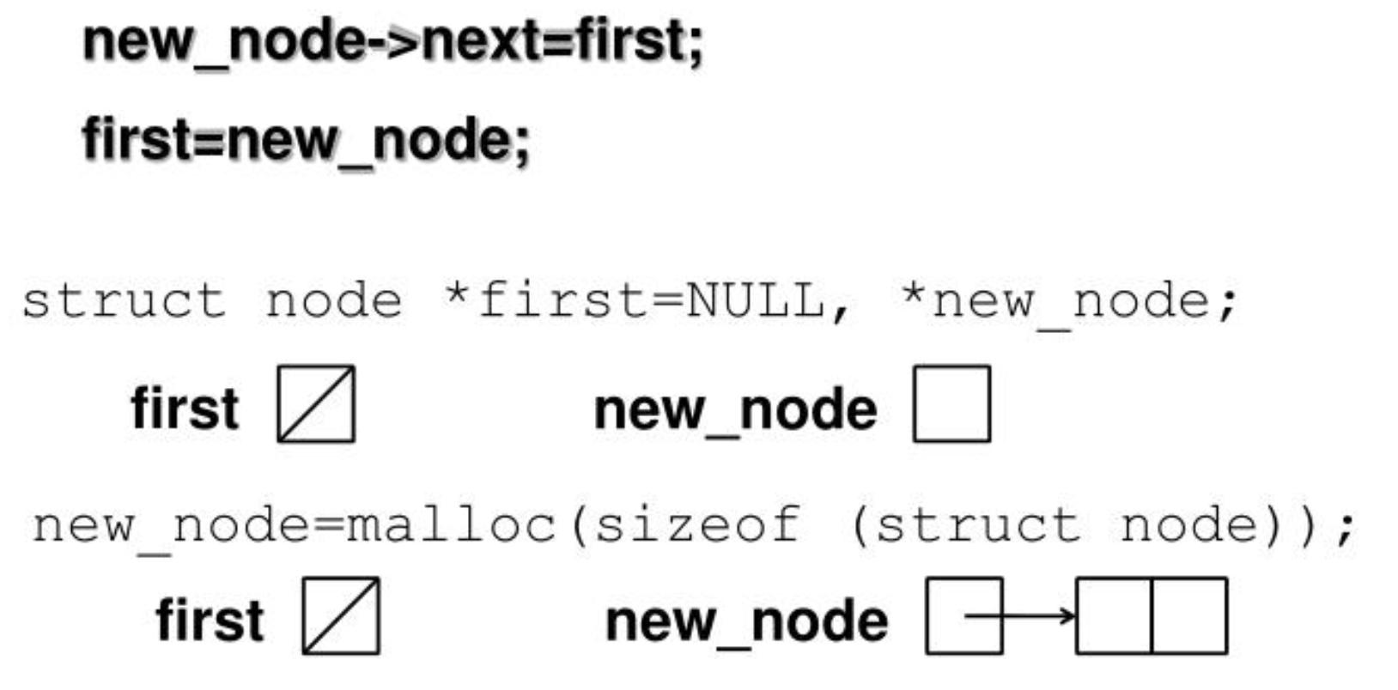
Inserting a Node at the Beginning of the List
If first points to the first node of the linked list:

Slide 6
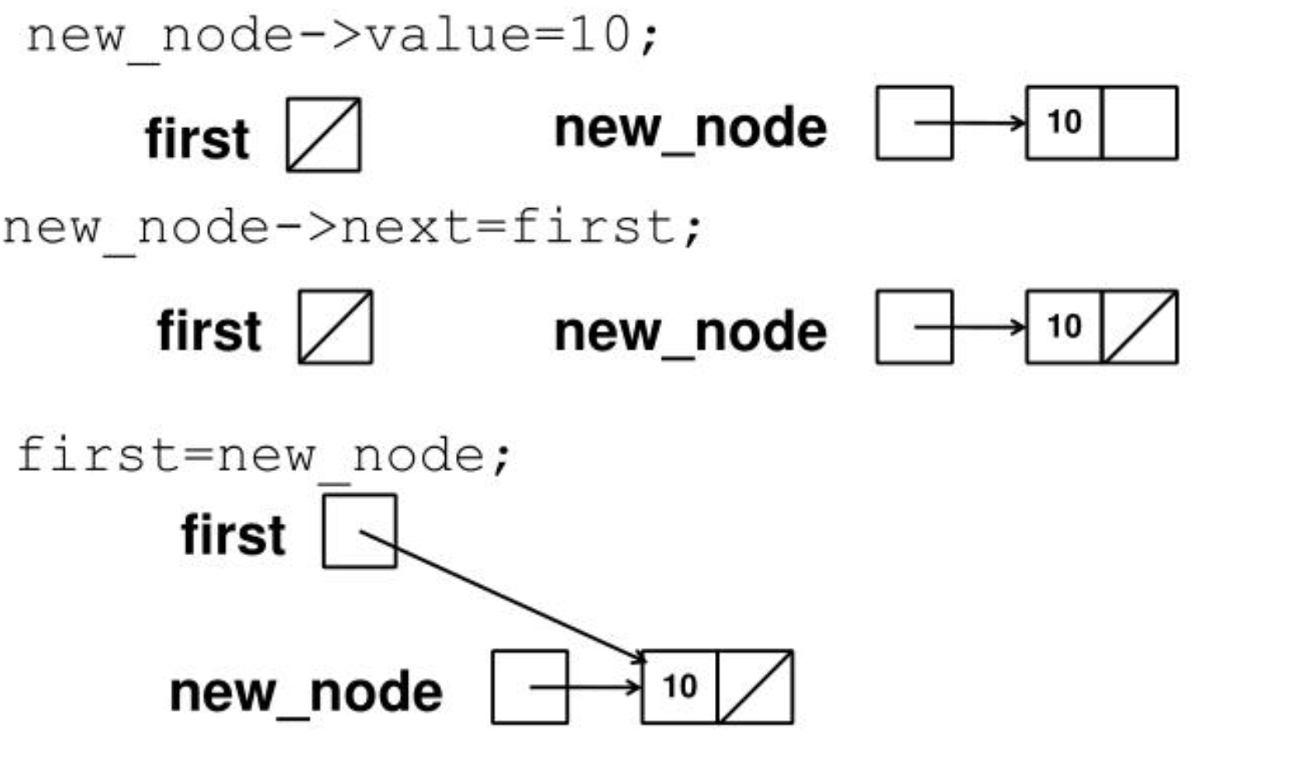
Inserting a Node at the Beginning of the List

Slide 7
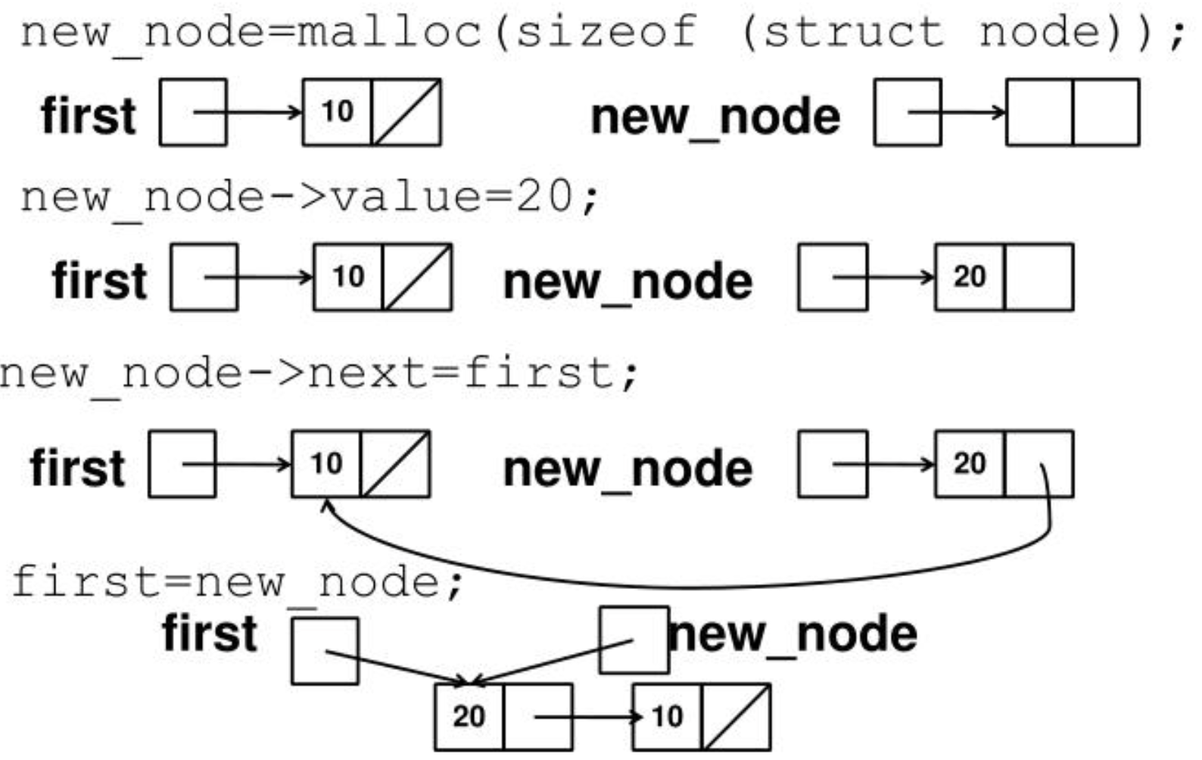
Inserting a Node at the Beginning of the List

Slide 8
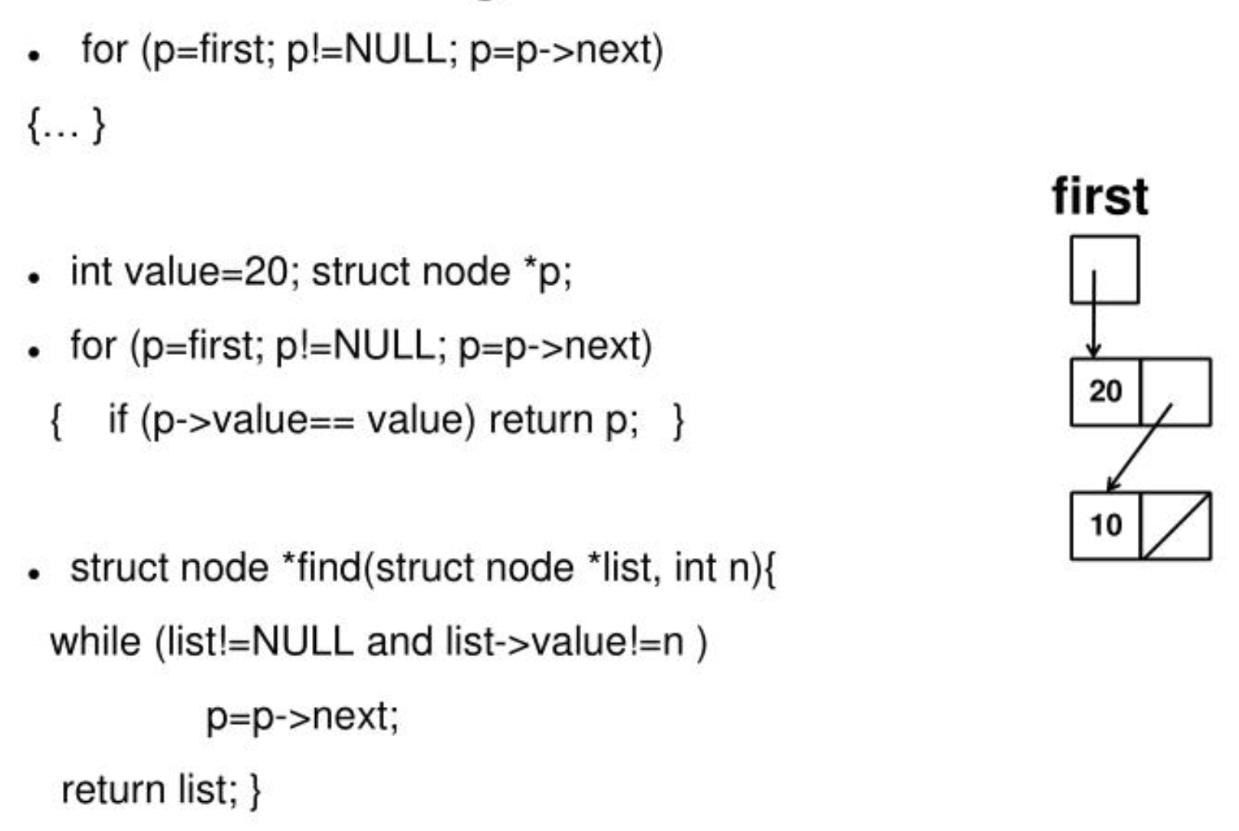
Searching a Linked List

Slide 9
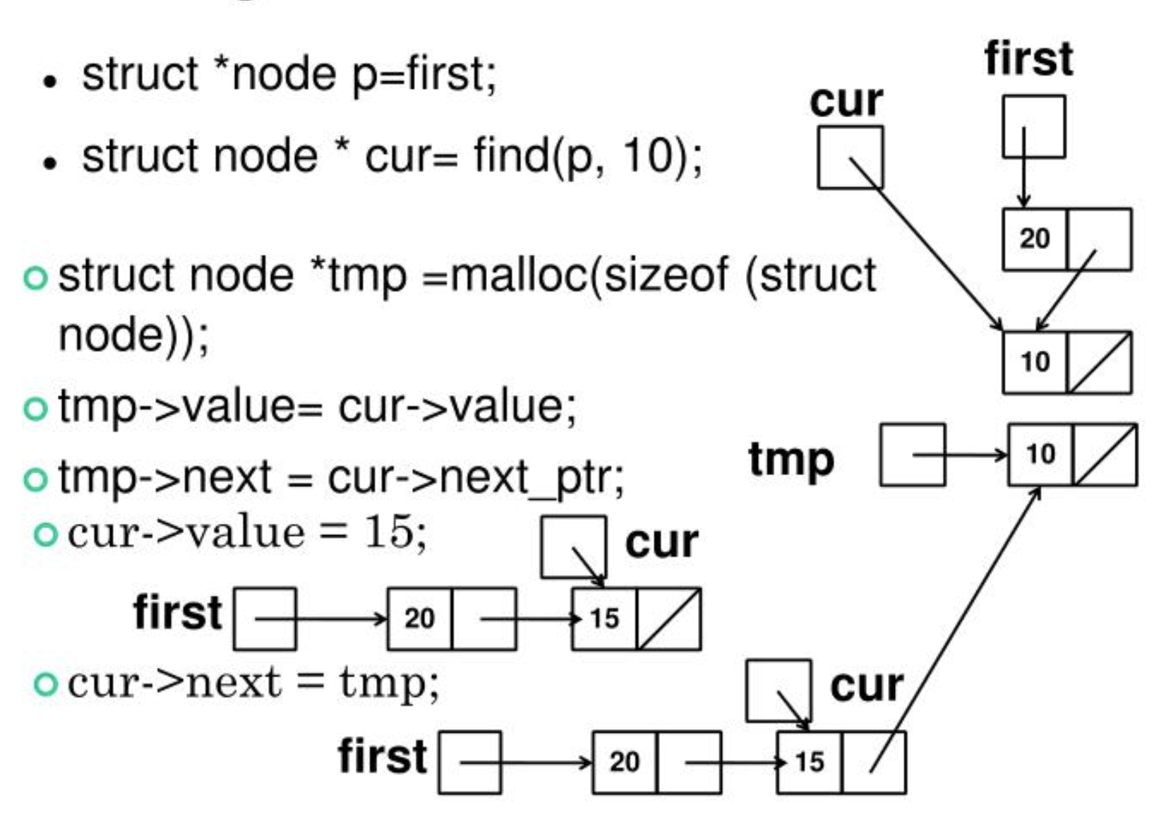
Insert a Node in the Middle of the List

Slide 10
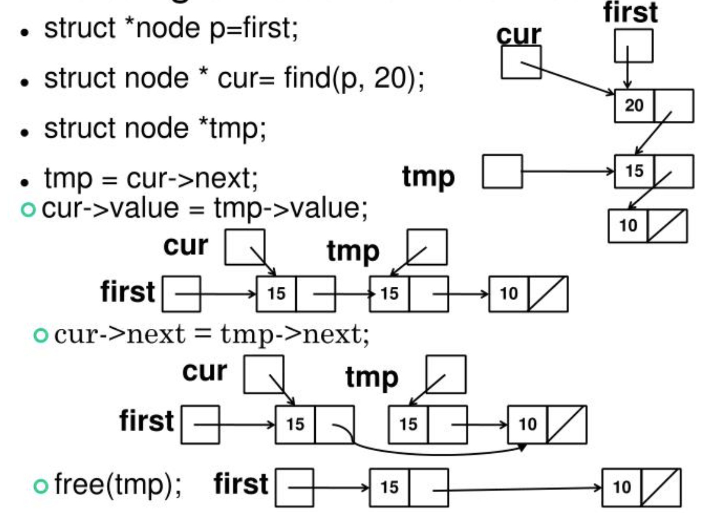
Deleting a Node from the List

Slide 11
SIRS Forms
You grade me and Manni online.
You are encouraged to write comments, not just filling in those bubbles
The Department Chair will read them
The College Deans will get the statistics
Manni and I will read every word carefully SIRS forms
If you'd like to leave additional feedback, use the Piazza thread.

