Slide 1
CSE 220 – C Programming
Exam Review

Slide 2
Time and Organization
Wednesday 15:00 PM – 15:50 PM
Mimir homework
Stable Internet connection, no extension allowed.
Submit your answers before leave.
Remind you at 15:49 PM, automatically submit at the end
Zoom Link
Session 1: https://msu.zoom.us/j/6269778746 (Passcode: EB3224)
Session 2: https://msu.zoom.us/j/5462365219 (Password: cse220-lab)
Breakout rooms
Share your screen and open your camera.
Join at least 2 minutes earlier.

Slide 3
Can and Can’t
Do it by yourself
Can
Lecture slides
Lab codes
Mimir IDE or other online C programming environment
Online materials
Can’t
Put your answer to online discussion group or forum
Cooperation through mobile Apps

Slide 4
Grading
7 problems, each 3 points
Long answer format as you experienced in homework
Manually grading
The highest 6 points will be counted
Earn at least 9 points

Slide 5
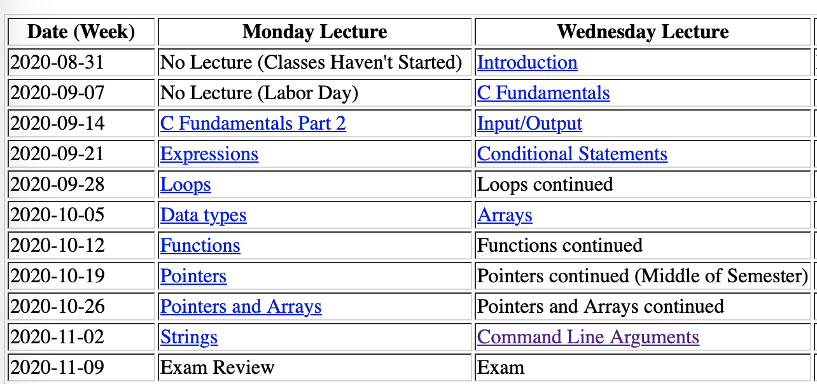
Exam Scope
All contents discussed before (https://www.cse.msu.edu/~cse220/schedule-20-fall.html)

Slide 6
Problem Types
Legal or Illegal?
Statements, Expressions, Declaration and Initialization
Coding
Function
Pointer
Array
String
Output
Data types
Recursive Function
Pointer and Array

Slide 7
Legal or Illegal

Slide 8
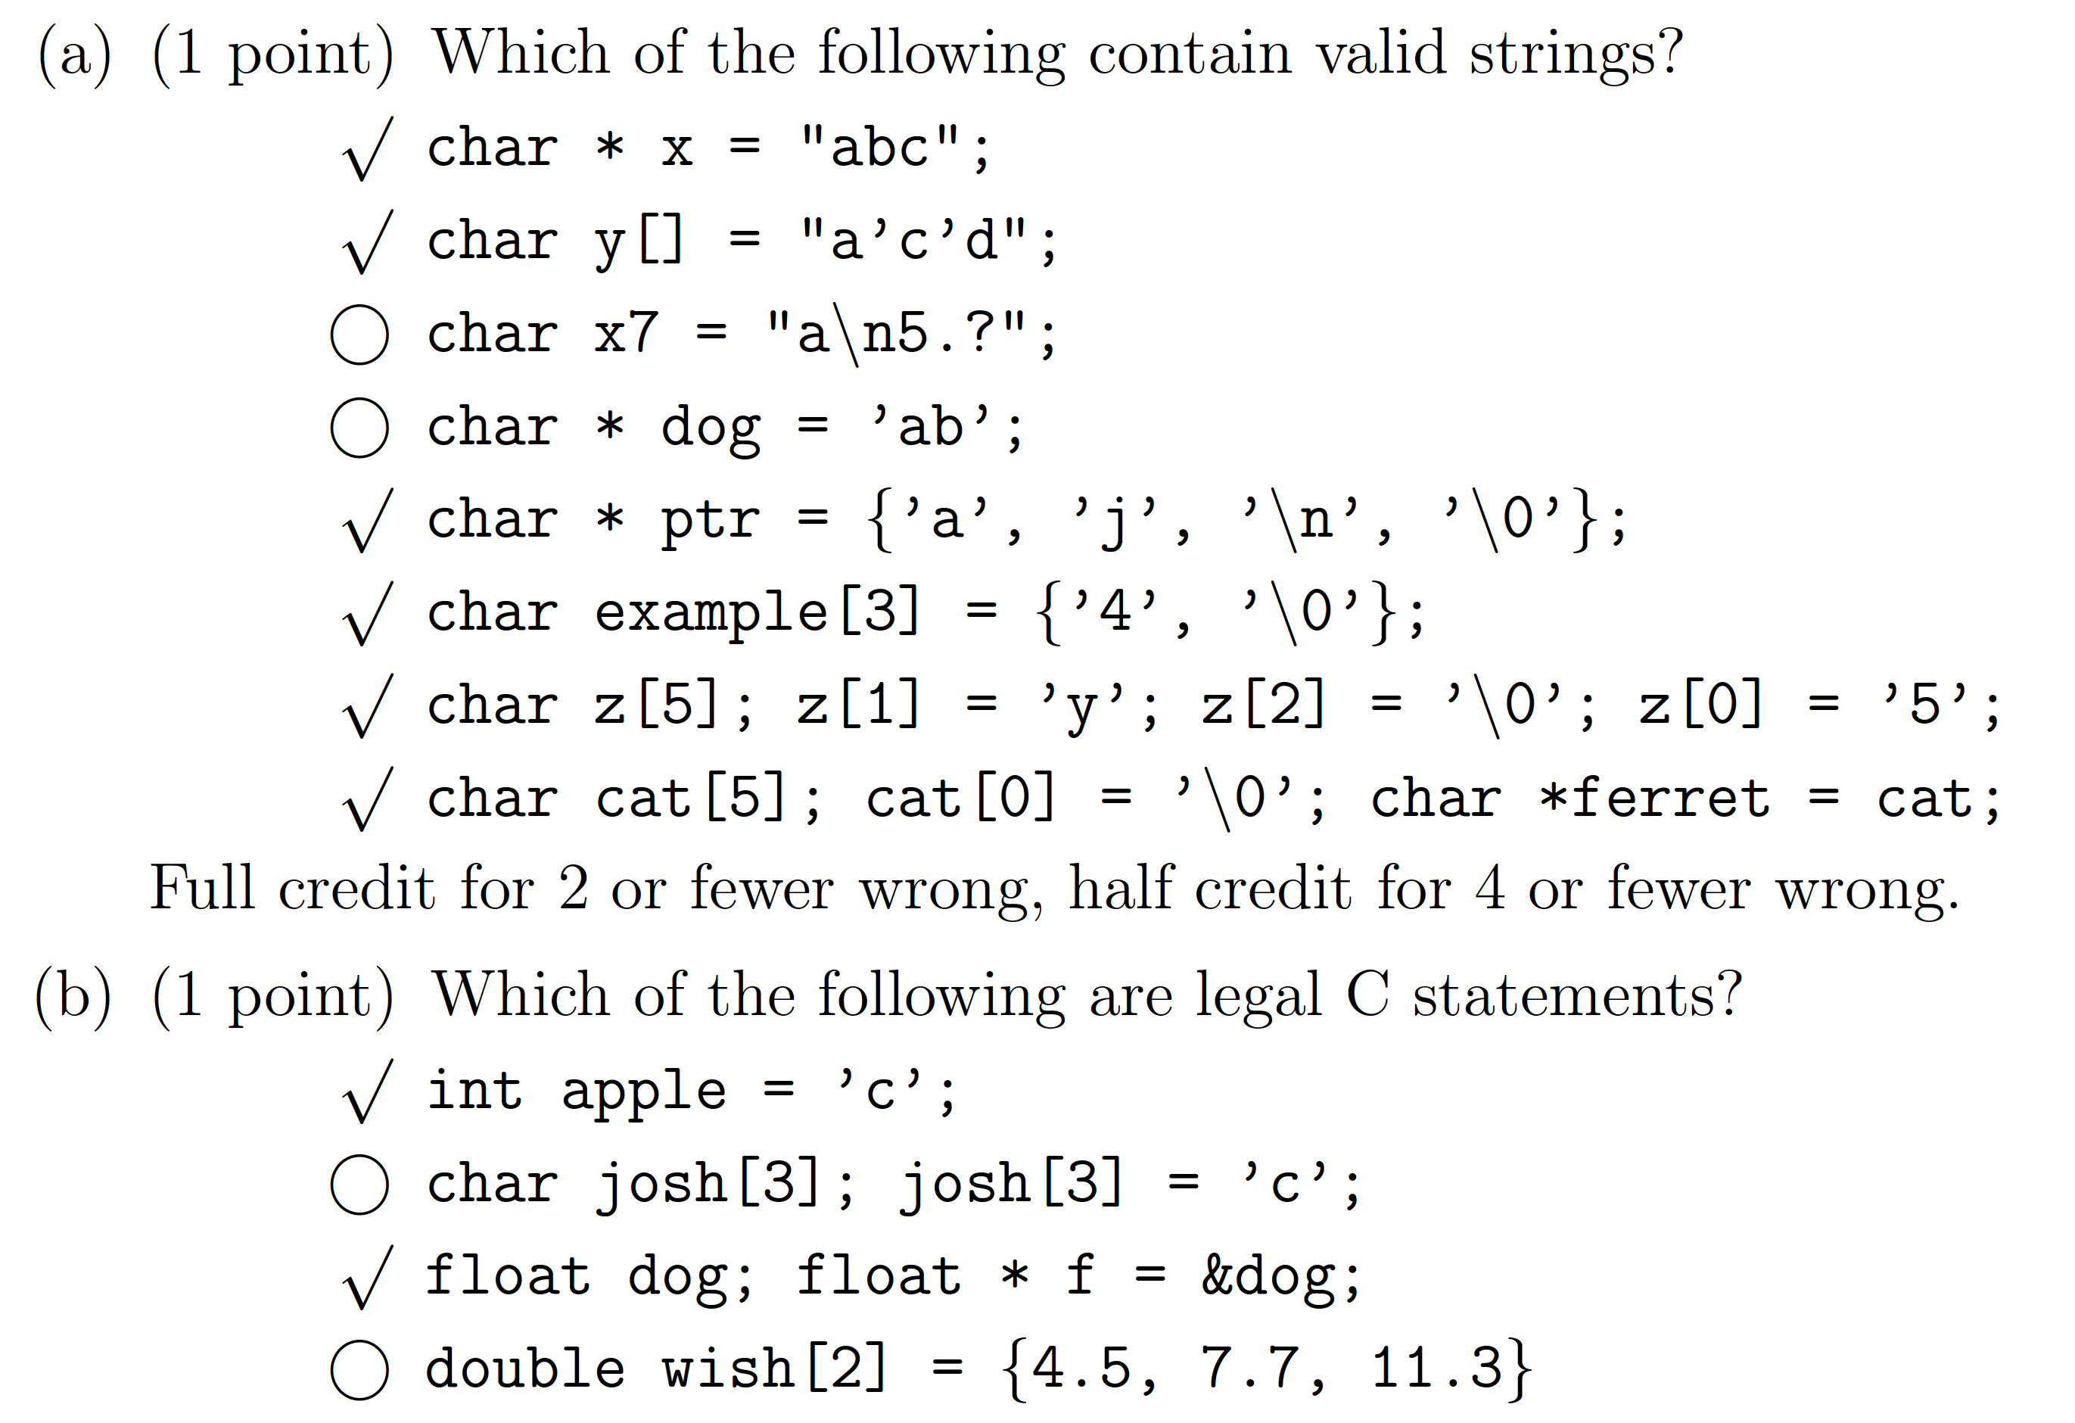
Legality (Exam Sample 1)

Slide 9
Coding

Slide 10
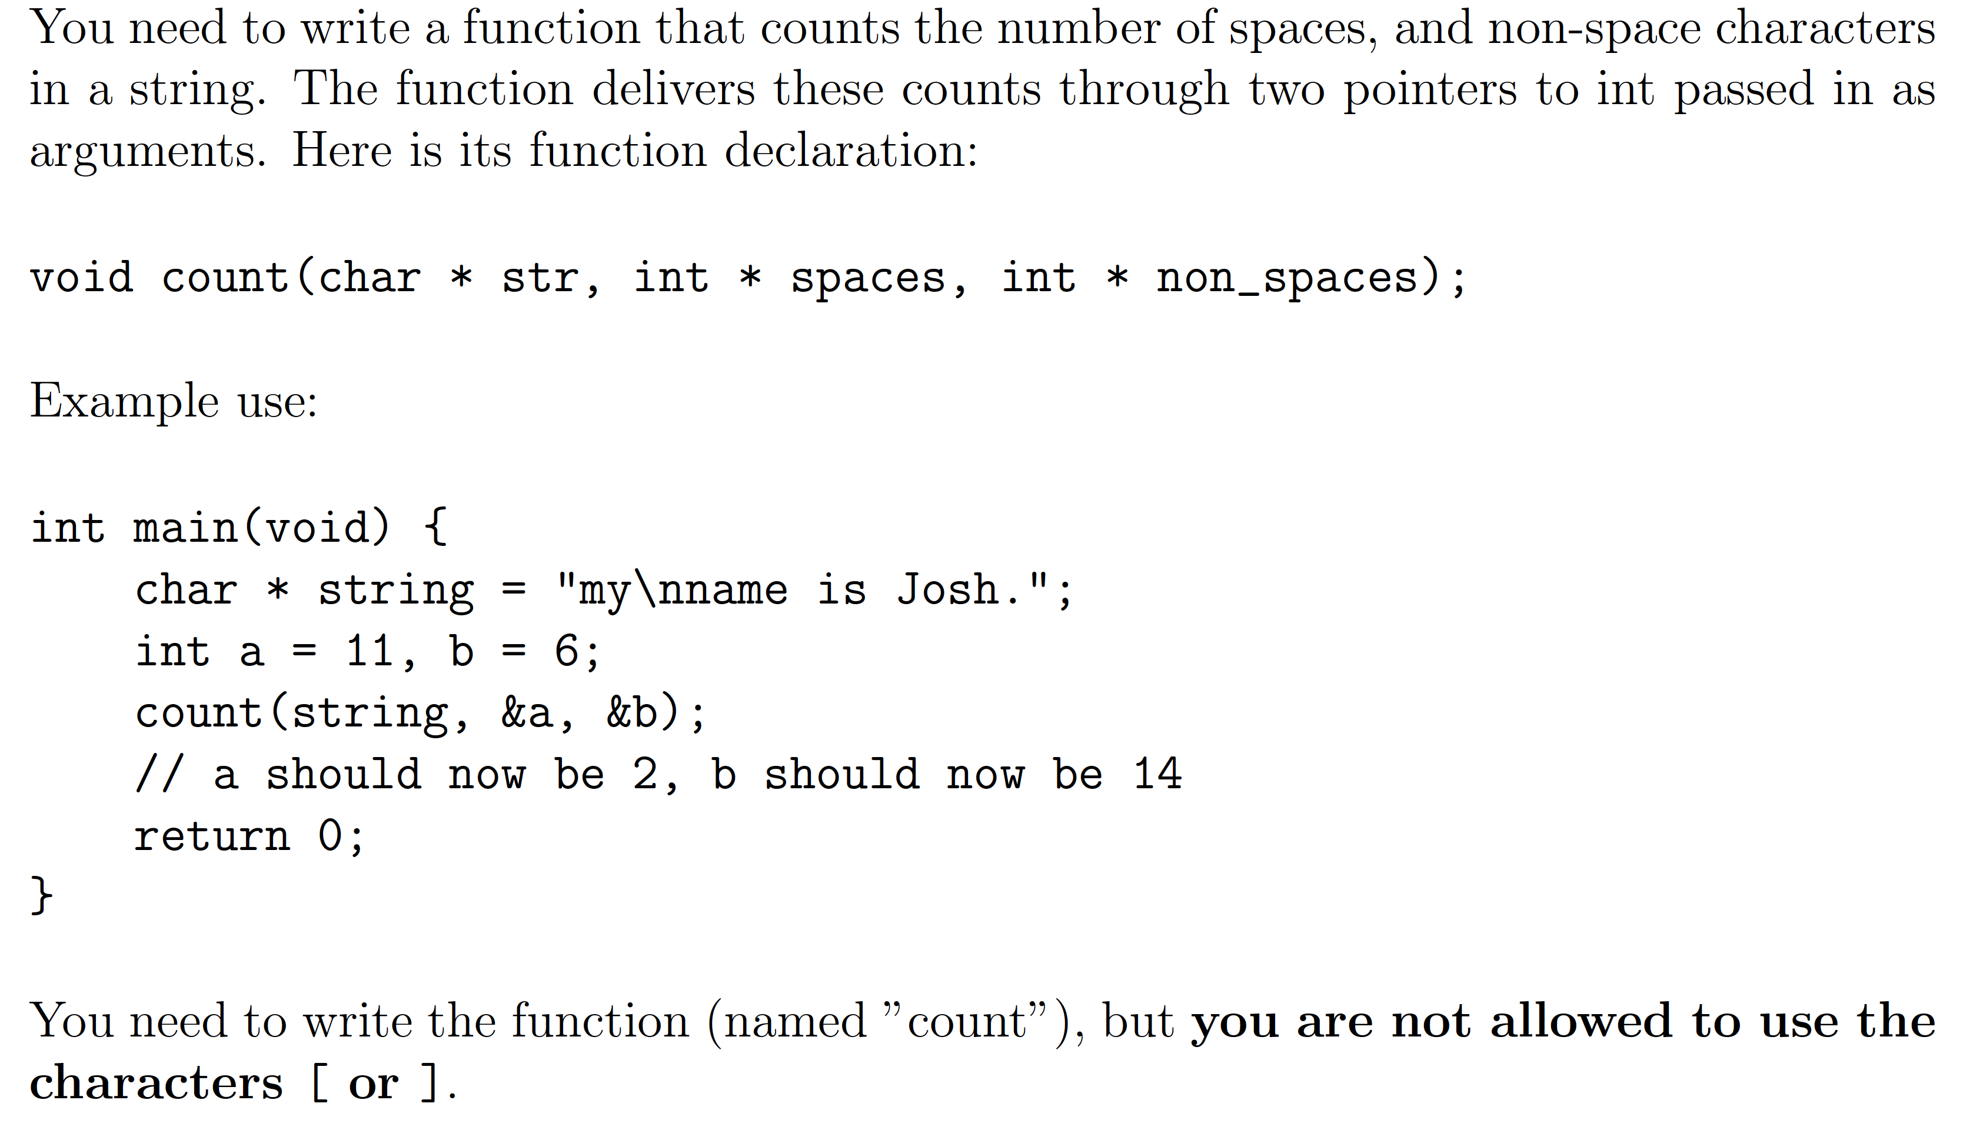
No Indexing (Exam Sample 1)

Slide 11
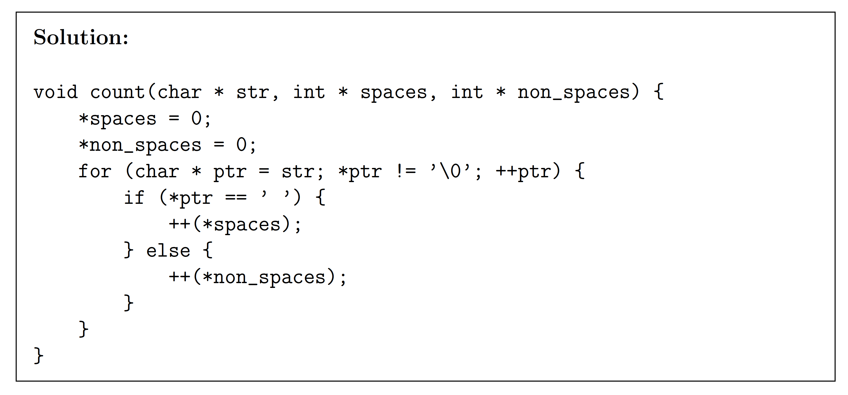
No Indexing (con’t)

Slide 12
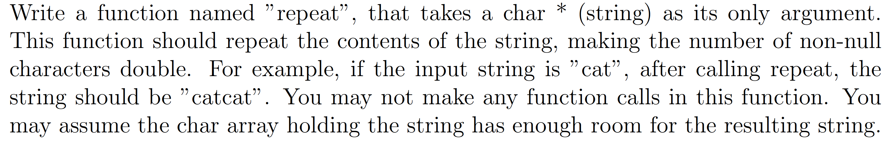
Repeat String (Exam Sample 2)

Slide 13
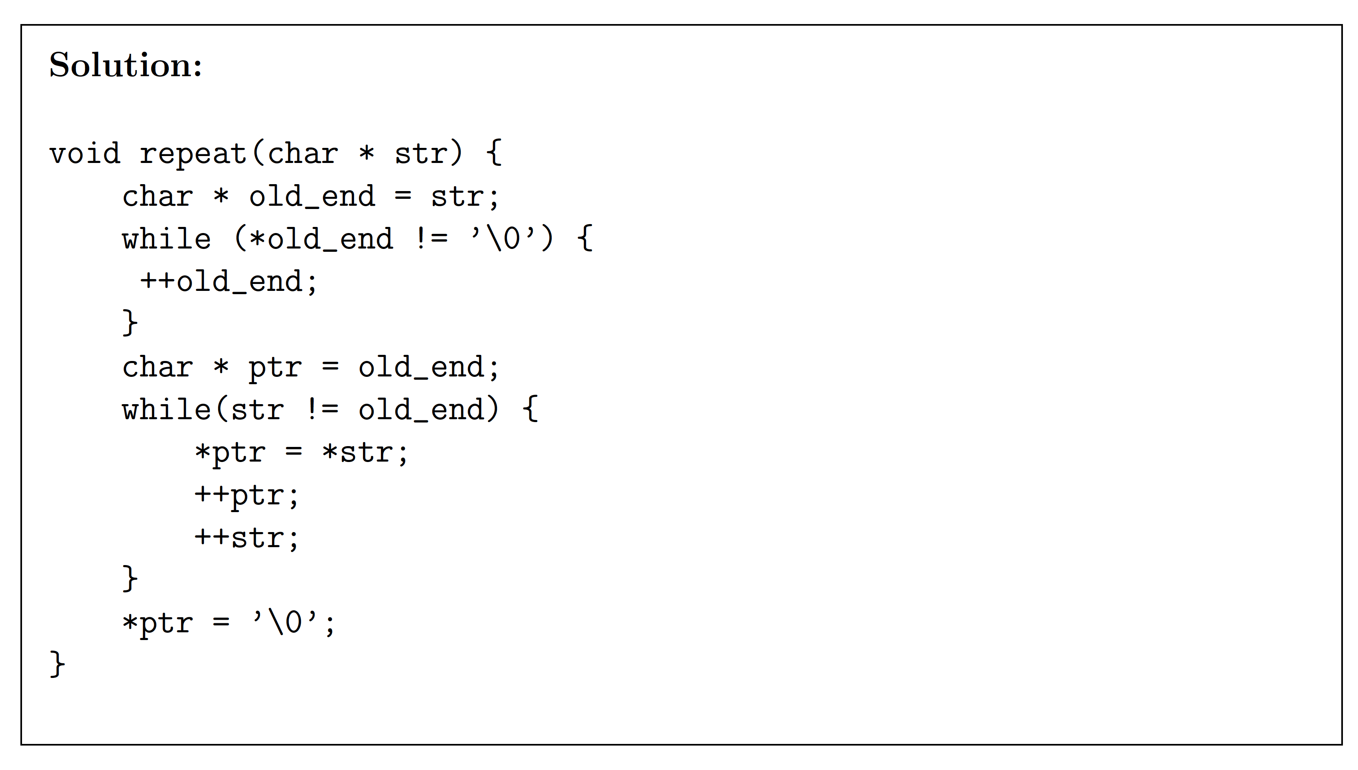
Repeat String (con’t)

Slide 14
Input and Output

Slide 15
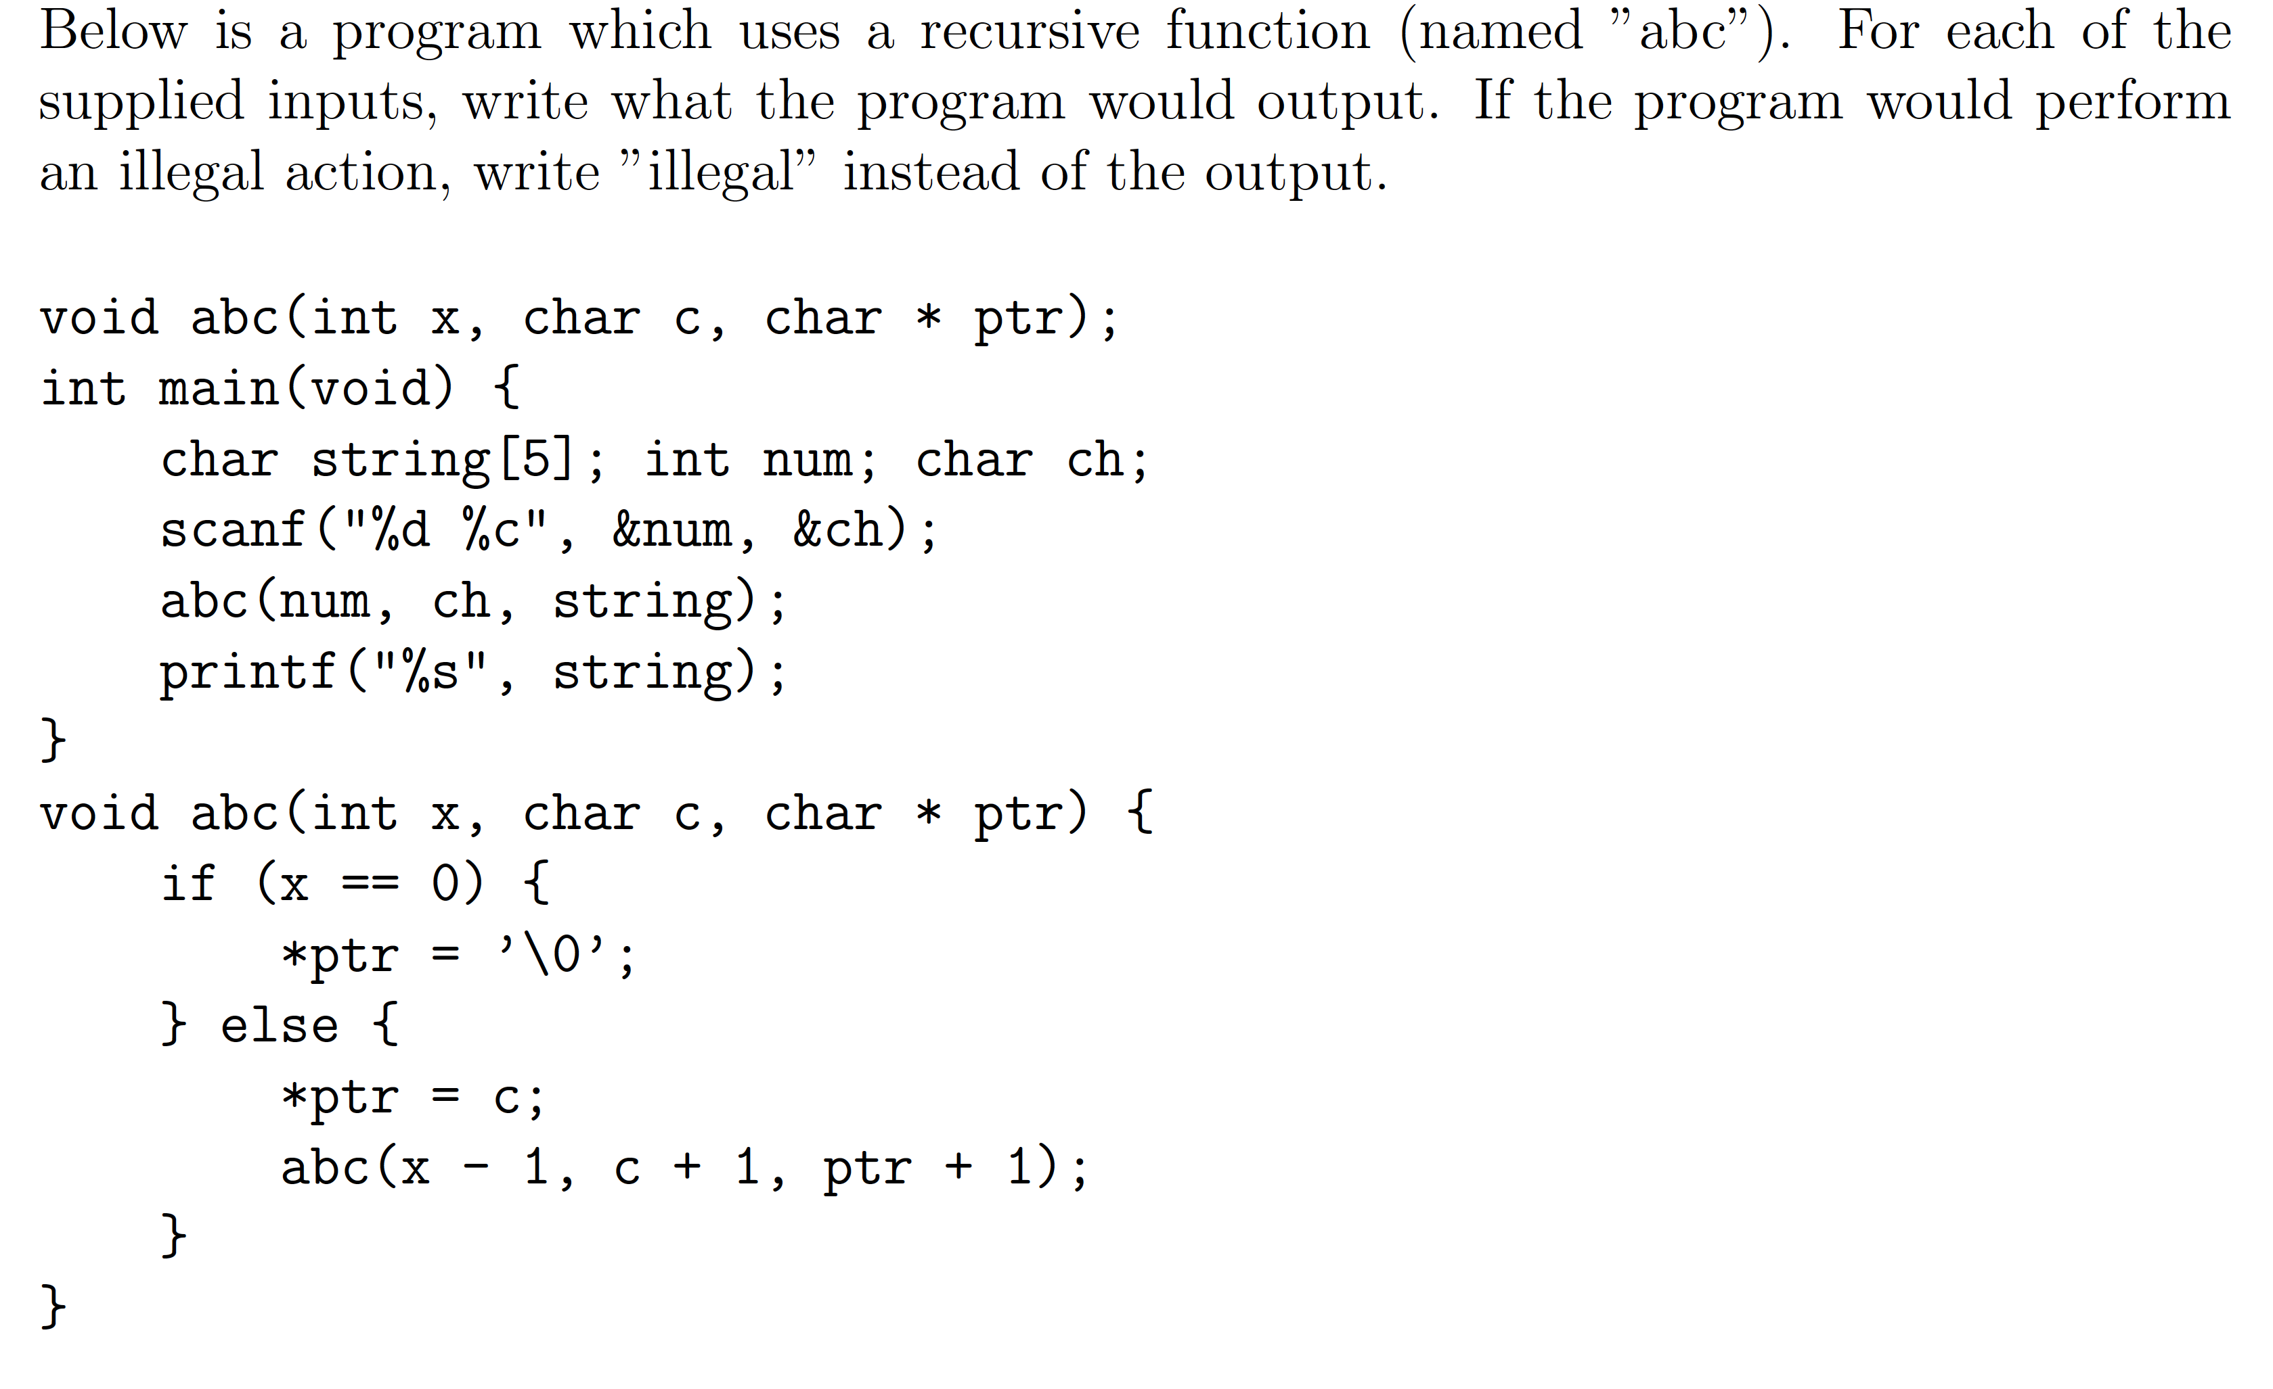
Recursion (Exam Sample 1)

Slide 16
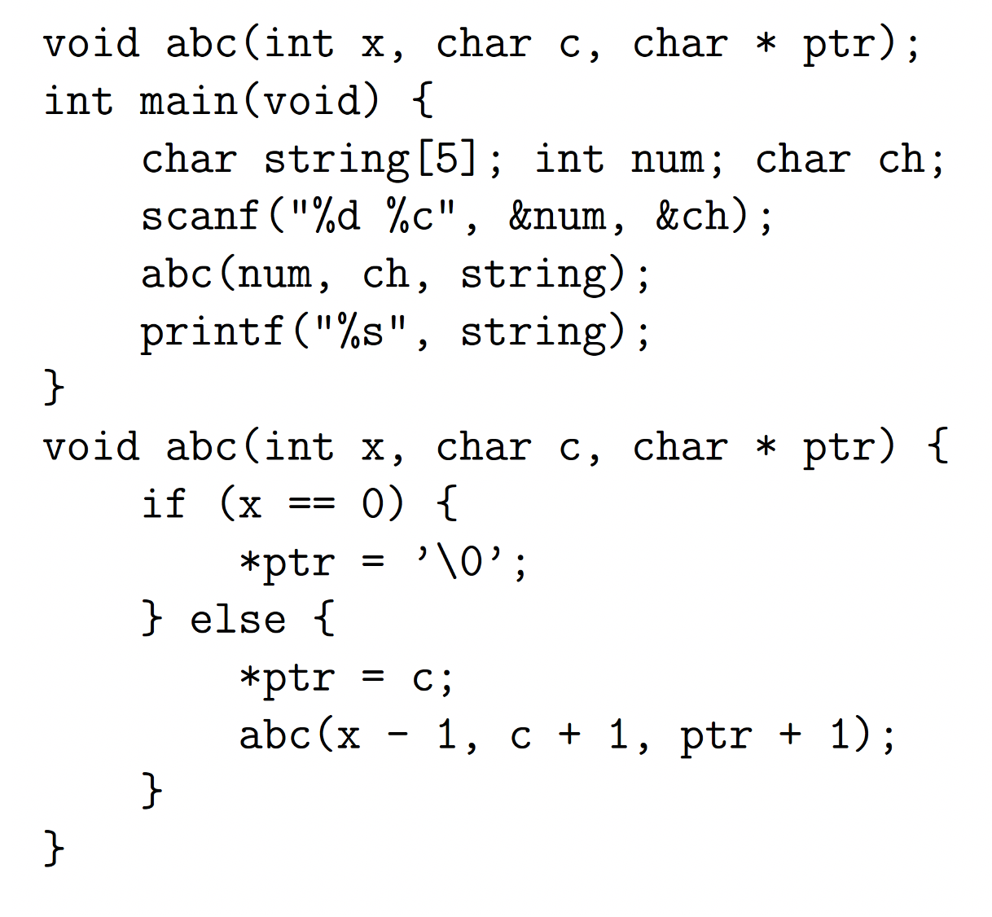
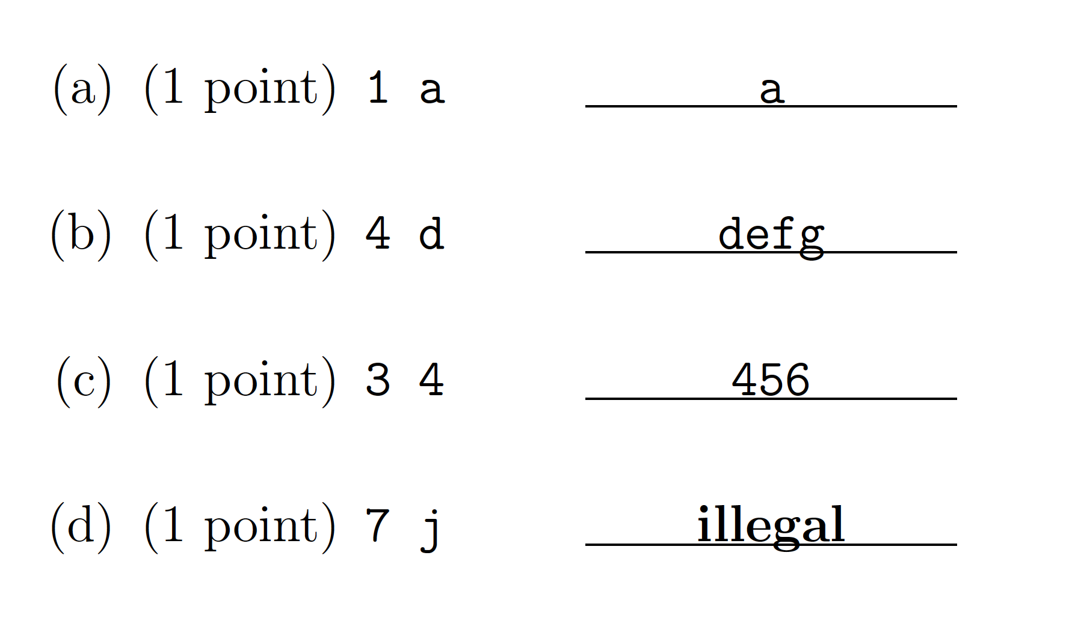
Recursion (con’t)

Slide 17
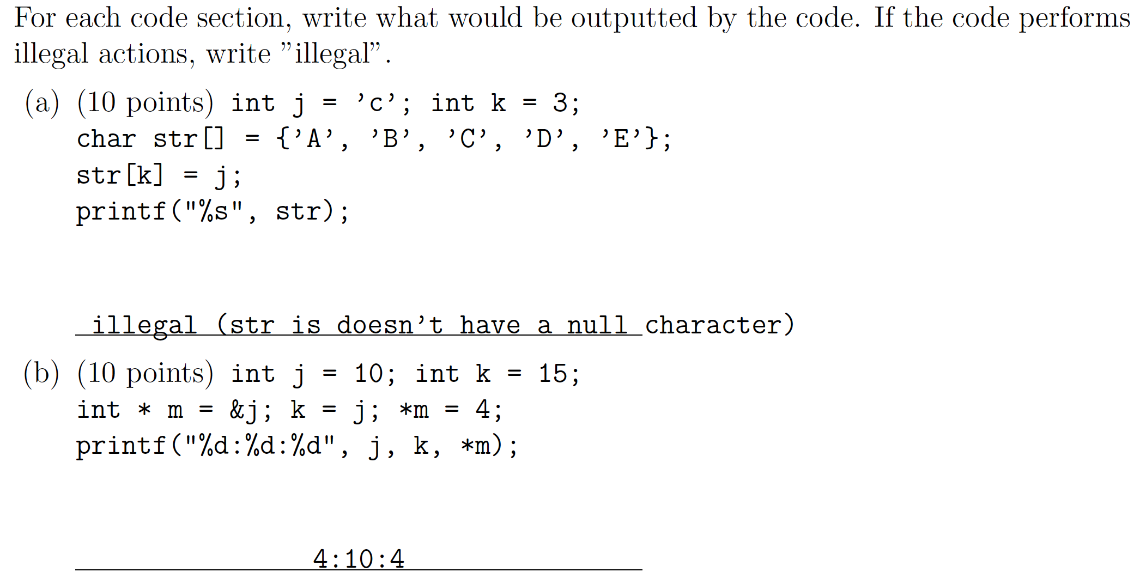
Pointers and Arrays (Exam Sample 2)

Slide 18
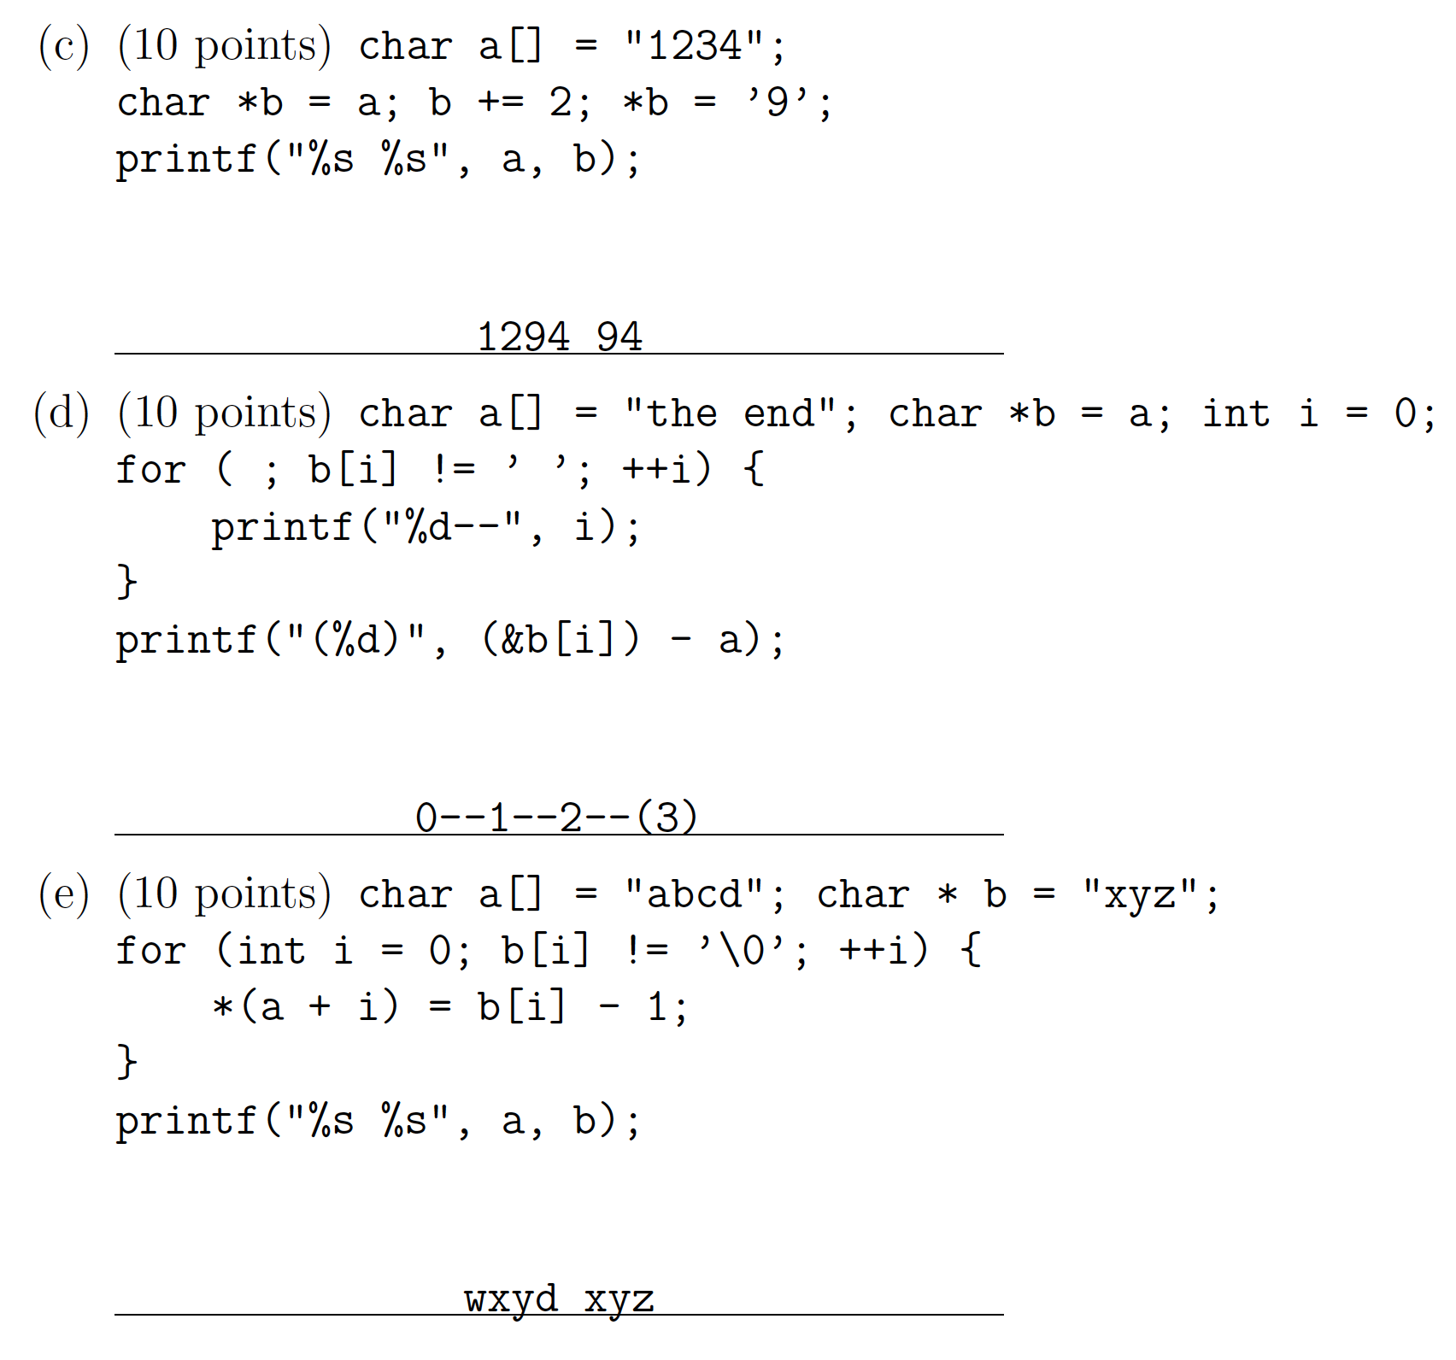
Pointers and Arrays (con’t)

