Slide 1
CSE 220 – C Programming Lecture 02
Introduction to C
Thanks to Fatme El-Moukaddem

Slide 2
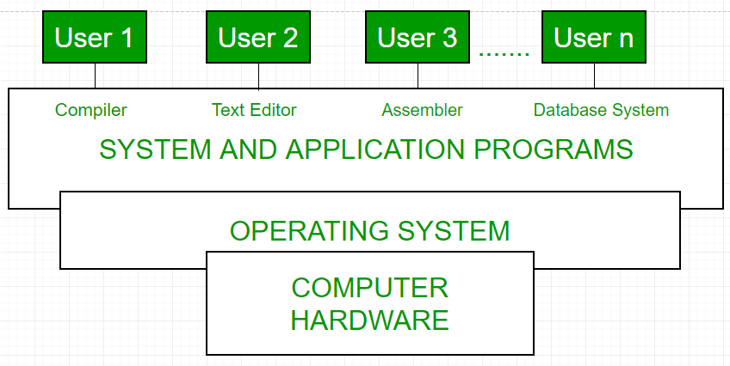
Where is an Operating System (Unix)?

Slide 3
Unix (Linux is a variant of it)
Commands written in C language
C Shell and later tcsh: command processors
Multilevel file hierarchy called directory tree
The top is a single directory called “root” designated by a slash /
File types:
Ordinary files
Device files (represent physical devices, e.g., printer)
Directories
. denotes current directory
.. denotes parent directory

Slide 4
Unix Commands (I)
Filesystem Management
ls List “normal” files, not those start with.
ls -a List all files, including those start with.
rm file Remove file.
rm -r dir Recursive: Remove dir and all subdirs.
mv file1 file2 Rename file1 to file2.
mv dir1 dir2 Rename dir1 to dir2.
cp file1 file2 Copy file1 to file2.
cd dirname Change current directory to dir.
mkdir dirname Make a new directory dirname.
rmdir dirname Remove the directory dirname.
pwd Print working directory.

Slide 5
Quiz 01
Linux is a variant of Unix. Y/N

Slide 6
File System Management: Examples
/
List ordinary files in directory Trips:
cd Trips
ls
Trips
Projects
todo
Create a copy of Trip1, call it Trip_dec2016
cp Trip1 Trip_dec2016
Trip1
Trip2.jpg
Budget.txt

Slide 7
Unix Commands (II)
File Management
more file Show contents of file.
head -n file Show first n lines of file.
tail -n file Show last n lines of file.
grep pattern file Search file for pattern.
cat file1 file2 > file Append file2 to file1 and save as file
Process Management
top Show the top cpu processes.
ps -elf Show info about all processes.
kill pid Kill process pid.

Slide 8
File Management: Example
/
Current directory: Trips Print (catenate) content of file Budget2016.txt
on screen:
cat ../Projects/Budget.txt
Trips
Projects
todo
Trip1
Trip2.jpg
Budget.txt

Slide 9
File Editors
A number of editors are available:
gedit
vi
emacs
pico
kate

Slide 10
Why C Language?
Base to other languages:
C++, Java, C#, Perl, Objective-C
Low level language:
Suitable for system-level programming
Small language:
Easy to learn
Powerful language
Core of many software/hardware

Slide 11
Strengths of C Language
Efficiency:
C programs run quickly and use limited memory
Portability:
C source program can be compiled on other machines due to ANSI/ISO standards
Power:
Collection of data types and operators accomplish a lot with few lines of code
Standard Library:
Do not need to write everything by yourself: library for input/output, string handling, storage allocation, etc.

Slide 12
Weaknesses
Error prone:
Flexibility allows programmers to make mistakes without warnings: e.g., without garbage collection
Hard to debug and fix: AI debugging?
Hard to maintain: e.g., when new programmers replace old ones
Lacks new features:
Object oriented design: e.g., grow to C++, C#, Java
Exception handling: E.g., when a file cannot be found do not simply terminate, give helpful information

Slide 13
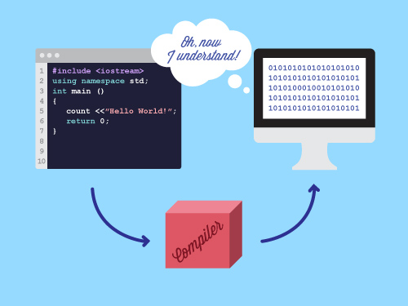
Compiling & Linking
Cannot execute the source code directly

Slide 14
Compiling
Compilation:
Syntax: Checks if you followed the rules of C
If no errors => creates an executable code
If errors found => returns a list of errors
Errors can be cryptic
Executable code
The binary file you run
Generated only when all compilation errors are fixed

Slide 15
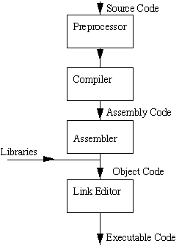
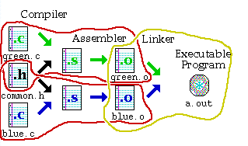
Preprocessor, compiler, assembler, linker
(Image from www.dartmouth.edu/~rc/classes/softdev_linux/Images and https://www.cs.bgu.ac.il/~spl191/index.php?page=PracticalSession01.Makefile)

Slide 16
Gnu compiler
A number of compilers available: cc, gcc
gcc myProgram.c
Generates an executable called a.out in the same directory
Run a.out by typing ./a.out
gcc –o myProgram myProgram.c
Changes the default name a.out
The generated executable name is myProgram

Slide 17
Errors
Compilation errors:
Program violates C rules
Statements must end with a semicolon
x = y + 5
Runtime errors:
Errors that occur during the execution of the program
Division by zero
Algorithmic errors:
Program does not run as desired
Compute the area of circle as
area = 2*3.14*radius
Compiler will complain about missing ;
Will give NaN during execution
Program will output incorrect value

