Slide 1

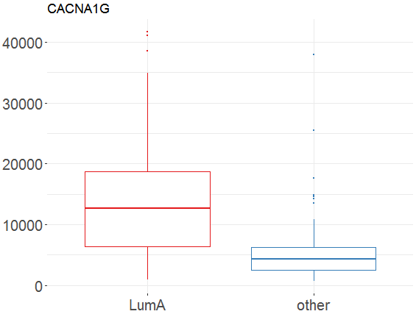
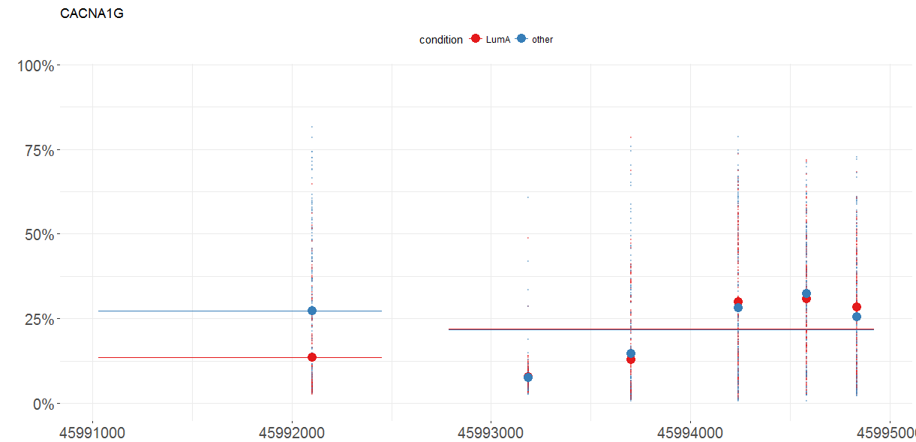
MLExpResso Cheat Sheet
Methylation
Data
Expression
Data
MLExpResso::aggregate_probes(data)
Data sets for testing expression differences must contain per gene read counts. Columns should correspond to genes, rows to samples. As input for tests correspond to expression, the caluclate_test function expects count data in the form of a matrix of integer values. The value in the i-th row and the j-th column tells how many reads can be assigned to gene j in sample i.
Note that for some tests the values in the matrix should be un-normalized counts. so transformed or normalized values such as counts scaled by library size should not be used as input. More idetails is in the documentation of calculate_test function.
Tests
Tests
Testing for differences.
MLExpResso::calculate_test(data, condition, test)
Testing for differences.
MLExpResso::calculate_test(data, condition, test)
Value | Test
'ttest' | student's t-tets
'nbinom2' | negative binomial test
'lrt' | likelihood-ratio test
'qlf' | quasi-likelihood F-test
Value | Test
'ttest' | student's t-test
'methyanalysis' | quasi-likelihood F-test
Example
Example
library(MLExpResso)
library(MLExpRessodata)
met <- aggregate_probes(BRCA_methylation_chr17[ ,-1])
gr_met <- BRCA_methylation_chr17[ ,-1]
gr_met <- ifelse(group=='LumA', 'LumA', 'other')
calculate_test(met, gr_met, 'ttest'
library(MLExpResso
library(MLExpRessodata)
exp <- BRCA_mRNAseq_chr17[ ,-1]
gr_exp <- BRCA_mRNAseq_chr17[ ,-1]
gr_exp <- ifelse(group=='LumA', 'LumA', 'other')
calculate_test(exp, gr_exp, 'lrt')
Plots
Plots
MLExpResso::plot_diff_boxplot(data, condition, gene)
MLExpResso::plot_methylation_path(data, condition, gene)
Example
Example
plot_diff_boxplot(exp, gr_exp, 'CACNA1G')
plot_methylation_path(met ,gr_met,
'CACNA1G')
RStudio® is a trademark of RStudio, Inc. • CC BY Your Name • Your@email.com • 844-448-1212 • rstudio.com
Learn more at web page or vignette • package version • Updated: 3/15

Slide 2
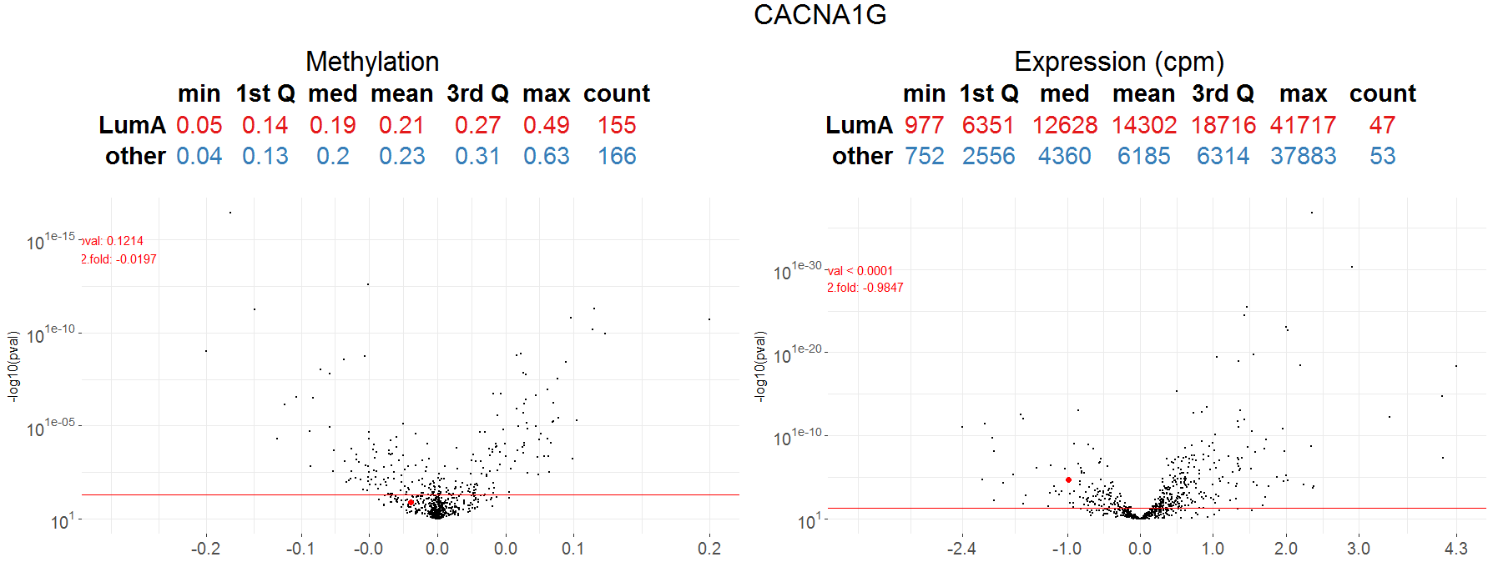
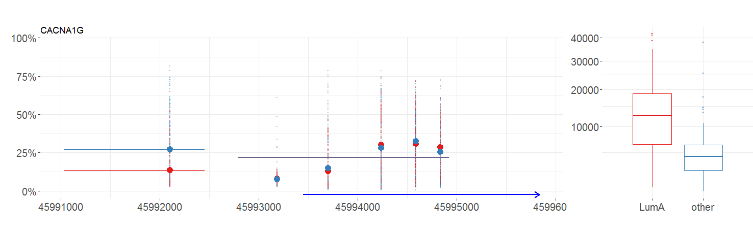
Visualizations
Plot_volcanoes()
MLExpResso::plot_volcanoes(data.m, data.e, condition.m, condition.e, gene, test.m, test.e)
Plot_gene()
MLExpResso::plot_genes(data.m, data.e, condition.m, condition.e, gene)
RStudio® is a trademark of RStudio, Inc. • CC BY Your Name • Your@email.com • 844-448-1212 • rstudio.com
Learn more at web page or vignette • package version • Updated: 3/15

