Slide 1

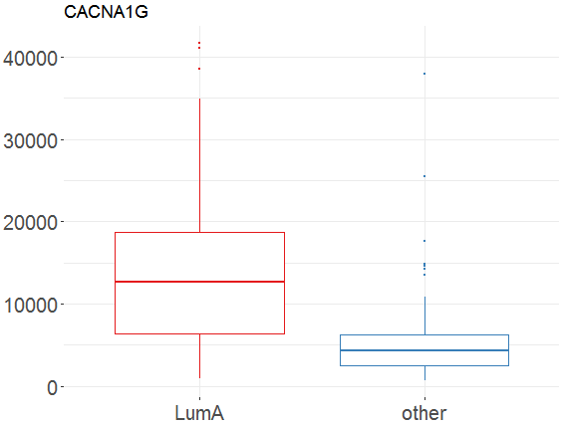
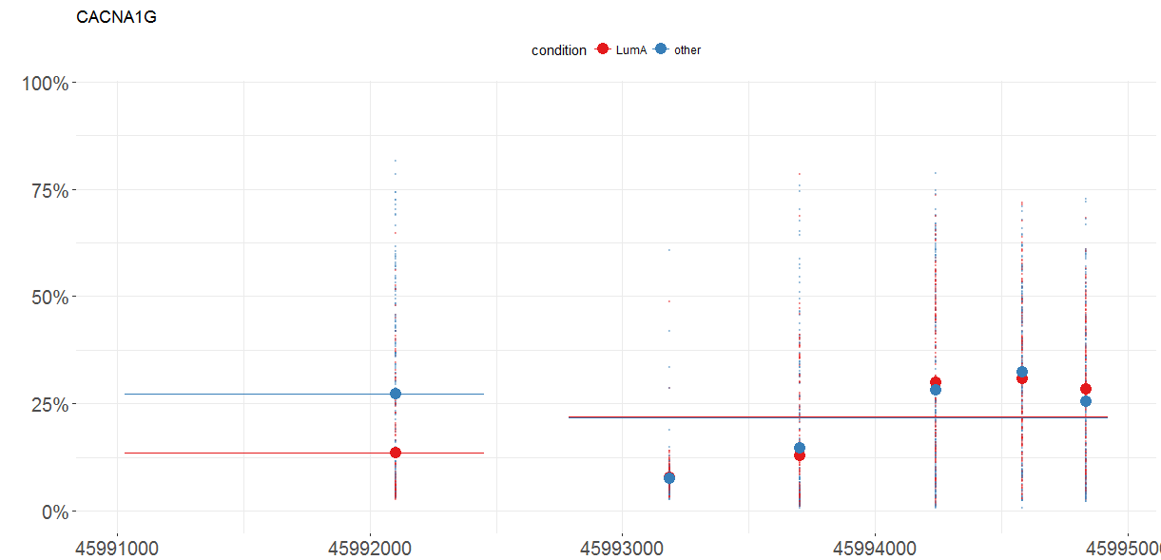
MLExpResso Cheat Sheet
Methylation
Data
Expression
Data
MLExpResso::aggregate_probes(data)
Data sets for testing expression differences must contain per gene read counts. Columns should correspond to genes, rows to samples. As input for tests correspond to expression, the caluclate_test function expects count data in the form of a matrix of integer values. The value in the i-th row and the j-th column tells how many reads can be assigned to gene j in sample i.
Note that for some tests the values in the matrix should be un-normalized counts. so transformed or normalized values such as counts scaled by library size should not be used as input. More idetails is in the documentation of calculate_test function.
Tests
Tests
Testing for differences.
MLExpResso::calculate_test(data, condition, test)
Testing for differences.
MLExpResso::calculate_test(data, condition, test)
Value | Test
'ttest' | student's t-tets
'nbinom2' | negative binomial test
'lrt' | likelihood-ratio test
'qlf' | quasi-likelihood F-test
Value | Test
'ttest' | student's t-test
'methyanalysis' | quasi-likelihood F-test
Example
Example
library(MLExpResso)
library(MLExpRessodata)
met <- aggregate_probes(BRCA_methylation_chr17[ ,-1])
gr_met <- BRCA_methylation_chr17[ ,-1]
gr_met <- ifelse(group=='LumA', 'LumA', 'other')
calculate_test(met, gr_met, 'ttest'
library(MLExpResso
library(MLExpRessodata)
exp <- BRCA_mRNAseq_chr17[ ,-1]
gr_exp <- BRCA_mRNAseq_chr17[ ,-1]
gr_exp <- ifelse(group=='LumA', 'LumA', 'other')
calculate_test(exp, gr_exp, 'lrt')
Plots
Plots
MLExpResso::plot_diff_boxplot(data, condition, gene)
MLExpResso::plot_methylation_path(data, condition, gene)
Example
Example
plot_diff_boxplot(exp, gr_exp, 'CACNA1G')
plot_methylation_path(met ,gr_met,
'CACNA1G')
RStudio® is a trademark of RStudio, Inc. • CC BY Your Name • Your@email.com • 844-448-1212 • rstudio.com
Learn more at web page or vignette • package version • Updated: 3/15

Slide 2
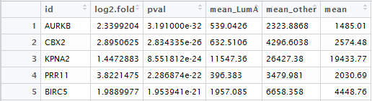
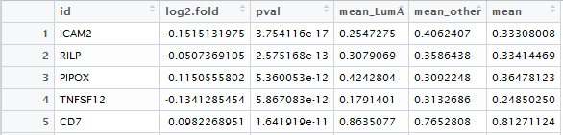
MLExpResso Cheat Sheet
Expression
Blah blah
Example
The calculate_test() function calculates…
library(MLExpResso
library(MLExpRessodata)
exp <- BRCA_mRNAseq_chr17[ ,-1]
gr_exp <- BRCA_mRNAseq_chr17[ ,-1]
gr_exp <- ifelse(group=='LumA', 'LumA', 'other')
res_exp <- calculate_test(exp, gr_exp, 'lrt')
plot_diff_boxplot(exp, gr_exp, 'CACNA1G')
Intro
MLExpResso::calculate_test(data, condition, test)
The aim of MLExpResso is to …
MLExpResso::plot_diff_boxplot(data, condition, gene)
Value | Test
'ttest' | student's t-tets
'nbinom2' | negative binomial test
'lrt' | likelihood-ratio test
'qlf' | quasi-likelihood F-test
Data
Data sets for testing expression differences must contain per gene read counts. Columns should correspond to genes, rows to samples. As input for tests correspond to expression, the caluclate_test function expects count data in the form of a matrix of integer values. The value in the i-th row and the j-th column tells how many reads can be assigned to gene j in sample i.
Note that for some tests the values in the matrix should be un-normalized counts. so transformed or normalized values such as counts scaled by library size should not be used as input. More idetails is in the documentation of calculate_test function.
Methylation …
Methylation
MLExpResso::calculate_test(data, condition, test)
Example
library(MLExpResso)
library(MLExpRessodata)
met <- aggregate_probes(BRCA_methylation_chr17[ ,-1])
gr_met <- BRCA_methylation_chr17[ ,-1]
gr_met <- ifelse(group=='LumA', 'LumA', 'other')
res_met <- calculate_test(met, gr_met, 'ttest'
plot_methylation_path(met ,gr_met, 'CACNA1G'
MLExpResso::plot_methylation_path(data, condition, gene)
Value | Test
'ttest' | student's t-test
'methyanalysis' | quasi-likelihood F-test
MLExpResso::aggregate_probes(data)
RStudio® is a trademark of RStudio, Inc. • CC BY Your Name • Your@email.com • 844-448-1212 • rstudio.com
Learn more at web page or vignette • package version • Updated: 3/15

Slide 3
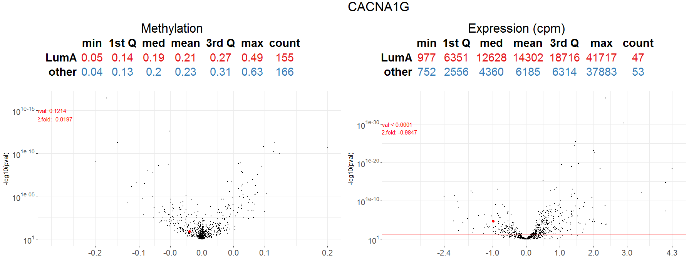
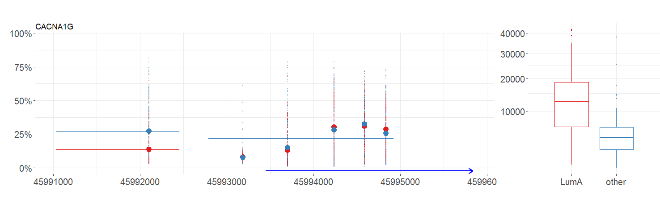
Visualizations
Plot_volcanoes()
MLExpResso::plot_volcanoes(data.m, data.e, condition.m, condition.e, gene, test.m, test.e)
Example
plot_volcanoes(met, exp, gr_met, gr_exp, 'CACNA1G', res_met, res_exp)
Plot_gene()
MLExpResso::plot_genes(data.m, data.e, condition.m, condition.e, gene)
Example
plot_volcanoes(met, exp, gr_met, gr_exp, 'CACNA1G', res_met, res_exp)
RStudio® is a trademark of RStudio, Inc. • CC BY Your Name • Your@email.com • 844-448-1212 • rstudio.com
Learn more at web page or vignette • package version • Updated: 3/15

