Slide 1

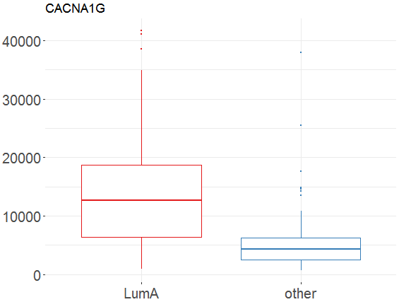
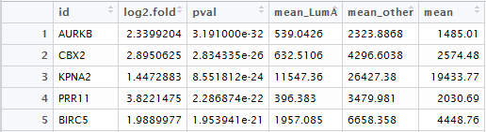
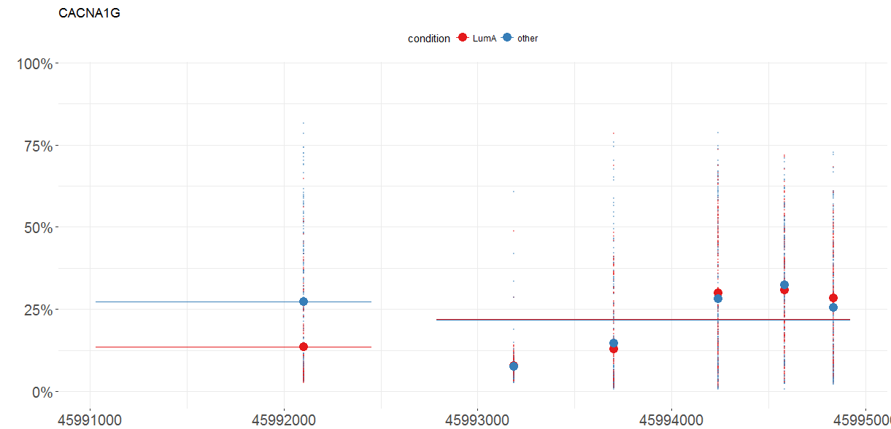
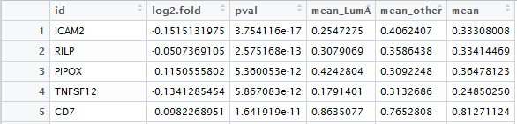
MLExpResso Cheat Sheet
Expression
MLExpResso::calculate_test(data, condition, test)
MLExpResso::plot_diff_boxplot(data, condition, gene)
Function calculate_test() computes log folds, p-values and means for choosen test for data from methylation or expression.
Value | Test
'ttest' | student's t-tets
'nbinom2' | negative binomial test
'lrt' | likelihood-ratio test
'qlf' | quasi-likelihood F-test
Function plot_diff_boxplot() generates a boxplot of values from choosen data frame column with division in groups (two or more).
Introduction
MLExpResso is an R package for integrative analyses and visualization of gene expression and DNA methylation data.
Key functions of this package are:
identification of DMR - differentially methylated regions,
identification of genes with affected expression,
identification regions with changes in expression and methylation,
visualization of identified regions.
The joint modeling and visualization of genes expression and methylation improve interpretability of identified signals.
The methodology is supplemented with example applications to The Cancer Genome Atlas data.
Example
Example
library(MLExpResso)
library(MLExpRessodata)
exp <- BRCA_mRNAseq_chr17[ ,-1]
gr_exp <- BRCA_mRNAseq_chr17[ ,1]
gr_exp <- ifelse(gr_exp=='LumA', 'LumA', 'other')
res_exp <- calculate_test(exp, gr_exp, 'lrt')
plot_diff_boxplot(exp, gr_exp, 'CACNA1G')
Data
Methylation
Expression
MLExpResso::calculate_test(data, condition, test)
MLExpResso::plot_methylation_path(data, condition, gene)
Data sets for testing expression differences must contain per gene read counts. Columns should correspond to genes, rows to samples. As input for tests corresponds to expression, the calculate_test() function expects count data in the form of a matrix of integer values. The value in the i-th row and the j-th column tells how many reads can be assigned to gene j in sample i.
Note that for some tests the values in the matrix should be un-normalized counts, so transformed or normalized values such as counts scaled by library size should not be used as input.
MLExpResso::aggregate_probes(data)
Function aggregate_probes() aggregates CpG probes to corresponding genes using, by default, the IlluminaHumanMethylation data.
Function plot_methylation_path() visualises a chosen gene with marked CpG probes. It shows the mean methylation level for each probe in group. Also we can exact the line corresonding to gene. In this case we see what are the locations of probes on gene in HG18 coordinates. We can as well draw a locations of CpG islands.
Value | Test
'ttest' | student's t-test
'methyanalysis' | quasi-likelihood F-test
Example
Example
library(MLExpResso)
library(MLExpRessodata)
met <- aggregate_probes(BRCA_methylation_chr17)
gr_met <- BRCA_methylation_chr17[ ,1]
gr_met <- ifelse(gr_met=='LumA', 'LumA', 'other')
res_met <- calculate_test(met, gr_met, 'ttest')
plot_methylation_path(BRCA_methylation_chr17 ,gr_met, 'CACNA1G')
Methylation
Data sets for testing methylation differences must contain a percentage of methylation for each CpG probe. Columns should correspond to probes, rows to samples. As input for tests corresponds to methylation, the calculate_test() function expects values aggregated to genes. For aggregation of probes for genes is used the aggregate_probes() function. The value in the i-th row and the j-th column tells how much gene j is methylated in sample i.
RStudio® is a trademark of RStudio, Inc. • CC BY Your Name • Your@email.com • 844-448-1212 • rstudio.com
Learn more at web page or vignette • package version • Updated: 3/15

Slide 2
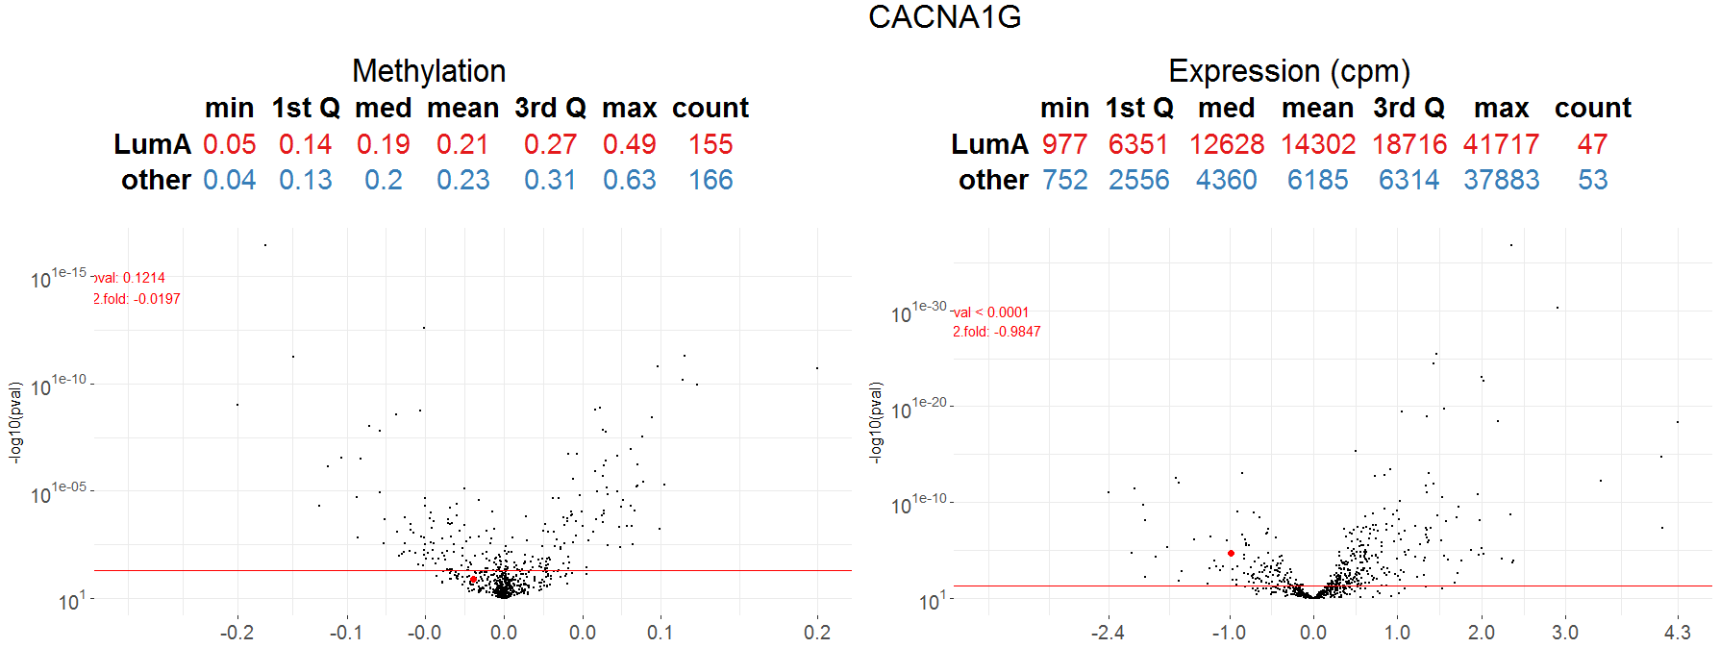
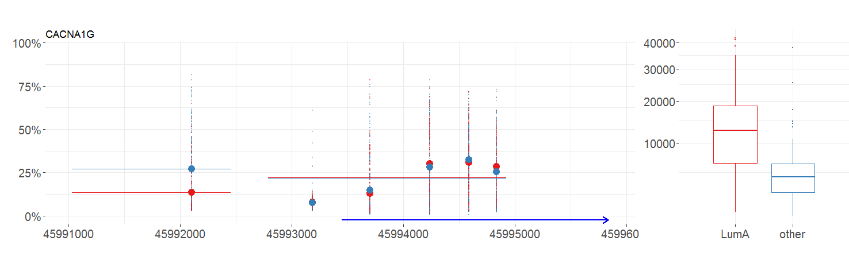
Visualizations
Plot_volcanoes()
MLExpResso::plot_volcanoes(data.m, data.e, condition.m, condition.e, gene, test.m, test.e)
Function plot_volcanoes() generates a dashboard with volcano plots for expression and methylation. Also it adds a tables with basic statistics for chosen gene.
Example
plot_volcanoes(met, exp, gr_met, gr_exp, 'CACNA1G', res_met, res_exp)
Plot_gene()
MLExpResso::plot_genes(data.m, data.e, condition.m, condition.e, gene)
Function plot_gene() generates a dashboard with methylation path for methylation and boxplots for groups for chosen gene.
Example
plot_volcanoes(met, exp, gr_met, gr_exp, 'CACNA1G', res_met, res_exp)
RStudio® is a trademark of RStudio, Inc. • CC BY Your Name • Your@email.com • 844-448-1212 • rstudio.com
Learn more at web page or vignette • package version • Updated: 3/15

