Slide 1

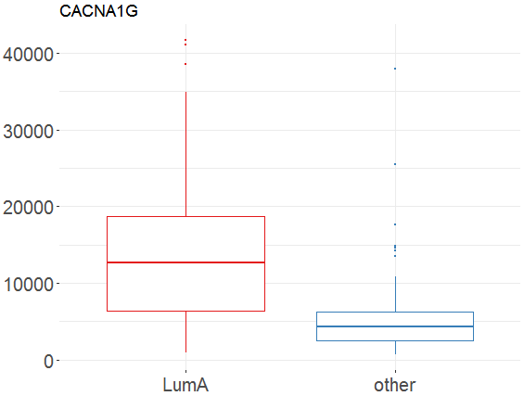
MLExpResso Cheat Sheet
Methylation
Data
library(MLExpRessodata)
met <- BRCA_meyhulation_chr17[ ,-1]
gr_met <- BRCA_mrthylation_chr17[ ,-1]
gr_met <- ifelse(group=='LumA', 'LumA', 'other')
Expression
Data
library(MLExpRessodata)
exp <- BRCA_mRNAseq_chr17[ ,-1]
g_exp <- BRCA_mRNAseq_chr17[ ,-1]
g_exp <- ifelse(group=='LumA', 'LumA', 'other')
Tests
Tests
Testing for differences.
MLExpResso::calculate_test(data=exp, condition=g_exp, test='lrt')
Testing for differences.
MLExpResso::calculate_test(data=meth, condition=g_met, test='ttest')
'ttest' | student's t-test
'nbinom2' | negative binomial test
'lrt' | likelihood-ratio test
'qlf' | quasi-likelihood F-test
'ttest' | student's t-test
'methyanalysis' | quasi-likelihood F-test
Plots
Plots
MLExpResso::plot_diff_boxplot(data=expr, condition=g_expr, gene='CACNA1G')
RStudio® is a trademark of RStudio, Inc. • CC BY Your Name • Your@email.com • 844-448-1212 • rstudio.com
Learn more at web page or vignette • package version • Updated: 3/15

Slide 2
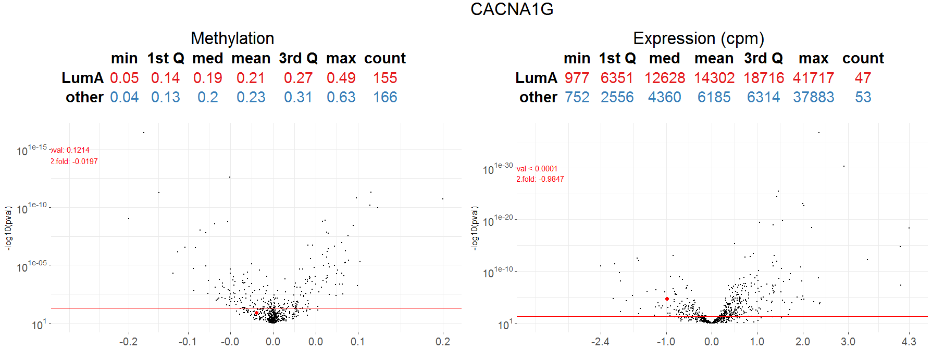
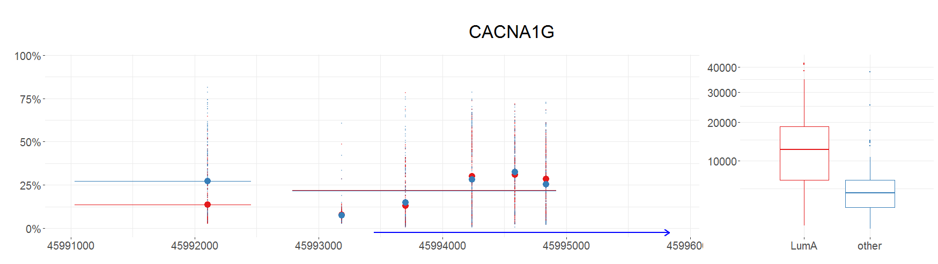
Visualizations
Plot_volcanoes()
Plot_gene()
RStudio® is a trademark of RStudio, Inc. • CC BY Your Name • Your@email.com • 844-448-1212 • rstudio.com
Learn more at web page or vignette • package version • Updated: 3/15

Slide 3
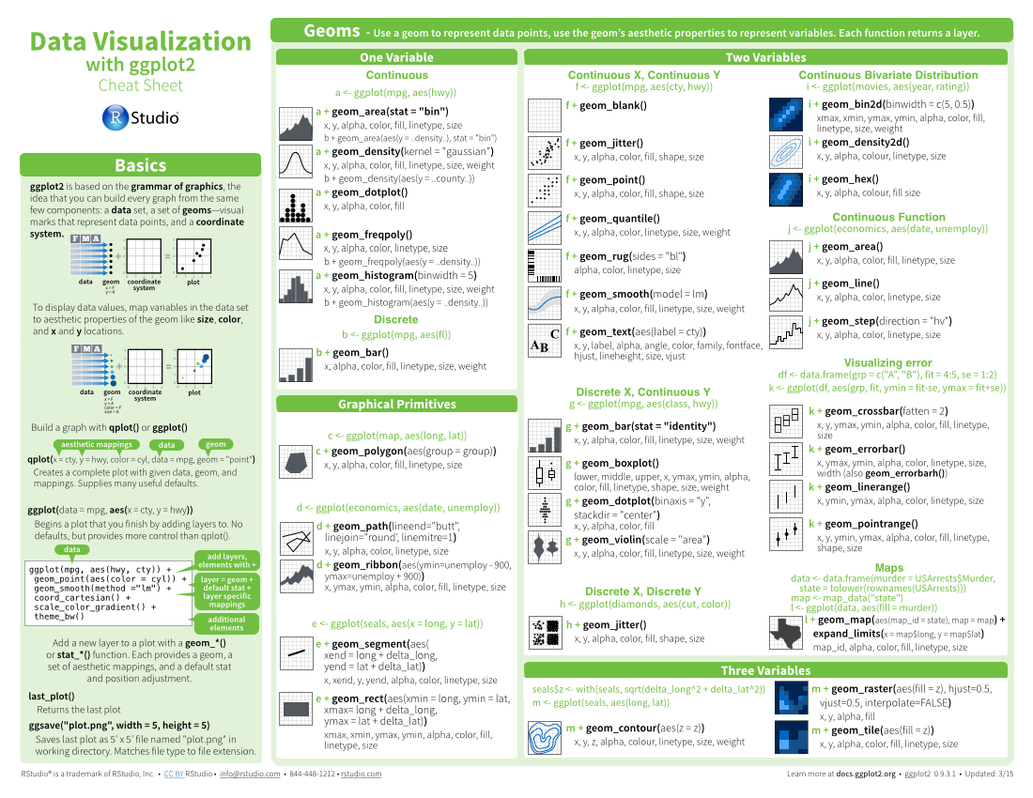
Four Column
layout
Cheat Sheet
Title - Group sections with titles, subtitles, and subsubtitles to create a visual hierarchy
Layout suggestions
Subtitle
Use headers, outlines, and/or backgrounds to separate or group together sections.
Use titles, subtitles, and subsubtitles to create a visual hierarchy that will help users navigate the page.
Fit sections to content. Try several different layouts.
Use numbers or arrows to link sections if the order/flow is confusing.
Example code
Color Scheme
Where possible, use code that works when run.
Please use the following color scheme when designing new cheatsheets to be distributed through http://www.rstudio.com/resources/cheatsheets/
Your
LOGO
Section 1
Section 2
Section 3
dplyr::lead
Copy with values shifted by 1.
dplyr::lag
Copy with values lagged by 1.
dplyr::dense_rank
Ranks with no gaps.
dplyr::min_rank
Ranks. Ties get min rank.
dplyr::percent_rank
Ranks rescaled to [0, 1].
dplyr::row_number
Ranks. Ties got to first value.
dplyr::ntile
Bin vector into n buckets.
dplyr::between
Are values between a and b?
dplyr::cume_dist
Cumulative distribution.
Basics
Greys - Programming topics
Thank you for making a new cheatsheet for R! These cheatsheets have an important job:
Cheatsheets make it easy for R users
to look up useful information.
Remember that the best cheatsheets are visual—not written—documents. Whenever possible use visual elements to make it easier for readers to find the information they need.
Use a layout that flows and makes it easy to zero in on specific topics.
Use visualizations to explain concepts quickly and concisely.
Use visual elements to make the sheet scannable.
Use visual emphasis (like color, size, and font weight) to make important information easy to find.
Purples - Reporting topics (knitr, R Markdown, etc.)
Title
Blues - Shiny or RStudio related
Subtitle
Greens - Data Visualization
Subsubtitle
Warm Colors - Data Manipulation and modeling topics
Useful elements
Keynote
icons
I make my cheatsheets in Apple Keynote, and not latex or R Markdown, because presentation software makes it much easier to tweak the visual appearance of a document
☞    
These are just font awesome characters
Mock tables
F | M | A
 | wind | wind
 | wwindind | wind
 | wwindind | wind
 | Allison | 1005
 | Allison | 1013
 | Arlene | 1010
 | Arthur | 1010
Keynote tips
Code snippets
Select multiple elements by holding down shift and then selecting each. Click on a selected element before letting go of shift to unselect it.
To group elements together. Select them all , then click Arrange > Group
To evenly space multiple objects, select them all then Right Click > Align objects or Right Click > Distribute objects
Click on a table, then visit Format >Table > Row and Column Size to make even width rows/columns.
summary
function
Mock graphs
ggplot(mpg, aes(hwy, cty)) +
geom_point(aes(color = cyl)) +
geom_smooth(method ="lm") +
coord_cartesian() +
scale_color_gradient() +
theme_bw()
j + geom_area()
x, y, alpha, color, fill, linetype, size
j + geom_line()
x, y, alpha, color, linetype, size
Tables
expect_equal() | is equal within small numerical tolerance?
expect_identical() | is exactly equal?
expect_match() | matches specified string or regular expression?
expect_output() | prints specified output?
Word balloons
can be
useful for
explaining code
Copyright
Each cheatsheet should be licensed under the creative commons license.
To license the sheet as creative commons, put CC'd by <your name> in the small print at the bottom of each page and link it to http://creativecommons.org/licenses/by/4.0/
Fonts
This template uses several fonts: Helvetica Neue, Menlo, Source Sans pro, which you can acquire for free here, http://www.fontsquirrel.com/fonts/source-sans-pro, and Font Awesome, which you can acquire here, http://fortawesome.github.io/Font-Awesome/get-started/
dplyr::bind_rows(y, z)
Append z to y as new rows.
To use a font awesome icon, copy and paste one from here http://fortawesome.github.io/Font-Awesome/cheatsheet/. Then set the text font to font awesome.
RStudio® is a trademark of RStudio, Inc. • CC BY Your Name • Your@email.com • 844-448-1212 • rstudio.com
Learn more at web page or vignette • package version • Updated: 3/15

Slide 4
Three Column
layout
Cheat Sheet
Layout Suggestions
Use headers, outlines, and/or backgrounds to separate or group together sections.
Create a visual hierarchy. Help users navigate the page with titles, subtitles, and subsubtitles
Fit sections to content. Try several different layouts.
Use numbers or arrows to link sections if the order/flow is confusing.
Section 1
Section 2
Section 3
Title
Your
LOGO
Subtitle
Subsubtitle
Basics
Code and Color
Example code
Thank you for making a new cheatsheet for R! These cheatsheets have an important job:
Cheatsheets make it easy for R users
to look up useful information.
Remember that the best cheatsheets are visual—not written—documents. Whenever possible use visual elements to make it easier for readers to find the information they need.
Use a layout that flows and makes it easy to zero in on specific topics.
Use visualizations to explain concepts quickly and concisely.
Use visual elements to make the sheet scannable.
Use visual emphasis (like color, size, and font weight) to make important information easy to find.
Where possible, use code that works when run.
Color Scheme
dplyr::lead
Copy with values shifted by 1.
dplyr::lag
Copy with values lagged by 1.
Please use the following color scheme when designing new cheatsheets to be distributed through http://www.rstudio.com/resources/cheatsheets/
Greys - Programming topics
Word balloons
Purples - Reporting topics (knitr, R Markdown, etc.)
ggplot(mpg, aes(hwy, cty)) +
geom_point(aes(color = cyl)) +
geom_smooth(method ="lm") +
coord_cartesian() +
scale_color_gradient() +
theme_bw()
Blues - Shiny or RStudio related
can be
useful for
Greens - Data Visualization
Warm Colors - Data Manipulation and modeling topics
explaining code
Useful Elements
Logistics
icons
Fonts
☞    
These are just font awesome characters
This template uses several fonts: Helvetica Neue, Menlo, Source Sans pro, which you can acquire for free here, http://www.fontsquirrel.com/fonts/source-sans-pro, and Font Awesome, which you can acquire here, http://fortawesome.github.io/Font-Awesome/get-started/
summary
function
Mock tables
F | M | A
 | wind | wind
 | wwindind | wind
 | wwindind | wind
 | Allison | 1005
 | Allison | 1013
 | Arlene | 1010
 | Arthur | 1010
To use a font awesome icon, copy and paste one from here http://fortawesome.github.io/Font-Awesome/cheatsheet/. Then set the text font to font awesome.
j + geom_area()
x, y, alpha, color, fill, linetype, size
j + geom_line()
x, y, alpha, color, linetype, size
Mock graphs
Keynote
I make my cheatsheets in Apple Keynote, and not latex or R Markdown, because presentation software makes it much easier to tweak the visual appearance of a document
Tables
Keynote tips
dplyr::bind_rows(y, z)
Append z to y as new rows.
expect_equal() | is equal within small numerical tolerance?
expect_identical() | is exactly equal?
expect_match() | matches specified string or regular expression?
expect_output() | prints specified output?
Select multiple elements by holding down shift and then selecting each. Click on a selected element before letting go of shift to unselect it.
To group elements together. Select them all , then click Arrange > Group
To evenly space multiple objects, select them all then Right Click > Align objects or Right Click > Distribute objects
Click on a table, then visit Format >Table > Row and Column Size to make even width rows/columns.
Copyright
Each cheatsheet should be licensed under the creative commons license.
To license the sheet as creative commons, put CC'd by <your name> in the small print at the bottom of each page and link it to http://creativecommons.org/licenses/by/4.0/
RStudio® is a trademark of RStudio, Inc. • CC BY Your Name • Your@email.com • 844-448-1212 • rstudio.com
Learn more at web page or vignette • package version • Updated: 3/15

