Slide 1

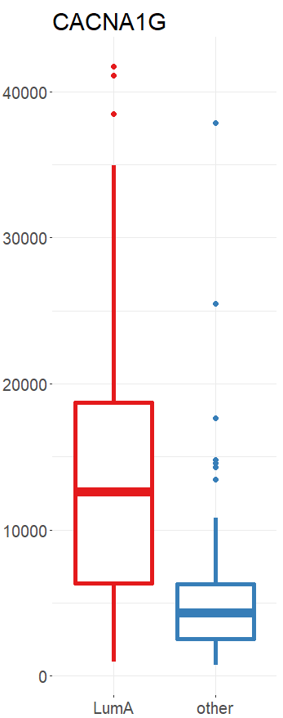
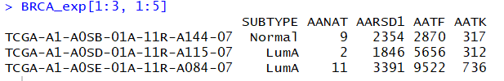
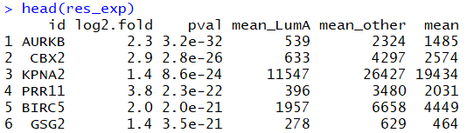

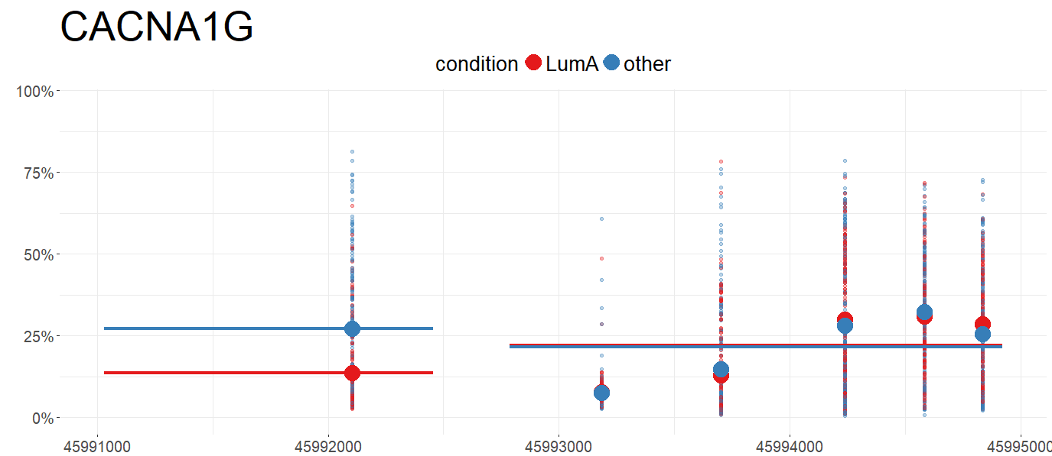
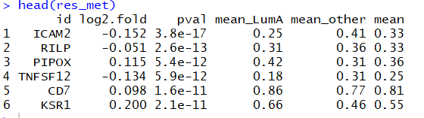
MLExpResso Cheat Sheet Aleksandra Dąbrowska [aut, cre] Alicja Gosiewska [aut] Przemysław Biecek [aut, ths]
Identification of genes with affected expression
MLExpResso::calculate_test(data, condition, test)
Argument test allows using many different statistic tests for finding differences in expression. All available values are in the table below.
Function calculate_test() computes log folds, p-values and means for chosen test for both, methylation and expression data.
Value | Test
'ttest' | student's t-tets
'nbinom2' | negative binomial test
'lrt' | likelihood-ratio test
'qlf' | quasi-likelihood F-test
Introduction
MLExpResso is an R package for integrative analyses and visualization of gene expression and DNA methylation data.
Key functions of this package are:
identification of genes with affected expression – calculate_test() function,
identification of DMR - differentially methylated regions - calculate_test() function,
identification of regions with changes in expression and methylation - calculate_comparition_table() function,
visualization of identified regions – plot_gene() and plot_volcanoes() functions.
The joint modeling and visualization of genes expression and methylation improve interpretability of identified signals.
Example
library("MLExpResso")
library("MLExpRessoData")
exp <- BRCA_exp[ ,-1]
gr_exp <- BRCA_exp$SUBTYPE
gr_exp <- ifelse(gr_exp == 'LumA', 'LumA', 'other')
res_exp <- calculate_test(exp, gr_exp, 'lrt')
MLExpResso::plot_diff_boxplot(data, condition, gene)
Function plot_diff_boxplot() generates a boxplot of values from choosen data frame column with division in groups (two or more).
Example
plot_diff_boxplot(data = exp,
condition = gr_exp,
gene = 'CACNA1G')
MLExpRessoData
Identification of DMR - differentially methylated regions
The methodology is supplemented with example applications to The Cancer Genome Atlas data.
MLExpRssoData is an R package which contains information from The Cancer Genome Atlas (TCGA) Data Portal. Data sets in this package are based on Bioconductor package RTCGA. In examples, we use both, methylation and expression data.
BRCA_exp - It contains information about gene expression: read counts per-gene, computed for genes for 736 patients with breast cancer. Rows of this data set correspond to samples taken from patients. First column SUBTYPE corresponds to a subtype of BRCA cancer, next columns correspond to genes.
BRCA_met - It contains information about methylation of CpG probes for patients with breast cancer. Rows of this data set correspond to patients, more precisely, to samples taken from patients. First column SUBTYPE corresponds to a subtype of BRCA cancer, next columns correspond to CpG probes. Values inside the table indicate the percentage methylation level of CpG probe for a specified sample.
For aggregation CpG probes to correspond genes we use the Illumina human methylation data set from TxDb.Hsapiens.UCSC.hg18.knownGene Bioconductor package.
MLExpResso::calculate_test(data, condition, test)
MLExpResso::plot_methylation_path(data, condition, gene)
Argument test allows using two different statistic tests for finding differences in methylation levels. All available values are in the table on the right.
Value | Test
'ttest' | student's t-test
'methyanalysis' | quasi-likelihood F-test
Function plot_methylation_path() visualizes a chosen gene with marked CpG probes.
Y axis describes methylation level.
X axis describes a location of the probe on the chromosome.
Horizontal lines show the mean methylation level for each Island in a division to groups. Groups are defined by colors. Large dots symbolize means of methylation level for CpG probes, small dots symbolize methylation levels for each observation.
MLExpResso::aggregate_probes(data)
Function aggregate_probes() aggregates CpG probes to corresponding genes using, by default, the Illumina human methylation data.
Example
plot_methylation_path(data = BRCA_met ,
condition = gr_met,
gene = 'CACNA1G',
observ = T)
Example
met <- aggregate_probes(BRCA_met)
gr_met <- BRCA_met$SUBTYPE
gr_met <- ifelse(gr_met == 'LumA', 'LumA', 'other')
res_met <- calculate_test(met, gr_met, 'ttest')
MLExpResso in vesrion 0.2.0(2017) Aleksandra Dąbrowska, Alicja Gosiewska, Przemysław Biecek • CC BY

Slide 2
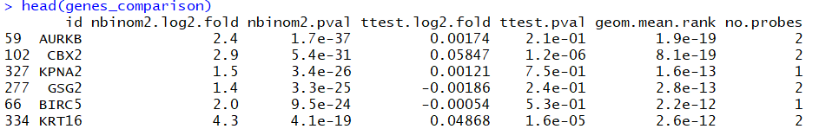
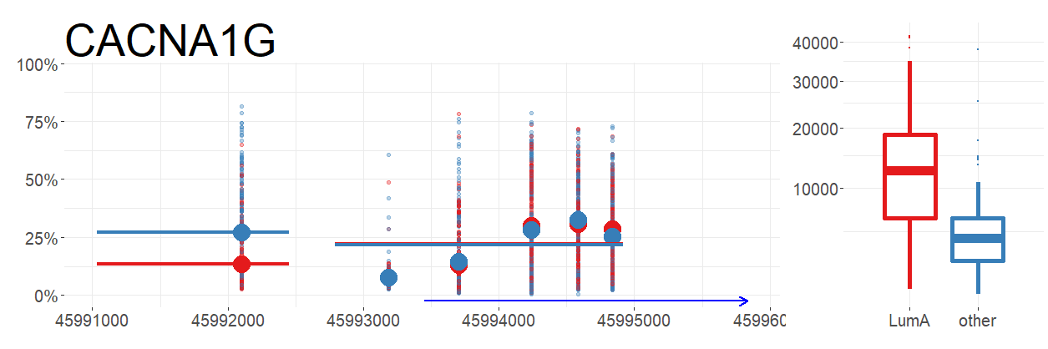
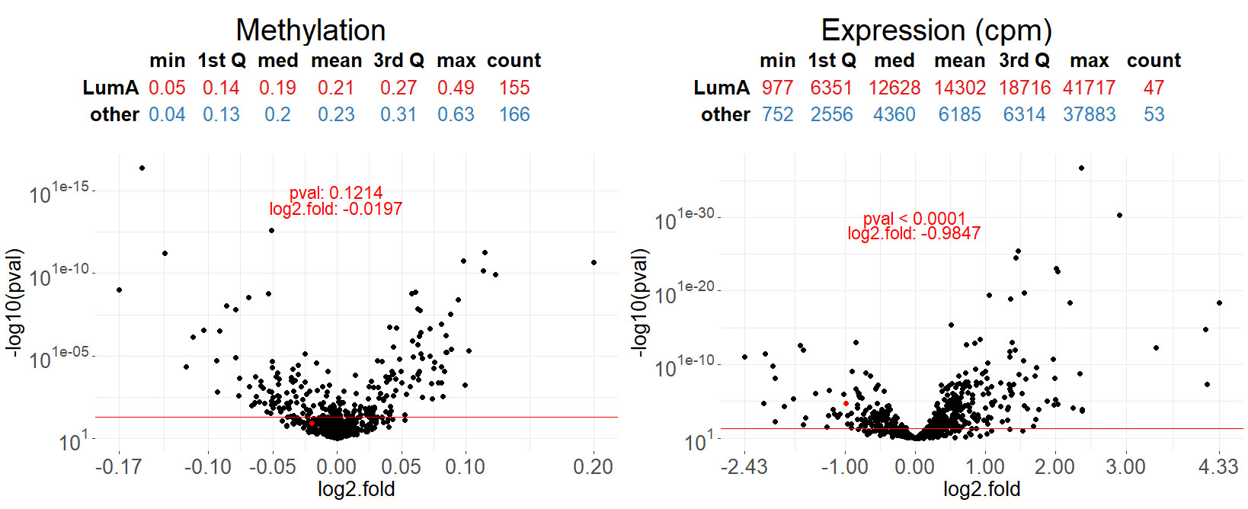
Comparing test results
MLExpResso::calculate_comparison_table(data1, data2, condition1, condition2, test1, test2)
Function calculate_comparison_table() produces a dataset containing p-values and folds from tests evaluated on two datasets e.g methylation or expression. In addition, it produces an importance ranking column, which is the geometric mean of p-values ​​from both tests and a column with a number of probes related to the gene.
Example
calculate_comparison_table(data1 = BRCA_exp[,-1], data2 = BRCA_met_gen,
condition1 = condition_exp, condition2 = condition_met,
test1 = "nbinom2", test2 = "ttest")
Visualization of identified regions
Plot_gene()
MLExpResso::plot_genes(data.m, data.e, condition.m, condition.e, gene)
Function plot_gene() generates a dashboard with methylation path for methylation and boxplots for groups for chosen gene.
Example
plot_gene(data.m = BRCA_met,
data.e = BRCA_exp,
condition.m = gr_met,
condition.e = gr_exp,
gene = "CACNA1G",
observ = TRUE,
show.gene = TRUE,
islands = TRUE)
Plot_volcanoes()
MLExpResso::plot_volcanoes(data.m, data.e, condition.m, condition.e, gene, test.m, test.e)
Function plot_volcanoes() generates a dashboard with volcano plots for expression and methylation. Also it adds a tables with basic statistics for chosen gene.
Example
plot_volcanoes(data.m = met,
data.e = exp,
condition.m = gr_met,
condition.e = gr_exp,
gene = 'CACNA1G',
test.m = res_met,
test.e = res_exp)
MLExpResso in vesrion 0.2.0(2017) Aleksandra Dąbrowska, Alicja Gosiewska, Przemysław Biecek • CC BY

