Slide 1























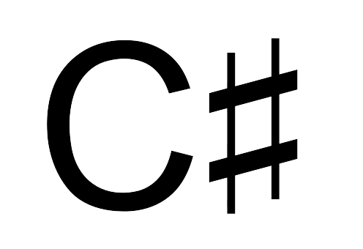
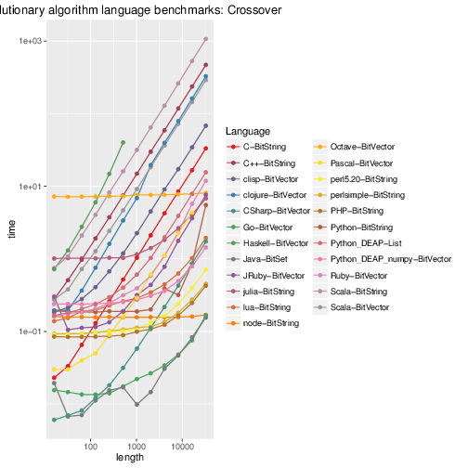
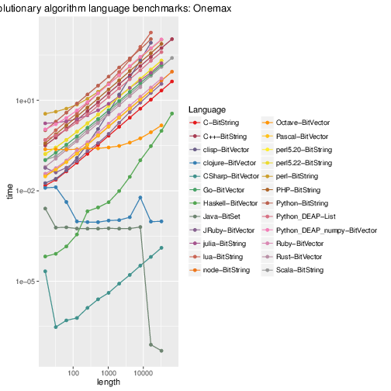
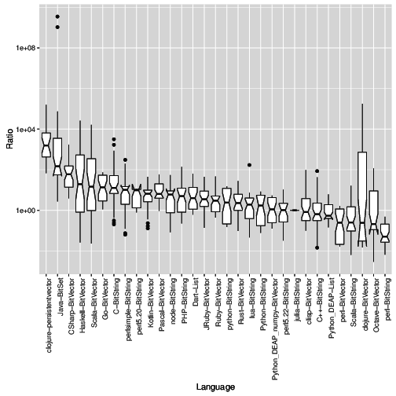
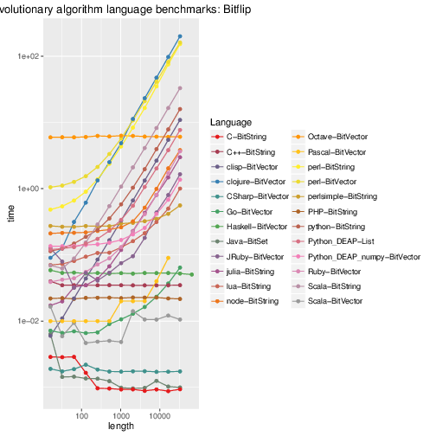
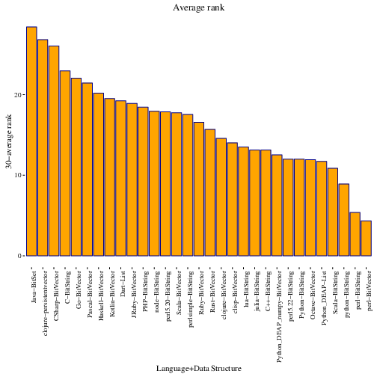

Ranking the performance of compiled and interpreted languages in genetic algorithms
“10110011001100”
(T,F,T,T,F,F,T,T,F,F,T,T,F,F)
Compiled languages are best.
Python is fast.
Perl and Node are fast.
Data structures don't matter.
Check out Rust and Go!
This work has been supported in part by projects TIN2014-56494-C4-3-P (Spanish Ministry of Economy and Competitiveness) and project V17-2015 of the Microprojects program 2015 from CEI BioTIC Granada.
Image credits
Background: N. Raymond at flic.kr/p/h6R8go
Cars: CarSpotter at flic.kr/p/d1kZ3J
Language logos from Wikipedia
Winners from goo.gl/BeLv0H by Chris McDonald

