Slide 1
Particle Swarm Optimization for Large-scale Industrial Applications
APIEMS Conference
Kitakyushu, Japan
December 14-16, 2009
Voratas Kachitvichyanukul
Asian Institute of Technology
voratas@ait.ac.th

Slide 2
Outline
Introduction
A Classical PSO Algorithm
Swarm Dynamic
Parameters Adaptation in PSO
Summary of successful applications
Future research directions

Slide 3
Contributors
T. J. Ai
Pisut Pongchairerks
Thongchai Pratchayaborirak
Suparat Wongnen
Suntaree Sae Huere
Dao Duc Cuong
Vu Xuan Truong
Nguyen Phan Bach Su
Chompoonoot Kasemset

Slide 4
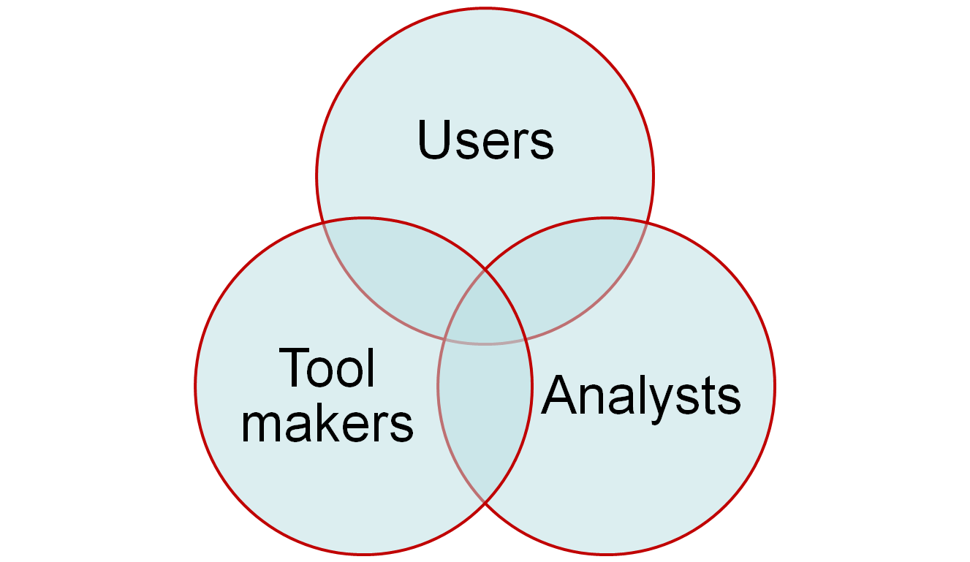
Three groups of stakeholders

Slide 5
Search Techniques
Deterministic Search Techniques
  Steepest ascend
  Golden section
  ….
Stochastic or Random Search Techniques
  Genetic Algorithm
  Particle Swarm
  Differential Evolution
  Ant Colony
  Immunological System

Slide 6
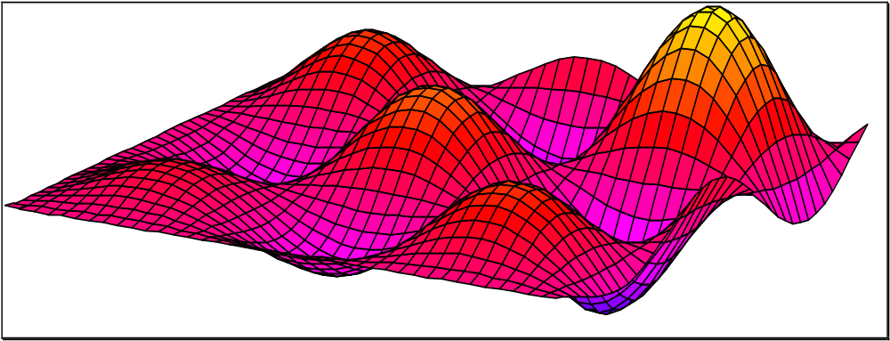
Alpine function

Slide 7
Components of Search Techniques
Initial solution
Search direction
Update criteria
Stopping criteria
All above elements can be either
  Deterministic or Probabilistic
  Single points or population based

Slide 8
What is Metaheuristic?
“heuriskein” means to find
“meta” means beyond
A metaheuristic is defined as an iterative generation process which guides a subordinate heuristic by combining intelligently different concepts for exploring and exploiting the search space, learning strategies are used to structure information in order to find efficiently near-optimal solution (Osman and Laporte, 1996)

Slide 9
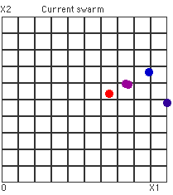
Two aspects
Exploration
Exploitation

Slide 10
Main Components
Intensification is the exploitation of the solutions found in previous searches
Diversification is the exploration of the unvisited regions
BALANCE !
Exploitation
Exploration
Quickly find the best solution(s) with in a region
Quickly identify region with potentially high quality solution(s)

Slide 11
Introduction:
Particle Swarm Optimization
An emerging evolutionary computation proposed by Kennedy & Eberhart (1995)
A population based search method with Position of particle is representing solution and Swarm of particles as searching agent
Many successful applications, examples of works done at AIT includes:
  Job shop scheduling, Vehicle routing
  Multicommodity network design, etc.

Slide 12
Introduction (1)
Particle Swarm Optimization (PSO) was first proposed by Kennedy & Eberhart in 1995
PSO’s development was motivated by the group organism behavior such as bee swarm, fish school, and bird flock. It imitates the physical movements of the individuals in the swarm as well as its cognitive and social behavior as a searching method.

Slide 13
Introduction (2)
The idea is similar to bird flocks searching for food.
  Bird = a particle, Food = a solution
  pbest = the best solution (fitness) a particle has achieved so far.
  gbest = the global best solution of all particles within the swarm

Slide 14
Personal best
Personal best position of a particle expresses the cognitive behavior of particle,
It is defined as the best position found by the particle.
It will be updated whenever the particle reaches a position with better fitness value than the fitness value of the previous personal best.

Slide 15

Particle Swarm Optimization
~ Basic Idea: Cognitive Behavior ~
An individual remembers its past knowledge
Where should I move to?
Food : 80
Food : 50
Food : 100

Slide 16
Global best
Global best position expresses the social behavior
It is defined as the best position found by all the particles in the swarm.
It will be updated whenever a particle reaches a position with better fitness value than the fitness value of the previous global best.

Slide 17
Particle Swarm Optimization
~ Basic Idea: Social Behavior ~
An individual gains knowledge from other members in the swarm (population)
Where should I move to?
Bird 3
Food : 100
Bird 1
Food : 150
Bird 2
Food : 100
Bird 4
Food : 400

Slide 18
PSO in a Nutshell
The PSO algorithm consists of a swarm of particles, each particle represents a position in an n-dimensional space
With each particle, there is an associated velocity and a memory of personal best position
With each swarm, there is a memory of the best position achieved by all the particles in the swarm

Slide 19
PSO Demo

Slide 20
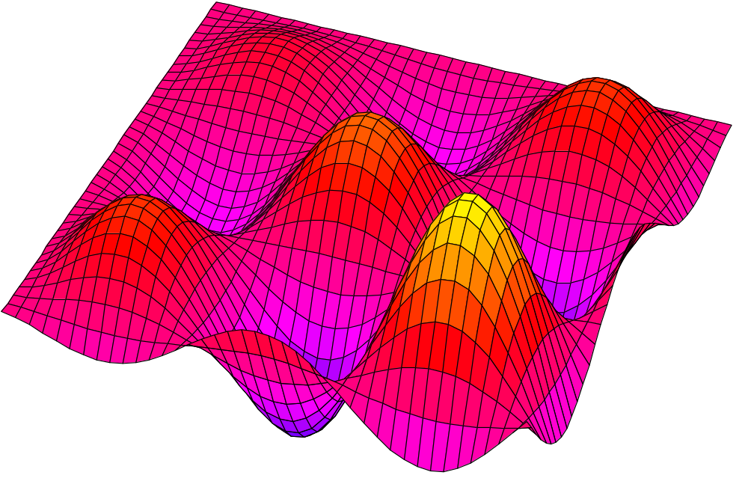
Results with "toy" examples
Notes:
Let us see now some results with two simple functions.

Slide 21
Alpine function
Notes:
This function is interesting for it has as many optima as we want, just by changing its definition area, and for we can easily compute exactly these optima.
I hope you do recognize the French Mont-Blanc and the Côte d'Azur ...

Slide 22
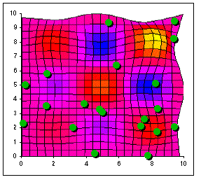

Slide 23
PSO is like Genetic algorithm
The basic concept is cooperation instead of rivalry. Each particle has the same properties as followed:
  ability to exchange information with its neighbors
  ability to memorize a previous position
  ability to use information to make a decision
  Basically work with real number

Slide 24
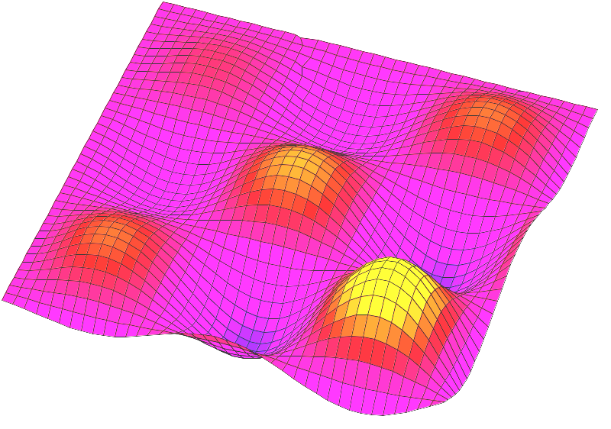
First Iteration
1. Initializing Position
2. Create Velocity (Vector)
2
3
1
Minimization Problem
Best Particle
Other Particle

Slide 25
Second Iteration
1. Update New Position
2. Create Velocity (Vector)
2
3
1
Minimization Problem
Best Particle
Other Particle

Slide 26
Third Iteration
1. Update New Position
2. Create Velocity (Vector)
Until
Meet Criteria
2
1
3
Minimization Problem
Best Particle
Other Particle

Slide 27
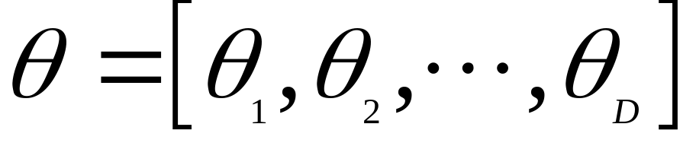
(ψ^{G} − θ)
u *
C_{g} *
Social learning
ψ^{G} Global best
Velocity Wω
New Velocity
Velocity ω
Momentum
Position θ
ψ Personal best
C_{p} *
u *
(ψ – θ)
Cognitive learning

Slide 28

Basic Particle Swarm Optimization
Imitating swarm organism behavior:
  Cognitive behavior: previous best
  Social behavior: global best, local best, near-neighbor best
Particle position
Particle movement
  Driven by velocity ω

Slide 29
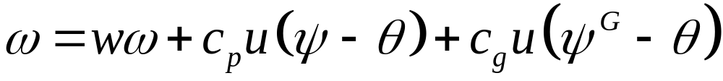
Basic Particle Swarm Optimization
Particle movement
  Driven by velocity
  Velocity equation shows its cognitive and social behaviors:
Velocity
Cognitive Learning
Social Learning

Slide 30
Design Considerations
Particle representation
Encoding and decoding procedures
Swarm size (number of particles)
Number of parallel swarms
Variants of PSO
  Movement of particles
Number of iterations
Reinitialization

Slide 31
Pitfalls of PSO algorithm
Tendency to cluster very quickly
  Reinitialization
  Use multiple velocity update strategies
Particles may move into infeasible region
  Disregard the particles
  Modify or repair the particle to move it back into feasible region
  Problem specific

Slide 32

Modified Social Behavior
Subgrouping
Bird 5
Food : 250
Bird 7
Food : 225
Where should I move to?
Bird 8
Food : 150
Bird 3
Food : 100
Bird 1
Food : 175
Bird 2
Food : 100
Bird 4
Food : 400
Bird 6
Food : 300

Slide 33
Other update strategies
Generally move toward the best particle within the swarm.
There are researchers that proposed the strategy of moving away from the worst particle.
Alternate uses of the above strategies may allow the swarm to be more diversify thus may avoid premature convergence.
Movement strategies not guided by the best particle (especially for Multiobjective)

Slide 34
PSO Algorithm
Initialization:
  Initialize L particles, i.e. with random initial position and velocity
Iteration:
  Evaluate fitness function
  Update cognitive & social information
  Move particle
Stop
  i.e. stop after T iterations

Slide 35
Key considerations
Mapping of particle into solution spaces
For most combinatorial problems, indirect approach is more convenient.
The effectiveness of the algorithm is dependent on the design of the mapping, movement strategies, and the selection of parameters

Slide 36
PSO Algorithm
PSO algorithm’s behavior and performance are affected by many parameters:
  Number of particles
  Number of iterations
  Inertia weight
  Acceleration constants
  Local grouping of particles
  Number of neighbors

Slide 37
Performance Advantage
No sorting or ranking of particles is required in each iteration
Given the same representation, PSO has advantage over GA since GA normally requires ranking of chromosomes and this can be very slow for large population.

Slide 38
How good is good?
Solution quality
  How close is the solution to the optimal solution? (should look at max, min, and average)
Solution time
Need to use both
  Average
  Variance

Slide 39
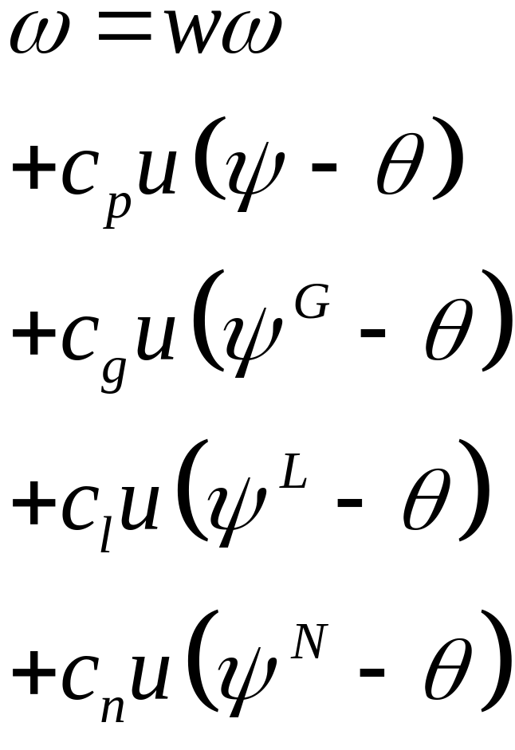
PSO with Multiple Social Terms
Momentum
Cognitive Term
Social Learning Terms
  Global Best
  Local Best
  Near Neighbor Best

Slide 40
General Issues
For most common evolutionary methods, the parameters need to be fine-tuned for each problem instance to get the best algorithm’s performance
For general users, this could be quite a burden and in practice, parameters from other successful applications are used directly instead of a fine-tuned ones.

Slide 41
Existing Approach to Set Parameters
A New Problem
Instance
DOE
replaced by
Adaptive PSO
Parameter Set
(Candidates)
Computational
Experiments
(on PSO runs)
Actual PSO run
Selected (Best)
Parameter
Problem Solution

Slide 42
Adaptive PSO:
proposed approach to set parameters
A New Problem
Instance
Adaptive PSO
run
Problem Solution

Slide 43
To be “Adaptive”
Must check the environment or measure the performance of the swarm and adjust the parameter accordingly
This implies that we need some form of index to measure the dynamic of swarms
Many published literatures proposed methods that adjust parameters according to a predefined function and cannot be called adaptive based on this criterion.

Slide 44
Swarm Dynamic
Particles are multidimensional in nature and it is difficult to visualize
How to measure the dispersion of the particles within a swarm?
Two convenient measures are
  Dispersion Index
  Velocity Index

Slide 45
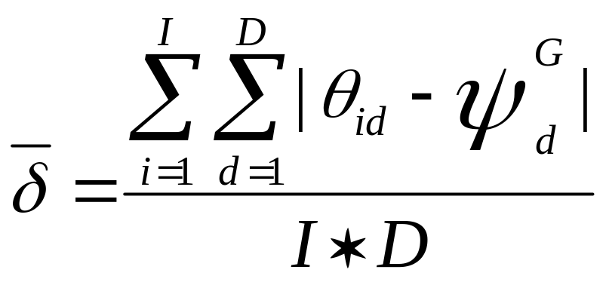
Dispersion Index
The dispersion index measures how particles spread around the best particle in the swarm, and is defined as the average absolute distance of each dimension from the best particle.

Slide 46
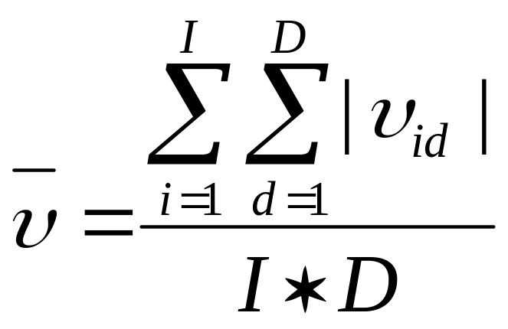
Velocity Index
The velocity index measures how fast the swarm moves in certain iteration, and is defined as the average of absolute velocity.

Slide 47
Testing
Standard PSO
PSO with multiple social learning terms GLNPSO
It was found that GLNPSO converge much faster than PSO in terms of number of iterations.
Overall GLNPSO is faster even when it requires more calculation in each iteration
We use the indices to study the performances of both algorithms

Slide 48
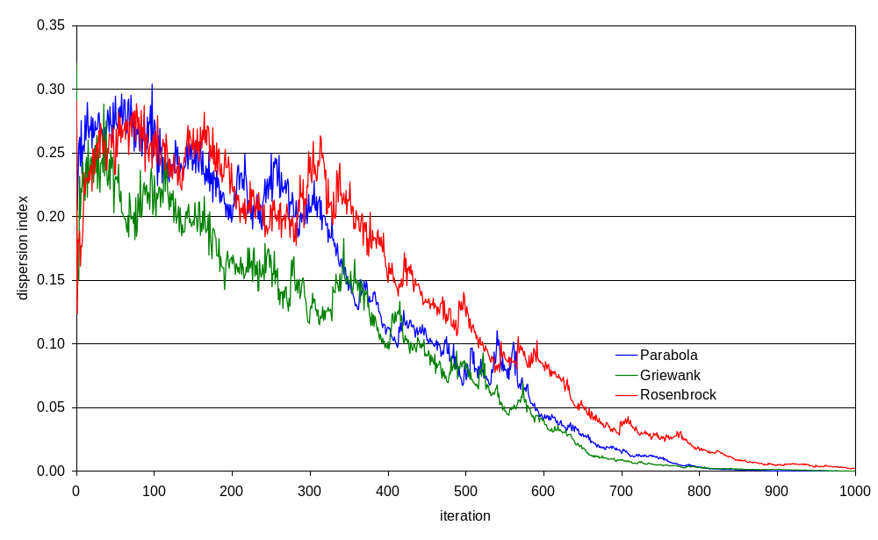
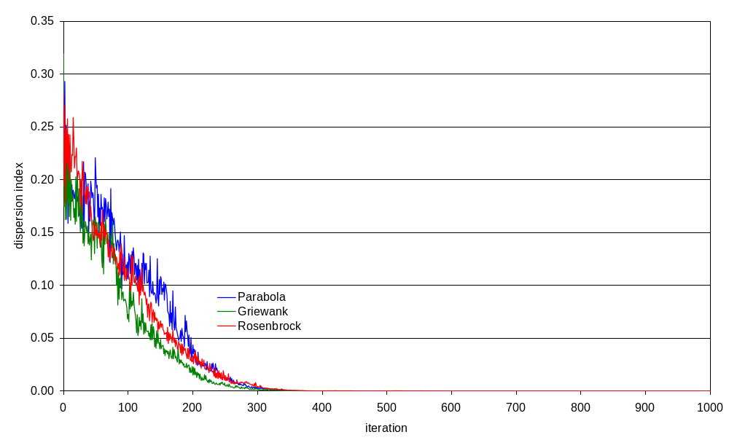
Fig. 1. Dispersion index on typical run of basic version PSO.
Fig. 2. Dispersion index on typical run of GLNPSO.

Slide 49
Observations
The velocity index and the dispersion index behave in similar ways
The index plots should not be used alone. The convergence plot of objective function should be viewed simultaneously with the index plots
Calculating the indices will slow the algorithm.

Slide 50
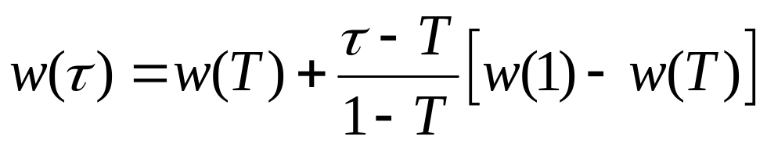
Parameter Adaptation (1):
Inertia Weight
Existing approach
  Linear decreasing weight (Shi & Eberhart, 1998)
  Non-linear decreasing weight (Gao & Ren, 2007)
  Function of local best and global best (Arumugam & Rao, 2008)
  Function of population diversity (Dan et al., 2006; Jie et al., 2006; Zhang et al., 2007)
  Fuzzy logic rules (Shi & Eberhart, 2001; Bajpai & Singh, 2007)

Slide 51


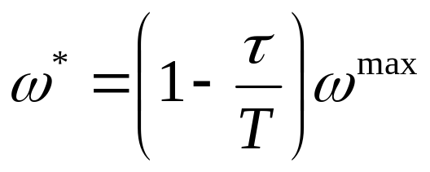
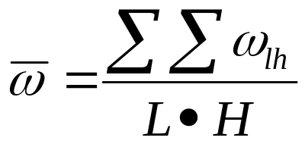


Parameter Adaptation (2):
Inertia Weight
Existing approach
  Individual weight for each particle based on velocity & acceleration component (Feng et al., 2007)
  Individual weight for each particle based on its performance (Panigrahi et al., 2008)
  Alternating weight between high and low to control swarm velocity index (Ueno et al., 2005)
    if
    if

Slide 52
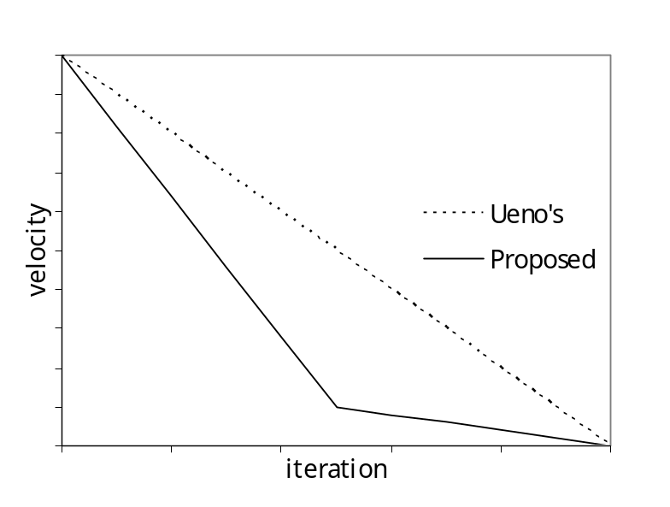
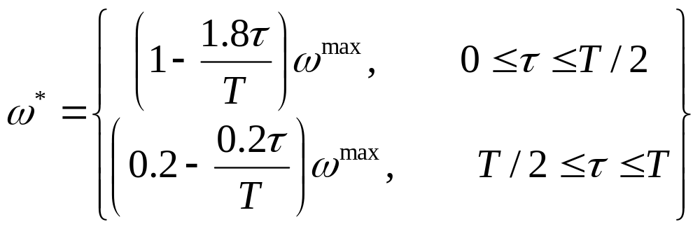
Parameter Adaptation (3):
Inertia Weight
Modification of Ueno et al. (2005) approach
  Different velocity index pattern based on previous work (Ai & Kachitvichyanukul, 2007)

Slide 53
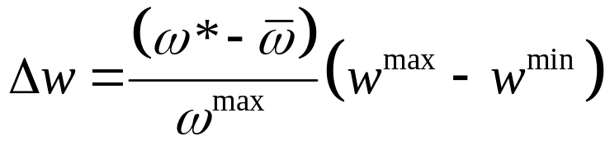



Parameter Adaptation (4):
Inertia Weight
Modification of Ueno et al. (2005) approach
  Setting inertia weight value in the range of minimum and maximum value

Slide 54
Parameter Adaptation (5):
Acceleration Constants
Existing approach
  Function of local best and global best (Arumugam & Rao, 2008)
  Time varying acceleration constant (TVAC): linear decreasing cognitive acceleration constant & linear increasing social acceleration constant (Ratnaweera et al., 2004)

Slide 55
Parameter Adaptation (6):
Acceleration Constants
Proposed approach: basic idea
  Different acceleration constants → relative importance on respective cognitive/social terms
  Heavier constant on a term → particles tend to move in the direction of this term
  Objective function difference among particle position and the cognitive/social terms is selected as basis for determining constants

Slide 56
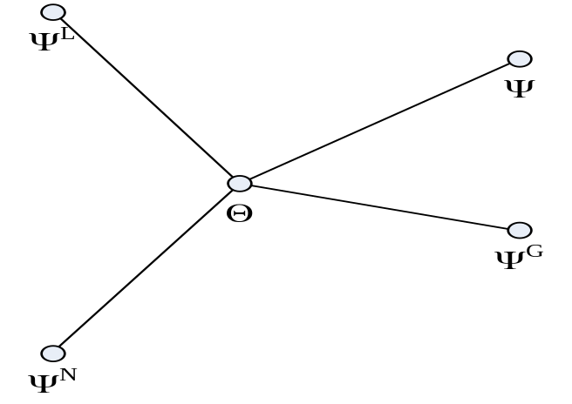
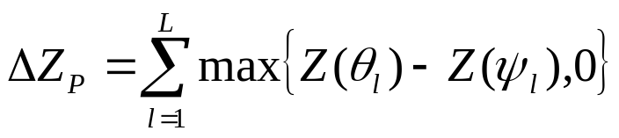
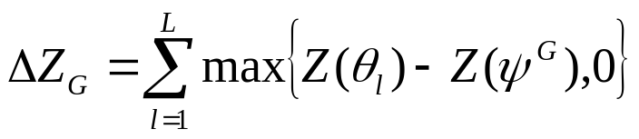
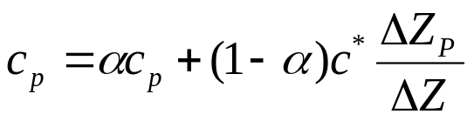
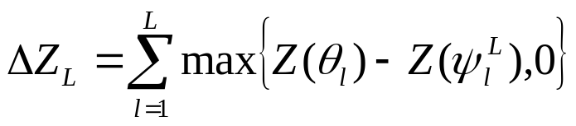

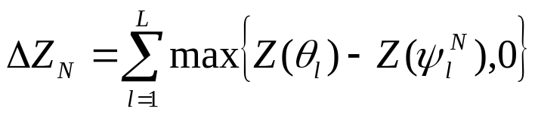
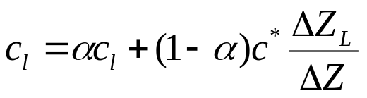

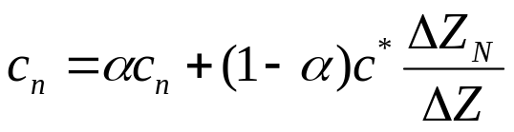
Parameter Adaptation (7):
Acceleration Constants
Proposed approach:

Slide 57
Parameter Adaptation (8):
Other Parameters
Adaptive Population Size (Chen & Zhao, 2008)
  Population size as function of population diversity
Number of iteration & number of neighbor
  no existing approach yet in the literature

Slide 58
Proposed Adaptive PSO Algorithm
Initialization:
  Initialize particles
Iteration:
  Evaluate fitness function
  Update cognitive & social information
  Update inertia weight & acceleration constants
  Update velocity and move particle
Stop
  i.e. stop after T iterations

Slide 59

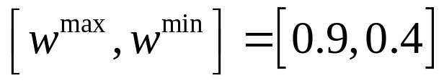


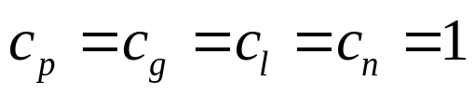
Application Example:
Algorithm Setting
Updating parameter not in every iteration, i.e. every 10 iterations → saving computational efforts
is set as initial velocity index
Equal initial acceleration constants, i.e.

Slide 60
Illustrative Example:
Applied to Vehicle Routing Problem (VRP)
Solution representation and decoding method from previous work on non-adaptive PSO algorithm
A VRP instance with 200 customers and 16 vehicles is generated as test case

Slide 61
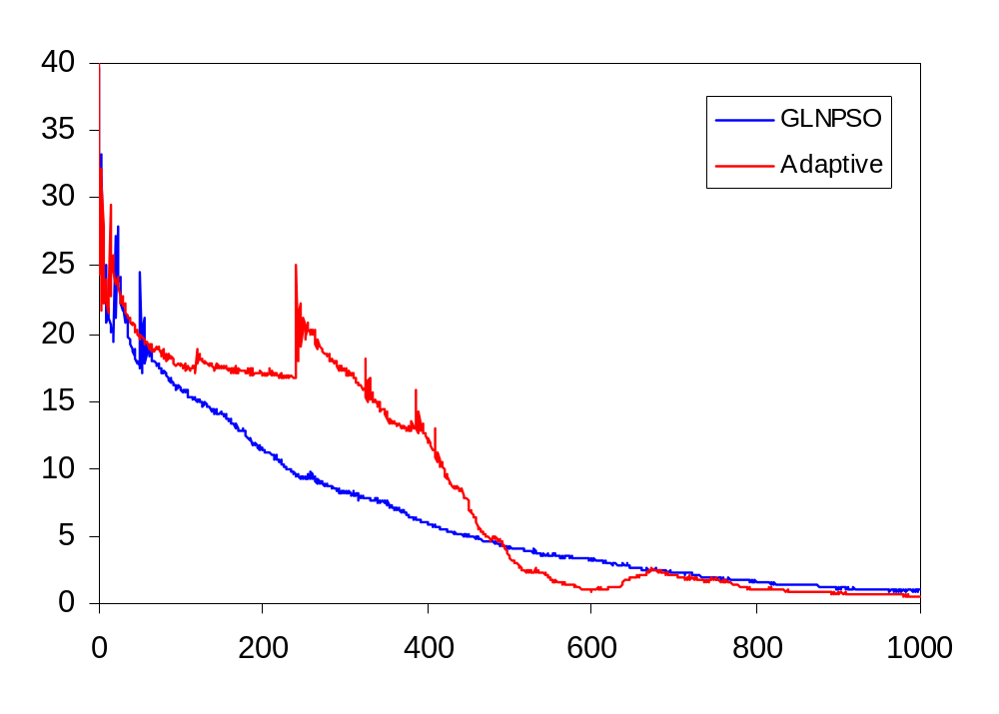
Application Example:
Result – Velocity Index Comparison

Slide 62
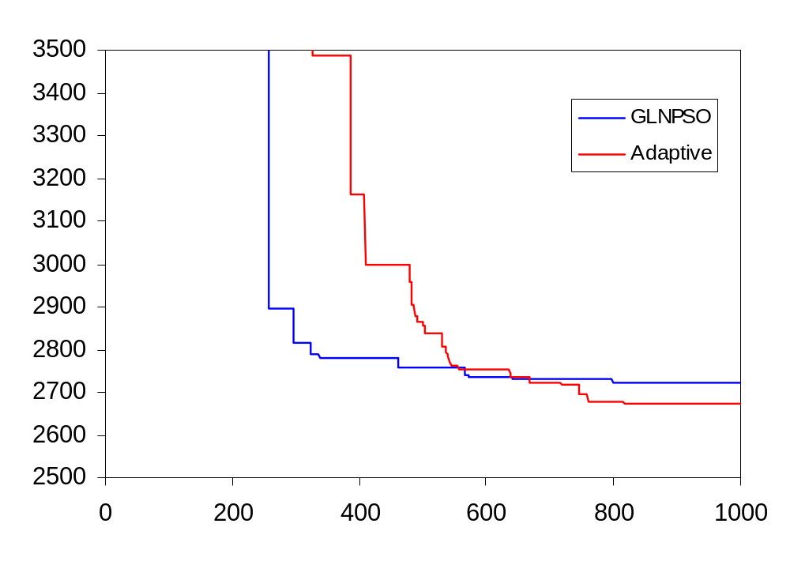
Application Example:
Result – Objective Function Comparison

Slide 63
Applications
Job shop scheduling problem
Vehicle routing problem
  CVRP, VRPPD, HVRP, VRPTW
Multicommodity distribution network problem
On-going research
  Multidepot VRP with practical constraints
  Multimode Resource Constrained Project Scheduling Problem

Slide 64
Job Shop Scheduling
A set of n jobs are scheduled on a set of m machines
Each job consists of a set of operations which their machine orders are pre-specified.
The required machine and the fixed processing time characterize each operation

Slide 65
Example
n×m problem size: 3 jobs × 4 machines
Job | Machine Sequence | Processing Time
1 | M1 M2 M4 M3 | 3 3 5 2
2 | M4 M1 M2 M3 | 4 1 2 3
3 | M2 M1 M3 M4 | 3 2 6 3

Slide 66
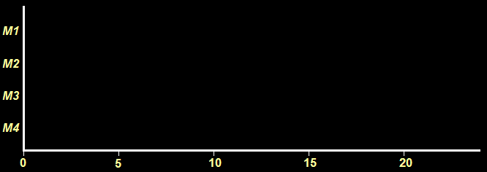
Output is a schedule with
Start time of each operation
End time of each operation
Solution space = (n!)^{m}
J1
J2
J3
J1
J1
J3
J2
J3
J2
J2
J1
J3

Slide 67
PSO for JSP
Particle Representation
  Random key
  Initially the value in each position is randomly generated
  Subsequent values are defined via the position update equation defined previously
Dim.
1
2
3
4
5
6
7
8
9
10
11
12
Particle
no. i
.13
2.1
3.2
3.6
3.9
2.5
1.8
.21
.23
.45
.29
.32
.09
.46
.36
.39
.25
.18

Slide 68
Decoding procedure
Apply the m-repetition of job numbers permutation (Tasgetiren et al. 2005). For 3 jobs × 4 machines;
Dim.
1
2
3
4
5
6
7
8
9
10
11
12
Particle
no. i
.13
.21
.23
.45
.29
.32
.09
.46
.36
.39
.25
.18
Dim.
7
1
12
2
3
11
5
6
9
10
4
8
Particle
no. i
.09
.13
.18
.21
.23
.25
.29
.32
.36
.39
.45
.46
1
1
1
1
2
2
2
2
3
3
3
3

Slide 69
Decoding procedure
Apply the m-repetition of job numbers permutation (Tasgetiren et al. 2005). For 3 jobs × 4 machines;
Dim.
7
1
12
2
3
11
5
6
9
10
4
8
Particle
no. i
1
1
1
1
2
2
2
2
3
3
3
3
Dim.
1
2
3
4
5
6
7
8
9
10
11
12
Particle
no. i
1
1
2
3
2
2
1
3
3
3
2
1

Slide 70
Job | Machine Sequence | Processing Time
1 | M1 M2 M4 M3 | 3 3 5 2
2 | M4 M1 M2 M3 | 4 1 2 3
3 | M2 M1 M3 M4 | 3 2 6 3
Dim.
1
2
3
4
5
6
7
8
9
10
11
12
Particle
no. i
1
2.1
1
2
3
2
3.2
2
3
3.6
3
3.9
3
2.5
1
2
1.8
1
J1
J2
J3
J1
J1
J3
J2
J3
J2
J2
J1
J3

Slide 71
Local search:
Enhance the exploitation of search space whenever the algorithm meet local search criteria
  apply the CB neighborhood (Yamada and Nakano, 1995)

Slide 72
Local search:
  find a critical path and a critical block
  if the fitness value is improved then update it
  local search ends when all moves are completed
Critical path
J1
J2
J3
J1
Critical block
J1
J3
J2
J3
J2
J2
J1
J3

Slide 73
Re-initialize strategy:
Diversify some particles over the search space by relocating selected particles away from local optima.
  By keeping the best particle, some fixed numbers (set in advance) of the particles will be reinitialized
  By selecting some fixed numbers of particles and perform crossover with the best particle

Slide 74
Migration strategy:
The solution may be improved by the diversification of particles over the search space.
By random selection, some fixed number (set in advance) of particles will be picked and moved to the next swarm to be part of a new swarm

Slide 75
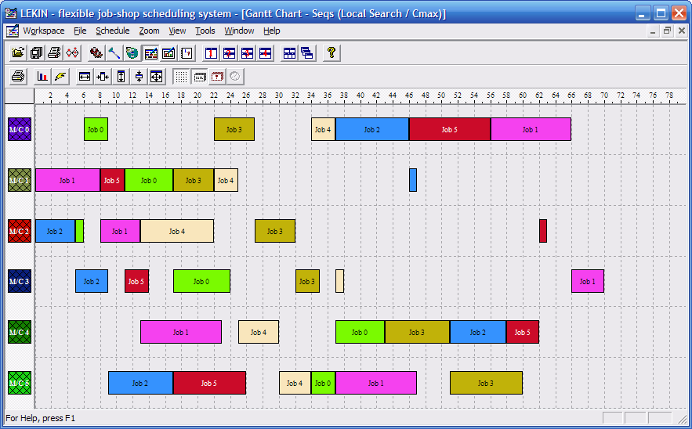
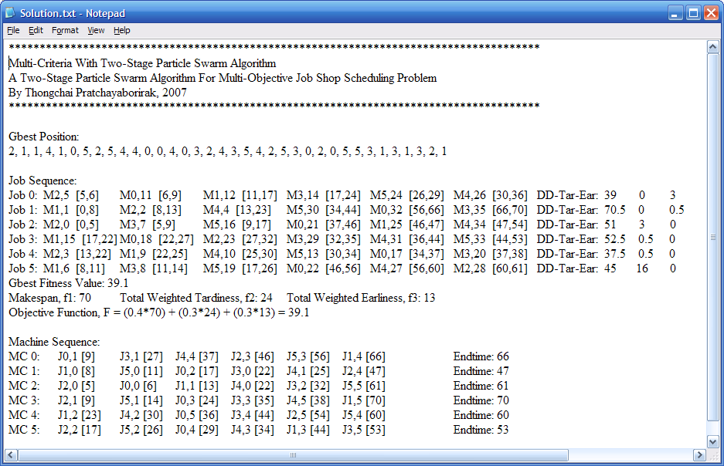
Output Data

Slide 76
Issues to be considered
Parameters
The average, maximum, minimum and standard deviation of solutions
Normally, the relative percentage deviation is used
Solution quality and solution time

Slide 77
General Strategies
Parallel swarms with migration
Partial re-initialization
Selective local search

Slide 78
Structure of 2ST-PSO
Start
100% initilization
80% initilization
80% initilization
80% initilization
20% migrate
20% migrate
20% migrate
Swarm 1
Swarm 2
Swarm 3
Swarm 4
Phase I: Swarm evolve independently
Last Swarm
Phase II: Last swarm started by randomly select the particles from all swarms from phase I in equal numbers
End Phase II

Slide 79
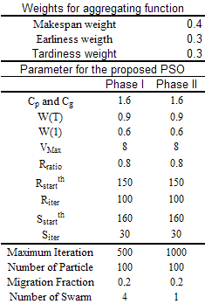
Experiments
The parameters are selected after a careful design of experiments
Ideally, the outcomes should not be so sensitive to the choice of parameters

Slide 80
Related references
Pratchaborirak and Kachitvichyanukul (2007)
Kachitvichyanukul and Sitthitham (2009)
Kachitvichyanukul and Pratchaborirak (2010)

Slide 81
Summary
The 2ST-PSO is evaluated by using the benchmark problems compared with existing heuristics for both single and multi-objective, the following conclusions can be drawn:
The 2ST-PSO can efficiently achieve good solutions in both single and multi-objective job shop scheduling problems. Moreover, in single objective related to due dates, the algorithm discover 10 new best known solutions.
For multi-criteria, the experimental result depicts that the proposed algorithm is more efficient than MSGA and 2ST-GA in terms of computational time. In addition, for the large size problem, the proposed algorithm performs best both in terms of computational time and solution quality.

Slide 82
Q & A

Slide 83
PSO for VRP
Particle Swarm Optimization for Generalized Vehicle Routing Problem

Slide 84
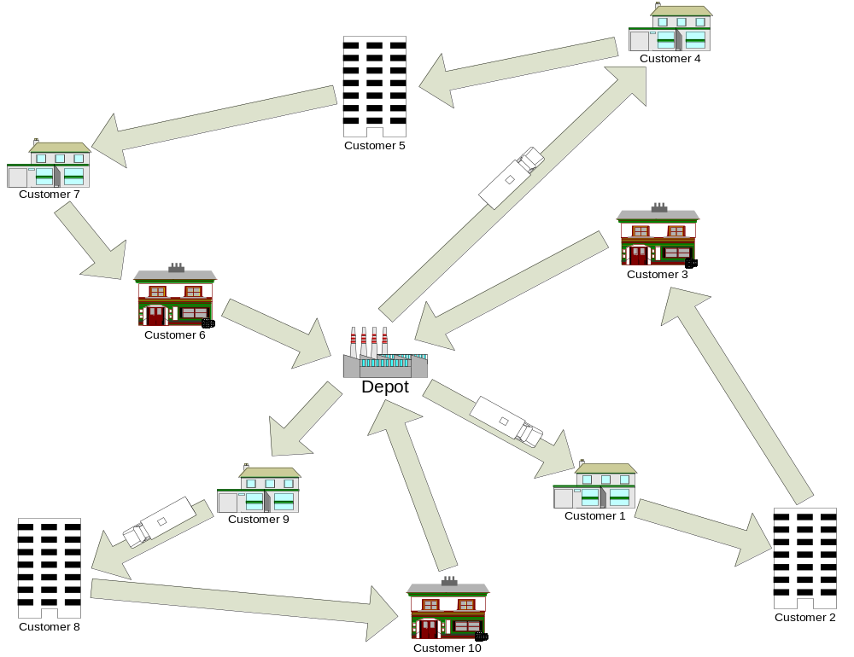
Research Overview:
Particle Swarm Optimization
for Generalized Vehicle Routing Problem
Second Route:
0 – 4 – 5 – 7 – 6 – 0
First Route:
0 – 1 – 2 – 3 – 0
Third Route:
0 – 9 – 8 – 10 – 0

Slide 85
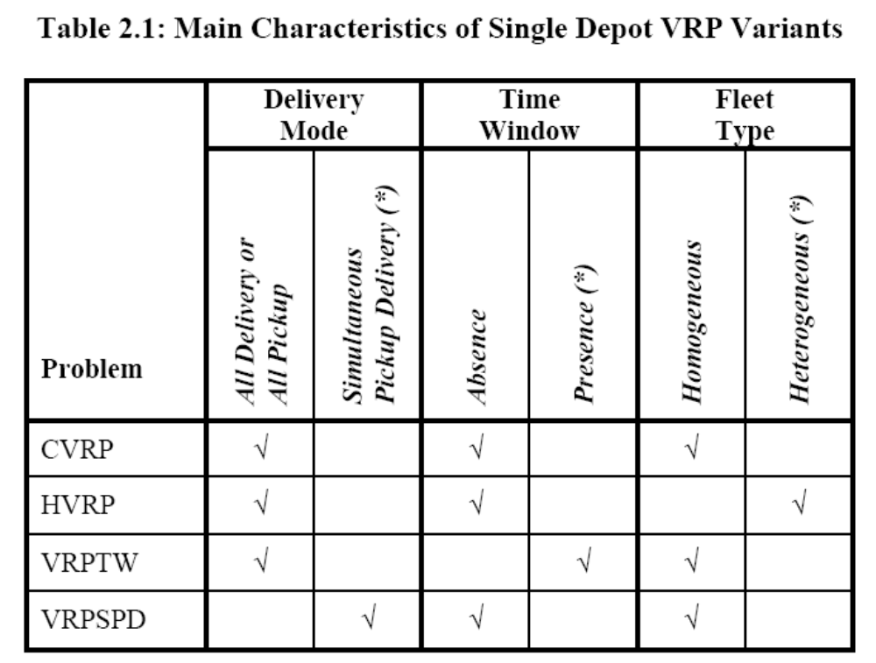
Research Overview:
Particle Swarm Optimization
for Generalized Vehicle Routing Problem

Slide 86
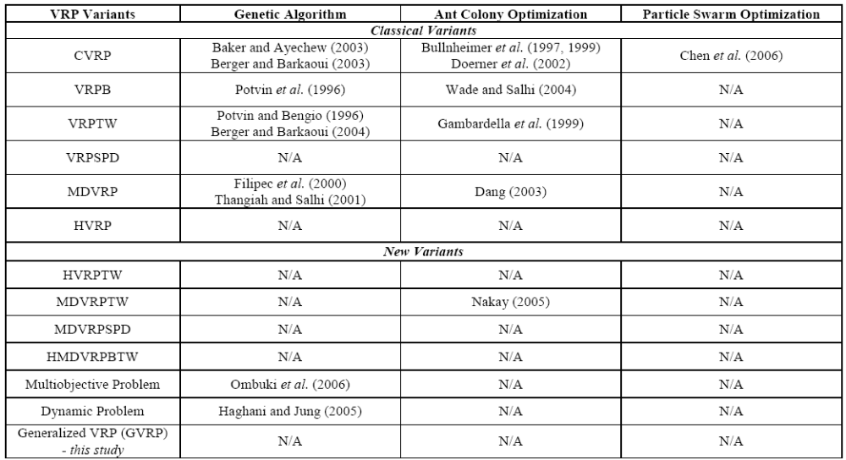
Research Overview:
Particle Swarm Optimization
for Generalized Vehicle Routing Problem

Slide 87
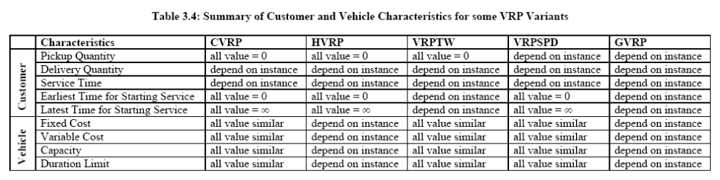
Generalized Vehicle Routing Problem
The GVRP can be considered as a single problem that generalized four existing single-depot VRP variants, which are the CVRP, the HVRP, the VRPTW, and the VRPSPD.

Slide 88
Generalized Vehicle Routing Problem
By having this generalized problem, any single method that is able to solve the GVRP can be considered as a general method that can solve the respective variants individually.

Slide 89
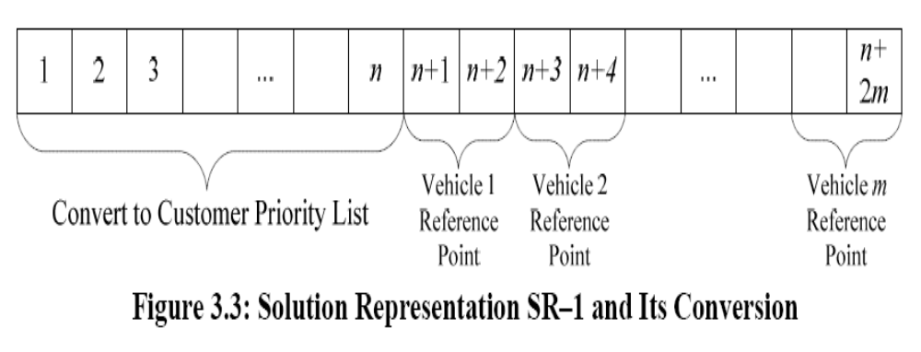
Particle Swarm Optimization for VRP
Solution Representation SR–1

Slide 90
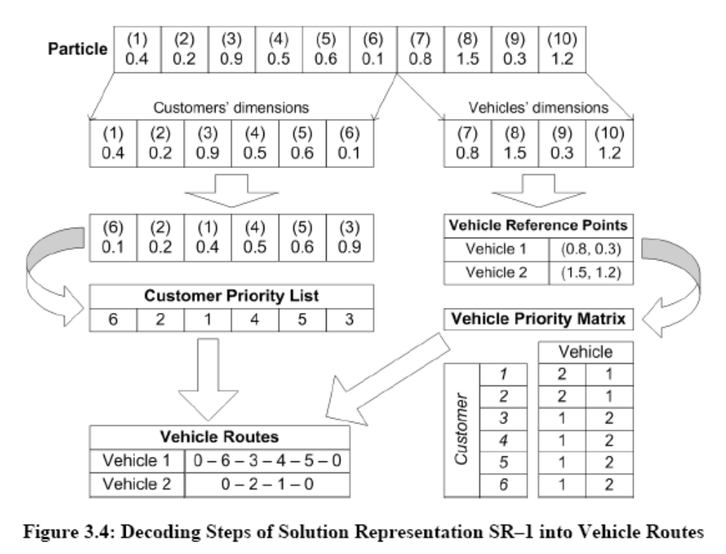
Particle Swarm Optimization for VRP

Slide 91
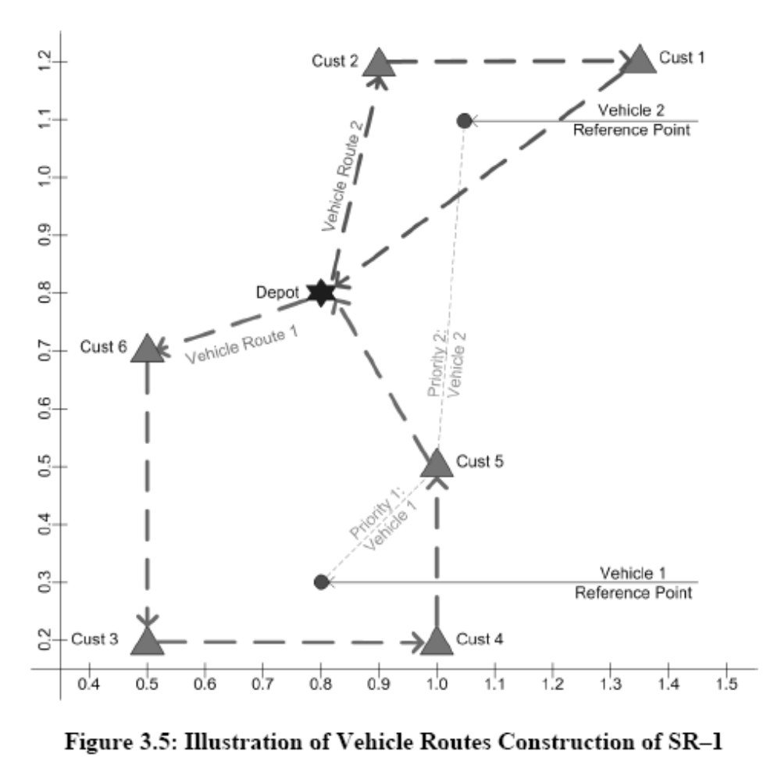
Particle Swarm Optimization for VRP

Slide 92
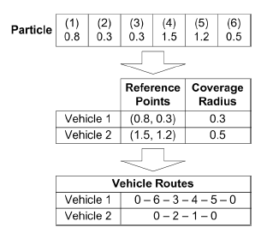
Particle Swarm Optimization for VRP
Solution Representation SR–2

Slide 93
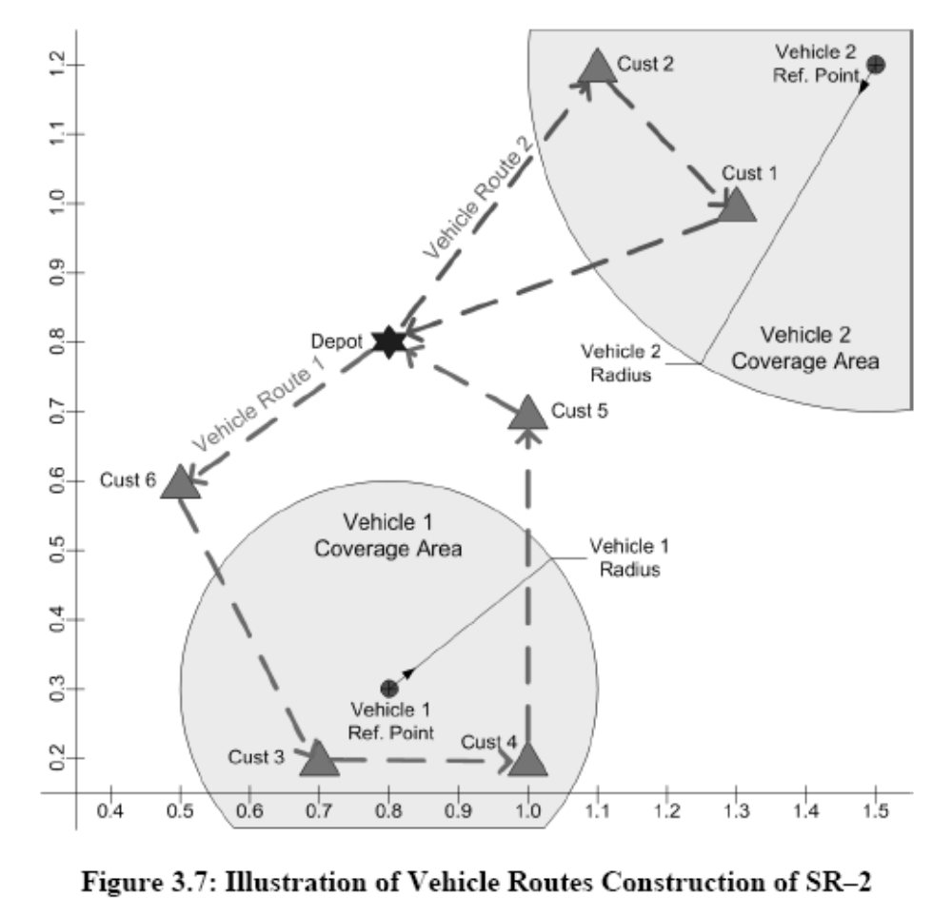
Particle Swarm Optimization for VRP

Slide 94
Conclusions (1)
The proposed GVRP generalizes four single-depot VRP variants (CVRP, HVRP, VRPTW, and VRPSPD)
The proposed PSO method for solving GVRP is demonstrated as general method for solving each of the VRP variants:
  High-quality solution (close to the best-known solution) in reasonable time can be provided
  Some VRPSPD benchmark results are improved by the proposed PSO

Slide 95
Conclusions (2)
PSO with solution representation SR–2 is providing better solution than PSO with solution representation SR–1
The proposed adaptive PSO algorithms are able to replace the mechanism for obtaining the best parameter set

Slide 96

PSO for Multicommodity Network Design

Slide 97





Introduction
Multicommodity Distribution Network Problem
(MDNP)
How many maximum allowable and Where?
Which should be served from?
Which should be received product from?
The candidate plants/DCs
C
C
C
C
C
C
C
C
C
C
C
Notes:
MDNP deal with long term planning to find out the best sites for locating facilities
and the best way to transfer the product at economical cost
So, the decision maker want to located plant and dcs from candidate plants and ds that they have
In this case there are 3 candidate plants and 5 candidate dcs
and the maximum allowable plant is 2
And maximum allowable dcs is 3
And they have to make decisions about allocating the numberof products from plant to dcs and dcs to customer

Slide 98


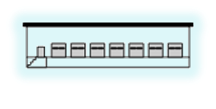














Introduction
Multiple products
Multiple level of capacities
Distance limitation
C
Plant
Distribution Center
Customer
Level 1
Level 1
Level 2
Level 2
enough to supply each type of the products
storage in term of the product’s group in each DC

Slide 99





Methodology
1 particle is 1 solution
Maximum allowable plants (i)
Plants opening decision
Maximum allowable DCs (j)
DCs opening decision
No. of customer (k)
Customer priority decision
Dimension
1
2
3
4
5
6
7
8
9
10
No. of customer
Candidate plants
Candidate DCs
11
12
13
14
15
1
2
3
1
2
3
4
5
1
2
3
4
5
6
7
8
9
10
Particle no. m
0.35
0.76
0.44
0.28
0.03
0.51
0.78
0.33
0.12
0.98
0.01
0.67
0.18
0.84
0.32
Plants opening decision
DCs opening decision
Customer priority decision
Notes:
Before we initialize particle with random position and zero velocity, we have to encode the particle.

Slide 100








Maximum allowable plants (i)
Plants opening decision
Methodology
The opening decision plants
Dimension
1
2
Step 1
0.35
Particle no. m
0.35
0.76
1
2
3
2
0
0.33
0.67
1
Candidate plants
Step 2
0.76
Dimension
1
2
1
3
3
Particle no. m
?
?
2
3
0
0.5
1
Remaining candidate plants

Slide 101











Methodology
Maximum allowable DCs (j)
DCs opening decision
The opening decision DCs
Step 1
0.44
Dimension
1
2
3
Particle no. m
0.44
0.28
0.03
3
4
5
1
2
3
0
0.2
0.4
0.6
0.8
1
Candidate DCs
Step 2
0.28
1
2
2
4
5
0
0.25
0.5
0.75
1
Remaining candidate DCs
Step 3
0.03
Dimension
1
2
3
1
4
5
?
1
?
?
1
Particle no. m
3
2
0
0.33
0.67
1
Remaining candidate DCs

Slide 102






Methodology
No. of customer (k)
Customer priority decision
Dimension
1
2
3
4
5
6
7
8
9
10
Particle no. m
0.51
0.78
0.33
0.12
0.98
0.01
0.67
0.18
0.84
0.32
Dimension
1
2
3
4
5
6
7
8
9
10
Dimension
1
2
3
4
5
6
7
8
9
10
11
12
13
14
15
Particle no. m
6
4
8
10
3
1
7
2
9
5
Particle no. m
2
3
3
2
1
6
4
8
10
3
1
7
2
9
5
Customer priority decision
Plants
opening decision
DCs
opening
decision

Slide 103
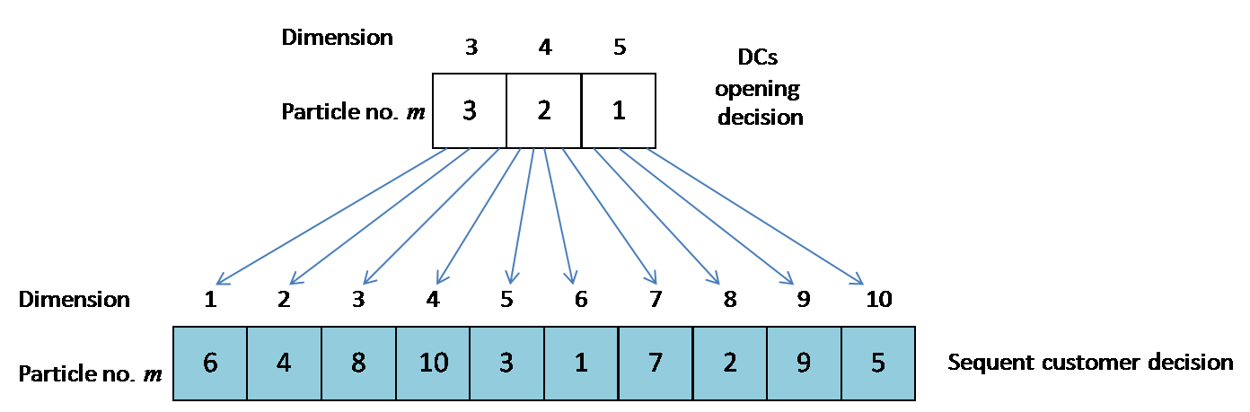
Product Allocation
From DC to Customers

Slide 104
Application Example:
Result
Final objective function
  Non-adaptive : 2720.86
  Adaptive : 2671.59
Computational time
  Non-adaptive : 08:12
  Adaptive : 08:21

Slide 105
Adaptive Particle Swarm Optimization
Proposed Algorithms:
  APSO-1: adaptive inertia weight
  APSO-2: APSO-1 + adaptive acceleration constants
  adjustment of parameters are inserted before the updating velocity in the PSO algorithm, without disrupt whole algorithm

Slide 106
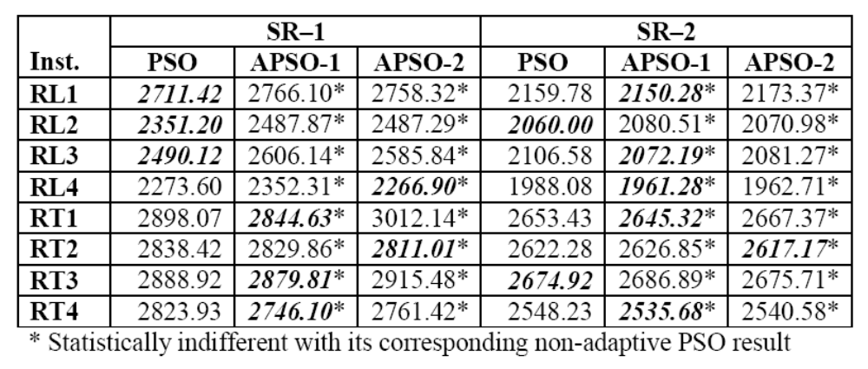
Adaptive Particle Swarm Optimization
Computational Result on new generated GVRP instances:

Slide 107
Lessons Learned
Re-initialization
Heterogeneous population
Parallel population
Local search

Slide 108
Software Library
Adaptive PSO, GLNPSO (with adaptive inertia weight and acceleration constants) is implemented as object library in C# at AIT with the following applications
  Job Shop Scheduling
  Vehicle Routing
  Multicommodity distribution network design
On-going works include
  multi-mode resource constrained project scheduling (MMRCPS) problems,
  multi-depot VRP with practical constraints,
  multiple objective search strategies
  Differential evolution

Slide 109
Questions
voratas@ait.ac.th
List of references can be found on
http://www.citeulike.org/user/satarov/

Slide 110
References (AIT1)
Ai, The Jin, and Kachitvichyanukul, V., A Particle Swarm Optimization for Vehicle Routing Problem with Time Windows, International Journal of Operational Research, , Vol. 6, No. 4, pp519-537, 2009
Pongchairerks, P. and Kachitvichyanukul, V., Particle Swarm Optimization Algorithm with Multiple Social Learning Structures, International Journal of Operational Research, Vol. 6, No. 2, pp176-194, 2009.
Pongchairerks, P. and Kachitvichyanukul, V., A Two-level Particle Swarm Optimization Algorithm on Job-shop Scheduling Problems, International Journal of Operational Research, Vol. 4, No. 4 , pp.390-411, 2009.
Ai, The Jin, and Kachitvichyanukul, V., A particle swarm optimization for the vehicle routing problem with simultaneous pickup and delivery, Computers & Operations Research, 36, 1693-1702, 2009.
Ai, The Jin, and Kachitvichyanukul, V., Particle Swarm Optimization and Two Solution Representations for Solving the Capacitated Vehicle Routing Problem, Computers & Industrial Engineering, Volume 56, Issue 1, pp380-387, 2009.
Ai, The Jin, and Kachitvichyanukul, V., A Particle Swarm Optimization for the Heterogeneous Fleet Vehicle Routing Problem, International Journal of Logistics and SCM Systems, Vol. 3, No. 1, pp32-39, 2009
Ai, The Jin, and Kachitvichyanukul, V., A Particle Swarm Optimization for the Capacitated Vehicle Routing Problem, International Journal of Logistic and SCM Systems, Volume 2, Number 1, pp.50-55, 2007

Slide 111
References (AIT2)
Pongchairerks, P. and Kachitvichyanukul, V. “A non-homogenous particle swarm optimization with multiple social structures,” Proceedings of the International Conference on Simulation and Modeling, paper A5-02, 2005.
Ai, T. J. and Kachitvichyanukul, V., Dispersion and velocity indices for observing dynamic behavior of particle swarm optimization, Procedings of IEEE Congress on Evolutionary Computation 2007, pp. 3264–3271, 2007.
Udomsakdigool, A and Kachitvichyanukul, V., Multiple Colony Ant Algorithm for Job Shop Scheduling Problems, International Journal of Production Research, Volume 46, Issue 15, pp 4155-4175, August 2008.
Udomsakdigool, A. and Kachitvichyanukul, V., Multiple-Colony Ant Algorithm with Forward–Backward Scheduling Approach for Job-Shop Scheduling Problem, Advances in Industrial Engineering and Operations Research, Chan, Alan H. S. and Ao, Sio-Iong, (Eds), ISBN 978-0-387-74903-7, pp.39-54, 2008.
Udomsakdigool, A and Kachitvichyanukul, V., Two-way Scheduling Approach in Ant Algorithm for Solving Job Shop Problems, International Journal of Industrial Engineering and Management Systems, volume 5, number 2, pp.68-75, 2006.
Ai, The Jin, and Kachitvichyanukul, V., A Study on Adaptive Particle Swarm Optimization for Solving Vehicle Routing Problems, Proceedings of the 9th Asia Pacific Industrial Engineering and Management Systems Conference (APIEMS 2008), Bali, Indonesia, December 2008.
Ai, The Jin, and Kachitvichyanukul, V., Recent Advances in Adaptive Particle Swarm Optimization Algorithms, Proceedings of the Korea Institute of Industrial Engineering Conference, Seoul, Korea, November 2008

Slide 112
References (AIT3)
Ai, The Jin, and Kachitvichyanukul, V., Adaptive Particle Swarm Optimization Algorithms, Proceedings of the 4th International Conference on Intelligent Logistics Systems（ILS2008）, Shanghai, China August 2008
Pratchayaborirak, T., and Kachitvichyanukul, V., A Comparison of GA and PSO Algorithm for Multi-objective Job Shop Scheduling Problem, Proceedings of the 4th International Conference on Intelligent Logistics Systems (ILS2008), Shanghai, China August 2008
Kachitvichyanukul, V., and Sitthitham, S., A Two-Stage Multi-objective Genetic Algorithm for Job Shop Scheduling Problems, Proceedings of the Asia Conference on Intelligent Manufacturing & Logistics Systems(IML 2008), Kitakyushu, Japan, February 2008
Ai, The Jin, and Kachitvichyanukul, V., A Particle Swarm Optimization for the Vehicle Routing Problem with Clustered Customers, Proceedings of the APIEMS 2007 Conference, Taiwan, December 2007
Pratchayaborirak, T., and Kachitvichyanukul, V., A Two-Stage Particle Swarm Optimization for Multi-Objective Job Shop Scheduling Problems, Proceedings of the APIEMS 2007 Conference, Taiwan, December 2007
Vu, Xuan Truong, and Kachitvichyanukul, V., A Hybrid PSO Algorithm for Multi-Mode Resource-Constrained Project Scheduling Problems, Proceedings of the APIEMS 2007 Conference, Taiwan, December 2007

Slide 113
References (General 1)
J. Kennedy and R. Eberhart, “Particle swarm optimization,” in Proc. IEEE International Conference on Neural Networks, pp. 1942–1948, 1995.
J. Kennedy and R. C. Eberhart, Swarm Intelligence, San Francisco: Morgan Kaufmann Publishers, 2001.
M. Clerc, Particle Swarm Optimization, London: ISTE, 2006.
M. Annunziato and S. Pizzuti, “Adaptive parameterization of evolutionary algorithms driven by reproduction and competition,” in Proc. European Symposium on Intelligent Techniques 2000, pp. 246–256, 2000.
T. Back, A. E. Eiben, N. A. L. Van Der Vaart, “An empirical study on GAs without parameters,” in Lecture Notes in Computer Science Vol. 1917: Parallel Problem Solving from Nature PPSN VI, pp. 315–324, 2000.
Y. Shi and R. Eberhart, “A modified particle swarm optimizer,” in Proc. IEEE International Conference on Evolutionary Computation 1998, pp. 69–73, 1998.
Y. Gao and Z. Ren, “Adaptive particle swarm optimization algorithm with genetic mutation operation,” in Proc. Third International Conference on Natural Computation, pp. 211–215, 2007.
G. Ueno, K. Yasuda, N. Iwasaki, “Robust adaptive particle swarm optimization,” in Proc. IEEE International Conference on Systems, Man and Cybernetics 2005, pp. 3915–3920, 2005.

Slide 114
References (General 2)
M. S. Arumugam and M. V. C. Rao, “On the improved performances of the particle swarm optimization algorithms with adaptive parameters, cross-over operators and root mean square (RMS) variants for computing optimal control of a class of hybrid systems,” Applied Soft Computing Journal, vol. 8(1), pp. 324–336, 2008.
L. Dan, G. Liqun, Z. Junzheng and L. Yang, “Power system reactive power optimization based on adaptive particle swarm optimization algorithm,” in Proc. World Congress on Intelligent Control and Automation, pp. 7572–7576, 2006.
J. Jie, J. Zeng and C. Han, “Adaptive particle swarm optimization with feedback control of diversity,” in Lecture Notes in Computer Science Vol. 4115 LNBI-III, pp. 81–92, 2006.
D. Zhang, Z. Guan and X. Liu, “An adaptive particle swarm optimization algorithm and simulation,” in Proc. IEEE International Conference on Automation and Logistics 2007, pp. 2399–2402, 2007.
Y. Shi and R. C. Eberhart, “Fuzzy adaptive particle swarm optimization,” in Proc. IEEE Congress on Evolutionary Computation 2001, pp. 101–106, 2001.

Slide 115
References (General 3)
P. Bajpai and S. N. Singh, “Fuzzy adaptive particle swarm optimization for bidding strategy in uniform price spot market,” IEEE Transactions on Power Systems, vol. 22(4), pp. 2152–2160, 2007.
C. S. Feng, S. Cong, and X. Y. Feng, “A new adaptive inertia weight strategy in particle swarm optimization,” in Proc. IEEE Congress on Evolutionary Computation 2007, pp. 4186–4190, 2007.
B. K. Panigrahi, V. R. Pandi, and S. Das, “Adaptive particle swarm optimization approach for static and dynamic economic load dispatch,” Energy Conversion and Management, vol. 49(6), pp. 1407–1415, 2008.
A. Ratnaweera, S. K. Halgamuge, and H. C. Watson, “Self-organizing hierarchical particle swarm optimizer with time-varying acceleration coefficients,” IEEE Transactions on Evolutionary Computation, vol. 8(3), pp. 240–255, 2004.
D. B. Chen and C. X. Zhao, “Particle swarm optimization with adaptive population size and its application,” Applied Soft Computing Journal, doi: 10.1016/j.asoc.2008.03.001, 2008

