Slide 1
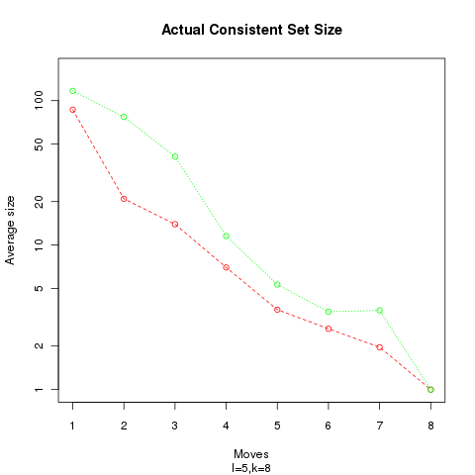
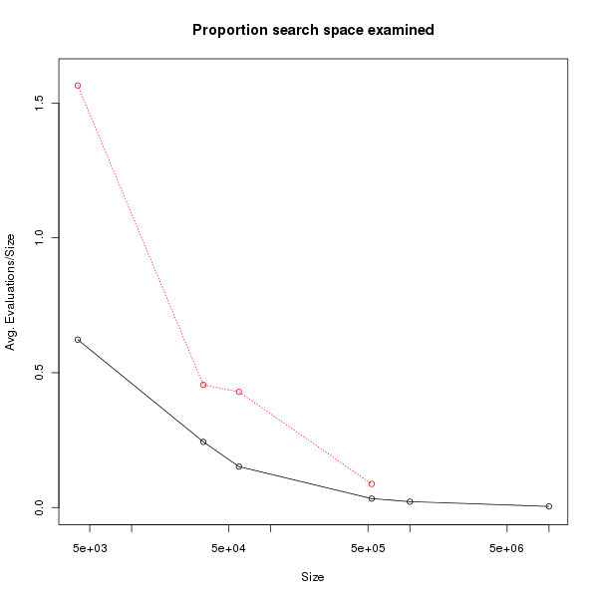

Slide 2
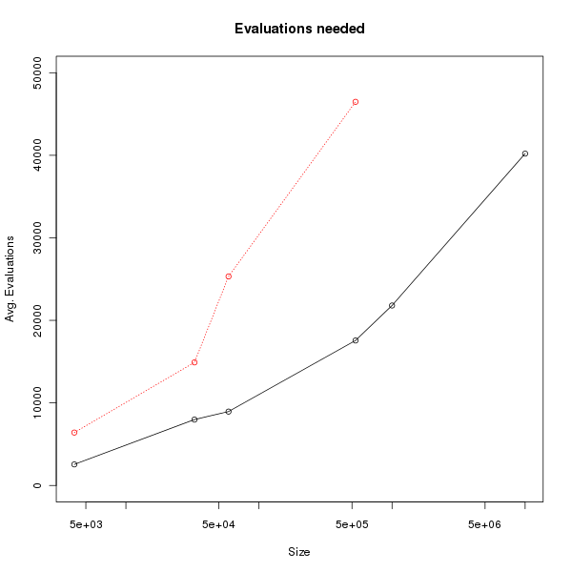
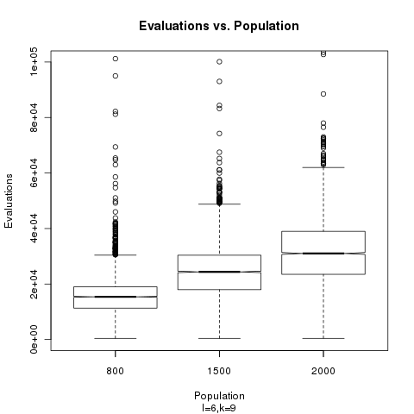

Slide 6
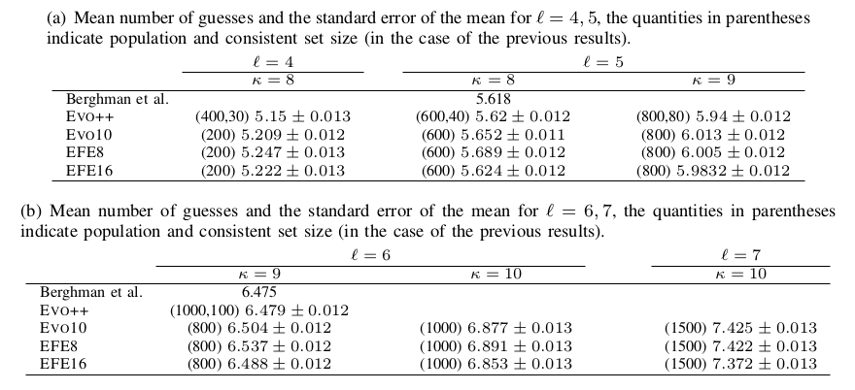

Slide 7
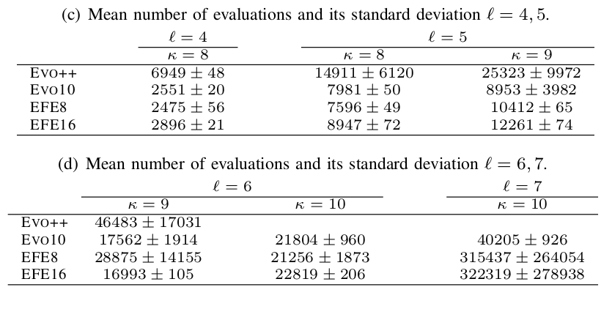

Slide 8
We use entropy for scoring.
Check the size of the consistent set needed for good and fast solutions.
We use entropy for scoring.
Check the size of the consistent set needed for good and fast solutions.
We use entropy for scoring.
Check the size of the consistent set needed for good and fast solutions.
We use entropy for scoring.
Check the size of the consistent set needed for good and fast solutions.
We use entropy for scoring.
Check the size of the consistent set needed for good and fast solutions.
We can obtain good results fast using small consistent set size.
Range of Affordable sizes can be extended.
Small consistent set size delays the beginning of the evolutionary algorithm.

Slide 9
Open science!
Check me out at
http://git.io/mm-cec
http://git.io/mm-cec
http://git.io/mm-cec
http://git.io/mm-cec
http://git.io/mm-cec
http://git.io/mm-cec
http://git.io/mm-cec
http://git.io/mm-cec
http://git.io/mm-cec
http://git.io/mm-cec

