Slide 1

A Study on Time-varying Partially Connected
Topologies for the Particle Swarm
Fernandes, Merelo, Laredo, Cotta, Rosa
UGR+UMA+UNILU+IST
Notes:
Imagen de fondo de Simon Strandgaard en http://www.flickr.com/photos/12739382@N04/2411501455/

Slide 2
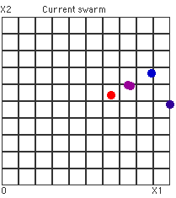
Particle Swarm optimization
Notes:
This slide is taken from http://www.slideshare.net/many87/pso-apiems2009ppt and reproduced using the free license of that presentation.

Slide 3
No formula here, get a move on
Movement combines inertia term with following the best.
The best is a term that depends on population topology.
  You only follow the best if you know about it.
Different population structures are defined.

Slide 4
Act local, think global
GBest
LBest
Notes:
Problem with gbest is that it usually get stuck, but it's very fast, lbest is slower, but it is usually able to find the solution.

Slide 5
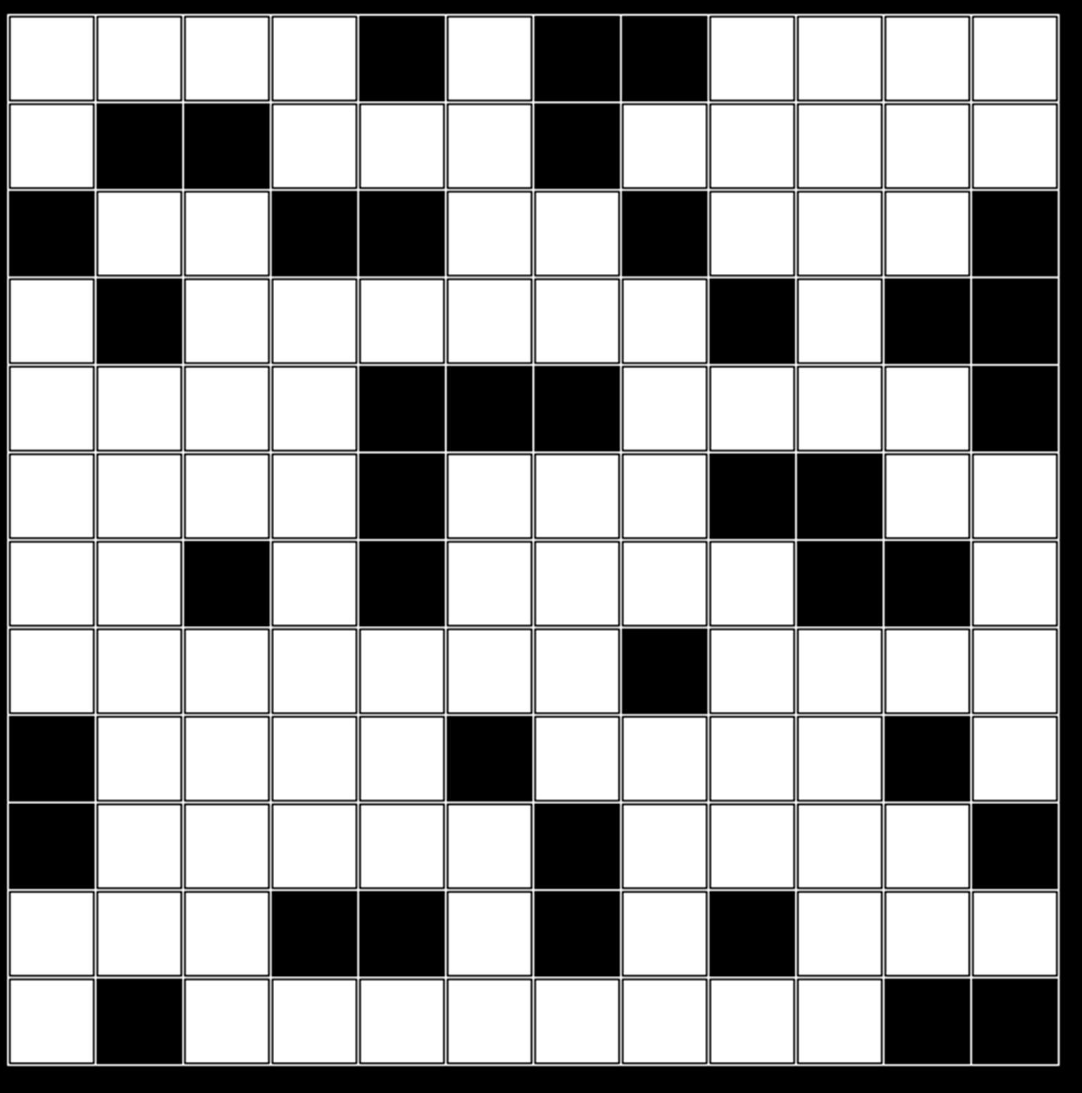
A bit of this and that
Von Neumann

Slide 6
A dynamic, partially connected, population structure
Nodes move every timestep to one of the nodes in their Moore Neighborhood, if there's one available.

Slide 7
Testing the new populaton structure
Using the usual Sphere, Rosenbrock, Rastrigin, Griewank and Schaffer functions.
Best fitness at the origin.
Multimodal.
Usually difficult for gbest

Slide 8
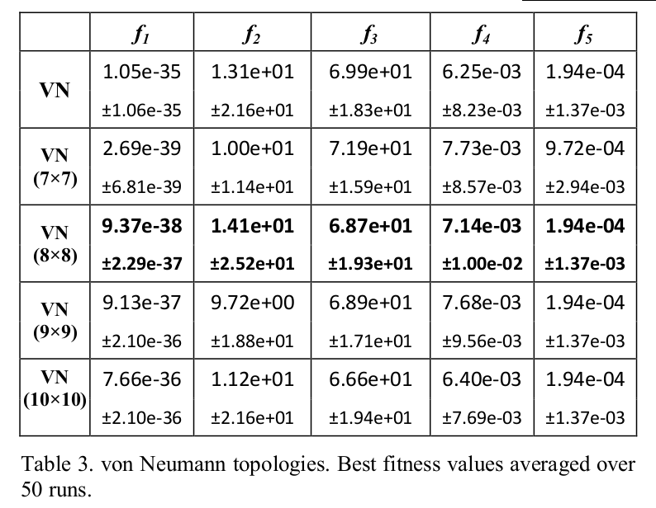
Comparison with static vN: best fitness

Slide 9
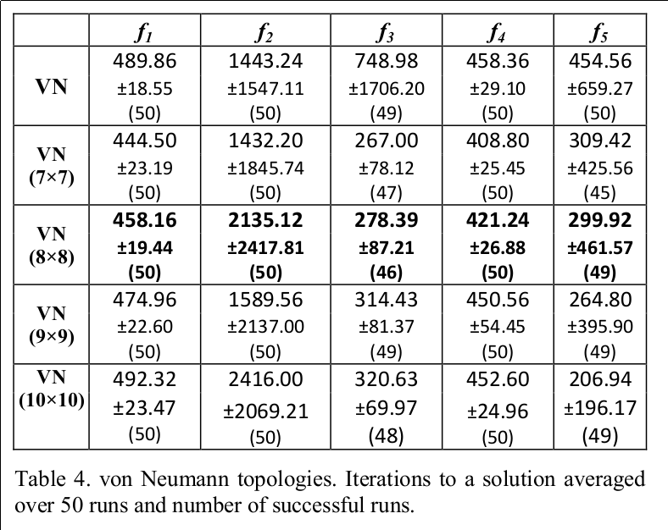
Comparison with static vN: iterations

Slide 10
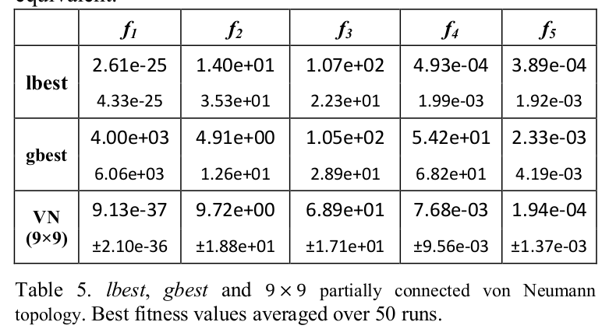
Comparison with l/gbest

Slide 11
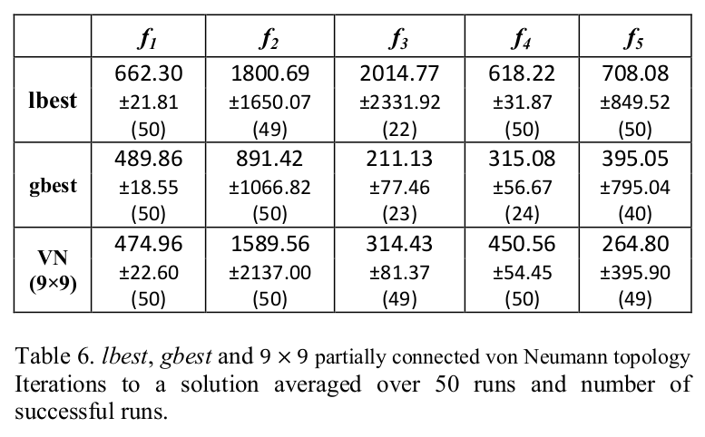
Comparison with l/gbest: iterations

Slide 12
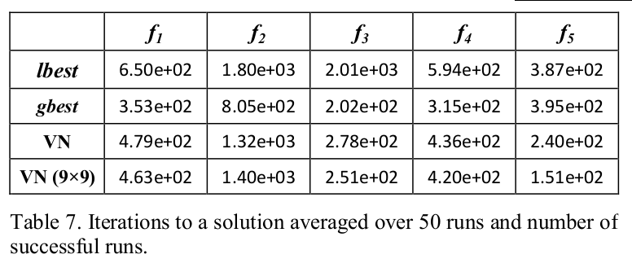
Iterations to solution in successful runs
VN faster than lbest, some times also faster than gbest

Slide 13
Rank by success rate

Slide 14
Rank by overall performance

Slide 15
Connectivity histogram.

Slide 16
Evolution of connectivity

Slide 17
Conclusions
Dynamic and partially connected structures offer the best of both worlds.
Size of the grid is not critical, but as a rule of thumb: 2 x number of particles.
Dynamic structures are better than static.

Slide 18


That's all
AnyselfProject
ANYSELF
@AnyselfProject
Check us out at @geneura
@canubeproject
Any questions?

