Slide 1

The L-Co-R co-evolutionary algorithm: a comparative analysis in medium-term time-series forecasting problems
Parras-Gutiérrez, Rivas and Merelo
U. Jaén & Granada (Spain)
http://geneura.wordpress.com

Slide 2

It's difficult to make predictions, especially about the future
Yogi Berra
Notes:
Cropped from Image by Pensiero at http://www.flickr.com/photos/pensiero/2878055175/

Slide 3
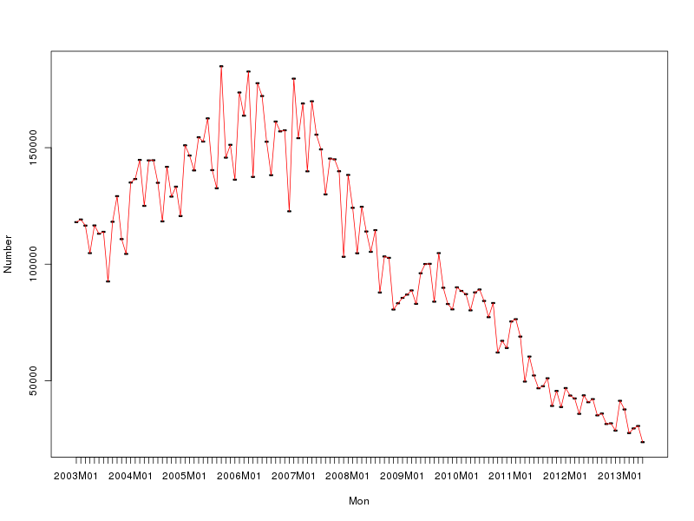
Smells like a bubble

Slide 4
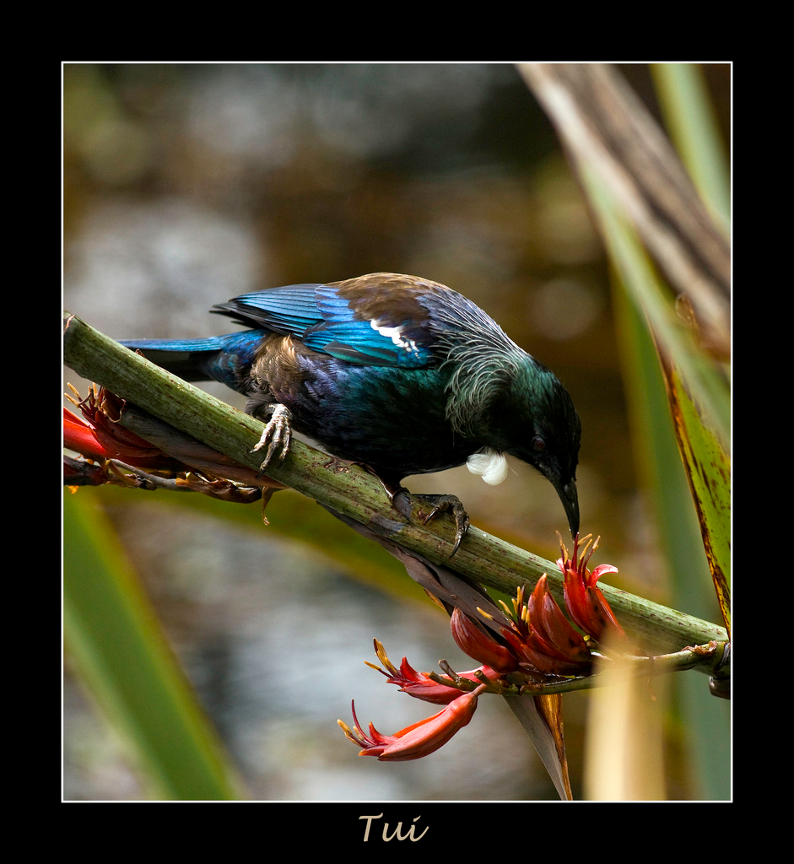
Using coevolution to predict bubble-bursting
Notes:
Image by Light Knight at http://www.flickr.com/photos/lightknight/3176554248

Slide 5
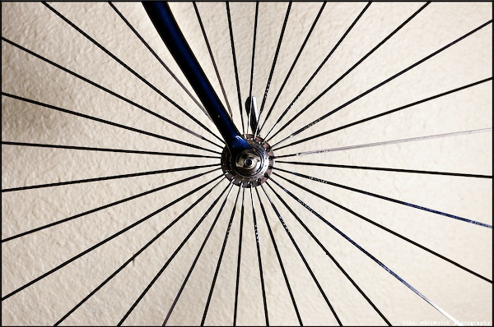
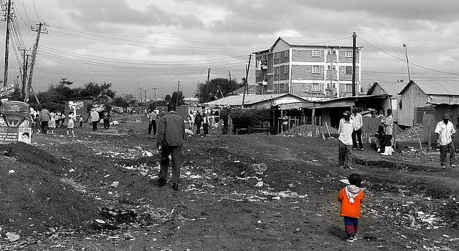
Radial Basis Function neural nets and time lags
Coevolving!
Notes:
Image by JWPĥotowerks at http://www.flickr.com/photos/john_whitworth_photography/3017645549 (spokes) and Eduardo Zárate at http://www.flickr.com/photos/eduardozarate/3513912756/

Slide 6
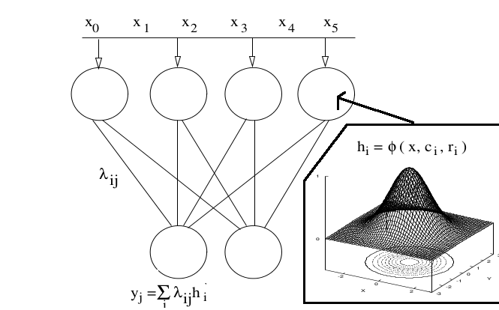
What are RBFNNs?

Slide 7
What do we mean by time lags?
Notes:
Horizon is what lies between the predicted value and the first previous datum used to predict it. A consistent value of horizon was used throughout the experiments.

Slide 8
Trend pre-processing
Initializate lags
Lags
Initializate RBFNN
Evaluate lags
Evaluate RBFNN
RBFNNs
Main loop
Lags' loop
Evolve Lags: CHC
Evaluate Lags
RBFNs' loop
Trend post-processing
Evolve RBFNN: EA
Evaluate RBFNN
Final forecasting

Slide 9
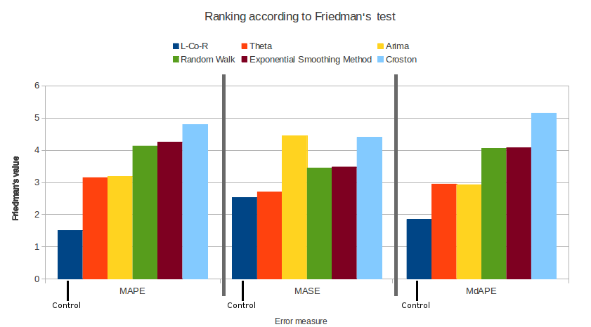
Who's the best?

Slide 10


That's all
AnyselfProject
ANYSELF
Check us out at @geneura
@canubeproject
@anyselfproject
Any questions?

