Slide 1
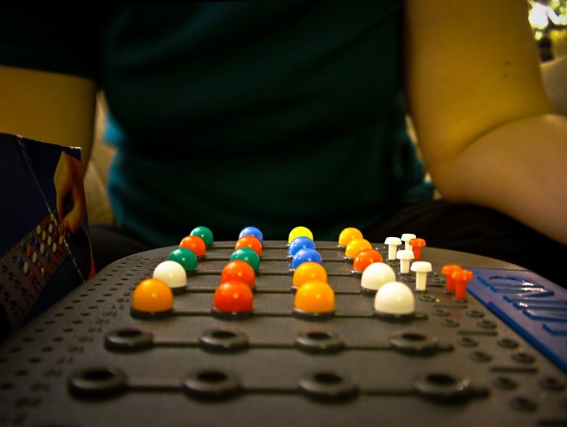
Comparing evolutionary algorithms to solve the game of MasterMind
J. J. Merelo, A. M. Mora, P. A. Castillo, C. Cotta, M. Valdez
UGR, UMA, ITT
Not all consistent combinations are the same: use partitions
Combination played
Consistent!
Always play consistent!
Not consistent!
Optimization algorithm based on distance to consistency (for all combinations played)
D = 2
Most parts. Score = 5
Best worst case. Score = -3
Entropy. Score = 1.67
1.31
0.96
0.96
1.58
1.52
1.67
1.42
1.52
1.67

