Slide 1
Introduction to Object Oriented Programming (OOP)

Slide 2
You already know objects
String Objects
pet =‘dog’
pet is an object with data ‘dog’ and methods like ‘upper’, ‘lower’..etc.
File Objects
fin = open(‘my.txt’,’w’)
fin is a file object initially with no data but methods like ‘write’
Lists, dictionaries are objects
Python has lots of objects already created, but it doesn’t come with anything for Bioinformatics

Slide 3
Abstraction upon an abstraction
Why do we need OOP? Don’t we already have functions?
There are some great reasons to use objects: Code reuse being number one.
Reason 1: You have a lot of data and you need to manipulate, but you don’t want it to affect the other data.
Reason 2: You have code that can be used for many similar tasks.

Slide 4
RPGs – A perfect place for OOP
Complex, and not so complex, video games heavily use OOP
Everything in the game is a custom object
Characters, weapons, treasure, trees, flying carpets, monsters…
Every object in the game has its own data and methods
Each object needs to be independent of all the other objects in the game

Slide 5
World of Warcraft: Objects everywhere

Slide 6
OOP Example: The Character Class

Slide 7
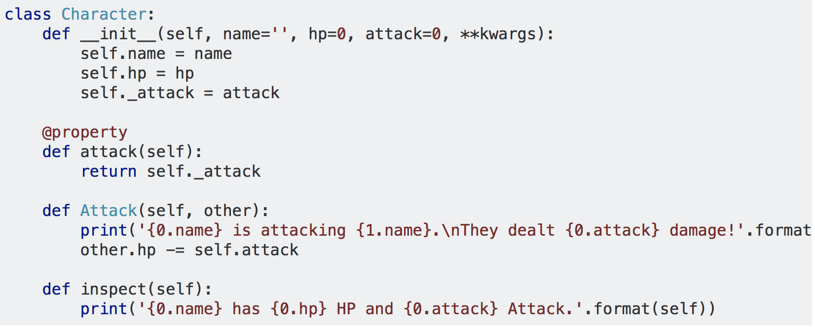
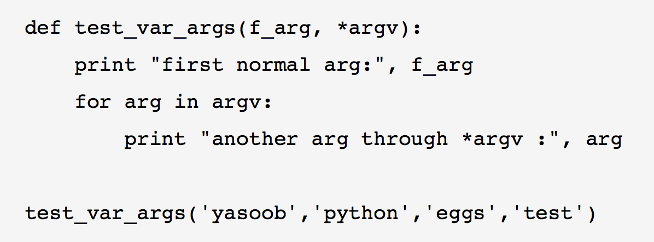
Character Class example
http://book.pythontips.com/en/latest/args_and_kwargs.html

Slide 8
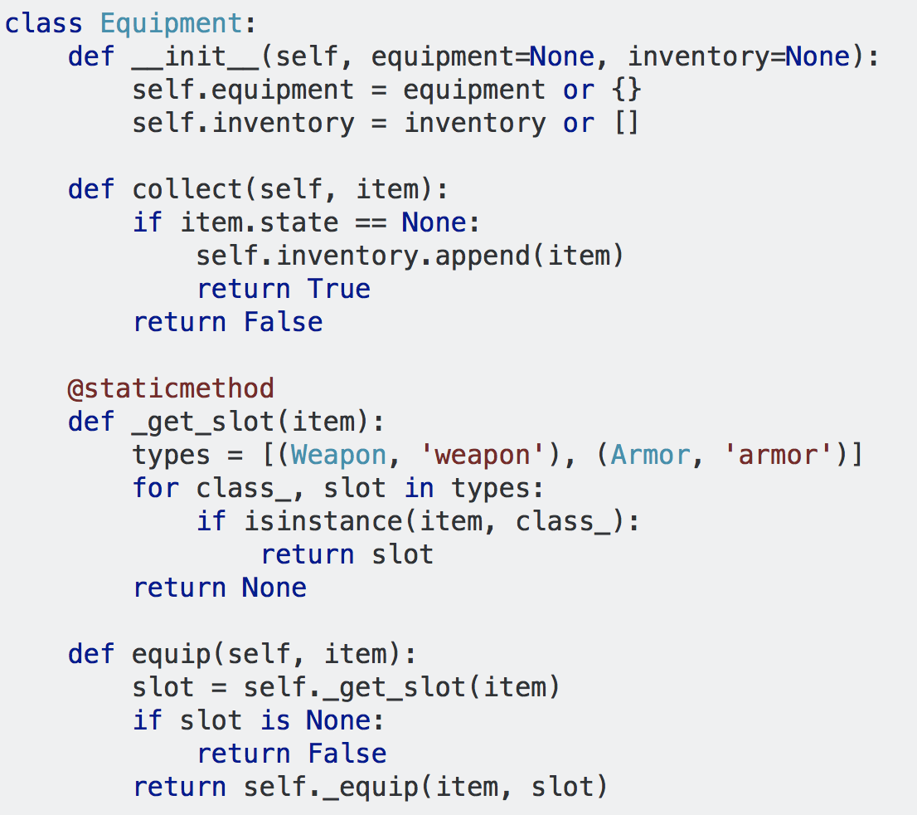
Equipment Class
The Constructor
A method that works to add inventory.
Looks for item in equipment

Slide 9
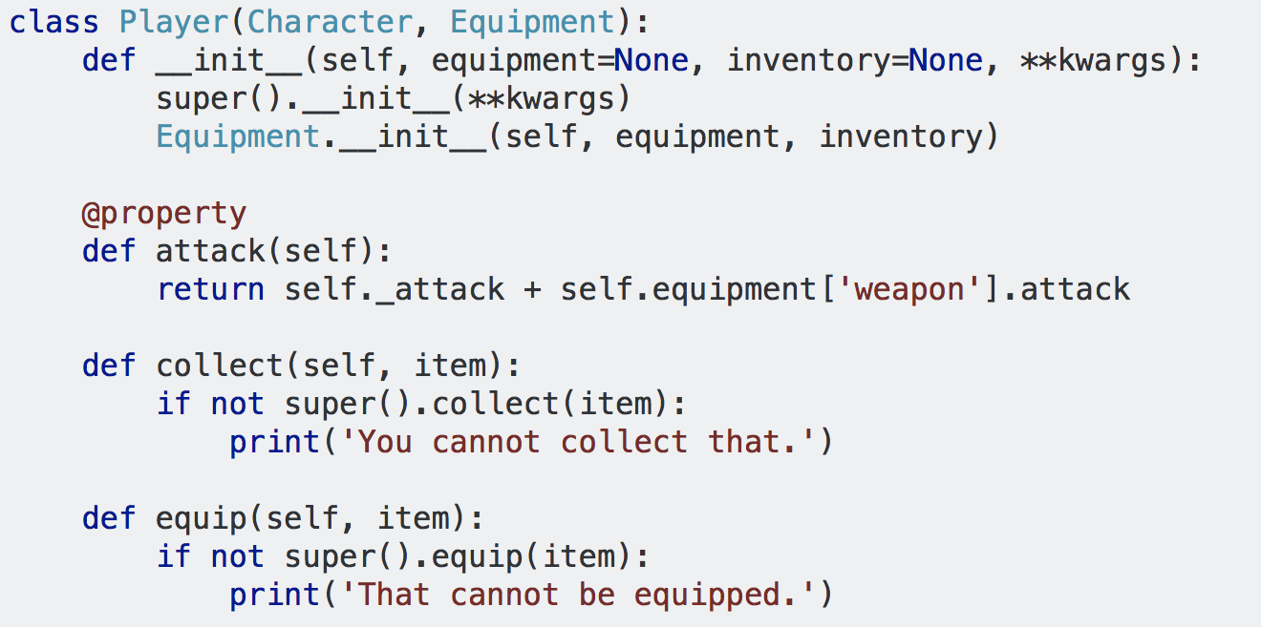
Inheritance: New class builds on old classes

